Slide 1
Transaction

Slide 2
Definition
Transaction can be defined as a group of tasks. A single task is the minimum processing unit which cannot be
divided further.
Example: Transfer of money from one account to another.
Properties
Atomicity
Consistency
Integrity
Durability

Slide 3
Atomicity − This property states that a transaction must be treated as an atomic unit, that is, either all of its operations are executed or none.
Consistency − The database must remain in a consistent state after any transaction.
Isolation − The property of isolation states that all the transactions will be carried out and executed as if it is the only transaction in the system.
Durability − The database should be durable enough to hold all its latest updates even if the system fails or restarts.

Slide 4
Serializability
Schedule : Chronological execution of transaction
Serial Schedule: Transactions are aligned in such a way that one transaction is executed first with same outcome as above
Parallel execution of transaction is allowed in the database only if there is any equivalence relation among the transactions.
Equivalence Schedules
Result Equivalence
View Equivalence
Conflict Equivalence

Slide 5
Types
Result Equivalence: - If the two transactions generate same result after their execution then it is called as result equivalence.
View Equivalence: -Two schedules are said to be view equivalence, if the transaction in one schedule is same as the one in other.
Conflict Equivalence: - In this case both schedules will have different set of transactions, but they would be accessing same data and one of the schedules will be inserting/updating the records.

Slide 6
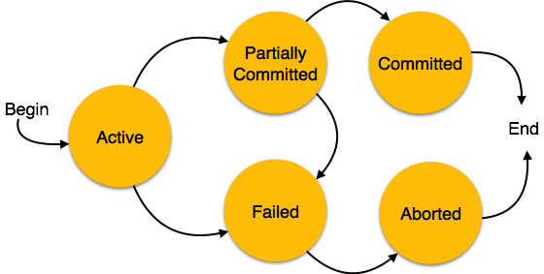
States of Transactions
Active: Initial state when transaction is executed
Partially Committed: Transaction executes its final operation
Failed: If any of the checks made by the database recovery system fails
Aborted: The recovery manager rolls back all its write operations on the database
Committed: If a transaction executes all its operations successfully

