Slide 1
Structuring Code Using Abstract Classes Interfaces & Packages

Slide 2
Overview
An abstract class is a shared superclass
  Provides a high-level partial implementation of some concept
  Cannot be instantiated
Vehicle
Vehicle
Abstract superclass
Concrete subclasses
Car
Car
Truck
Notes:
##
*
*
07/16/96

Slide 3
Defining Abstract Classes in Java
Use the abstract keyword to declare a class as abstract
public abstract class Vehicle {
private String regNum;
public String getRegNum()…
}
public class Car
extends Vehicle{
private int numSeats;
public void fitRack()…
public class Truck
extends Vehicle{
private int axles;
public void setLoad()…
Notes:
##
*
*
07/16/96

Slide 4
Abstract Methods
  An abstract method is one that cannot meaningfully be implemented by a class
    A generic operation
    Part of an abstract class
  Must be implemented by a concrete subclass
    Each concrete subclass can implement the method differently
Notes:
##
*
*
07/16/96

Slide 5
Defining Abstract Methods in Java
  Use the abstract keyword to declare a method as abstract
    Only provide the method signature
    Class must also be abstract
  Why is this useful?
public abstract class Vehicle {
public abstract boolean isRoadWorthy();
…
Notes:
##
*
*
07/16/96

Slide 6
Polymorphism with Abstract Classes
Polymorphic collections can be defined using abstract classes
public abstract class Vehicle {
public abstract boolean isRoadWorthy();
…
Vehicle[] fleet = {
new Car(…),
new Truck(…), …
};
…
for (int i=0; i < fleet.length; i++)
if (!fleet[i].isRoadWorthy()) …
Notes:
##
*
*
07/16/96

Slide 7
Interfaces
  An interface is like a fully abstract class
    All of its methods are abstract
    No instance variables
  An interface defines a set of methods that other classes can implement
    A class can implement many interfaces, but can extend only one class
Notes:
##
*
*
07/16/96

Slide 8



Example of Interfaces
  Interfaces describe an aspect of behavior that different classes can support
  For example, any class that supports the “Steerable” interface can be steered:
Steerable
Not Steerable
Notes:
##
*
*
07/16/96

Slide 9
Defining an Interface in Java
  Use interface keyword instead of class
  All methods public abstract
  All variables public static final
public interface Steerable {
public static final int maxTurn = 135;
public void turnLeft(int deg);
public void turnRight(int deg);
}
Notes:
##
*
*
07/16/96

Slide 10
Implementing an Interface
public interface Steerable {
int maxTurn = 135;
void turnLeft(int deg);
void turnRight(int deg);
}
public class Car
extends Vehicle
implements Steerable {
public void turnLeft(int deg)
{…}
public void turnRight(int deg)
{…}
Notes:
##
*
*
07/16/96

Slide 11
Partial Implementation of an Interface
Declare the class as abstract if the class does not implement all the methods of an interface
Implement the methods in the sub class level
Public abstract class Car
extends Vehicle
implements Steerable {
public void turnLeft(int deg)
{…}
}

Slide 12
Polymorphism with Interfaces
public class Car
extends Vehicle
implements Steerable {
…
public void turnLeft(int deg) {…}
public void turnRight(int deg) {…}
}
Methods can have
an interface type as an argument
  What kind of object can be passed into the method? How can the object be used?
navigate(Steerable s) {
s.turnLeft(90);
}
Notes:
##
*
*
07/16/96

Slide 13
Using instanceof with Interfaces
  The instanceof operator can be used to check if an object implements an interface
  Downcasting can be used if necessary, to call methods defined in the interface
public void aMethod(Object obj) {
…
if (obj instanceof Steerable)
((Steerable)obj).turnLeft();
}
Notes:
##
*
*
07/16/96

Slide 14
Extending an Interface
One Interface can extend another Interface
public interface Steerable {
int maxTurn = 135;
void turnLeft(int deg);
void turnRight(int deg);
}
public interface Navigator
extends Steerable {
void calcSpeed(int distance);
}

Slide 15
Handling Exceptions: An Overview

Slide 16
What Is an Exception?
  Java methods “throw an exception” if they fail for some reason
    Control returns immediately to the appropriate “exception handler”
  Exceptions are a more robust and cleaner technique for dealing with
  errors

Slide 17
Error-handling Overview
Traditional error-handling techniques:
void highLevelMethod() {
if (!method1())
// Error recovery…
boolean method1() {
if (!method2())
return false;
boolean method2() {
if (…problem…)
return false;
Exception handling is cleaner:
  Throw an exception if an error occurs
  Catch exception in a high-level method

Slide 18
Catching Exceptions
If you call a method that might throw an exception:
Enclose call
in try block
try {
// Might throw I/O exception
b = stream1.read();
b = stream2.read();
b = stream3.read();
}
catch ( IOException e ) {
// Handle the exception
System.out.println(e);
}
Define catch block to deal with exception

Slide 19
Throwable Classes
All errors and exceptions extend the Throwable class
Throwable
Error
Exception
Abnormal unrecoverable errors
Checked exceptions
RuntimeException
Run time exceptions

Slide 20
Examples
  Errors:
    OutOfMemoryError,
    InternalError
  Checked exceptions:
    MalformedURLException,IllegalAccessException,
    ClassNotFoundException, IOException
  Run time exceptions:
    ArrayIndexOutOfBoundsException,
    ArithmeticException, SecurityException,
    ClassCastException,NullPointerException,
    NegetiveArraySizeException

Slide 21
Dealing with Multiple Exceptions
Use multiple catch blocks to deal with multiple types of exception
try {
URL u = new URL("http://java.sun.com");
URLConnection c = u.openConnection();
}
catch (MalformedURLException e) {
System.err.println("Could not open URL: " + e);
}
catch (IOException e) {
System.err.println("Could not connect: " + e);
}

Slide 22
Displaying the Exception Information
Print the Exception Object in the handler method
toString method is called on the Exception Object
try {
…
}
catch(AnException e) {
System.out.println(“Exception caught : “ + e);
}

Slide 23
The finally Keyword
  A finally clause can be used to ensure that a block of code is always executed
  Can be used
  with or without
  a catch block
try {
…
}
catch(AnException e) {
…
}
finally {
// Always executed…
}

Slide 24
More About finally
The finally clause is executed regardless of how the try block exits
  Normal termination, by falling through the end brace
  Because of return or break statement
  Because an exception was thrown

Slide 25
Using try, catch, and finally
void makeConnection(String host) {
try {
URL u = new URL("http://" + host);
}
catch (MalformedURLException e) {
System.out.println("Cannot contact " + host);
return;
}
finally {
System.out.println("Don't forget about me");
}
System.out.println("Goodbye");
}

Slide 26
Declared Exceptions
  Methods advertise which exceptions they throw, or do not catch:
  You must catch these declared exceptions somewhere in your code
public class URL {
public URL(String s) throws MalformedURLException
{ … }

Slide 27
Catching Declared Exceptions Locally
One approach is to catch any exceptions locally, in your method
public URL changeURL(URL oldURL) {
try {
return new URL("http://java.sun.com");
}
catch (MalformedURLException e) {
return oldURL;
}
}

Slide 28
Passing Declared Exceptions on to the Calling Method
Another approach is to ignore the exception at this level
  Exception propagates to calling method
  Must advertise this fact using throws
public URL changeURL(URL oldURL)
throws MalformedURLException {
return new URL("http://java.sun.com");
}
Notes:
##
*
*
07/16/96

Slide 29
Throwing Exceptions
Throw exceptions using the throw keyword
public void method1() {
try {
method2();
}
catch (IOException e) {
System.err.println("Caught: " + e);
}
}
public void method2() throws IOException {
if (…problem…)
throw new IOException();
}

Slide 30
User defined Exceptions
Extend the Exception class.
public class exception1 extends Exception { … }
public class UserFileException extends Exception {
public UserFileException (String message) {
super(message);
}
}

Slide 31
Building Applets

Slide 32
Overview
  An applet is embedded in a Web page
  Applets can be loaded from local disk or from an application (Web) server
Client , running a
Web browser
Application server,
serving page that
contains Java applet
Notes:
##
*
*
07/16/96
What Is an Applet?
An applet is a Java program that is embedded into an HTML page, in a similar way to an image. A Java applet does not run in a standalone Java VM; instead, it uses a VM built into a Java-enabled browser, such as Netscape or Internet Explorer.
When the browser interprets an HTML page that contains an embedded applet, it automatically downloads the applet class file from the Web server.
During its execution, a Java applet might require other classes to perform its task. These classes are loaded automatically as required by a class loader, which is part of the Java VM. These classes can reside either on the local disk, or on the Web server.
Note that during development, an applet can be tested with a tool called the appletviewer, which is shipped with the JDK. AppBuilder for Java also provides the appletviewer tool, and we shall see how to use it later in this lesson.
Instructor Note
You might also like to mention intranets; the user might be visiting an HTML page on the corporate intranet rather than across the Internet.

Slide 33
Applications and Applets:
Profile of a Java Application
  A Java application is a standalone program:
    Executed using a standalone Java VM
    Entry point is the main() method, called by the class loader
    Usually contains constructors
    Can be graphical
Notes:
##
*
*
07/16/96
Java Applications
Java Applications Are Executed Using a Standalone Java VM
A Java application is executed as a standalone program, under the auspices of the Java Virtual Machine (VM.) Much of this is hidden from you when you use AppBuilder for Java to run a Java application. If you run the program from the command line, using the java.exe tool provided with the JDK, it is more obvious that the program is standalone:
prompt> java MyApplicationClass.class
The Entry Point Is the Main() Method, Called by the Class Loader
When you run a Java application, the class loader in the Java VM inspects your class and looks for a main() method, which is the entry point for your application. If no main() method is found, your program cannot be executed.
Java Applications Usually Contain Constructors
As we have seen already in the course, the entry-point class often provides one or more constructors, to perform initialization when the program starts up.
Java Applications Can Be Graphical
Java applications can be graphical in nature, but they do not have to be. When you build a skeleton application using AppBuilder for Java, it creates a Frame class that provides a graphical user interface for your application. However, it is equally possible to write a Java application that has no graphical user interface.

Slide 34
Applications and Applets:
Profile of a Java Applet
  Java applet is executed by a browser:
    The browser provides the Java VM
    Several entry points called by the browser, such as init()
    Constructors tend to be empty
    Almost always graphical
  Applets must provide a class that extends Applet
Notes:
##
*
*
07/16/96
Java Applets
The Browser Provides the Java VM
Applets are executed in the context of an HTML page, in a browser. The browser contains a Java VM, to interpret the Java bytecodes, load Java classes, and take care of security issues.
Entry Point Is the init() Method, Called by the Browser
The first method that the browser calls in your applet class is init(). This method is called when your applet is first loaded. Typically, you override init(), to perform initialization tasks such as downloading images, creating objects for your applet, and so on.
Constructors Tend to Be Empty
You can provide constructors in your applet class if you want to, but most Java developers tend to put their initialization logic in init() instead.
Java Applets Are Almost Always Graphical
Applets are almost always graphical; they appear within the HTML page in the browser, and can contain controls such as buttons, list boxes, and so on.
A Java Applet Must Be a Subclass Of Applet
All Java applets must define a subclass of Applet. When your applet is downloaded, the browser creates an instance of your applet class, and calls various documented methods at strategic moments, to tell your applet to do something.

Slide 35
The Applet Class
To build an applet, create a subclass of Applet, and override certain methods:
  init()
  start()
  stop()
  destroy()
  paint()
  update()
Object
Component
Container
Panel
Applet
MyApplet
Notes:
##
*
*
07/16/96
Entry Points in the Applet Class
The Applet class provides a number of entry points, or “callback methods,” that are called automatically by the browser or applet viewer, such as init(), start(), stop(), and destroy(). These methods are described on the next slide. To build an applet, you must subclass Applet, and override one or more of the methods shown on this slide.
The Applet Hierarchy
The Applet class is inherited from the Panel class, which is itself inherited from the Container class. The abstract Container class inherits many methods from the abstract Component class, such as the following:
paint(), called automatically by the Abstract Windowing Toolkit (AWT), to tell a component to paint itself. The paint() method receives one parameter, which is a Graphics object. This Graphics object contains many drawXXX() methods for drawing text and graphics on the drawing surface of the component.
update(), called automatically by the AWT whenever part of a component becomes invalid and needs to be repainted. The default implementation of update() in the Component class erases the background of the component, and then calls paint(). A simple applet only needs to override paint().
repaint(), a method you can call yourself, to force a component to repaint itself.
setFont(), another method you can call, to change the font for a component.
setBackground(), a method you can call to set the background color.

Slide 36
Applet Life Cycle
New applet
Initialized
init()
destroy()
stop()
start()
Dead
Running
paint()
Notes:
##
*
*
07/16/96
Initializing an Applet
When the browser downloads an HTML page containing applets, it creates an instance for each of the applet classes, using the no-arg constructor. Applets must have a no-arg constructor, otherwise they cannot be loaded.
In the constructor, the applet is uninitialized; in particular, its link with the browser, known as its “applet context,” is incomplete.
Starting A
Immediately after calling init(), the browser calls the start() method. start() is also called whenever a user returns to an HTML page that contains the applet, after having visited other pages. An applet only needs to override start() if it has to resume some activity such as animation, which was previously stopped in stop().
Stopping an Applet
stop() is called automatically, whenever the user moves away from the HTML page that contains the applet. The stop() method gives an applet a chance to suspend or stop some processor-intensive activity such as animation, which will not be visible to the user until he returns to the page that contains the applet. Typically, if an applet needs to make use of background threads, these threads should be started in start(), and stopped in stop().
Destroying an Applet
The browser calls destroy() immediately before the applet is unloaded from memory, and after calling its stop() method. Your applet can override this method if necessary.

Slide 37
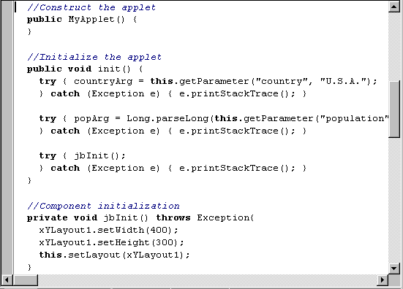
Profile of the Applet Subclass
Many imported
packages
Extends Applet
Variables
package SimpleApplet;
import java.awt.*;
import java.awt.event.*;
import java.applet.*;
public class MyApplet extends Applet {
String countryArg;
long popArg;
Notes:
##
*
*
07/16/96
More About the Applet Subclass
This topic takes a closer look at the Applet subclass that is generated for you by AppBuilder for Java. It is important to understand these features first, before trying to augment the applet with extra features.
Imported packages
The applet needs to import various standard and non-standard packages to do its work:
java.awt contains Abstract Windowing Toolkit classes, such as Button.
java.awt.event contains classes to deal with events, such as button clicks.
java.applet contains the Applet class, amongst others.
borland.jbcl.layout contains classes to influence layout of controls.
borland.jbcl.control contains extension controls, such as GridControl.
Our Applet Class Extends Applet
You must extend Applet if you want a class to act as the starting point in an applet.
Instance Variables
The class defines a number of instance variables:
xyLayout1 is a “layout manager” object; more on this topic in the next lesson.
isStandalone defines whether the applet can be run as a standalone application.
countryArg and popArg store the applet parameters from Applet Wizard.

Slide 38
Applet Initialization
Constructor
init()
// construct the applet
public MyApplet () {
}
// initialize the applet
public void init () {
…
}
Notes:
##
*
*
07/16/96
Applet Initialization
This slide describes how an applet is initialized, when it is launched by a Web browser or an appletviewer. There are three methods involved:
The Applet Constructor
The applet constructor was generated automatically for us by Applet Wizard, but many Java developers leave the constructor empty. This is because the constructor gets called as soon as the browser creates the MyApplet object, but before the applet context has been set up; in other words, it is too early in the life cycle of the applet for certain initialization tasks.
The init() Method
Recall from earlier in the lesson that init() is a standard applet method that gets called as soon as the applet context has been established. This is where you put most of your applet initialization code, rather than in the constructor. The version in the slide fetches the applet parameters from the HTML page, and stores them in the appropriate instance variables, namely countryArg and popArg. The method then calls jbInit().
The jbInit() method
jbInit() is not a standard Java method; it is specific to the AppBuilder for Java environment. You should not need to modify this method; it is maintained automatically by AppBuilder for Java. The method initializes the graphical appearance of the applet, such as its width, height, and “layout manager.” Layout managers are discussed in the next lesson.

Slide 39
Profile of the HTML File
<APPLET> tag
Parameters
<HTML>
<HEAD>
<META HTTP EQUIV=“Content-Type” CONTENT=“text/ht
<TITLE>
HTML Test Page
</TITLE>
</HEAD>
<BODY>
MyApplet will appear below in a Java enabled browser.
<APPLET
CODEBASE = “.” CODE = “SimpleApplet.MyApplet.class”
NAME = “TestApplet” WIDTH = 400 HEIGHT = 300
HSPACE = 0 VSPACE = 0 ALIGN = middle>
<PARAM NAME = “country” VALUE = “U.S.A”>
<PARAM NAME = “Population” VALUE = “0”>
</APPLET>
</BODY>
Notes:
##
*
*
07/16/96
The <TITLE> and <BODY> Tags
These tags mark the beginning of the title section and body section, respectively.
The <APPLET> Tag
This tag marks the beginning of the applet. Within the <APPLET> tag, you must provide the following information:
CODE specifies the name of the Java class to execute, including the .class extension. The Java class in the example is SimpleApplet.MyApplet.class, which instructs the browser that MyApplet.class is located in a package called SimpleApplet. This causes the browser to look in a subdirectory called SimpleApplet off the codebase.
WIDTH and HEIGHT specify the initial width and height of the applet, in pixels.
The following information in the APPLET tag is optional:
CODEBASE, the base URL from which to start searching for the applet class file.
NAME, a name that allows inter-applet communication, or scripting from JavaScript.
HSPACE, VSPACE, and ALIGN define the applet position within the browser.
The <PARAM> Tags
These tags specify parameters to the Java applet, from the HTML page. The NAME and VALUE attributes specify the parameter name and its string value. Any number of <PARAM> tags can be included between the <APPLET> and </APPLET> tags. These parameters correspond with the information you entered in Step 2 of Applet Wizard.

Slide 40
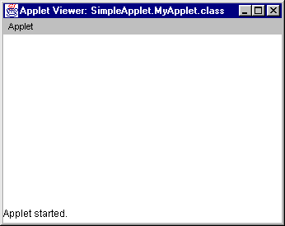
Building and Executing the Applet
To run the applet: c:\>appletviewer MyApplet.html
  Launches “appletviewer”
  Appletviewer runs
  the HTML file
  The HTML file
  runs the applet
Notes:
##
*
*
07/16/96
Running the Applet
Before you can run a Java applet, you have to compile all the .java source files into .class bytecode files. Select “Run—>Run Applet in Xxxx.html” from the Menu bar to compile all the files, and run the applet.
What Happens When You Run an Applet In AppBuilder for Java?
Applets are executed in the context of an HTML file in a browser. When you “run” an applet in AppBuilder for Java, this is what is really happening under the surface:
AppBuilder for Java launches a tool called “appletviewer,” which is part of the JDK. Appletviewer behaves like a cut-down Web browser, in the sense that it parses HTML files and launches Java applets. Appletviewer is the most convenient way to test you applets using AppBuilder for Java, but you can also launch Netscape or Internet Explorer, and specify your HTML file there instead. If you are interested, appletviewer.exe is installed in the <AppBuilderDir>\java\bin\.
When appletviewer gets going, it reads the HTML file that contains your applet. When it encounters the APPLET tag for your applet, it launches your applet. In other words, it creates an instance of your applet class, and calls its init() method.
Appletviewer calls other methods in your applet class as necessary, such as start(), paint(), and stop().

Slide 41
Applet Life Cycle
  Methods that you may need to override:
  start()
  stop()
  destroy()
  Plus other info methods
    getAppletInfo()
    getParameterInfo()
Notes:
##
*
*
07/16/96
Applet Life Cycle
This slide describes some of the other important methods that you might need to override in your applet class. The methods are described in the following paragraphs.
start()
The start() method is called immediately after init(), and also each time the user revisits the Web page containing this applet. start() is the ideal place to restart any operations each time the applet is revisited, such as audio clips, animations, and threads.
stop()
The stop() method is the opposite of start(). stop() is called each time the user moves off the current Web page, to give you the chance to stop any operations that are not required when the applet is inactive, such as stopping audio clips and animations. destroy()
destroy() is called just before the applet is unloaded from memory, so that you can release any resources such as files and database connections.
getAppletInfo()
This method returns details about the applet, such as author, version number, and copyright.
getParameterInfo()
This method returns the following information about each parameter: the name of the parameter in the HTML file; the type of the parameter; and a brief description.

Slide 42
Retrieving Applet Parameters
  Call getParameter() to get parameter
  init() sets up instance variables to use
public void anyAppletMethod() {
String c = getParameter("country");
long pop = Long.parseLong(
getParameter("population"));
public void init() {
countryArg = getParameter("country", "U.S.A.");
popArg = Long.parseLong(
getParameter("population", "0"));
Notes:
##
*
*
07/16/96
Retrieving Applet Parameters Using getParameter()
The applet can retrieve parameter values by calling the getParameter() method of the Applet class, as shown in the first example. This method takes a single String argument, which is the name of the attribute in the <PARAM> tag. This string is case sensitive.
getParameter() returns a String value, or null if the parameter does not exist. You might need to convert the String to a numeric type, if this is what the applet expects. For example, the population parameter will be used as a long in the applet, so we must convert the String from getParameter() into a long. This can be achieved using the parseLong() class method of the Long wrapper class, as shown on the slide.
Retrieving Applet Parameters Using the Instance Variables in the Applet
When you build an applet using AppBuilder for Java, it generates additional code to simplify the task of retrieving parameters from an HTML page. For each parameter you specify in Applet Wizard, an instance variable is defined to hold that parameter value.
These instance variables are initialized automatically in the code generated in the init() method. The code has been simplified here, but the idea is as follows: init() calls getParameter() for each of the parameters in the HTML file, converts the returned String into the appropriate data type, and stores the value in an instance variable.
Instructor Note
Exception handling has been omitted from these examples, for simplicity.

Slide 43
Performing Output in an Applet
  Override the paint() method to perform output in an applet
  Use standard AWT classes, such as Graphics, Font, and Color
  After any changes in the data call repaint()
public void paint(Graphics g) {
Font f = new Font("SansSerif", Font.BOLD, 72);
g.setFont(f);
g.setColor(Color.red);
g.drawString("Hello", 10, 100);
}
Notes:
##
*
*
07/16/96
Performing Output in an Applet
The easiest way to output text and graphics in an applet is to override the paint() method, which must be declared as shown in the slide. The method is called in two situations:
When the browser decides your applet needs to repaint itself, because part of the applet that was previously hidden has been exposed.
When repaint() is called somewhere in the program, to tell the applet to repaint itself. This causes the applet update() method to be called, which erases the background and calls paint(). In most cases, you do not need to override update(); just override paint().
The Graphics Argument in paint()
paint() has a single argument, which is a reference to a Graphics object. A Graphics object is a handle to the applet display surface, the size of which is initially specified in the HTML file. It stores graphical information such as the applet width and height, its current font, and color. The Graphics class also provides many drawing methods.
Changing the Font and Color
The Font and Color classes represent fonts and colors. To change the font, create a Font object with a name ("SansSerif", "Serif", "Monospaced"), style (Font.BOLD, Font.ITALIC, Font.PLAIN), and pointsize. Tell the Graphics object to use this font in subsequent text output, by calling the setFont() method on the Graphics object. To change the color, call setColor() and specify a color, such as Color.red.

Slide 44
Overriding update method
Applets can override update()of AWT for complex repainting
First fills the background with the default color then calls paint()
Public void update(Graphics g){
//redisplay code
}
public void paint(Graphics g) {
update(g);
}

Slide 45
Background and Foreground Properties
Can obtain current settings of background and foreground colors by
  Color getBackground()
  Color getForeground()
Can also set background and foreground colors by
  Color setBackground(Color newColor)
  Color setForeground(Color newColor)

Slide 46
Other Applet properties
AppletContext and showDocument()
  getAppletContext() returns the applet’s current execution environment
  Once you have obtained the applet’s context can use showDocument() to bring another doucument into view
URL getDocumentBase()
  returns the url of the HTML file that loaded the applet
URL getCodeBase()
  returns the url of the Applet class file

Slide 47
The AudioClip Interface
AppletContext defines
  AudioClip getAudioClip(URL url)
  returns an AudioClip from the url
AudioClip Interface defines
  play()
  stop()
  loop()
Can use these methods to play the AudioClip

Slide 48
Displaying Diagnostic Information
  Call showStatus() at any time, to display text in the browser status line
  Can also use System.out.println(), to display text on the console
public void anyAppletMethod() {
showStatus("Hello from my method…");
}
public void anyAppletMethod() {
System.out.println("This goes to the console");
}
Notes:
##
*
*
07/16/96
Displaying Information in the Status Line of the Browser
An applet can display messages in the status line of the browser. However, this is of limited use, since any information displayed here can be overwritten by the browser at any time. Therefore, showStatus() should be used only for simple status or error messages.
Displaying Information in the Java Console
For diagnostic purposes, an applet can also use System.out.println() to write to the console. How this console is implemented depends on the browser:
With appletviewer, the console is visible in the background when the applet is running. You can easily switch to the console at any time, to see the diagnostic messages.
With Netscape, the user has the option to enable the Java Console, which is a separate top-level window.
Internet Explorer does not provide a separate console window. Instead, any console output is written to a log file, such as C:\WINNT\JAVA\JAVALOG.TXT on Windows NT 4.
Instructor Note
Remind students that they can still use the debugger to debug an applet. The best approach is to put a breakpoint at the start of key methods, such as init(), paint(), start() and stop().

Slide 49
Applet Security
  Browsers restrict what applets can do:
    Cannot access local file system
    Cannot access other systems on the network, apart from your Web server
    Cannot start new programs
    Cannot listen for inbound connections
  With Java 1.1, a browser can
  relax some restrictions
  for “signed” applets
Notes:
##
*
*
07/16/96
Security Issues
One of the main concerns about Java applets is that the browser downloads code across the network, possibly from an unknown or untrusted source, and executes it on the client system. This is a classic seeding ground for viruses.
To alleviate these fears, certain security restrictions are placed on applets. To start with, Java applets are inherently more secure than many other types of component. For example, Java does not support pointers, so it is impossible to access invalid memory locations either intentionally or unintentionally. In addition, the class loader in the Java VM checks the bytecodes in the Java class file, to make sure they follows the semantic rules expected.
Java-enabled browsers also place certain security restrictions on applets, so that applets are only allowed to play in a “sandbox.” For example, Netscape and Internet Explorer 3 do not allow applets to access files on the local disk, or to communicate with systems on the network apart from the Web server that provided the HTML page containing the applet. The latter is important if the client system is behind a firewall. Also, any dialog box created by an applet is noted as untrusted in its status line.
Signed Applets
In Java 1.1, an applet provider can sign a Java applet with a digital signature, to verify that it comes from a trusted source. If such an applet is downloaded by a Java 1.1-enabled browser, the client has to decide whether he or she trusts the applet provider. If so, the browser can grant extended powers to the applet.

Slide 50
Working with User Interface Components

Slide 51
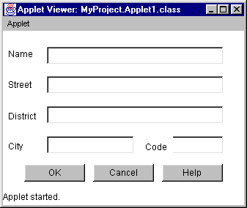
Overview
  Components can be added to an applet or application
  Methods can be provided to handle events
Components
Java object
Events
handler method

Slide 52

Handling Events
Java 1.1 and above use the Delegation Event Model for event handling
The Delegation Event Model is based on the concept of an event source and an event listener
The advantage of this design is that the application logic that processes events is cleanly separated from the GUI logic that generates those events
Event source
Event listener
object
Event
handler method

Slide 53
What are Events
In Delegation Event Model, an event is an object that describes a state change in a source
Event can be generated when
  user interacts
  a timer expires
  a counter exceeds a value
  an operation is completed

Slide 54
A Closer Look at the Delegation Event Model
Java 1.1 events are based on the concept of an event source and an event listener
The listener waits until it receives an event object
Once received, the listener processes that event and then returns
There are many different types of events
  Each requires different handler methods
Event source
Event listener
object
XXXEvent
handler method

Slide 55
Event Classes in java.awt.event pack
java.util.EventObject
java.awt.AWTEvent
ActionEvent
ContainerEvent
AdjustmentEvent
KeyEvent
ComponentEvent
MouseEvent
FocusEvent
TextEvent
InputEvent
WindowEvent
ItemEvent

Slide 56
Adapter Classes
ComponentAdapter
ContainerAdapter
FocusAdapter
KeyAdapter
MouseAdapter
MouseMotionAdapter
WindowAdapter

Slide 57
Using Adapter Classes
public class MyApplet extends Applet {
public void init(){
addMouseListener(new MyMouseAdapter(this));
}
}
class MyMouseAdapter extends MouseAdapter{
MyApplet adaptee;
public MyMouseAdapter(MyApplet mA){
adaptee=mA;
}
public void MousePressed(MouseEvent me){
adaptee.showStatus(“Mouse Pressed);
}
}

Slide 58
Listener Interfaces
Each event type has a corresponding “listener interface”
  Listeners must implement this interface
public interface ActionListener {
void actionPerformed(ActionEvent e);
}
public class MyListenerClass
implements ActionListener {
public void actionPerformed(ActionEvent e) {
// Your code to handle the ActionEvent …
}

Slide 59
Event Listener Interfaces
ActionListener
AdjustmentListener
ComponentListener
ContainerListener
FocusListener
ItemListener
KeyListener
MouseListener
MouseMotionListener
TextListener
WindowListener

Slide 60
Registering an Object as an Event Listener
  Each event type has a corresponding “add listener” method
  Can only add a listener if it implements appropriate listener interface
public class MyApplet extends Applet {
Button button1 = new Button();
public void init() {
button1.addActionListener(actionListenerObj);
…
}

Slide 61
What Happens to Events
Event source
class MyApplet_button1_actionAdapter
implements ActionListener {
…
MyApplet adaptee;
public void actionPerformed(ActionEvent e) {
adaptee.button1_actionPerformed(e);
}
public class MyApplet extends Applet {
void button1_actionPerformed(ActionEvent e) {
// Your code to handle the ActionEvent …
}

Slide 62
Handling Mouse Events in an Applet
public class MyApplet extends Applet
implements MouseListener, MouseMotionListener{
String msg=“”;
public void init(){
addMouseListener(this);
addMouseMotionListener(this);
}
public void mouseClicked(MouseEvent e){
msg = “Mouse Clicked”;
repaint();
}
public void paint(Graphics g)
g.drawString(msg,10,20);
}
}

Slide 63
Handling Keyboard Events in an Applet
public class MyApplet extends Applet
implements KeyListener{
String msg=“”;
public void init(){
addkeyListener(this);
requestFocus();
}
public void keyTyped(KeyEvent ke){
msg += ke.getKeyChar();
repaint();
}
public void paint(Graphics g)
g.drawString(msg,10,20);
}
}

Slide 64
Inner Classes for Listeners
public class MyApplet extends Applet {
public void init() {
addMouseListener(new MyMouseAdapter());
}
class MyMouseAdapter extends MouseAdapter{
public void mousePressed(MouseEvent e){
showStatus(“Mouse Pressed);
}
}
}

Slide 65
Anonymous Inner Classes for Listeners
public class MyApplet extends Applet {
public void init() {
addMouseListener(new MouseAdapter(){
public void mousePressed(MouseEvent e){
showStatus(“Mouse Pressed);
}
});
}
}

Slide 66
Working with windows
Component
Container
MenuContainer
Interface
Window
Panel
Frame

Slide 67
Working with Frames
Frame represents a child window
  Constructors of Frame class are
    Frame()
    Frame(String title)
  Functions of Frame class are
    void setSize(int width, int height)
    void setVisible(boolean visibility)
    void setTitle(String newTitle)
To handle the events on the frame implement WindowListener Interface and void windowClosing fucntion

Slide 68
Creating a Frame in Applet
public class MyFrame extends Frame implements MouseListener, MouseMotionListener{
public MyFrame(String title) {
super(title);
addWindowListener(new MyWindowAdapter(this));
addMouseListener(this);
addMouseMotionListener(this);
}
public void mouseEntered(MouseEvent me){ … }
public void paint(Graphics g){ … }
}
public class MyApplet extends Applet {
MyFrame f;
public void init() {
f = new MyFrame(“ExampleFrame”);
f.setSize(250, 250);
f.setVisible(true);

Slide 69
Handling Events on Frame
public class MyWindowAdapter extends WindowAdapter{
MyFrame mf;
public MyWindowAdapter(MyFrame mf) {
this.mf=mf;
}
public void windowClosing(WindowEvent we){
mf.setVisible(false);
}
}

Slide 70
Working with GUI Components
AWT provides many components; all extend the Component class
Components are added to containers, such an applet or frame
Component
Button
Checkbox
Choice
Label
List
Scrollbar
TextField
TextComponent
TextArea
Container

Slide 71
Adding and Removing Components
public class MyApplet extends Applet {
Label label1=new Label(“One”);
Button button1=new Button(“Button1”);
public void init() {
add(label1);
add(button1);
addMouseListener(new MouseAdapter(){
public void mousePressed(MouseEvent e){
removeAll();
showStatus(“Mouse Pressed);
}
});
}
}

Slide 72
Handling Button Clicks
  When a button is clicked, an ActionEvent object is created
  Handler method is actionPerformed()
    actionPerformed() is called on each listener object
Event source
Event listener
object
ActionEvent
actionPerformed()

Slide 73
The Event Handler Method
public class MyApplet extends Applet {
…
void button1_actionPerformed(ActionEvent e) {
if(button1.getForeground() == Color.red) {
button1.setForeground(Color.black);
label1.setText("Color is now black");
}
else {
button1.setForeground(Color.red);
label1.setText("Color is now red");
}
}

Slide 74
Choice and Checkbox Components
Choice represents a drop-down list box
Checkbox represents check boxes and option buttons
Checkbox class defines
    boolean getState()
    void setState(boolean on)
    String getLabel()
    void setLabel(String label)
Choice class defines
    void addItem(String name)
    void add(String name)
    String getSelectedItem()
    int getSelectedIndex()
    int getItemCount()
    void select(String name)

Slide 75
Handling Choce and Checkboxes
Choice and Checkbox are handled in a similar fashion:
Listener Interface is ItemListener
When an item is selected an ItemEvent object is created
The handler method is: itemStateChanged(ItemEvent ie){ }
Main Events
ItemEvent
Interfaces
ItemListener
Handler methods
itemStateChanged()

Slide 76
CheckboxGroup
CheckboxGroup is a component that cannot be added to the containers
CheckboxGroup creates a mutually exclusive checkboxes in which Only single selection is possible which represents the radio buttons
CheckboxGroup define methods
    Checkbox getSelectedCheckbox()
    void setSelectedCheckbox(Checkbox which)
CheckboxGroup cbg = new CheckboxGroup();
public void init() {
Checkbox checkbox1=new Checkbox(“Checkbox1”,cbg,true);
Checkbox checkbox2=new Checkbox(“Checkbox2”,cbg,false);
Checkbox checkbox3=new Checkbox(“Checkbox3”,null,false);
}

Slide 77
Handling Choice Lists
public class MyApplet extends Applet
implements ItemListener{
public void init(){
Checkbox cb1=new Checkbox(“Checkbox”,null,true); add(cb1);
checkbox1.addItemListener(this);
}
public void itemStateChanged(ItemEvent ie){
repaint();
}

Slide 78
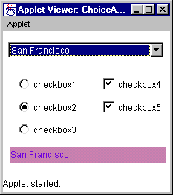
Choice and Checkbox:
Event Handler Methods
void c1_itemStateChanged(ItemEvent e) {
String t = choice1.getSelectedItem();
label1.setText(t);
}
void checkbox1_itemStateChanged(ItemEvent e) {
Checkbox cb = (Checkbox)e.getSource();
String text = cb.getLabel();
label1.setText(text);
}

Slide 79
List Component
List represents a list box
  Can be single- or multiple-selection
List class defienes methods
    void add(String name)
    void add(String name, int index)
    String getSelectedItem()
    int getSelectedIndex()
    String[] getSelectedItems()
    int getItemCount()
Main events:
Main Events
ActionEvent
ItemEvent
Interfaces
ActionListener
ItemListener
Handler methods
actionPerformed()
itemStateChanged()

Slide 80
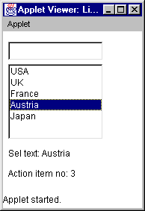
List: An Example
void textField1_actionPerformed(ActionEvent e) {
String s = textField1.getText();
list1.addItem(s);
}
void list1_itemStateChanged(ItemEvent e){
String t = list1.getSelectedItem();
label1.setText("Sel text: " + t);
}
void list1_actionPerformed(ActionEvent e){
int i = list1.getSelectedIndex();
label2.setText("Action item no: " + i);
}

Slide 81
Other AWT Components: TextField and TextArea
TextField displays a single line of text and defines
    String getText()
    void setText(String text)
    String getSelectedText()
    void setEchoChar(char ch)
TextArea displays multiple lines of text and defines
    void append()
    void insert(String str, int index)
    void replaceRange(String str, int startIndex, int endIndex)
Main events:
Main Events
ActionEvent
TextEvent
Interfaces
ActionListener
TextListener
Handler methods
actionPerformed()
textValueChanged()

Slide 82
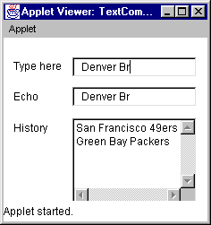
TextField and TextArea:
An Example
public class MyApplet extends Applet {
void textField1_textValueChanged(TextEvent e) {
String s = textField1.getText();
textField2.setText(s);
}
void textField1_actionPerformed(ActionEvent e) {
String s = textField1.getText();
textArea1.append(s + "\n");
textField1.setText("");
}

Slide 83
Using Panels to Partition an Applet
Object
Component
  Panel is a kind
  of Container
  An applet can be
  partitioned into
  many Panels
  Each Panel can be
  given a different “layout manager”
Container
Panel
Applet

Slide 84
Layout Management
  Layout managers ensure that the UI looks good on any platform
    Positions and sizes all components
    Provides platform independence
  AWT provides several layout managers:
    FlowLayout, BorderLayout, CardLayout, GridLayout, GridBagLayout
Notes:
##
*
*
07/16/96
What Is a Layout Manager?
A layout manager is an object that assumes responsibility for laying out components in a suitable arrangement in a container. The layout manager makes intelligent decisions about the size of all the components it has to fit into the container.
AWT provides five different layout managers:
BorderLayout allows a container to hold up to five components: one on the top (“North”) of the container, one on the bottom (“South”), one on the left (“West”), one on the right (“East”), and one in the “Center.”
CardLayout emulates a tabbed dialog box. A container can contain several “cards” which overlay the same screen area; only one card is visible at a time.
FlowLayout allows components to be arranged like words on a page; the first component is placed at the top left of the container, and components are added horizontally until there is no more room on that row for any more. Subsequent components are added at the start of the next row.
GridLayout is useful if you are building a form. GridLayout arranges components in a grid arrangement. For example, you might set up a grid containing two columns, with labels placed in the left hand column, and text fields placed in the right-hand column.
GridBagLayout is a more generic version of GridLayout; it allows each cell in a grid to be a different size, for maximum flexibility.

Slide 85
Using Layouts
Layouts can be set for all the containers like, Applets, Frames, Panels
In the constructor of the Applet or Frame use
  setLayout(new LayoutObject);
The default layout for Applets and Panels is the FlowLayout
For Frames the default layout is BorderLayout

Slide 86
FlowLayout
Flow layout is the default layout
The components will be added row by row in a flow
Defines Constructors like
FlowLayout()
    Creates the default layout, centers all components, and leaves 5 pixels space between components
FlowLayout(int how)
    Can set the flow alignment
    FlowLayout.LEFT / RIGHT / CENTER
FlowLayout(int how, int horz, int vert)
    Can set the flow alignment, and the pixel gap between components

Slide 87
BorderLayout
Border Layout implements a common layout style for top-level windows
It can accommodate five components one on each side and one on the center
Defines constructors
    BorderLayout()
    BorderLayout(int horz, int vert)
Defines constants
    BorderLayout.CENTER, BorderLayout.NORTH, BorderLayout.SOUTH, BorderLayout.EAST, BorderLayout.WEST
Can add components using
    void add(Component compObj, Object region)

Slide 88
GridLayout
Grid Layout allows to add components in a two-dimensional grid
Defines constructors
    GridLayout()
    GridLayout(int numRows, int numColumns)
    GridLayout(int numRows, int numCols, int horz, int vert)

Slide 89
CardLayout
Card Layout can hold cards, each card can be assigned with a different layout
Defines constructors
    CardLayout()
    CardLayout(int horz, int vert)
Defines methods
    void add(Component panelObj, Object name)
    void first(Container deck)
    void last(Container deck)
    void next(Container deck)
    void previous(Container deck)
    void show(Container deck)

Slide 90
GridBagLayout
GridBag layout can accommodate components in a grid of variable rows and columns
Each component can be of different size
Each component can be placed on different x,y locations

Slide 91
Using Dialogs
Dialogs are child windows of a top-level window
Dialogs cannot have menu bars
Dialogs cannot be minimized nor maximized
Defines constructors
    Dialog(Frame parentWindow, boolean mode)
    Dialog(Frame parentWindow, String title, boolean mode)
The mode if set to true, the window will not loose focus
File save and open Dialogs can be created
    FileDialog fd=new FileDialog(new Frame(),”Open”, FileDialog.LOAD)
  String getDirectory(), String getFile() can be used to select directories and load files

Slide 92
Working with Menus
A Menu Bar can be added to the top-level window
Menu Bar can have a menu
Menus can have a menu item and checkbox menu item
Constructors
    Menu()
    Menu(String optionName)
    Menu(String optionName, boolan removable)
    MenuItem()
    MenuItem(String itemName)
    MenuItem(String itemName, MenuShortcut keyAccel)
    CheckboxMenuItem()
    CheckboxMenuItem(String itemName)
    CheckboxMenuItem(String itemName, boolean on)

Slide 93
More on Menus
Menu class defines
    Menu add(Menu menu)
MenuItem class defines
    void setEnabled(boolean flag)
    boolean isEnabled()
    void setLable(String name)
    String getLabel()
    MenuItem add(MenuItem item)
CheckboxMenuItem class defines
    boolean getState()
    void setState(boolean checked)
The Menu Items when clicked generate ActionEvent
The CheckboxMenuItems when clicked generate ItemEvent

Slide 94
Multithreading

Slide 95
Why Use Multithreading?
Most programs perform many tasks:
  Updating the screen
  Waiting for user input
  Writing data to or from a file
  Communicating with a server
Reasons for multithreading
  Improve processor usage
  Simplify program logic
  Create responsive programs
Notes:
##
*
*
07/16/96
The Problems with Single-Threaded Programs
Traditional single-threaded programs work sequentially; that is, they perform one task after another. This is a very inefficient way of doing things; for example, if one of the tasks involves reading data from disk, thousands of CPU cycles might pass as the heads scan the disk for the desired data. While waiting for this disk access, the program is unable to make use of the CPU cycles, even though it might have other operations it could usefully perform, given the chance.
Multiple Threads Allow Programs to Perform Tasks in Parallel
By using multiple threads, a program can make better use of the system resources available for its own tasks. This improves the perceived performance of the program.
Multiple Threads Can Simplify Program Logic
The use of multiple threads can simplify the coding of a program. Older single-threaded operating systems, such as Windows 3.1, are forced to provide many asynchronous API functions to prevent a thread from blocking and impacting on other critical activities, such as handling the user interface. Additional API functions have to be used to wait for one of many possible completion or error events, without having to loop around checking for each one in turn. This complicates the code, because a significant amount of processing is required to determine which particular event occurred.
A multithreaded program can dedicate a thread to a specific task, thereby reducing the complexity of the code and the possible error conditions that might occur.

Slide 96
What Is a Thread?
A thread is an execution path in a program
  Every program has at least one thread
  Each thread has its own stack, priority, and virtual set of registers
Threads compete for processor time
  Scheduled by the operating system
  The scheduler maintains a list of ready threads, and decides which thread to run
Notes:
##
*
*
07/16/96
Multithreaded Programs Perform Multiple Tasks Concurrently
Threads provide a mechanism for carrying out several programming tasks simultaneously within a running program. Each thread has a priority, and switching between threads is carried out automatically. Each thread runs independently, and maintains a set of data structures for saving its context while waiting to be scheduled to run on the processor.
Switching Between Threads
When the system switches from one thread to another, it saves the context of the suspended thread and restores the saved context of the thread to be run. On a single-processor system, although it appears that multiple threads are executing at the same time, only one thread can actually run at any one time. A scheduler decides which thread should run and when.

Slide 97
Java Threads
In Java the Thread class represents threads:
  Maintains state of thread
  Provides several constructors
  Provides several control methods
  Create a Thread object per thread
Threads are scheduled by the Java VM:
  Using operating system support
Notes:
##
*
*
07/16/96
Java Threads Are Scheduled by the Operating System
The responsibility for scheduling threads is delegated to the operating system. In cases where the operating system does not support threads, such as in Windows 3.1, a package called “green threads” is ported together with the Java Virtual Machine, to provide a threads layer on top of the operating system. Hence, Java can implement threads on all platforms, including Windows 3.1.

Slide 98
Thread Life Cycle
New thread
Running
start()
suspend()
sleep()
wait()
run() exits stop()
Stopped
Scheduled
by VM
Ready
to run
Blocked
resume()
notify()
Notes:
##
*
*
07/16/96
How Do You Start a Thread?
When you create a new Thread object, it has all the resources required to run. However, it is not actually runnable until you call its start() method. This causes the scheduler to call the thread run() method; all of the action for a thread takes place in its run() method.
What Happens If There Are Many Threads in the Runnable State?
Typically, many threads are in the runnable state at the same time. All of these threads compete for processor time, but on a single-processor system only one thread can run at any given time. The remaining threads are simply waiting for their turn. However, on multi-processor systems, many threads can run at the same time, one on each processor. From a design point of view, it is safer to assume that all runnable threads can run at any given time.
How Do Threads Become Blocked?
A runnable thread may block for a number of reasons:
The running thread calls sleep() or wait()
Any running thread calls suspend()
The running thread calls an I/O method that blocks until the I/O operation is complete
How Does a Thread Die?
A thread may die for one of two reasons:
It dies a natural death because its run() method exits
It is killed because another object calls its stop() method

Slide 99
Controlling the Main thread
public class MyMainThread {
public static void main(String args[]){
Thread t = Thread.currentThread();
t.setName(“My Main Thread”);
System.out.println(“My Thread “+t);
try{
for(int I=0; I<10; I++){
System.out.println(I);
Thread.sleep(5000);
}
}catch(InterruptedException e){
System.out.println(“Main thread”+
“ Interrupted.”);
}
}
}

Slide 100
Creating a New Child Threads
Create new threads as follows:
  Define a subclass of Thread
  Override its run() method
  Create an instance of the class
  Call its start() method
  Scheduler then calls its run() method
run() is the only code to run in a separate thread
Notes:
##
*
*
07/16/96
run() Is the Entry Point for a Thread
As mentioned previously, the Thread class provides a run() method, which is called by the scheduler when a thread is first scheduled. It is important to realize that the run() method is the only code in a Thread object to run in a separate thread of execution.
run() is the entry point for the new thread; as soon as run() returns, the thread dies and cannot be restarted. The role of run() with threads is similar to the role of main() with applications. main() is the entry point for an application; as soon as main() returns, the application dies and cannot be restarted.
Useful Threads Are Provided by Subclassing the Standard Thread Class
If the run() method in the Thread class is empty, the method returns immediately and the thread terminates straightaway. Clearly, this is not particularly useful.
The solution is to subclass the Thread class, and override its run() method. Inside the run() method of the subclass, you can do anything you want, often within an infinite loop.
To create and start a new thread, create an object of the subclass and call its start() method. This causes the scheduler to launch the new thread by calling its run() method.

Slide 101
Creating Child thread by Extending Thread class
public class AnyClass {
public void anyMethod() {
MyThread t = new MyThread();
t.start();
}
}
public class MyThread extends Thread {
public MyThread() {
… // A constructor
}
public void run(){
… // Your code here
}
}
Notes:
##
*
*
07/16/96
Extending Thread
In this example, MyThread extends Thread, and overrides its run() method. The class can also provide any other methods it sees fit, such as constructors, accessor methods, and so on.
Creating a MyThread Object
To create a thread, a MyThread object can be created anywhere in the program; once its start() method is called, the thread becomes runnable and its run() method will be called by the scheduler.

Slide 102
Another Way to Create Threads
Alternatively, implement Runnable:
  Override its run() method
  Create an instance of the class (the “target object”)
  Create an instance of Thread, passing your target object as a parameter
  Call start() on the Thread object
  Scheduler calls run() on the target
Notes:
##
*
*
07/16/96
How Can You Make a Class Threadable If It Already Extends Another Class?
On the previous page, we saw that a class can be made threadable by extending Thread and overriding its run() method. However, if the class already extends another class, such as Applet, we have a problem; Java does not support multiple inheritance, so we cannot extend the Thread class and another class at the same time.
Introducing the Runnable Interface
Subclassing Thread is usually reserved for worker classes, where you do not need to handle the user interface or a network connection. A more flexible way to define a useful thread is to implement the Runnable interface. The Runnable interface is defined as follows:
interface Runnable {
void run();
}
A class that implements an interface must implement all the methods defined in that interface, so a class that implements the Runnable interface must define a run() method. Any code that is required to run in a separate thread of execution must be placed in this method.
Creating a Thread Using the Runnable Interface
The run() method must be called by the scheduler somehow, so a Thread object is still required. However, the Thread class provides an alternative constructor that takes a reference to a target Runnable object. When the start() method is invoked on the Thread object, the scheduler invokes the run() method from the target object. Exactly how this happens is explained in more detail on the next slide.

Slide 103
Implementing Runnable
public class Thread implements Runnable{
private Runnable target;
public Thread(Runnable r){
target = r;
}
public void run(){
if (target != null)
target.run();
} …
public class MyApplet
extends Applet
implements Runnable{
private Thread t;
public void start(){
t = new Thread(this);
t.start();
}
public void run(){
// method runs in a
// separate thread
} …
Notes:
##
*
*
07/16/96
Providing Multiple Threads in an Applet Class
Here is an example of how an applet, MyApplet, can implement the Runnable interface to create another thread. The applet’s start() method, not to be confused with the start() method of a thread, creates a Thread object and passes it a reference to the target Runnable object. In this example, the Runnable object is defined as this; in other words, the applet class itself provides the run() method that is to be executed in a separate thread.
The Thread constructor stores a reference to the target Runnable object in an instance variable called target. The applet then calls the thread start() method, to put the new thread into a runnable state.
How Does the Thread Object Decide Which run() Method to Call?
When a Thread object enters the runnable state, it becomes a candidate for scheduling. The first time it is scheduled, the scheduler calls the run() method in the Thread class itself.
The Thread’s run() method checks to see if the target object is not null, and calls the run() method in the target object, which in this example is the MyApplet object. Therefore, the run() method in MyApplet is executed in a separate thread.
Typically, the applet thread needs to perform some repetitive task such as an animation, so the applet run() method usually contains an infinite loop.

Slide 104
Multithreading in Applets
An applet is started by the browser
  Applet can start other threads
  Usually done in the start() method
Applets start threads when they become visible, and stop or suspend them when the applet is hidden
  Saves system resource
  Prevents interference with other programs
Notes:
##
*
*
07/16/96
Threads in Applets
Unlike an application, an applet must start up threads if it is to have a life of its own. The applet’s start() method is called initially by the container, which in most cases is a browser such as Netscape or Internet Explorer.
If the applet does not start up one or more threads, it will not run at the same time as the Web browser or appletviewer. In other words, while a method in the applet is executing, the browser is blocked until the applet’s method return.

Slide 105
Terminating Threads
If run() exits, the thread ends naturally
To end a thread prematurely, call stop()
  Clean up in a finally clause
public void run() {
try {
… // Code to run in separate thread
}
finally {
… // Performs this when thread dies
}
}
Notes:
##
*
*
07/16/96
What Happens When a Thread Dies?
A thread ends naturally if its run() method returns. Alternatively, a thread can be ended prematurely by calling its stop() method; this causes a ThreadDeath exception to be thrown to the target thread.
ThreadDeath is a subclass of Error, not a subclass of Exception. It is possible to catch ThreadDeath errors, but you must remember to rethrow the error to ensure that the thread is shut down properly. In practice, catching ThreadDeath errors is an advanced technique that is seldom seen in user code; the recommended way to clean up a thread when it exits is to use a finally clause.

Slide 106
Starting and Stopping Threads
public class Cnt extends Applet implements Runnable {
private Thread theThread;
private int c;
public void start() {
if (theThread == null || !theThread.isAlive()) {
theThread = new Thread(this);
theThread.start();
}
}
public void stop() {
theThread.stop();
theThread = null;
} // Continued ...
Notes:
##
*
*
07/16/96
Starting a Thread in an Applet
The slide shows the first part of an applet that displays a running count. The example is continued on the next slide. To display a running count, the applet requires the use of a second thread; for this reason, the Cnt class implements the Runnable interface and overrides the run() method, as we shall see on the following page.
The applet contains an instance variable called theThread, which refers to the Thread object that the applet uses to start and stop its counter thread. When the applet’s start() method is called by the browser, it checks the value of theThread to see whether a thread has already been created. If it hasn’t, start() creates a new Thread object, and passes this to the constructor; this indicates that the applet run() method should be used by the new thread.
After creating the Thread object, a call is made to its start() method. Once this method returns, the applet start() method returns control to the browser. Meanwhile, the new thread starts executing the applet run() method.
Stopping a Thread in an Applet
When the user leaves the page that contains the applet, the browser in which the applet is running calls the applet stop() method. In turn, this method stops the thread, and sets the thread variable to null. If and when the applet becomes visible again, the applet start() method is called once more, and a new thread is created to carry on incrementing the running count.
Technical Note
You can also use suspend() and resume(), to pause and resume a thread.

Slide 107
Example
public void run() {
for (c = 0; true; c++) {
repaint();
try {
Thread.sleep(10);
}
catch (InterruptedException e) {}
}
}
public void paint(Graphics g) {
g.drawString("Count = " + c, 10, 10);
}
}
Notes:
##
*
*
07/16/96
Providing a run() Method for an Applet
This slide shows the run() method and paint() method for the applet introduced on the previous slide.
The run() method contains an infinite loop, so that the new thread continues to run while the page is visible. Inside the loop, the run() method increments the count variable c, and calls repaint() to request a refresh of the applet display window. Finally, the thread puts itself to sleep for at least 10 milliseconds, by calling Thread.sleep(10).
It is important to sleep or block somewhere in the loop; otherwise, the thread could hog the processor and impact the performance of other threads. Note that the sleep() method might throw an InterruptedException; this exception must be caught as shown in the slide.

Slide 108
Creating Multiple Threads
public class Mythread
implements Runnable{
Thread t;
String name;
public Mythread(String s){
name=s;
t=new Thread(this,s);
t.start()
}
public void run(){
try{
for(int I=0;I<10;I++){
System.out.println(name+” “+I);
Thread.sleep(1000);
}catch(Exception e){ }
} }
public class Test
extends Applet{
Mythread c1, c2;
public void start(){
c1 = new Mythread(“ONE”);
c2 = new Mythread(“TWO”);
c1.start();
c2.start();
}
Notes:
##
*
*
07/16/96
Dealing with Two or More Threads
A class can contain only one run() method; therefore, if an applet needs to create more than one thread, and each thread needs to be different, each run() method needs to be defined in a class of its own.
The example in the the slide shows a Cnt class, which displays a running count in a TextField component. It provides a constructor to initialize the txt instance variable to refer to a TextField object. The run() method is similar to that shown in the previous example, except that the count is displayed in the TextField component.
Creating Multiple Threads
The Test class, which is an applet, can create as many Cnt objects as required. The applet requires an init() method such as the following, to create the appropriate number of TextField components and add them to the applet’s window.
public void init() {
add(txt1 = new TextField(12));
add(txt2 = new TextField(12));
}
A separate Thread object must be associated with each Cnt object. Therefore, when we create the Thread objects, we pass the reference to the appropriate Cnt object to the Thread constructor, and call the thread’s start() method. After creating the second Thread object, control is returned to the browser. Meanwhile, the two TextField components will display running counts.

Slide 109
Using isAlive and Join
Thread class defines
  final boolean isAlive() - returns true if the thread object is still not exited
  final void join() - if used in the main thread on the child thread, makes the main thread wait( ) until the child exits
public class Appln{
public static void main(String args[]){
Mythread t1=new Thread(“My new Thread”);
t1.start();
System.out.println(“Child is alive :”+
t1.t.isAlive());
t1.t.join();
}
}

Slide 110
Scheduling and Priorities
  Every thread has a priority (1 to 10)
  Scheduling is operating-system specific
    A high-priority thread can preempt a lower-priority thread at any time
    High-priority processor-intensive threads can dominate the processor
    Threads of the same priority can be scheduled in a circular fashion
  Call sleep( ) in loops
Notes:
##
*
*
07/16/96
Setting Thread Priorities
You can change the priority of a thread by calling its setPriority() method. The Thread class defines the following useful constants:
MIN_PRIORITY (1)
MAX_PRIORITY (10)
NORM_PRIORITY (5)
In general, you should set processor-intensive threads to a lower priority than threads that need to respond quickly to user-interface events, such as button clicks. Most of the time, the thread waiting for the user-interface event is blocked, which allows the lower-priority threads to run. However, as soon as the user-interface event occurs, the higher-priority event thread will immediately preempt a lower-priority thread, and keep the user happy.
Java Threads Are Scheduled by the Operating System
The implementation of Java threads depends on the scheduling policy of the operating system. If there is no multithreading support in the operating system, the “green threads” package supplied with the Java VM is used instead. The basic rule is that you need to understand the scheduling policy of the operating system, in order to determine how the Java threads will be scheduled.

Slide 111
Setting Priorities
getPriority( ) - returns the current priority of thread
setPriority( ) - sets the priority to a thread
setPrioritry( ) - Can be used as follows
  setPriority(Thread.MAX_PRIORITY)
  setPriority(Thread.MIN_PRIORITY)
  setPriority(Thread.NORM_PRIORITY+2)
  setPriority(Thread.NORM_PRIORITY-2)

Slide 112
Accessing Shared Resources
Data might be corrupted if accessed by many threads:
  Suppose a thread is executing withdraw(), when it is interrupted by another thread
  Use the synchronized keyword
public class BankAccount {
private double balance;
public void withdraw(double amt) {
balance -= amt;
}
Notes:
##
*
*
07/16/96
Problems with Multithreaded Programs
Although threads are very useful, there is a downside. It is important to remember that a thread can be preempted at any time; if this occurs while the thread is manipulating a shared resource such as a global variable, it is possible that the thread could be interrupted by another thread, which proceeds immediately to use the same shared resource.
Serializing Access to Shared Resources
To avoid such problems, it is up to you to use the synchronized keyword, so that only one thread can access the shared resource at any given time. This is explained in more detail on the next slide.

Slide 113
synchronized Methods
If a thread calls a synchronized method in an object, no other thread can call a synchronized method in the same object
public class BankAccount {
private double balance;
public synchronized void withdraw(double amt) {
balance -= amt;
}
public synchronized void deposit(double amt) {
balance += amt;
} …
Notes:
##
*
*
07/16/96
Locking the Monitor of an Object to Achieve Thread Synchronization
Every object has a lock called a “monitor.” This monitor can be used to restrict access to shared resources, because only one thread can own an object’s monitor at any one time. If a thread has ownership of an object monitor, then other threads attempting to do so are blocked until it is released.
Synchronized Methods Lock Out a Particular Object
As soon as a synchronized method is called upon an object, the monitor for the object is locked. This prevents any other threads from entering this or any other synchronized method of the same object.
Synchronized Methods Can Still Be Called on Other Objects
Other objects can still be accessed by other threads. For example, if you have two objects of the BankAccount class, and the BankAccount class has a synchronized deposit() method, two threads could each call the deposit() method on different BankAccount objects, without blocking. Only if the threads try to call deposit() on the same BankAccount object, would one of the threads block.

Slide 114
Controlling a Thread with Suspend and Resume
A thread can be blocked or revoked by calling its suspend() and resume() methods
boolean suspended;
public void mouseClicked(MouseEvent e) {
if (suspended)
aThread.resume();
else
aThread.suspend();
suspended = !suspended;
}
Notes:
##
*
*
07/16/96
Suspending and Resuming Threads
A thread can suspend another thread by calling its suspend() method. If the target thread is displaying some animated text, an applet could use this facility to provide a “pause” button. A thread that has previously been suspended can be resumed by calling its resume() method.
Note that calling suspend() on a blocked thread, or resume() on a runnable thread, does not cause any problems.

Slide 115
Deadlock
Deadlock occurs when two threads have a circular dependency on a pair of synchronized objects
Main Thread
Thread1
Object of class1
Thread 2
Object of class2
Class1
Class2
Synchronized
Method
Synchronized
Method
Synchronized
Method
Synchronized
Method

Slide 116
Interthread Communication with wait and notify
A Thread can stop and wait for an event
  Use wait() to suspend current thread
  The thread must own the object monitor, that is, be synchronized
  The monitor will be unlocked when wait() is called
  Can wait() indefinitely or for a fixed amount of time
notifyAll() wakes up waiting threads
Notes:
##
*
*
07/16/96
The wait() and notifyAll() Methods
The Object class defines a pair of instance methods called wait() and notifyAll(), which enable threads to synchronize on other objects by explicitly waiting on them. This allows many threads to wait on a particular event, such as the arrival of work packets. The thread that deposits the work packets can then notify one or more waiting threads that there is work to do.
An example is shown on the following page.

Slide 117
Example
// Check if any work has been put in
// the queue. Wait if queue is empty
synchronized(taskQueue) {
while (taskQueue.getJob() == null)
taskQueue.wait();
}
Thread 1
Thread 2
// Put work in the queue, to be
// performed by another thread
synchronized(taskQueue) {
taskQueue.queueJob(newJob);
taskQueue.notifyAll();
}
Notes:
##
*
*
07/16/96
Waiting on an Object
A thread that wants to wait on an object must enter a code section which locks the monitor for that object. Once the monitor is locked, the calling thread calls wait() on the locked object. To avoid locking out any other threads waiting on the same object monitor, the monitor is automatically released when wait() is called.
Notifying Waiting Objects That They Can Proceed
Another thread can call the notifyAll() method, to notify all waiting threads that they can now proceed. The calling thread must lock the object monitor first, before notifyAll() can be called. When notifyAll() is called, any threads waiting on the object will be moved from the blocked state to runnable.
The notify() Method
notify() is an alternative to notifyAll(). Calling notify() on an object wakes up just one thread that previously made a call to wait() on that object. However, there is no way of determining which waiting thread will be woken up. Unless you know a great deal about what threads might be waiting, it is safer to use notifyAll().

Slide 118
Java Swing

Slide 119
What are JFC and Swing?
  JDK1.2 contains a sophisticated set of graphics and user interface API, called the Java Foundation Classes (JFC)
  Swing components are light weight components
  Swing components range from basic controls such as buttons, checkboxes, scrollbars, and sliders to complex widgets like text panes and editor panes
  JFC Contains five major technologies, one of which is Swing. JFC also contains the Abstract Window Toolkit(AWT), Accessibility, Drag and Drop, and 2D Graphics

Slide 120
JFC Costituents
JFC consists of five major packages
___Swing
___PLAF
___Drag and Drop
___Java 2D
____Accessibility

Slide 121
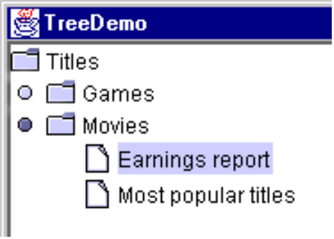

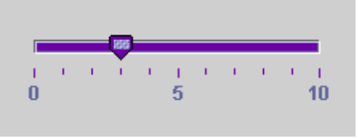
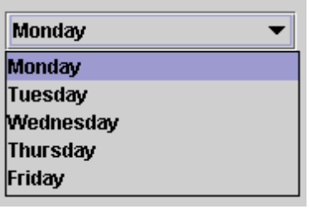
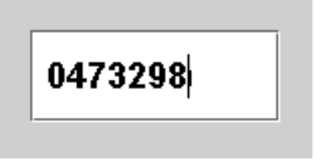

What Is Swing?
A set of visual components that is part of JDK 1.2
JButton
JSlider
JTree
JComboBox
JTextField
JProgressBar

Slide 122
Swing Features and Packages
  Swing development has its roots in the Model-view-Controller(MVC) architecture
  The Pluggable look-and-feel is a result of the MVC architecture
  Swing Packages:
  Javax.swing javax.swing.border javax.swing.colorchooser Javax.swing.event javax.swing.filechooser javax.swing.plaf
  Javax.plaf.basic javax.plaf.metal javax.swing.multi
  Javax.swing.table javax.swing.metal javax.swing.html
  javax.swing.tree javax.swing.undo
  Two more packages to store the look-and-feel classes of the Motif and windows operating systems
  com.sun.java.swing.plaf.motif.*
  com.sun.jva.swing.plaf.windows.*

Slide 123
Swing Componets Vs AWT Components
  Swing Components are implemented with absolutely no native code
  Swing components can have more functionality than AWT components
  Swing buttons & labels can display images, you can change or add the borders drawn around most Swing Components
  Assistive technologies such as screen readers can easily get information from Swing Components

Slide 124
Model - View - Controller Architecture
Popularly known as MVC pattern
Not a new architecture, has been used by programmers for years
Data is represented in a model
View presents the data
Controllers are used to interact with the model

Slide 125
JFC and MVC
JFC implements a slight variant of MVC
The visual components have both views and controllers
Models are represented by interfaces
Default implementation of models are available
More efficient as multiple copies are not maintained by the component

Slide 126
Model Interfaces in JFC
Some examples of model interfaces
___ButtonModel
___ComboBoxModel
___ListModel
___ListSelectionModel
___SingleSelectionModel

Slide 127
A Custom ListModel
Class TestListModel extends AbstraactModel {
String [ ] fruits = { “apple” , “banana” , “Orange” , “Pear” } ;
public int getSize ( ) {
return ( fruits . Length ) ;
}
public Object getElementAt( int index ) {
return ( fruits [ index ] ) ;
}
}

Slide 128
JComponent - The Root
Base for all Swing components
Derived from the container class of AWT
Carries the additional overhead of the container class, though may not be used
Can be combined or extended to create custom components

Slide 129
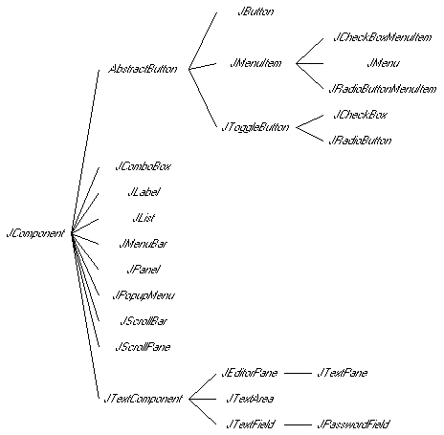
Swing Component Relations

Slide 130
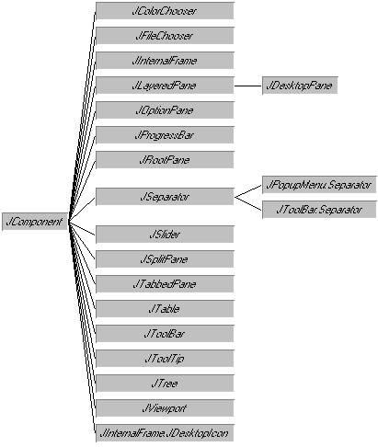
JAtomic Components

Slide 131
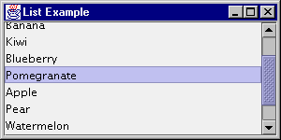
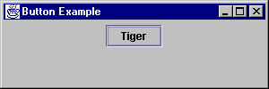
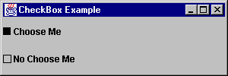
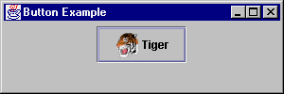
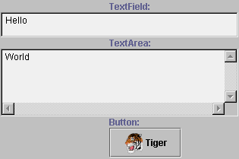
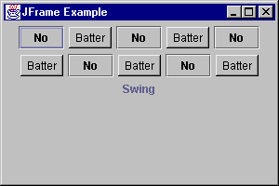

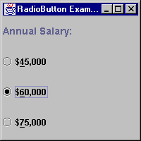
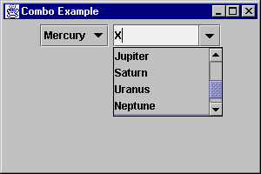
Swing Components

Slide 132
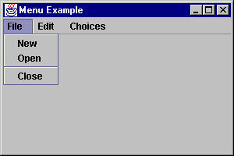
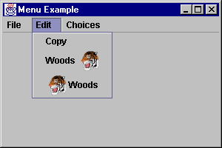
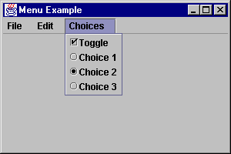
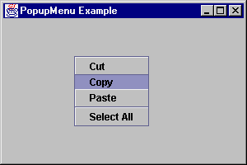
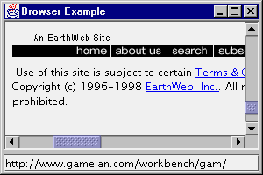
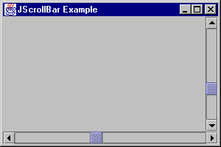
Swing Components

Slide 133

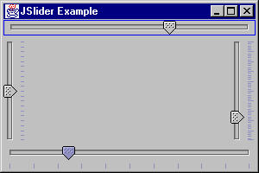
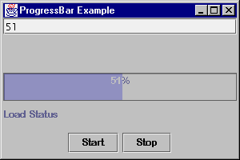
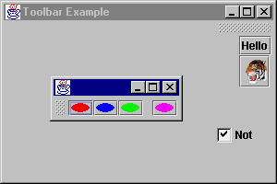
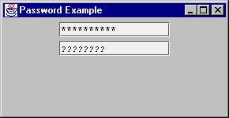
Swing Components

Slide 134
Top Level Containers
   Each program that uses Swing Components has at least one top-level container
  Example of Top Level containers
  JApplet, JFrame

Slide 135
Intermediate Swing Containers
  Swing components that are not top level containers, exist solely to contain other components are intermediate swing components
  Example of intermediate components
  JPanel, JScrollpane, JSplitpane, JTabbedpane, JToolbar, JInternalFrame, JLayeredpane, JRootpane
    A panel is a Swing container that is often used for grouping components with in one area of an applet or a frame

Slide 136
Atomic Components
  Atomic components are components that exist solely to present and accept information, rather than to contain other components
  Example of User Interface components
  JButtons, JCheckboxes, JLists, JMenus, JSliders.etc
  ⬥ The class AbstractButton is a direct subclass of JComponent and implement the interfaces swing constants and item selectable.
  ⬥ JButton, JCheckbox and JRadioButton’s parent class is Abstract Button class

Slide 137
Layout Management
  A layout is an arrangement of user interface components within a container such as an applet or a frame
  All the classes implement the interface java.awt.LayoutManager and are referred to as layout managers.
  After a specific layout manager object has been created, you need to assign it to a container so the components can be added to the container according to the layout pattern

Slide 138
BoxLayout
  The box layout allows creation of sophisticated layouts without the complexities experienced with the grid bag layout
  The box layout pattern are of two types: horizontal and vertical
  Constructor of Box Layout is:
   public BoxLayout(Container target, int axis)
  The class Box represents a lightweight container that can only use the box layout

Slide 139
The Box Container
  The Box container allows the components to be laid out either vertically or horizontally by specifying the direction of the layout
  The class Box also provides useful methods that add features such as inter-component spacing, component repositioning on resizing of the container, and so on
  A glue component expands as much as necessary to fill the space between its neighboring components in a box layout
  A filler allows you to specify the minimum, maximum, and preferred sizes of the components

Slide 140
Event Handling
  Swing set is an extension of AWT, Swing components also function based on the delegation event model
  The event delegation model consists of three separate objects to deal with event handling: event sources, events, and listeners
  Events are objects of specific class types that are extended from the class java.util.EventObject.
  To attend the events generated by event source, the listener object needs to be registered with that source

Slide 141
Pluggable Look-and-Feel
  Pluggable look-and-feel gives users an ability to switch the look-and-feel of an application without restarting it
  The pluggable look-and-feel API in Swing supports
   Cross-platform or default look-and-feel
   System look-and-feel
   Dynamically changing look-and-feel
  JDK 1.2 contains the other packages for the Motif look-and-feel and the Windows look-and-feel
  com.sun.java.swing.plaf.motif.*
  com.sun.java.swing.plaf.windows.*
  Call setLookAndFeel() to set the Look And Feel
Notes:
##
*
*
07/16/96

Slide 142
JRootPane - The Parent
JRootPane is fundamental to the JFC/Swing window, frame and panel containers
The container classes delegate operations to a JRootPane instance
JFrame, JDialog, JWindow , and JApplet are all heavy weight containers
The JInternalFrame is a lightweight container

Slide 143
JRootPane Hierarchy
Panel
Window
Applet
Dialog
Frame
JFrame
JDialog
JWindow
JApplet
JIteranlFrame
JRootpane

Slide 144
JRootPane - Constituents
A JRootPane is made up of a GlassPane, an optional MenuBar, and a ContentPane
The glassPane sits over the top of everything
The ContentPane must be the parent of any children of the JRootPane
The MeuBar component is optional
Root Pane
Layers
Menu Bar
Content Pane
Layered Pane
Glass Pane

Slide 145
The “JScrollPane” Class
A class typically used for scrolling a component
It manages a JViewport instance , scrollbars and viewport headings
The viewport is specified by using the setViewport() method

Slide 146
JScrollPane - an Example
JLabel label = new JLabel() ;
label . setFont(new Font(“Helvitica”, Font.BOLD, 24) ;
label.setText(“ This is a very long message that will not fit, better scroll this message !!! ”);
box.add(label) ;
JScrollPane s1=new JScrollPane(box) ;
frame.getContentPae().add(s1, ”Center”) ;

Slide 147
The “JTabbedPane” Class
A Visual component that allows multiple panels to be viewed one at a time
The tabs on the tabbed panel represent the complete set of options available for configuration
A great deal of information to be presented to the user in a relatively small amount of screen

Slide 148
JTabbedPane - an Example
JPanel panel = new JPanel ( ) ;
panel . setLayout(new BorderLayout( )) ;
panel . add(new JLabel(name), BorderLayout.NORTH) ;
panel . add(new JTextField( name ) , BorderLayout.SOUTH) ;
tabbedPane . add (panel , name) ;

Slide 149
JInternalFrame and JDesktopPane
The JInternalFrame and the JDesktopPane class together can be used for writing applications
An object of JDesktopPane holds objects of type JInternalFrame
JInternalFrame provides many of the features of a native frame, including dragging, closing, and becoming an icon, resizing, title display, and support for a menu bar.

Slide 150
Borders
Describes a border around the edges of a Swing component
Border supercedes the inset mechaism
The paintBorder() method paints the border
Use the setBorder(Border) API to set the borders for any component

Slide 151
The “Border” Interface
Interface describing an object capable of rendering a border
Some implemented border styles
__EmptyBorder
__BevelBorder
__TitleBorder
__MatteBorder
__CompoundBorder

Slide 152
The “JTable” Component
The most complex of the JFC components to construct
Undergone lot of modifications since its early release to be more stable
High performance views of tabular data
Highly customizable the table appearance based on requirements

Slide 153
The “JTable” Component
JTable is a user-interface component that presents data in a two-dimensional table format.
The model for JTable is the TableModel interface which contains the following methods
int getColumnCount()
int getRowCount()
Object getValueAt(int row, int col)
    void addTableModelListener(TableListener tl)
JTable jt = new JTable(model);
or JTable jt = new JTable();
jt.setModel(model);
You can specify a cell editor by using the method setCellEditor(…) method

Slide 154
Table Selection Models
JTable uses the ListSelectionModel for its selection abilities
Use the setSelectionMode ( int ) to specify the selection mode
__SINGLE_SELECCTION - Only one index can be selected
__SINGLE_INTERVAL_SELECTION - Allows single continuous selection
__MULTIPLE_INTERVAL_SELECTION- No restriction on what can be selected

Slide 155
The JTree Component
The JTree component is used for representing hierarchical data
Constructors :
Jtree(Hashtable value)
Jtree(Object[ ] value)
Jtree(TreeModel newModel)
The tree data structure is made of nodes and leaves, a given node can have zero or one parent nodes and zero or more child nodes
The JTree objects are built from TreeNode objects
The TreeNode interface contains methods like
    getParent(…)
    children(…)
    isLeaf(…)
    getChildAt(…)

