Slide 1
Deepika Kurup:
A young scientist's quest for clean water

Slide 2
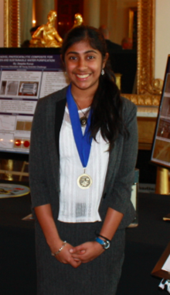
Inventor, Scientist, and clean water advocate.
Deepika Kurup

Slide 3
Global water crisis
75 percent of our planet is covered in water
Only 2.5 percent of that is freshwater
One percent of Earth's freshwater supply
is available for human consumption

Slide 4
Solution:
Passion + Interest

Slide 5
To purify water,
SODIS
Photocatalysis

Slide 6
Deepika’s method to purify water,
--Photocatalysis composite combines
titanium dioxide with cement

Slide 7
Thank you

