Slide 1
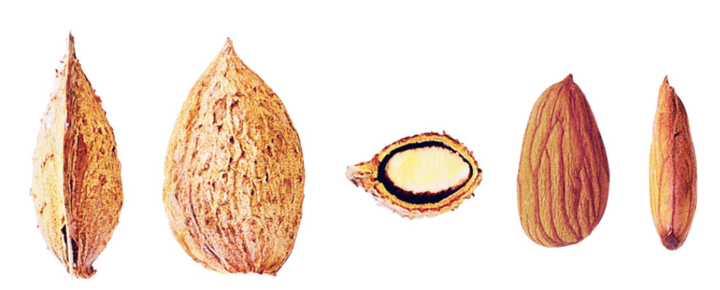
ALMOND TYPE CLASSIFICATION USING MACHINE LEARNING ALGORITHMS
Presented By:
Name
Under the Guidance of

Slide 2
AGENDA
Abstract
Introduction
System Requirements and Specifications
System Design
Implementation
Conclusion

Slide 3
1.INTRODUCTION
Almond type classification is the process of categorizing various almond varieties based on their unique physical characteristics and nutritional properties. Almonds come in multiple types, each distinguished by features such as shape, size, color, texture, and kernel density. This classification is essential in agriculture and the food industry since different almond types serve distinct purposes—from culinary applications to oil extraction—and vary in taste, nutritional content, and market value.
The primary distinguishing factor in almond types is kernel shape, which can vary between elongated, oval, and rounded forms. Other defining characteristics include skin color, kernel thickness, and surface texture. These factors determine an almond's suitability for different uses, such as roasting, raw consumption, or as an ingredient in various products.

Slide 4

1.INTRODUCTION

Slide 5
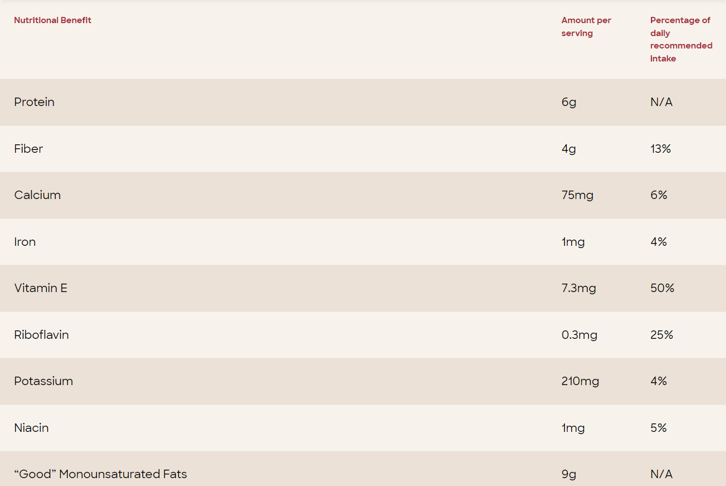

Slide 6
Aim and Objective
Aim:
The aim of the project is to predict the type of Almond using machine learning algorithms on Almond Type Classification Dataset.
Objective:
Data Collection
Data Preprocessing & Cleaning
Feature Extraction
Exploratory Data Analysis
Building Machine Learning Model
Prediction of the type of Almond

Slide 7
System Requirements and Specifications
Software Requirements
Scripting language : Python Programming
Scripting Tool : Anaconda Navigator (Jupiter Notebook) & Google Collab
Operating System : Microsoft Windows 11
Dataset : Almond Type Classification
Packages : NumPy, Pandas, Matplotlib, Seaborn , Sklearn etc.

Slide 8
System Requirements and Specifications
Hardware Requirements
Processor : 3.20 GHz
Output Devices : Monitor (LCD)
Input Devices : Keyboard
Hard Disk : 512 GB SSD
RAM : 16 GB

Slide 9
System Design
Machine Learning Algorithms
Almond type Dataset
Data
Train
Test
Data Preprocessing
Model Deployment
Random Forest, SVM , KNN and LR
Feature
Extraction
Missing Data Handling
Model Evaluation
Prediction of Almond Type
Mamra
Sanora
Regular

Slide 10
SYSTEM IMPLEMENTATIONS
In this study, The dataset consists of 2804 records of Almond samples, and the parameters are Length (major axis), Width (minor axis), Thickness (depth), Area, Perimeter, Roundness, Solidity, Compactness, Aspect Ratio, Eccentricity, Extent, Convex hull(convex area, or area hull), Type (target).
Data preprocessing involves checking for null values, filling them with mean, and dropping irrelevant columns.
Then feature scaling is applied to the data so that the values of numerical features in a dataset are set to a common scale, to improve the performance of machine learning algorithms.

Slide 11
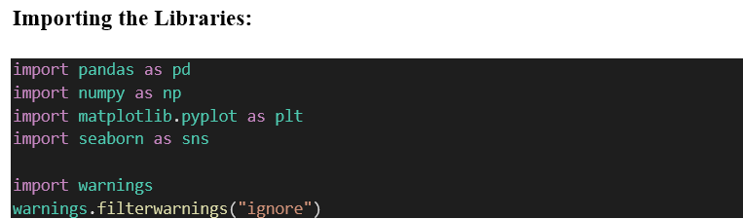
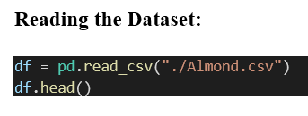
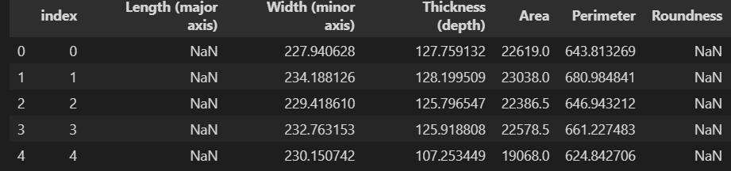
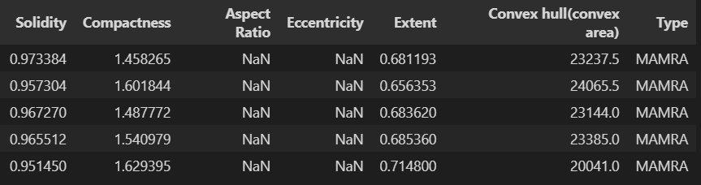

Slide 12
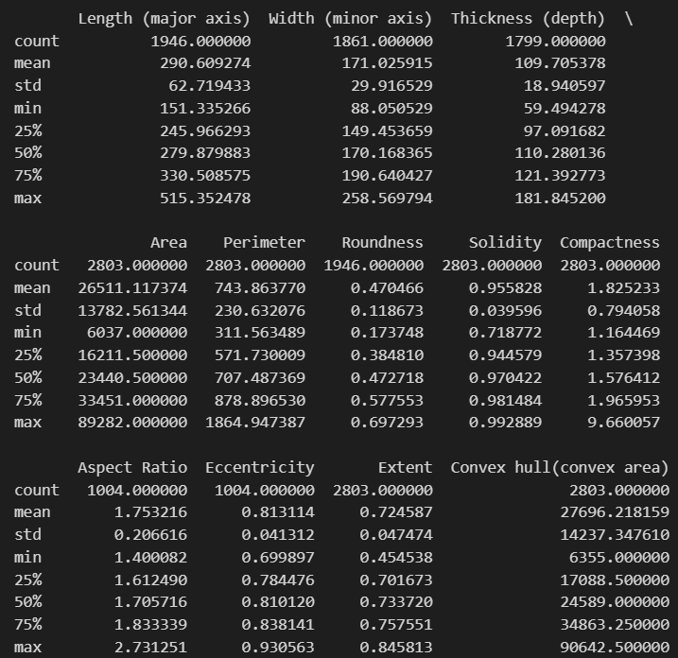
Statistical Description

Slide 13
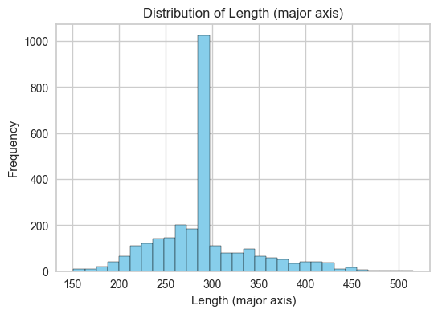
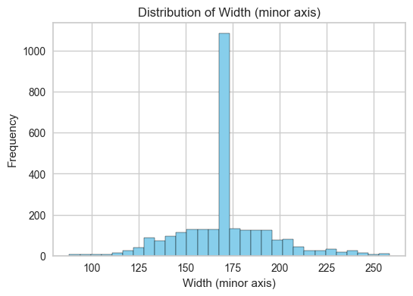
Exploratory Data Analysis (EDA)

Slide 14
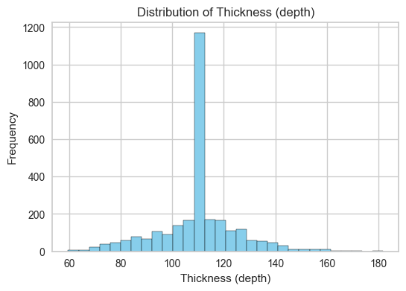
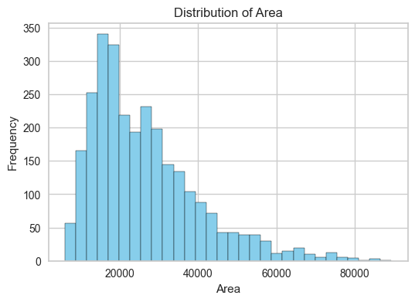

Slide 15
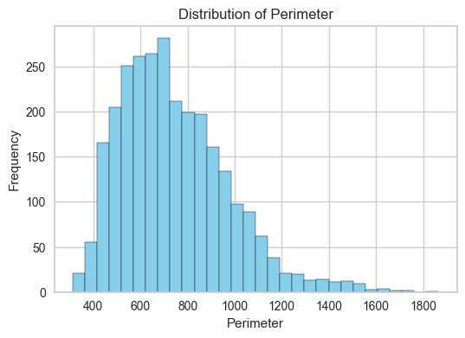
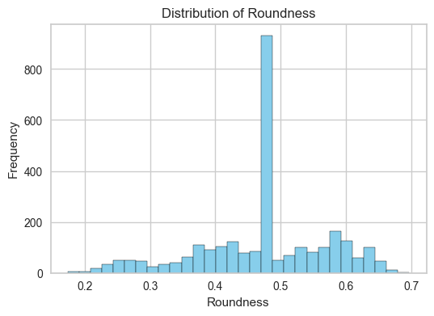

Slide 16
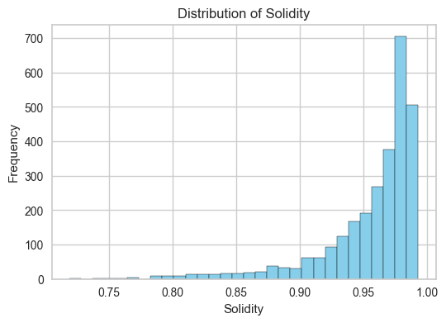
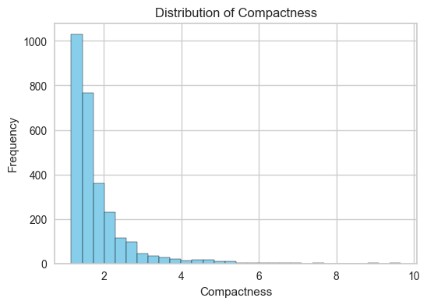

Slide 17
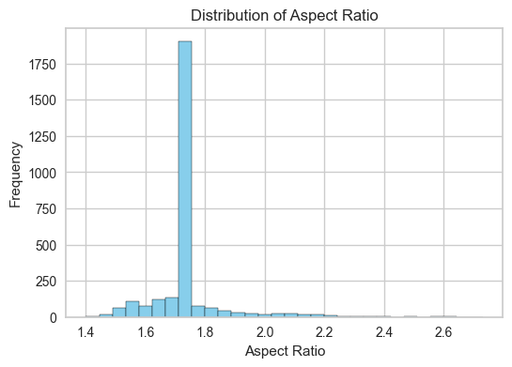
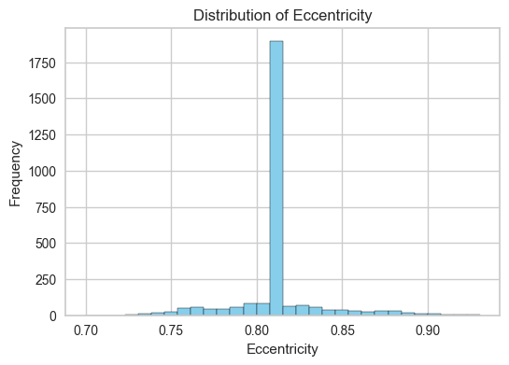

Slide 18
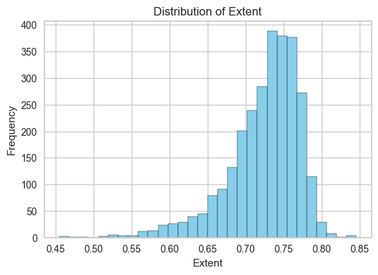
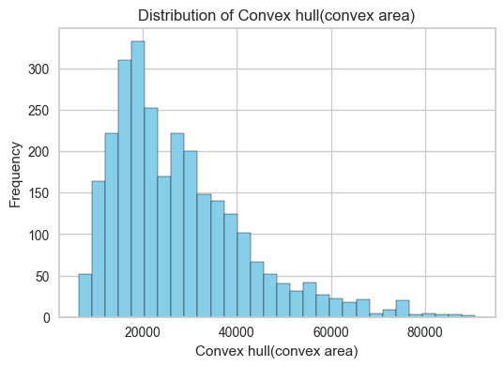

Slide 19
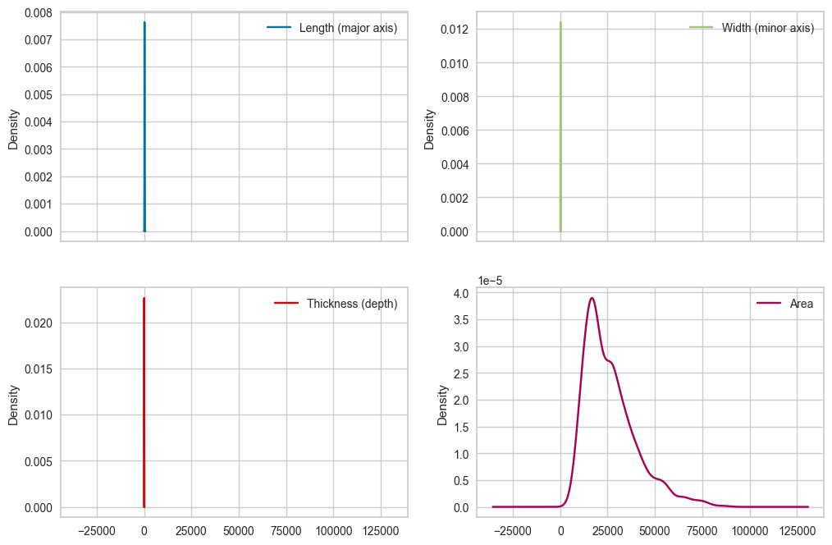

Slide 20
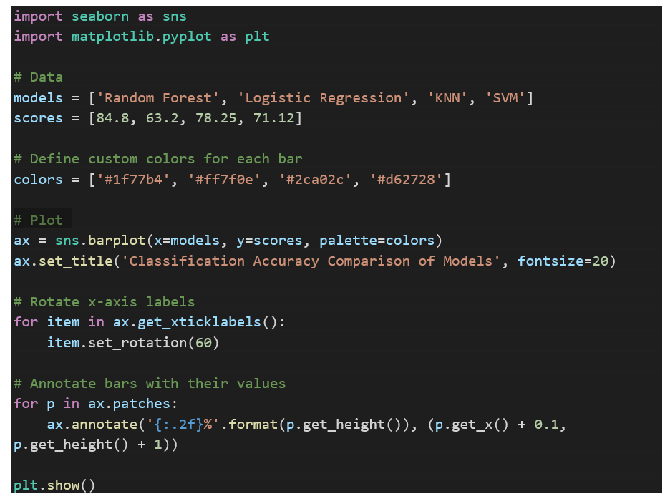

Slide 21
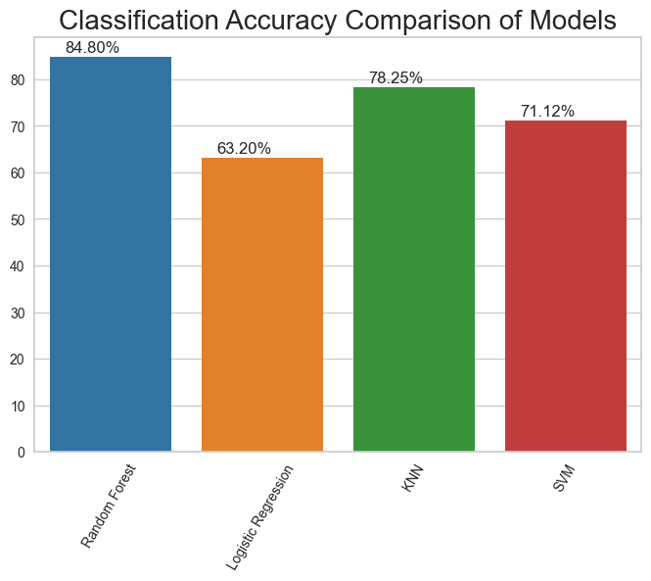

Slide 22
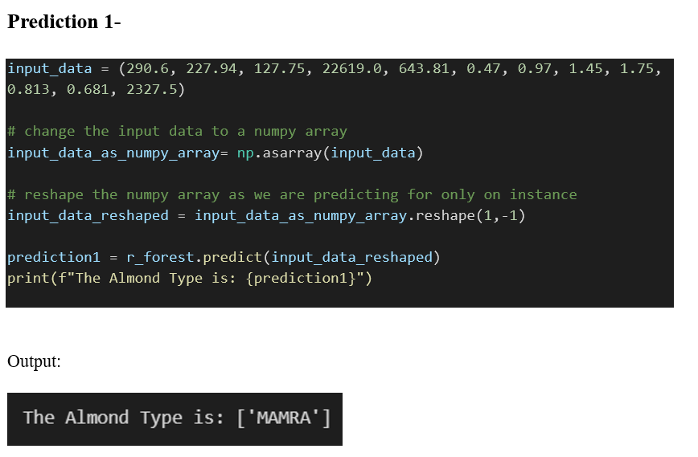

Slide 23
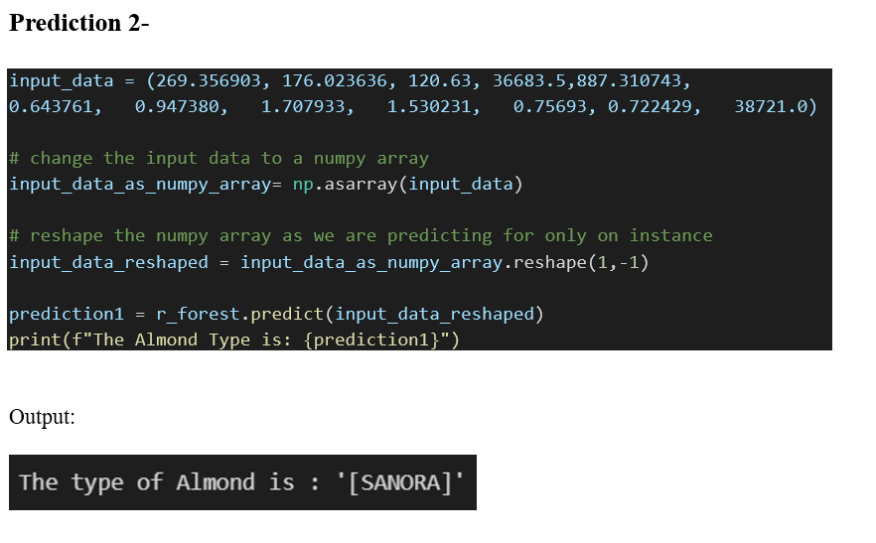

Slide 24
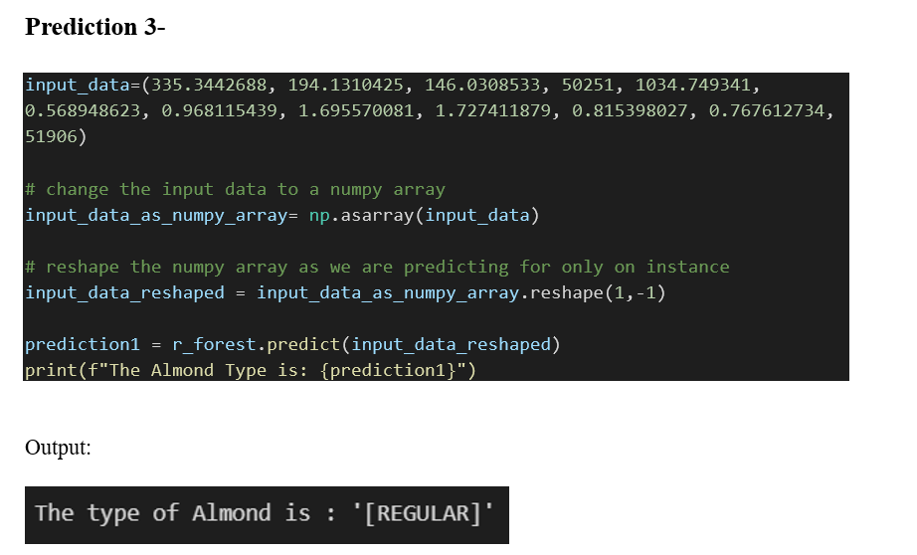

Slide 25
CONCLUSIONS
In this study by using four different classifiers the accuracy is measured and compared. Around 2080 records of Almond samples have been taken and the parameters are Length (major axis), Width (minor axis), Thickness (depth), Area, Perimeter, Roundness, Solidity, Compactness, Aspect Ratio, Eccentricity, Extent, Convex hull(convex area, or area hull), Type (target). The proposed method will segregate the almonds on the basis of these parameters.
The best classifier is Random forest in terms of accuracy. Some merits of these methods are it helps to increase decision tree accuracy by reducing overfitting. It can handle both categorical and continuous data.
This automates the process of filling in missing values in data. In higher dimensions, it performs excellently. Here, we used the best model i.e. Random Forest for predicting the type of Almond based on the features provided.

