Slide 1
INTERNET BANKING
Task - 3

Slide 2

Internet Banking
This project aims to design and develop a user-friendly and secure internet banking website that provides customers with a range of financial services, such as account management, fund transfer, and bill payment.
LMS Username | Name | Batch
2115a928 | JANANI S | A9
2115a929 | JOSHIKA J | A9
2115a935 | LIBA KEERTHIKA S | A9

Slide 3
Task 3 :: Frontend Creation
Create various Front End Programs
Draw and design a uniform front end code for “Your Project”
Draw and design a interactive front end code for “Your Project”
Evaluation Metric:
100% Completion of the above tasks
Learning outcome
Developing complicated UI using HTML components
Using props drilling and context to pass variables
Getting familiar with different type of api calls
Handling different input data

Slide 4
<!DOCTYPE html> <html lang=“en”> <head> <meta charset=“UTF-8”> <title>Internet Banking</title> </head> <body> <header> <h1>Internet Banking</h1> </header> <nav> <ul> <li><a href=“#”>Home</a></li> <li><a href=“#”>Accounts</a></li> <li><a href=“#”>Transfer Money</a></li> <li><a href=“#”>Payments</a></li> <li><a href=“#”>Settings</a></li> </ul>

Slide 5
</nav>
<main>
<h2>Welcome to Internet Banking</h2>
<p>Please log in to your account to access your banking information.</p> <form id="login-form">
<label for="username">Username:</label>
<input type="text" id="username" name="username"><br>
<label for="password">Password:</label>
<input type="password" id="password" name="password"><br>
<input type="submit" value="Log in">
</form>
</main>
<footer>
<p>&copy; 2023 Internet Banking. All rights reserved.</p>
</footer>

Slide 6
<script>
const form = document.querySelector('#login-form');
const usernameInput = document.querySelector('#username'); const passwordInput = document.querySelector('#password'); form.addEventListener('submit', (event) => { event.preventDefault(); const username = usernameInput.value.trim();
const password = passwordInput.value.trim();
if (username === '' || password === ‘’)
{
alert('Please enter both a username and password');
} else {
// Simulate server-side authentication
const isAuthenticated = authenticate(username, password);
if (isAuthenticated) {
alert('Welcome back ' + username);
// Redirect to user's account page
// window.location.href = 'accounts.html';
}

Slide 7
else {
alert('Incorrect username or password'); } } });
// Simulated authentication function - replace with actual server-side authentication function authenticate(username, password)
{
return username === 'user' && password === 'password';
}
</script>
</body>
</html>

Slide 8
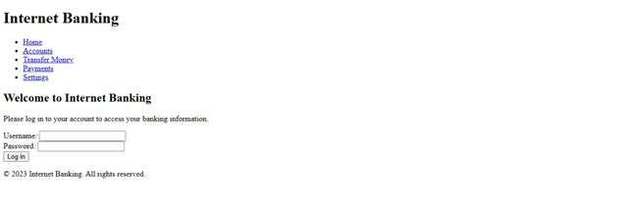

Slide 9
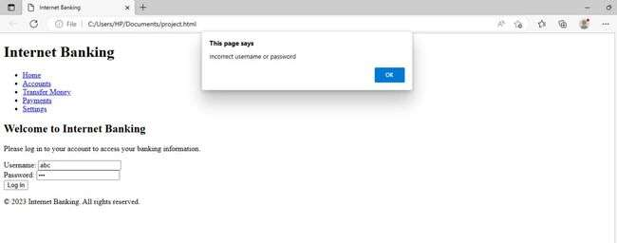

Slide 10
Assessment Parameter
Create folder structure for HTML application
Render Conditional components
Write Functions for event handling
Check-List
Overall UI of the project
Handling broken links
Optimizing render cycle

Slide 11
Submission Github
https://github.com/Jananijaa/Group_A9_11

