Slide 1
IF3311 PROJECT - I HATE SPEECH DETECTION USING TRANSFER LEARNING
Presented By
Janani Gopalakrishnan (2023611026)
Under the Guidance of
Dr. P.ANANDHA KUMAR, PROFESSOR,
Department of Information Technology, MIT

Slide 2
PROPOSED SYSTEM
The proposed system for hate speech detection integrates both text and emoji data to provide an understanding of online communications, particularly in the context of global events like the Paris 2024 Olympics.
Recognizing that emojis can alter the tone or intent of text, the system combines traditional language processing techniques with emoji sentiment analysis to capture both explicit and implicit hate speech.
The system utilizes two main architectures: Long Short-Term Memory (LSTM) and Bidirectional Long Short-Term Memory (BiLSTM) networks.
The LSTM captures sequential dependencies within text and emojis, effectively identifying hate speech patterns as they evolve within a sentence.
The BiLSTM, processing in both forward and backward directions, enhances this understanding by capturing context from surrounding words and emojis.

Slide 3
LITERATURE SURVEY
S.No | TITLE | METHODOLOGY | ADVANTAGES | LIMITATIONS
1 | Detection of Hateful Twitter Users with Graph Convolutional Network Model | Graph Convolutional Network (GCN) to detect hateful users on Twitter. | High Accuracy, Effective Analysis, User Data Integration. | Complex and computationally heavy, Data quality dependent, Limited to twitter
2 | Deep Explainable Hate Speech Active Learning on Social-Media Data | Explainable active learning with deep models | Enhances transparency in decision-making, iterative learning. | Complexity in model interpretability; Requires large labeled datasets for optimal active learning
3 | Hate Speech and Offensive Content Identification with Graph Convolutional Networks | Graph Convolutional Networks (GCN) for context-based content detection | Context-aware analysis, effective with offensive content | Requires structured data for GCNs, high model complexity

Slide 4
LITERATURE SURVEY
S.No | TITLE | METHODOLOGY | ADVANTAGES | LIMITATIONS
4 | Hate Speech and Offensive Content Identification in English and Indo-Aryan Languages | Variety of Machine Learning and Deep Learning models. | Supports multiple languages, extensive benchmarking. | Benchmark focus may not reflect real-world efficiency
5 | Deep LSTM with Attention for Sentiment Analysis | LSTM with attention mechanism | Mechanism improves model interpretability | Limited to sentiment analysis, can be computationally expensive
6 | Hate Speech Detection on Twitter Using BERT Algorithm | BERT model for hate speech detection on Twitter | High accuracy with BERT, effective for text-rich environments | Requires large datasets for fine-tuning, complex preprocessing

Slide 5
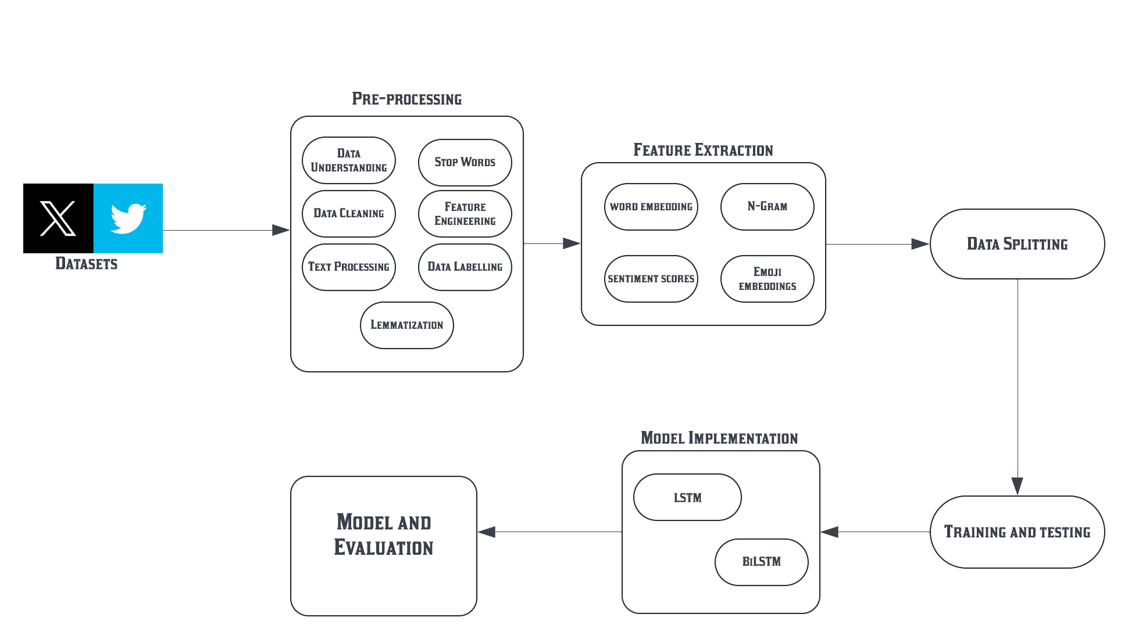
SYSTEM ARCHITECTURE

Slide 6
SYSTEM REQUIREMENTS:
Python Libraries:
nltk: For natural language processing tasks such as tokenization, stopword removal, lemmatization, and part-of-speech tagging.
Pandas and numpy: For data manipulation, analysis, numerical operations and array handling.
emoji: For processing and handling emojis in text.
textblob: For text polarity analysis and simple text processing.
gensim: For using pre-trained word embeddings for GloVe.
Developer Platform: Jupyter Notebook - The primary interactive environment for writing, testing, and visualizing code and models.
Machine Learning & Deep Learning:
scikit-learn: For data preprocessing and feature extraction.
TensorFlow/Keras: For building and training deep learning models, such as LSTM and BiLSTM, for hate speech detection.
Adam Optimizer: For optimizing the neural network models.

Slide 7
MODULE DESCRIPTION
Data Preprocessing and Feature Extraction:
This module prepares raw twitter tweets for effective hate speech detection.
Data Cleaning: Remove duplicates and Handling Missing Values
Text Standardization: remove stop words, apply lemmatization to get root words and eliminating non-ASCII characters.
Emoji Transformation: Converting Text into Emoji, allowing model to interpret emotional clues in post.
Once the data is preprocessed, feature extraction generates inputs that enable the model to understand both text and emoji contexts.
Word Embeddings: Using GloVe embedding to convert words into vectors.
Emoji Embeddings: Convert emojis into descriptive vector forms, enhancing the model’s ability to understand non-verbal sentiment.
N-grams: Identify frequent bigrams (two-word phrases) that may indicate hate speech, improving detection accuracy.
Sentiment Scoring: Use TextBlob to assign a sentiment score (-1 to 1) to each post, helping the model detect hate speech through tone analysis.

Slide 8
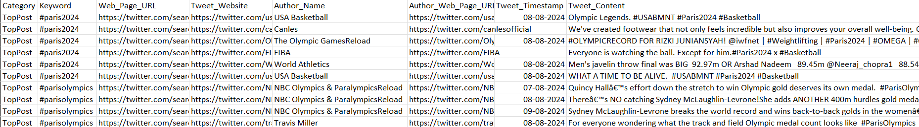
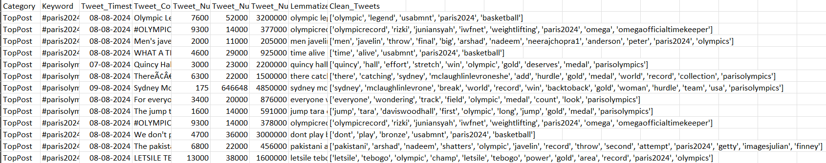
Data Pre-Processing:
Raw Data:
Pre-Processed Data:

Slide 9
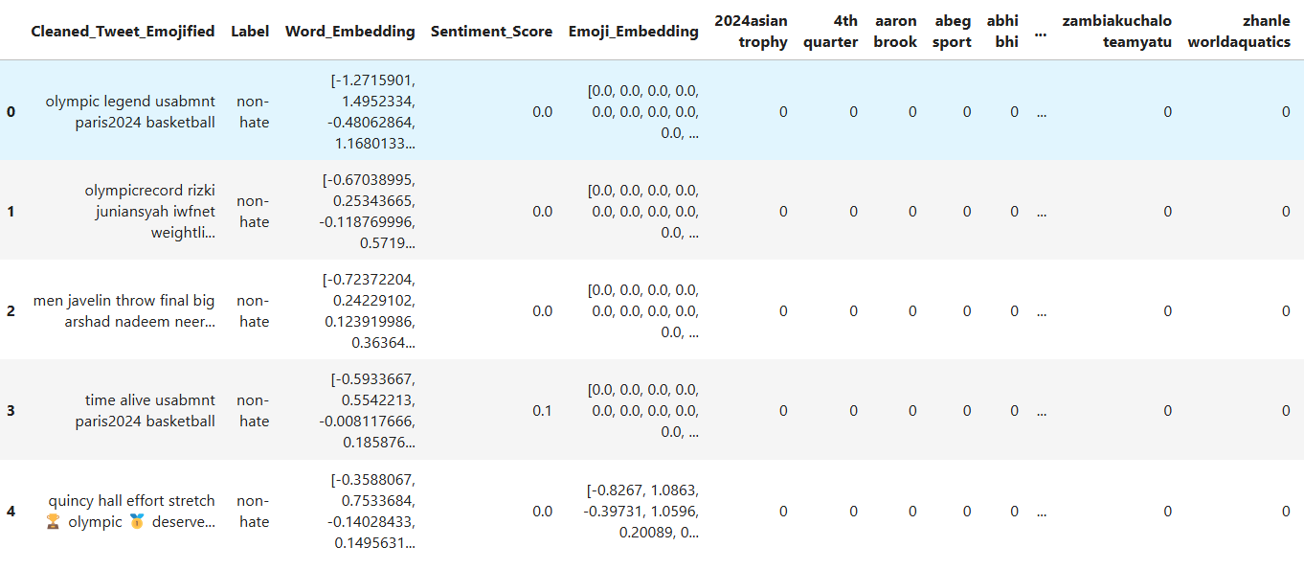
Feature Extraction:

Slide 10
Model Implementation:
Here I am using LSTM and Bi-LSTM Model to implement in my Datasets.
LSTM captures sequential dependencies in social media posts, helping detect hate speech patterns by understanding the order of words and emojis.
LSTM gates (forget, input, output) control the flow of information, allowing the model to remember relevant context and ignore irrelevant details over long text sequences.
Bi-LSTM processes text in both directions, capturing context from both preceding and following words, which improves understanding of phrases with complex meanings.

Slide 11
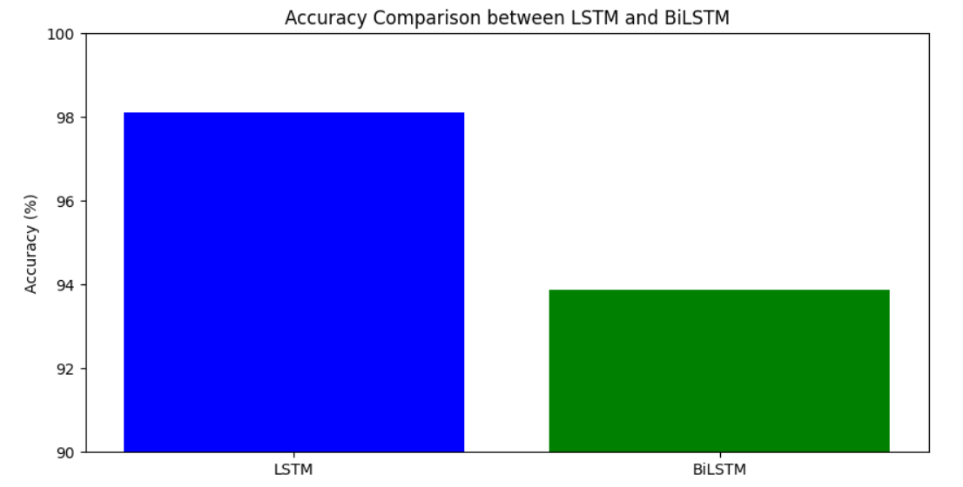
EXPERIMENTAL RESULT
Model | Training Accuracy | Testing Accuracy
LSTM | 98.11% | 98.61%
BiLSTM | 93.88% | 93.92%

Slide 12
CONCLUSION AND FUTURE WORK
Conclusion:
This project demonstrates the application of LSTM and BiLSTM models for detecting hate speech in social media text, with a focus on emoji-enhanced sentiment analysis.
By processing both text and emoji information, the models show high accuracy in classifying hate and non-hate speech, with LSTM performing better in terms of overall performance compared to BiLSTM.
Future Work:
Feature Extraction with ASCII Keys: Convert emojis into their ASCII representations for feature extraction, as the conversion of emojis into ASCII keys during Excel export affects the current feature extraction pipeline.
Model Enhancement with Transfer Learning: Investigate the use of Transfer Learning to fine-tune pre-trained models for better generalization on hate speech datasets, potentially improving accuracy and robustness.

Slide 13
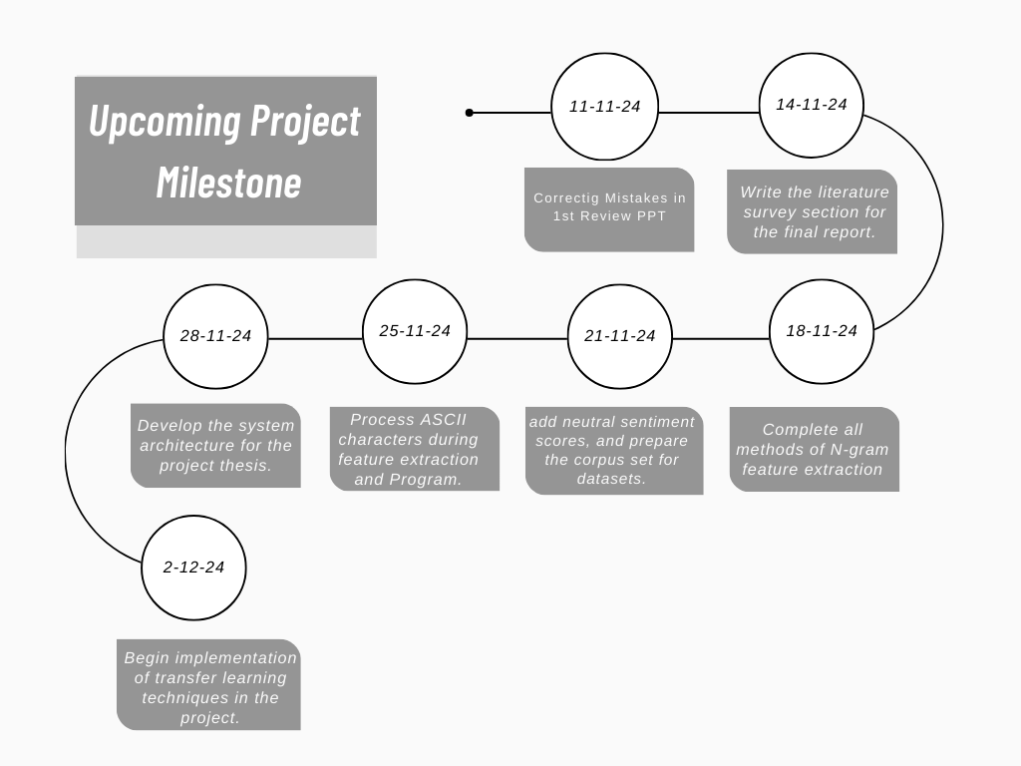

Slide 14
References
[1] U. Ahmed and J. C.-W. Lin, "Deep explainable hate speech active learning on social-media data", IEEE Trans. Computat. Social Syst., Apr. 2022.
[2] Alsafari, S., Sadaoui, S., Mouhoub, M., 2020. “Hate and offensive speech detection on Arabic social media”. Online Soc. Netw. Media 19, 100096.
[3] S. S. Aluru, B. Mathew, P. Saha, A. Mukherjee, “Deep learning models for multilingual hate
speech detection”, arXiv preprint arXiv:2004.06465 (2020).
[4] T. Mandl, S. Modha, G. K. Shahi, H. Madhu, S. Satapara, P. Majumder, J. Schäfer, T. Ranas-inghe, M. Zampieri, D. Nandini, A. K. Jaiswal, Overview of the HASOC subtrack at FIRE 2021: “Hate Speech and Offensive Content Identification in English and Indo-Aryan Languages”, in: Working Notes of FIRE 2021 - Forum for Information Retrieval Evaluation, CEUR, 2021.
[5] C. Baziotis, N. Pelekis, C. Doulkeridis, Datastories at semeval-2017 task 4: “Deep lstmwith attention for message-level and topic-based sentiment analysis”, in: Proceedings of the 11th International Workshop on Semantic Evaluation (SemEval-2017), Association for Computational Linguistics, Vancouver, Canada, 2017, pp. 747–754.

