Slide 1

Smart Course Enrollment System
SUMMER INTERNSHIP PRESENTATION | IT3711
A web application to see courses and enroll online
Janani L - 810023205034
B.Tech Information Technology, 7th Semester, 2025-2026
University College of Engineering (BIT Campus), Anna University, Tiruchirappalli
Internship: Astonish InfoTech, 01/06/2026 to 30/06/2026
Anna University
Notes:
Greet the panel. Say your name, the project title, and that this was done during the one-month internship at Astonish InfoTech, Tiruchirappalli.

Slide 2





Internship and Company
What I did
Made the web pages with HTML, CSS and JavaScript
Company: Astonish InfoTech Private Limited
Place: Tiruchirappalli (Trichy), Tamil Nadu
Work: Websites, software, mobile apps, ERP and CRM
Internship: 01/06/2026 to 30/06/2026
Project: Smart Course Enrollment System (Python Full Stack)
Wrote the backend with Python and FastAPI
Connected the MySQL database
Tested the application
Notes:
Source: Chapter 2 (Company Profile) and Daily Work Report. Astonish InfoTech is a software and web solutions company in Trichy.

Slide 3
Abstract and Introduction
Abstract
Introduction
A web app for course registration
Learners see categories and courses, filter them and enroll online
It has a login page and a staff dashboard
Built with Python (FastAPI), HTML, CSS, JavaScript and MySQL
Paper forms and spreadsheets are slow and cause mistakes
This project puts enrollment online
Learners can use a phone or a laptop
It follows a three-layer design: browser, backend, database
Notes:
Source: Abstract and Chapter 1. Keep it short: what the app is, who uses it, what it is built with.

Slide 4








Problem Statement
Manual enrollment is slow, has mistakes and is hard to track
Manual enrollment
No instant confirmation
Staff type paper forms again
No proof the request is saved
Scattered information
Hard to track
Details are in many places
Hard to count applicants
Limited access
Slow admin work
Only during office hours
Reports are counted by hand
Separate records
Long waiting time
Data is in separate files
Long queues at the counter
Notes:
Source: Chapter 5.1 Existing System. These are the eight problems of the manual system.

Slide 5
Objectives
Build a web app with Python, FastAPI and MySQL
Give an online enrollment form with checks
1
5
Store categories, courses and enrollments in a database
Give a login page with basic checks
2
6
Show courses with instructor, duration, level and seats
Show a dashboard with figures and latest enrollments
3
7
Let learners filter courses by category
Reduce paperwork and typing mistakes
4
8
Notes:
Source: Section 1.1. The report lists eleven objectives; these eight are the main ones. The others are: responsive design, automatic database setup, and showing practical use of full stack development.

Slide 6





Proposed System
One database
Browse categories
Course catalog
All data is kept in one place
See each category and open its courses
See details and filter by category
Online enrollment
Instant message
Dashboard
Fill one simple form to enroll
Success or error message at once
Staff see figures and latest requests
Also: login page | automatic database setup | works on desktop and mobile
Notes:
Source: Chapter 5.2 Proposed System. The new system is online, so learners and staff can use it from any device with a browser.

Slide 7
Technologies Used
Technology | What it is used for
Python | Main programming language
FastAPI and Pydantic | Backend: handles pages, forms and data model
Jinja2 | Puts database data into HTML pages
Uvicorn | Server that runs the application
HTML, CSS, JavaScript | Page structure, design and footer year
MySQL | Database that stores the data
mysql-connector-python | Connects Python to MySQL
VS Code, MySQL Workbench | Tools to write code and check the data
Notes:
Source: Chapter 1 and the code in Chapter 8. Python is the language. FastAPI is the framework. MySQL stores the data. Jinja2 creates the final HTML page.

Slide 8


Requirements
Who uses it
Software needed
Learner
Sees categories and courses, filters them, enrolls online
Python with a virtual environment
FastAPI, Uvicorn, Jinja2, Pydantic, mysql-connector-python
MySQL Server and MySQL Workbench
Visual Studio Code
A web browser
Staff (Administrator)
Sees figures, courses and the latest enrollment requests
Notes:
Source: Daily Work Report Days 2, 4 and 5. The report says a hardware and software list was prepared on Day 4 but does not print the hardware details, so do not quote hardware numbers. If asked, say any computer that can run Python and MySQL (this is a general statement, not from the report).

Slide 9
System Architecture
Presentation Layer
Logic Layer
Database Layer
HTML pages
CSS design
JavaScript
Seen in the browser
FastAPI routes
Checks the input
Jinja2 builds the page
Runs on Uvicorn
MySQL
3 tables
Made by init_db()
Sample data added
request
query
The browser sends a request. FastAPI reads or saves data in MySQL. A web page is sent back.
Notes:
Source: Chapter 1 and Day 8. Three-tier architecture. The report says this layering makes the system easier to maintain and more reliable. Simple example: a restaurant. Customer = browser, waiter = FastAPI, store room = MySQL.

Slide 10
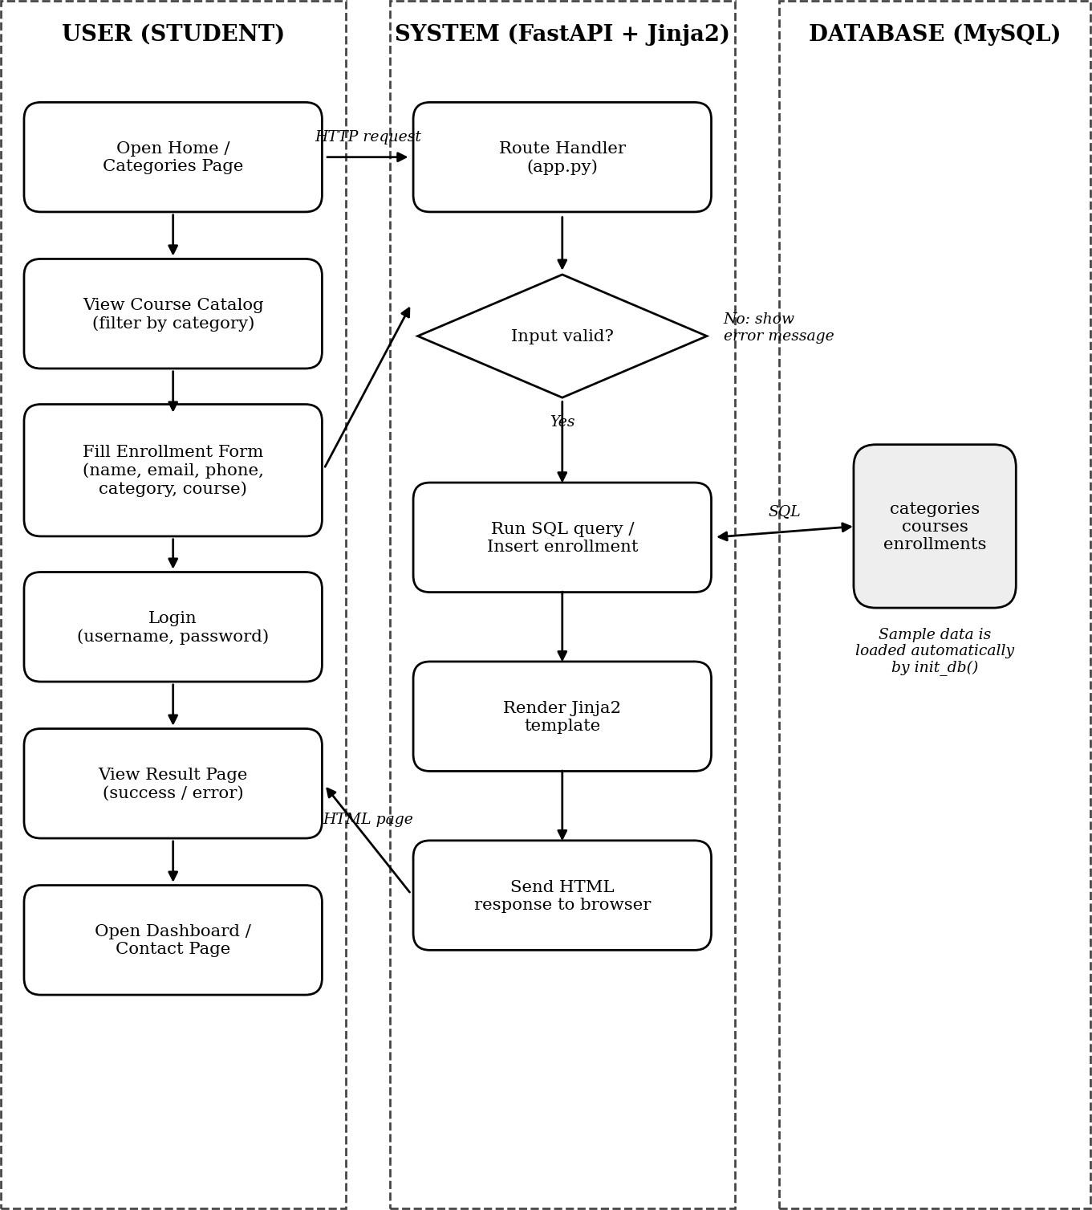
Workflow
1
Learner opens a page or sends the form
2
FastAPI receives the request
3
It checks the input
4
It reads or saves data in MySQL
5
Jinja2 builds the HTML page
6
The page is shown in the browser
Figure 4.1 - Block diagram (from the report)
Notes:
Source: Chapter 4, Figure 4.1. The diagram has three columns: user (student), system (FastAPI plus Jinja2) and database (MySQL). If the input is not valid, an error message is shown.

Slide 11




Modules
Home and Categories
Dashboard
Category cards with Open category link
Figures, courses, latest enrollments
Course Catalog
Contact
Course details and category filter
Support email, phone, working hours
Enrollment
Database
Form saves a request as Pending
Tables are made automatically
Login
Messages and Status
Checks both fields and password length
Success and error messages
Notes:
Source: Chapter 6 Proposed Method. Eight modules. The Dashboard and Contact pages have no screenshot in the report.

Slide 12
Database Design
categories
courses
enrollments
id (PK)
name
description
image
color
created_at
id (PK)
title
category_id (FK)
instructor
duration
level
description
seats
created_at
id (PK)
student_name
student_email
course_name
category_name
phone
status
created_at
One category has many courses (category_id)
New enrollment status is Pending
Notes:
Source: Section 8.2 and Day 9-10. PK = primary key, FK = foreign key. The enrollments table stores the course and category as names (text), not as foreign keys. This is listed as future work.

Slide 13
Implementation
courses_page() - filter by category
init_db() makes the tables and adds sample data
fetch_all() runs a query and gives back the rows
Login: empty field or short password shows an error, else go to /dashboard
query = """SELECT c.*, cat.name
AS category_name FROM courses c
JOIN categories cat
ON c.category_id = cat.id"""
if selected_category:
query += " WHERE cat.name = %s"
params = (selected_category,)
Shown in short form. %s passes the value safely (no SQL injection).
Pages (routes) / /categories /courses /enroll /login /dashboard /contact
Notes:
Source: Section 8.5 and 8.7. The code was lightly re-wrapped to fit the slide; the logic is the same as in the report. A route is a URL address, for example /courses shows the course list.

Slide 14
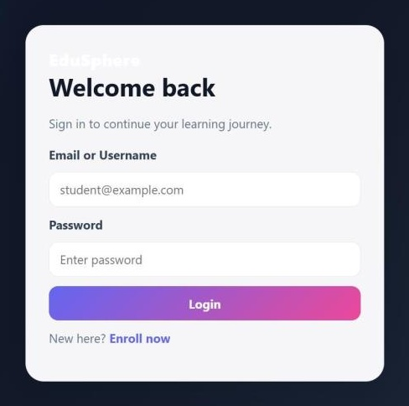
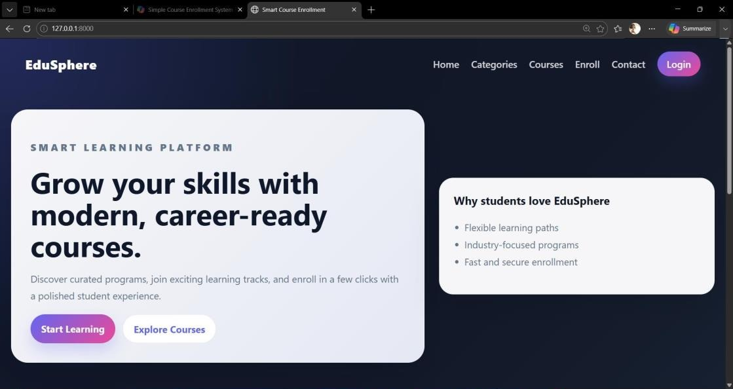
Output 1: Home and Login
Figure 9.1 Home page (screenshot from the report)
Figure 9.2 Login page (screenshot from the report)
The first page. It has Start Learning and Explore Courses buttons.
Learner types email or username and password. Wrong input shows an error.
Notes:
Actual screenshots from the report (Section 9.1 and 9.2). Home page headline: Grow your skills with modern, career-ready courses. The login screenshot is trimmed to remove empty background only.

Slide 15
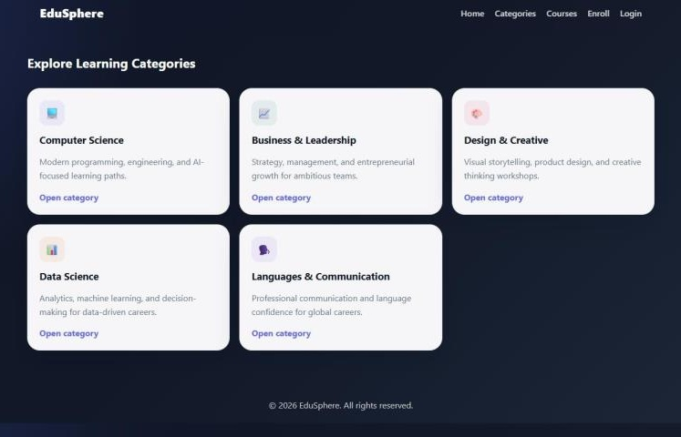
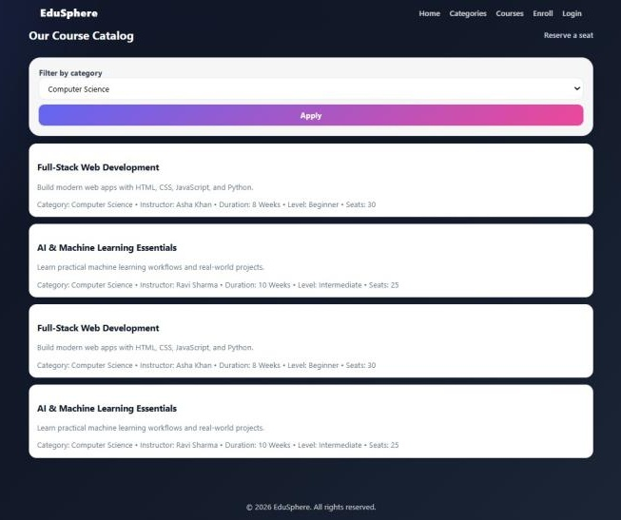
Output 2: Categories and Courses
Figure 9.3 Categories (screenshot from the report)
Figure 9.4 Course catalog (screenshot from the report)
Five category cards. Each has an Open category link.
Filter: Computer Science. Courses show twice because sample data loaded twice.
Notes:
Actual screenshots from the report (Section 9.3 and 9.4), trimmed of empty background only. Say openly that courses show twice: the report says the sample data was loaded once by the SQL script and once by the automatic setup. It is listed as an improvement.

Slide 16
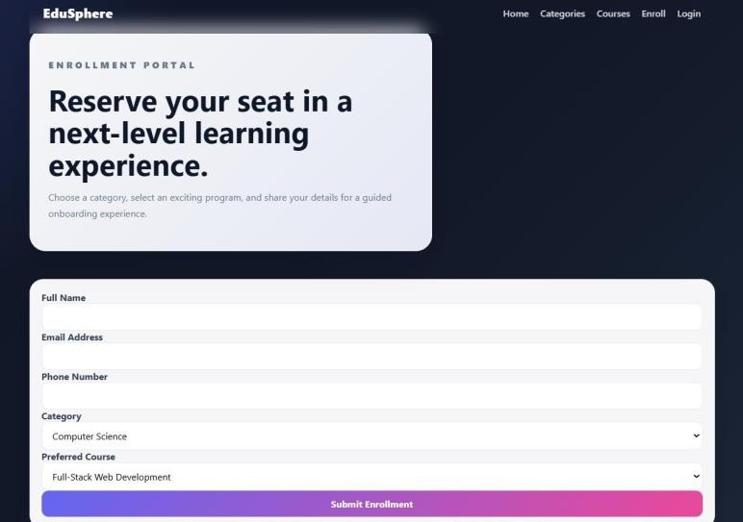
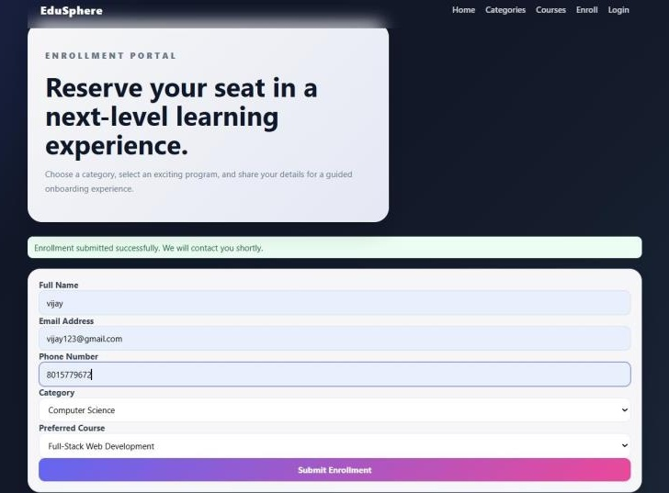
Output 3: Enrollment
Figure 9.5 Enrollment form (screenshot from the report)
Figure 9.6 Success message (screenshot from the report)
Learner fills name, email, phone, category and course, then submits.
The request is saved. The page says: Enrollment submitted successfully.
Notes:
Actual screenshots from the report (Section 9.5 and 9.6), trimmed of empty background only. The saved record gets the status Pending.

Slide 17

Testing
Tested in the browser
Wrong inputs tested
Category browsing
Course filter
Empty fields
Wrong email format
Short password
Database not running
Enrollment form
Login checks
Dashboard
Database setup
Result: pages worked as expected. Pages loaded fast because the queries are simple and the data is small.
Notes:
Source: Days 26-27 and Chapter 10 Analysis. Testing was done by hand in the browser and the saved records were checked in MySQL Workbench. Layout problems on small screens were fixed. The report does not mention automated tests (Pytest is listed as future work). Do not claim exact timings.

Slide 18

Advantages and Limitations
Advantages
Limitations (found in testing)
All course details in one place
Sample courses show twice
Enrollment in one simple form
Login does not check saved accounts
Checks reduce typing mistakes
Dashboard shows only latest 8
Instant success or error message
Any course with any category
Staff see latest enrollments
Seats do not go down on enroll
Safe queries (no SQL injection)
Database password is in the code
Notes:
Source: Section 10.1. The limitations are written by you in the report, so say them with confidence and add that each one is listed under future work.

Slide 19


Applications and Conclusion
Training institutes
Conclusion
Enroll learners online
Online enrollment replaces paper forms
Built with HTML, CSS, JavaScript, FastAPI and MySQL
Main modules were built and tested
I gained practical experience in Python web development, SQL and testing
Learning platforms
Browse and join courses
Institute staff
See latest requests in one place
Notes:
Source: Chapter 11. The report names training institutes and learning platforms (education and training). The third application, institute staff, comes from the dashboard feature.

Slide 20
Future Enhancements
01
02
03
04
Secure login with password hashing
Admin panel to manage courses
Seat control and waiting list
Stop duplicate enrollments
05
06
07
08
Course list changes with category
Foreign keys in enrollments table
Email and SMS messages
Online payment (Razorpay, Stripe)
09
10
11
12
Search and pagination
Reports with CSV or PDF export
Environment variables and Pytest tests
Docker, cloud and mobile apps
Thank you. Questions are welcome.
Notes:
Source: Chapter 12 Future Work. The report lists 14 items; these are grouped into 12 cards (environment variables and Pytest share one card, Docker/cloud and mobile apps share one card).

