Slide 1



Food Delivery Analysis
DATA ANALYSIS | 100,000 ORDERS
Data-driven business insights
Janani
Notes:
Introduce the project: an analysis of 100,000 online food delivery orders covering customers, revenue, delivery performance, restaurants and cancellations. Tip: the agenda on the next slide is clickable.

Slide 2



Agenda
Customers & Orders
Revenue & Profit
Delivery Performance
Restaurants & Cancellations
03
Top-spending customers
08
Monthly revenue
12
Delivery time by city
15
Top-rated restaurants
04
Age vs order value
09
Discounts vs profit
13
Distance vs delay
16
Cancellation rate
05
Weekend vs weekday
10
Cities & cuisines
14
Rating vs delivery time
17
Cancellation reasons
06
Peak-hour demand
11
Cuisine performance
07
Payment modes
18 Key takeaways and next steps
Notes:
Use this slide to navigate. Click a topic to jump to it; every content slide has a menu at the top right to return here or switch section.

Slide 3
Top-Spending Customers
01 CUSTOMERS & ORDERS
Agenda
Customers
Revenue
Delivery
Restaurants
CUST1606 spent the most; the #1 customer is 7% ahead of #5.
54,911
CUST1606 total spending (all orders)
+7%
gap between the #1 and #5 customers
Ranked by total spending, not average order size.
Notes:
CUST5267 had the highest total delivered-order spending (48,727). The top five range from about 43K to 49K. This ranks customers by total spending, not by average order size.

Slide 4
Age Group vs Order Value
01 CUSTOMERS & ORDERS
Agenda
Customers
Revenue
Delivery
Restaurants
Order value is almost identical across age groups, within about 0.5%.
2,089.94
Highest: age 25–35
2,078.64
Lowest: age Under 25
0.5%
gap between highest and lowest
Notes:
Average order value: 25 to 35 highest at 1,799.14; 36 to 50 lowest at 1,779.14. The gap is only 20, roughly 1.1%, so age is not a strong driver of order value. The axis starts at zero on purpose so the gap is not exaggerated.

Slide 5
Weekend vs Weekday Order Patterns
01 CUSTOMERS & ORDERS
Agenda
Customers
Revenue
Delivery
Restaurants
Weekdays hold 71% of orders, but per day the volume is nearly the same.
14,274
14,315
per weekday (71,370 ÷ 5)
per weekend day (28,630 ÷ 2)
Same demand, fewer days
Weekends make up 29% of orders, close to their 2/7 (29%) share of the week. Staffing can follow the calendar rather than a weekend surge.
Notes:
71,632 orders on weekdays and 28,368 on weekends. Divided by 5 weekdays and 2 weekend days, that is about 14,326 versus 14,184 orders per day, so demand per day barely changes.

Slide 6
Peak Hour Demand Analysis
01 CUSTOMERS & ORDERS
Agenda
Customers
Revenue
Delivery
Restaurants
Peak and off-peak orders are level, and one in three orders has no peak-hour label.
33%
of orders are labelled Unknown for peak hour
0.4%
gap between Off-Peak and Peak orders
Fix peak-hour tagging before using it for staffing.
Notes:
Off-peak 33,585, peak 33,453, unknown 32,962. Peak and off-peak differ by only 0.4%. A third of orders are tagged Unknown, so peak-hour tagging should be fixed before it is used for staffing decisions.

Slide 7
Payment Mode Preferences
01 CUSTOMERS & ORDERS
Agenda
Customers
Revenue
Delivery
Restaurants
All four payment modes are used almost equally, about 25% each.
≈25%
share of orders for each payment mode
162
orders separate Card (1st) from UPI (4th)
Based on the 80,089 orders in this chart.
Notes:
Card 20,094; Wallet 20,086; COD 19,977; UPI 19,932. Card leads UPI by only 162 orders, so no single mode dominates. The chart covers 80,089 orders.

Slide 8
Monthly Revenue Trends
02 REVENUE & PROFIT
Agenda
Customers
Revenue
Delivery
Restaurants
Revenue holds near 16.5M a month, with a clear spike in July.
19.25M
July: the peak month
+17%
above the other 11 months' average (16.47M)
15.82M
lowest month: February
Notes:
Monthly revenue sits between 13.5M and 14.6M for eleven months. July reaches 16.44M, about 17% above the average of the other months (14.04M). Worth checking what drove it: a promotion, a season, or a data issue.

Slide 9
Impact of Discounts on Profit
02 REVENUE & PROFIT
Agenda
Customers
Revenue
Delivery
Restaurants
Profit barely moves with discount size: every bucket sits between 14.1% and 15.4%.
14.1%
lowest: 200–249 bucket
15.4%
highest: 250–299 bucket
1.3 pts
spread across all buckets
Notes:
Average profit is about 15% at every discount level. The lowest is the 200 to 249 bucket at 14.1% and the highest is 250 to 299 at 15.4%, a spread of 1.3 points with no clear trend. Discount size alone does not explain profit.

Slide 10
High-Revenue Cities and Cuisines
02 REVENUE & PROFIT
Agenda
Customers
Revenue
Delivery
Restaurants
Revenue is spread evenly: the leading city and cuisine are only about 2% and 1% ahead of #5.
Hyderabad leads cities by 2.0% over #5 Mumbai. Indian leads cuisines by 1.2% over #5 Italian.
Notes:
Bangalore leads cities with 28.79M, about 2.3% ahead of fifth-placed Mumbai (28.15M). Indian leads cuisines with 28.65M, about 2.0% ahead of Italian (28.09M). Differences are small, so no city or cuisine is a clear outlier.

Slide 11
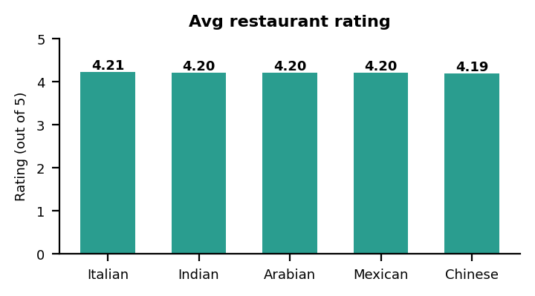
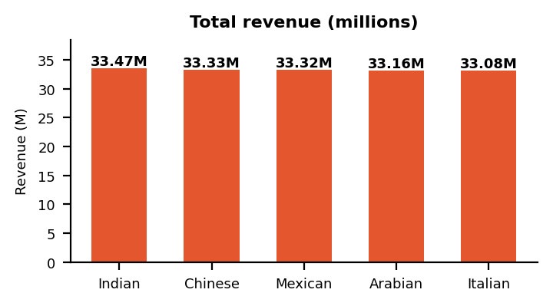
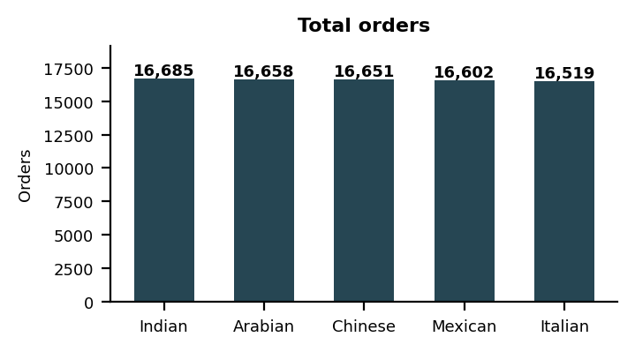
Cuisine-Wise Performance
02 REVENUE & PROFIT
Agenda
Customers
Revenue
Delivery
Restaurants
Indian leads on revenue, Italian on rating; the gaps between cuisines are small.
Indian
Indian
Italian
Italian
Highest revenue: 33.47M
Highest orders: 16,685
Highest avg rating: 4.21 / 5
Lowest revenue: 33.08M
Indian cuisine leads in revenue and orders, while Italian has the highest average restaurant rating.
Notes:
Highest revenue: Indian, 1,717.31. Highest orders: Indian, 16,685. Highest average rating: Italian, 4.21 out of 5. Lowest revenue: Arabian, 1,692.05. Indian cuisine leads in both order volume and revenue while Italian has the highest average restaurant rating. The differences across cuisines are small.

Slide 12
Average Delivery Time by City
03 DELIVERY PERFORMANCE
Agenda
Customers
Revenue
Delivery
Restaurants
All five cities average 126–129 minutes; the gap between fastest and slowest is only 2.5 min.
2.5 min
gap between fastest (Chennai, 126.3) and slowest
128.8 min
slowest city: Mumbai
Orange = slowest city. Delivered orders only, 'Unknown' city excluded.
Notes:
Bangalore 107.8 and Chennai 107.9 minutes versus Hyderabad 125.2, Delhi 125.4 and Mumbai 126.5. The three slower cities average about 125.7 minutes against 107.9, roughly 18 minutes or 16% longer.

Slide 13
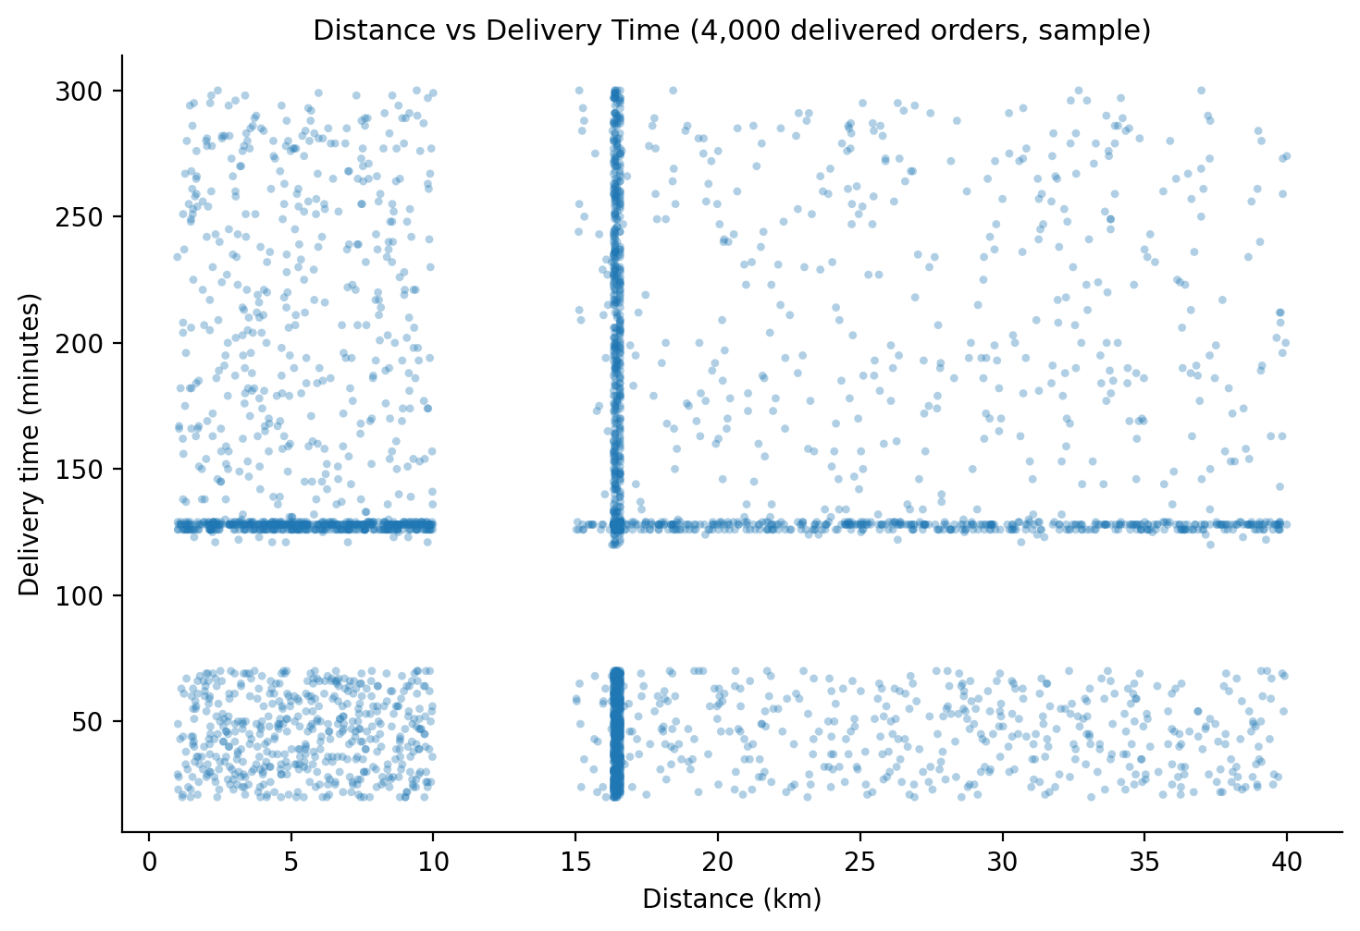
Distance vs Delivery Delay
03 DELIVERY PERFORMANCE
Agenda
Customers
Revenue
Delivery
Restaurants
Distance adds about one minute: long trips take only 1.07 min more than short ones.
Data note
34% of distances sit between 16.3 and 16.6 km, and 34% of delivery times fall between 126 and 129 min, which hints at filled-in values.
Notes:
Average delivery time is 118.98 minutes for short, 119.22 for medium and 119.95 for long distances. The scatter plot explains why the relationship is flat: distances bunch at about 16.5 km and delivery times stack at about 70 and 120 minutes, which suggests filled-in or capped values. Worth re-checking in the cleaning step.

Slide 14
Delivery Rating vs Delivery Time
03 DELIVERY PERFORMANCE
Agenda
Customers
Revenue
Delivery
Restaurants
Delayed orders take 5.9× longer than fast ones, yet ratings stay at about 3.0.
Notes:
Fast orders average 25.01 minutes, on-time 38.0 and delayed 137.61. The average delivery rating is 3.01, 2.97 and 3.00, so ratings do not reflect delivery speed in this data. The original single chart hid the rating bars because the two measures sit on very different scales, so they are shown separately here.

Slide 15
Top-Rated Restaurants
04 RESTAURANTS & CANCELLATIONS
Agenda
Customers
Revenue
Delivery
Restaurants
The ten best restaurants are separated by just 0.04 rating points.
4.33
Restaurant_101: highest average rating
0.04
rating-point gap between #1 and #10
All ten sit between 4.29 and 4.33 out of 5.
Notes:
Restaurant_101 leads with 4.33, followed by Restaurant_162 and Restaurant_1 at 4.31. The tenth restaurant is at 4.29, so all ten sit within 0.04 points of each other on a 5-point scale.

Slide 16
Cancellation Rate by Restaurant
04 RESTAURANTS & CANCELLATIONS
Agenda
Customers
Revenue
Delivery
Restaurants
The worst restaurants cancel about 1 in 5 orders, well above the overall rate.
21.9%
highest: Restaurant_391
1 in 5
orders cancelled at these 10 restaurants
≈15%
overall cancellation rate (15,036 of 100,000)
Notes:
The ten highest cancellation rates run from 20.9% to 21.9%, led by Restaurant_391 at 21.94%. Overall, 15,036 of 100,000 orders were cancelled (about 15%, see the next slide), so these restaurants are about 6 points above average.

Slide 17
Cancellation Reason Analysis
04 RESTAURANTS & CANCELLATIONS
Agenda
Customers
Revenue
Delivery
Restaurants
40% of cancellations have no reason recorded, the biggest gap in the data.
15,036
cancelled orders, about 15% of 100,000
40%
have no reason recorded (6,005 orders)
≈20% each
late delivery, customer cancelled, restaurant issue
Notes:
6,005 cancellations are Not Specified (40%). Late delivery accounts for 3,059, customer cancelled 2,993 and restaurant issue 2,979, each about 20%. In total 15,036 orders were cancelled, about 15% of 100,000. Capturing a reason at cancellation time would show what to fix.

Slide 18



Key Takeaways and Next Steps
Demand and revenue are steady; delivery time and cancellation data are where to focus.
Demand is even
Orders per day match on weekdays and weekends; peak and off-peak are level.
What to do next
Revenue is steady
About 16.5M a month with July up 17%; cities and cuisines within about 2%.
1
Check what drove July's 17% revenue spike
Discounts don't move profit
Average profit stays between 14.1% and 15.4% in every bucket.
2
Find why 83% of delivered orders are tagged Delayed (avg 127 min)
Speed is steady across cities
All cities average 126–129 min; distance adds about 1 min.
3
Require a reason on every cancelled order
Cancellation data has gaps
15,036 cancelled orders; 40% have no reason recorded.
4
Re-check filled-in data: 33% of order values are the same 2,082
Notes:
Summarise the five findings, then the four next steps. Demand and revenue are stable, so the biggest opportunities are in delivery times for three cities and in capturing cancellation reasons and cleaner data.

Slide 19
Thank you
Notes:
Invite questions. Use the Back to agenda button to jump to any topic.

