Slide 1
Presented By : k . S . janani , c s e - 3 rd yr, government college of engineering , dharmapuri , au613521104009 , jananiselvan56@gmail.com
Glaucoma detection using CNN

Slide 2
Outline
Problem statement
Solution
System development approach
Algorithm & deployment
Result
Conclusion
Future scope
reference

Slide 3
Problem statement
Developing a Convolution Neural Network
Algorithm for the prediction of glaucoma , leading cause of irreversible blindness worldwide , to aid in early detection and intervention. The goal to create a robust model that accurately classifies retinal images into normal and glaucomatous categories , enabling timely diagnosis and treatment.

Slide 4
Solution
Gather retinal images, standard them.
Design a CNN for glaucoma prediction , experiment with various architecture like batch normalization and dropout.
Train the model and validate its performance.
Develop a user-friendly interface for clinicians to upload images for prediction.
We can develop an effective CNN –based solution for this prediction that contributes to early detection and intervention , ultimately improving patient outcomes and quality of life.

Slide 5
System development approach
Requirement analysis:
Understand the objectives of the predicting system here including clinicians and patients.
Define the features and functionalities required in the system ,such as image uploading , prediction display and model evaluation.

Slide 6
System development approach
Data collection and annotation
Gathered a dataset of retinal images, ensuring a balance between normal and glaucomatous cases.
Annotate the images to indicate the presence or absence of glaucoma , facilitate supervised learning

Slide 7
System development approach
Preprocess the images by resizing them to a consistent resolution applying contrast enhancement techniques.
Design the architecture and experiment with different architecture.
Test or train the model dataset using back propagation and evaluate the model.
Continuous improvement and maintain the updated model with new data.

Slide 8
Algorithm and deployment
Successfully deploy a glaucoma prediction system using a CNN algorithm .
Providing clinicians with a valuable tool for early detection and intervention in glaucoma cases

Slide 9
result
Results indicate the potential of CNN algorithms in accurately identifying signs of glaucoma from retinal images provides valuable support for clinicians in early detection.

Slide 10
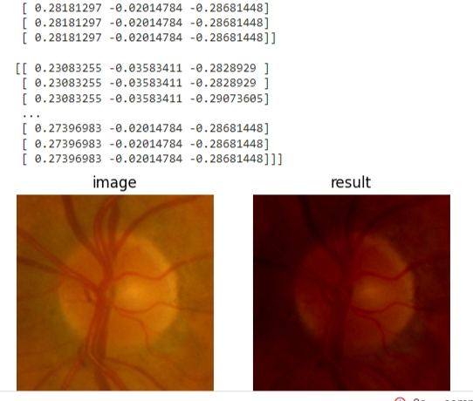
Output

Slide 11
conclusion
Developing a glaucoma prediction system using CNN algorithm holds great promise for improving patient outcomes by enabling early detection , ultimately reducing the burden of glaucoma-related vision loss.
Continuous research in this fields are essential to further advance the capabilities and accessibility of glaucoma prediction system.

Slide 12
reference
Raghavendra ,U., Fujita,H., Bhandary,S.V., Gudigar,A., Tan,J.H., Acharya,U,R.,& Gudigar,A.(2018)
https://www.kaggle.com/datasets/sshikamaru/glaucoma-detection

