Slide 1
DDR3-Style Memory Controller with Integrated SECDED ECC
RTL Design, Behavioral Verification & Vivado 2025.2 FPGA Implementation | Digital System Design Project
User / CPU
Interface
DDR-Style
Controller
SECDED
ECC
DRAM Model
72-bit
Notes:
SAY: This project combines a custom 64-bit SECDED protection path with a Xilinx MIG-based DDR3L interface on the Digilent Arty A7-100T. The custom controller and SECDED logic were verified with behavioral simulation. The integrated ECC AXI master and self-test logic connect to the MIG's 128-bit AXI user interface. The complete ecc_arty_ddr_top hierarchy has passed Vivado 2025.2 synthesis and place-and-route. Timing is positive; one MIG-generated PLL/BUFH DRC warning remains, and physical board validation is pending.
KEY TERMS: DDR3L, MIG, AXI, SECDED, FPGA implementation.
SIMPLE EXPLANATION: The MIG handles the physical DDR3L interface; the custom ECC logic protects the 64-bit payload before it is stored and after it is read.

Slide 2
Problem Statement & Motivation
read / write requests
Processor /
User Logic
Memory Controller
(commands + timing)
DDR Interface
DRAM
Banks
corrected / flagged data returns to user
SECDED ECC
encode / decode
bit error in stored data
DRAM needs ordered commands: ACTIVATE → READ/WRITE → PRECHARGE, plus periodic REFRESH.
Accesses must follow row / bank / column organisation and timing waits (tRCD, tRP).
Stored bits can flip, so data reliability needs ECC (SECDED: correct 1 bit, detect 2 bits).
User logic should issue simple requests; the controller handles the DRAM protocol.
Notes:
SAY: User logic cannot just poke DRAM. A row must be opened with ACTIVATE before a column read or write, closed with PRECHARGE before another row in the same bank is opened, and every cell must be refreshed periodically. The controller hides all of that behind a simple request interface. Separately, memory bits can flip, so I added SECDED ECC.
KEY TERMS: ACTIVATE, PRECHARGE, REFRESH, tRCD, tRP, SECDED.
SIMPLE EXPLANATION: The controller is a traffic manager that keeps DRAM commands legal; ECC is a safety net for the data.
VIVA Q: Why is a memory controller required?
A: Because DRAM has strict command ordering and timing, and needs refresh. The controller translates simple read/write requests into legal command sequences so user logic does not have to.
TRANSITION: Next, the concrete objectives.

Slide 3
Project Objectives
Controller
Simplified DDR3-style controller in Verilog
Addressing
Row / bank / column address mapping, open-page tracking
Commands
ACTIVATE, READ, WRITE, PRECHARGE, REFRESH via FSM
Timing
Simplified tRCD, tRP, CAS latency, tRFC waits + refresh deadline
ECC
64-bit data → 72-bit SECDED codeword
ECC behaviour
Correct single-bit errors, detect double-bit errors
Verification
Behavioral DRAM model + testbench (6 tests), GTKWave debug
Vivado 2025.2: MIG + Clock Wizard IP, synthesis, placement, routing, DRC and bitstream flow
Teal = controller Orange = ECC Blue = verification and implementation
Notes:
SAY: The project objectives are to build the RTL, integrate 64-bit payload SECDED with the MIG-facing 128-bit AXI interface, verify functional behavior in simulation, and implement the integrated top on the Arty A7-100T using Vivado 2025.2. The FPGA implementation uses the generated 7-Series MIG and a Vivado 2025.2-compatible Clock Wizard. The completed Vivado stages are IP generation, MIG out-of-context synthesis, full-top synthesis and place-and-route. The latest post-constraint bitstream generation and board-level DDR/ECC tests remain to be confirmed.
KEY TERMS: open-page controller, FSM, SECDED, MIG, AXI, Vivado implementation.
SIMPLE EXPLANATION: Build and verify the data protection logic, connect it to the MIG AXI interface, then map and route the complete design on the Artix-7 FPGA.

Slide 4
System Architecture
User Request Interface (one request at a time)
WRITE path
64-bit data
ECC encoder
Timing counters
(tRCD, tRP, CL, tRFC)
Request Register / Address Decoder
72-bit codeword
DRAM
Open-row / page tracking
(4 banks)
DDR Controller FSM
DDR Command Generation (ddr_cmd, RAS/CAS/WE)
READ path
Refresh logic
(deadline / pending)
72-bit codeword
ECC decoder
ECC Encoder / Decoder
Debug signals
(dbg_state, dbg_open_row_*)
Corrected / uncorrectable status
64-bit data + resp_valid
72-bit Behavioral DRAM Model
Based on README / PROJECT_REPORT block list; source blocks: src/ddr_controller.v, src/ecc_secded.v, tb/ddr3_model.v
Notes:
SAY: A request enters the user interface, is registered and its address is split into row/bank/column. The FSM drives command generation. On a write, the 64-bit word goes through the ECC encoder and a 72-bit codeword is stored. On a read, the 72-bit word is decoded, errors are corrected or flagged, and the 64-bit result returns with ecc_single_error / ecc_multiple_error. Timing counters, open-row tracking, refresh logic and debug signals support the FSM.
KEY TERMS: codeword, open-row tracking, command generation.
SIMPLE EXPLANATION: Request in, DRAM commands out, with ECC on the data path.
VIVA Q: Where is the ECC in the design?
A: In the controller data path: encode before data goes to DRAM, decode when it comes back.
NOTE: This is the project's simplified controller, loosely inspired by the controller / PHY / ECC split in the Xilinx PG150 reference. It does not reproduce that design.
TRANSITION: Now how an address becomes row, bank and column.

Slide 5
Address Mapping & Open-Page Tracking
ROW
addr[12:9] (4 bits)
BANK
addr[8:7] (2 bits)
COLUMN
addr[6:3] (4 bits)
IGNORED
addr[2:0]
User address = byte address (13 bits). Educational simplified mapping, not a full JEDEC memory mapping.
Worked example from the waveform: req_addr = 0x0242
Row selects the page; bank selects one of 4 banks; column selects the location in the open row.
One open row is tracked per bank (open-page policy).
Row hit: row already open, so go straight to READ/WRITE.
Row miss: PRECHARGE the bank, then ACTIVATE the new row.
0x0242 = 0 0010 0100 0010 (13 bits)
Field | Bits | Value
Row | addr[12:9] | 1
Bank | addr[8:7] | 0
Column | addr[6:3] | 8
Matches GTKWave: dbg_open_row_bank0 = 1, dbg_active_bank = 00
Notes:
SAY: The user address is a byte address. The lowest three bits are ignored. addr[6:3] is the column, addr[8:7] the bank, addr[12:9] the row. The controller remembers which row is open in each bank. If the request's row matches, it is a page hit. If not, it is a page miss and the controller must PRECHARGE first. In my waveform req_addr is 0x0242, which decodes to row 1, bank 0, column 8, and the debug signal dbg_open_row_bank0 shows row 1.
KEY TERMS: row, bank, column, open-page policy, page hit / miss.
SIMPLE EXPLANATION: Row = page, bank = independent sub-array, column = word within the page.
VIVA Q: What is the difference between row hit and row miss?
A: Hit: the requested row is already open in that bank, so no ACTIVATE is needed. Miss: a different row is open, so PRECHARGE then ACTIVATE is needed first.
ADDRESS DECODE: For req_addr = 0x0242, the stated bit fields yield row 1, bank 0 and column 8.
TRANSITION: Now the command sequences.

Slide 6
DDR Command Sequencing & Encoding
WRITE / READ
ROW MISS
REFRESH
Abstract command code → (RAS, CAS, WE)
Request
Open row ≠ request
Refresh pending
ddr_cmd | Op | RAS,CAS,WE
0 | ACTIVATE | 0,1,1
1 | READ | 1,0,1
2 | WRITE | 1,0,0
3 | PRECHARGE | 1,1,0
4 | REFRESH | 0,0,1
7 | NOP | 1,1,1
Check bank / row
PRECHARGE
Stop new requests
ACTIVATE if required
Wait tRP
PRECHARGE open banks
Wait tRCD
ACTIVATE new row
REFRESH
READ or WRITE (CAS)
Wait tRCD
Wait tRFC
Response / completion
READ / WRITE
Resume operation
ddr_cmd is an abstract code for simulation / GTKWave visibility; the individual RAS/CAS/WE outputs are also generated.
FSM waits (tRCD, tRP, CL, tRFC) are simplified timing counts, not full JEDEC values.
Notes:
SAY: For a normal access, check the bank's open row; ACTIVATE if needed; wait tRCD; then issue READ or WRITE. On a row miss the controller first PRECHARGEs, waits tRP, then ACTIVATEs the new row. For refresh, the controller stops new requests, precharges open banks, issues REFRESH and waits tRFC. ddr_cmd is an abstract 3-bit code I added so commands are visible in GTKWave; the RAS/CAS/WE pattern is the DDR-style control encoding.
KEY TERMS: tRCD (ACTIVATE to CAS delay), tRP (PRECHARGE time), tRFC (refresh cycle time).
SIMPLE EXPLANATION: Open the row, wait, access, and close it when needed.
VIVA Q: Why is PRECHARGE required, and why ACTIVATE before a column operation?
A: A bank can hold one open row; to use another row it must be closed (PRECHARGE) and the new row opened (ACTIVATE). Column reads/writes operate only on the open row's data.
VIVA Q: What are tRCD and tRP?
A: tRCD is the wait between ACTIVATE and the column command; tRP is the wait after PRECHARGE before the next ACTIVATE. Here they are simplified counters.
TRANSITION: The FSM that enforces this.

Slide 7
Controller FSM (states from the project report)
Row miss: IDLE → PRE → WAIT_TRP → ACT → WAIT_TRCD → READ/WRITE. Row already open: ACT is skipped. Idle bank: PRE is skipped.
IDLE
PRE
WAIT_TRP
ACT
WAIT_TRCD
READ / WRITE
READ_
WAIT
response done → back to IDLE (writes go directly after the CAS command)
reads only: wait for return, ECC decode
Refresh maintenance
REF_SCAN
REF_PRE
REF_TRP
REFRESH
REF_WAIT
→ IDLE
IDLE → (refresh pending)
IDLE accepts a request; ACT opens the row; WAIT_TRCD gives activate-to-CAS delay.
PRE closes an open page on a miss; WAIT_TRP observes precharge time.
REF_PRE / REF_TRP close open banks before REFRESH; REF_WAIT covers refresh time.
Notes:
SAY: These are the FSM states listed in my report: IDLE, ACT, WAIT_TRCD, READ, WRITE, READ_WAIT, PRE, WAIT_TRP, and the refresh set REF_SCAN, REF_PRE, REF_TRP, REFRESH, REF_WAIT. On a page miss the path is PRE, WAIT_TRP, ACT, WAIT_TRCD, then the CAS state. READ_WAIT waits for the memory return and does the ECC decode. Refresh has its own state chain that precharges open banks first.
KEY TERMS: FSM, legal command sequencing, timing wait states.
SIMPLE EXPLANATION: Each wait state is a counter that stops the next command until the timing interval has passed.
VIVA Q: Why are timing counters required?
A: DRAM needs minimum delays between commands (e.g. tRCD, tRP). Counters in the wait states enforce those delays so commands are never issued too early.
PRESENTATION TIP: Emphasize how the FSM uses timing wait states between DRAM commands; the named states and high-level paths are summarized on the slide.
TRANSITION: Now the ECC, the main technical feature.

Slide 8
SECDED ECC: 64-bit Data → 72-bit Codeword
64 DATA BITS
+
7 HAMMING PARITY BITS
+
1 OVERALL PARITY BIT
72-BIT CODEWORD (stored in DRAM model)
Hamming portion: 71 bits. Parity positions (1-based): 1, 2, 4, 8, 16, 32, 64.
Remaining positions carry the 64 payload bits. Bit 71 of the codeword = overall parity.
Decoder outputs: corrected 64-bit data, 7-bit syndrome, single-error and multiple-error flags.
Syndrome | Overall parity | Result
0 | 0 | No error
non-zero | 1 | Single-bit error → corrected
0 | 1 | Overall parity-bit error → data still valid
non-zero | 0 | Double-bit error → uncorrectable (flagged)
Syndrome = position of the flipped bit in the Hamming portion.
Overall parity separates 1-bit from 2-bit errors.
Notes:
SAY: SECDED stands for Single Error Correction, Double Error Detection. 64 data bits get 7 Hamming parity bits at positions 1, 2, 4, 8, 16, 32 and 64, plus one overall parity bit, giving a 72-bit codeword. The decoder recomputes the syndrome and overall parity. A non-zero syndrome with overall parity 1 means one bit flipped, and the syndrome points to it so it is corrected. Syndrome zero with parity 1 means only the overall parity bit was wrong. A non-zero syndrome with parity 0 means two bits flipped, which cannot be corrected, so the multiple-error flag is raised.
KEY TERMS: Hamming code, syndrome, overall parity, codeword.
SIMPLE EXPLANATION: Parity bits act like coordinates; the syndrome reads out which bit is wrong.
VIVA Q: Why do 64 data bits become 72 bits?
A: 7 Hamming parity bits are needed to locate any single error in the 71-bit Hamming word (2^7 >= 72), and 1 extra overall parity bit enables double-error detection: 64 + 7 + 1 = 72.
VIVA Q: How does SECDED detect a double error?
A: Two flips make the overall parity even again but the syndrome non-zero, a combination a single error cannot produce.
The decision table matches README.md and PROJECT_REPORT.md.
TRANSITION: Let me show it working with injected faults.

Slide 9
ECC Fault Injection & Simulation Evidence
WRITE DATA
(64-bit)
ECC ENCODER
72-bit
CODEWORD
FAULT INJECTION
(XOR mask)
ECC DECODER
CORRECT / DETECT
64-bit DATA
+ flags
Fault is injected in tb/ddr3_model.v as a one-shot XOR mask on the stored 72-bit word.
SINGLE-BIT: ECC CHECK PASS
addr=0242 data=0123456789abcdef
single=1 multiple=0 syndrome=0001011
One codeword bit corrupted
Decoder locates and corrects it
Original 64-bit data recovered
ecc_single_error = 1
DOUBLE-BIT: ECC CHECK PASS (expected)
addr=0242 uncorrectable data=0123456789ab4daf
single=0 multiple=1 syndrome=0011110
Two codeword bits corrupted
Uncorrectable condition detected
ecc_multiple_error = 1
Corrupted data is NOT presented as corrected. Detection = PASS, not a failure.
Notes:
SAY: The testbench writes data, then arranges for the behavioral DRAM model to flip bits in the stored codeword using an XOR mask. For one flipped bit, the simulation reported single=1, multiple=0, syndrome 0001011 and the original data 0123456789abcdef came back. For two flipped bits the decoder reported multiple=1, single=0, syndrome 0011110, and the returned data is flagged as uncorrectable. That is the expected SECDED behaviour, so the test passes.
KEY TERMS: fault injection, XOR mask, uncorrectable.
SIMPLE EXPLANATION: Break a bit on purpose and prove the decoder reacts correctly.
VIVA Q: What happens for a double-bit error?
A: The decoder cannot fix it, so it raises ecc_multiple_error and does not claim the data is corrected.
VIVA Q: What is a syndrome?
A: A 7-bit value computed from the received codeword; zero means the Hamming checks pass, non-zero points to the erroneous bit position.
RESULT INTERPRETATION: The single-bit case restores the original data and asserts the single-error flag; the double-bit case flags an uncorrectable condition.
TRANSITION: How the testbench is organised.

Slide 10
Verification Environment & Test Plan
tb/tb_ddr_controller.v (Testbench)
# | Test | Purpose
1 | Basic write/read | Data written is read back, no ECC error
2 | Page miss | Different row, same bank: PRE before ACT
3 | Cross-bank | Bank address change visible in GTKWave
4 | Single-bit ECC | Corrected data, ecc_single_error = 1
5 | Double-bit ECC | ecc_multiple_error = 1, not corrected
6 | Refresh | PRE open banks, then REFRESH
Clock / reset
Read / write stimulus
(send_write, send_read, send_read_ecc)
Refresh observation
ECC fault injection
DUT: ddr_controller
(+ u_ecc_enc / u_ecc_dec)
Flow: Verilog RTL → Icarus Verilog → vvp → VCD → GTKWave (make sim / make wave)
Model also checks basic command legality and returns reads after programmable latency.
tb/ddr3_model.v
behavioral 72-bit DRAM
Notes:
SAY: The testbench instantiates the controller and a behavioral DRAM model. The model stores 72-bit ECC words, checks basic command legality, returns reads after a programmable latency, and supports a one-shot XOR fault injection. Six tests cover basic write/read, page miss, cross-bank, single-bit correction, double-bit detection and refresh. I simulate with Icarus Verilog (make sim), which writes a VCD, and inspect it in GTKWave (make wave).
KEY TERMS: behavioral model, testbench, VCD.
SIMPLE EXPLANATION: The model stands in for real DRAM so I can test everything without hardware.
VIVA Q: What is the role of the behavioral DRAM model?
A: It provides storage and basic command checking for the controller and lets me inject bit errors, so I can verify function and ECC without physical DDR hardware.
PRESENTATION TIP: This slide lists the verification scenarios. Use the previous slide for the detailed single-bit correction and double-bit detection evidence.
TRANSITION: The RTL structure.

Slide 11
RTL Implementation & Repository Structure
Vivado project: arty_ecc25.xpr
Top: ecc_arty_ddr_top.v
RTL: ecc_example_top.v, ecc_mig_axi_master.v, ecc_mig_selftest.v, ecc_secded.v
IP: mig_7series_0 (MIG 7-Series), arty_clock_wiz_v25 (Clock Wizard)
Constraints: arty_ddr_top.xdc, sw_led_pin_fix.xdc, generated MIG XDC
Outputs: arty_ecc25.runs/synth_1/ecc_arty_ddr_top.dcp; impl_1 reports and bitstream output
ecc_secded.v 64→72-bit SECDED encoder + decoder, 7-bit syndrome
ddr_controller.v FSM, address decode, open-row tracking, timing, command gen, ECC datapath
ddr3_model.v Behavioral 72-bit DRAM model, command checks, fault injection
tb_ddr_controller.v Six tests, ECC fault injection, VCD generation
Notes:
SAY: The Vivado project is arty_ecc25.xpr. The board-level top is ecc_arty_ddr_top. It instantiates the Vivado 2025.2-compatible Clock Wizard and the ECC-enabled MIG example top. The RTL includes the ECC AXI master, the calibration-gated self-test controller and the SECDED encoder/decoder. Board XDC files provide the Arty A7 pin assignments and the MIG IP contributes generated DDR constraints. The MIG out-of-context DCP and the full top synthesis DCP are generated under the Vivado project runs directory.
KEY TERMS: top module, IP output products, XDC, DCP.
SIMPLE EXPLANATION: The project source contains the top wrapper, ECC/AXI logic, the MIG IP and board constraints.

Slide 12
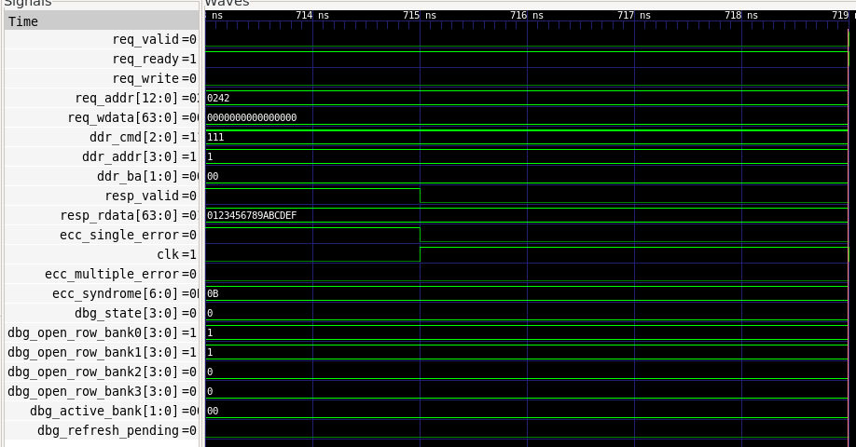
GTKWave Waveform Analysis (actual VCD screenshot)
resp_valid and ecc_single_error = 1 until 715 ns, then fall
ecc_syndrome = 0B (0001011)
resp_rdata = 0123456789ABCDEF
req_addr = 0242: dbg_open_row_bank0 = 1, dbg_active_bank = 00
Window 713–719 ns, cropped from the project's GTKWave capture (ddr_controller.vcd).
Single-bit read result: data recovered, syndrome 0B, single-error flag asserted with the response.
ddr_cmd = 111 (NOP), req_valid = 0, dbg_refresh_pending = 0: controller idle after the response.
Debug signals show per-bank open rows (banks 0 and 1 = row 1).
Notes:
SAY: This is a real GTKWave capture of ddr_controller.vcd around 713 to 719 ns. You can see the read response: resp_valid and ecc_single_error are high until about 715 ns, ecc_syndrome is 0B which is 0001011, and resp_rdata is 0123456789ABCDEF, the original data, so the single-bit fault was corrected. After the response the controller returns to idle: ddr_cmd is 111 (NOP) and req_valid is low. The dbg_open_row_bank signals show the open row in banks 0 and 1.
KEY TERMS: VCD, resp_valid, syndrome, dbg_ signals.
SIMPLE EXPLANATION: The simulation waveform shows the original data recovered while the single-error flag is asserted.
VIVA Q: How do you know the ECC corrected the data?
A: resp_rdata equals the original written data while ecc_single_error is asserted and the syndrome is non-zero.
TRANSITION: Next, synthesis.

Slide 13
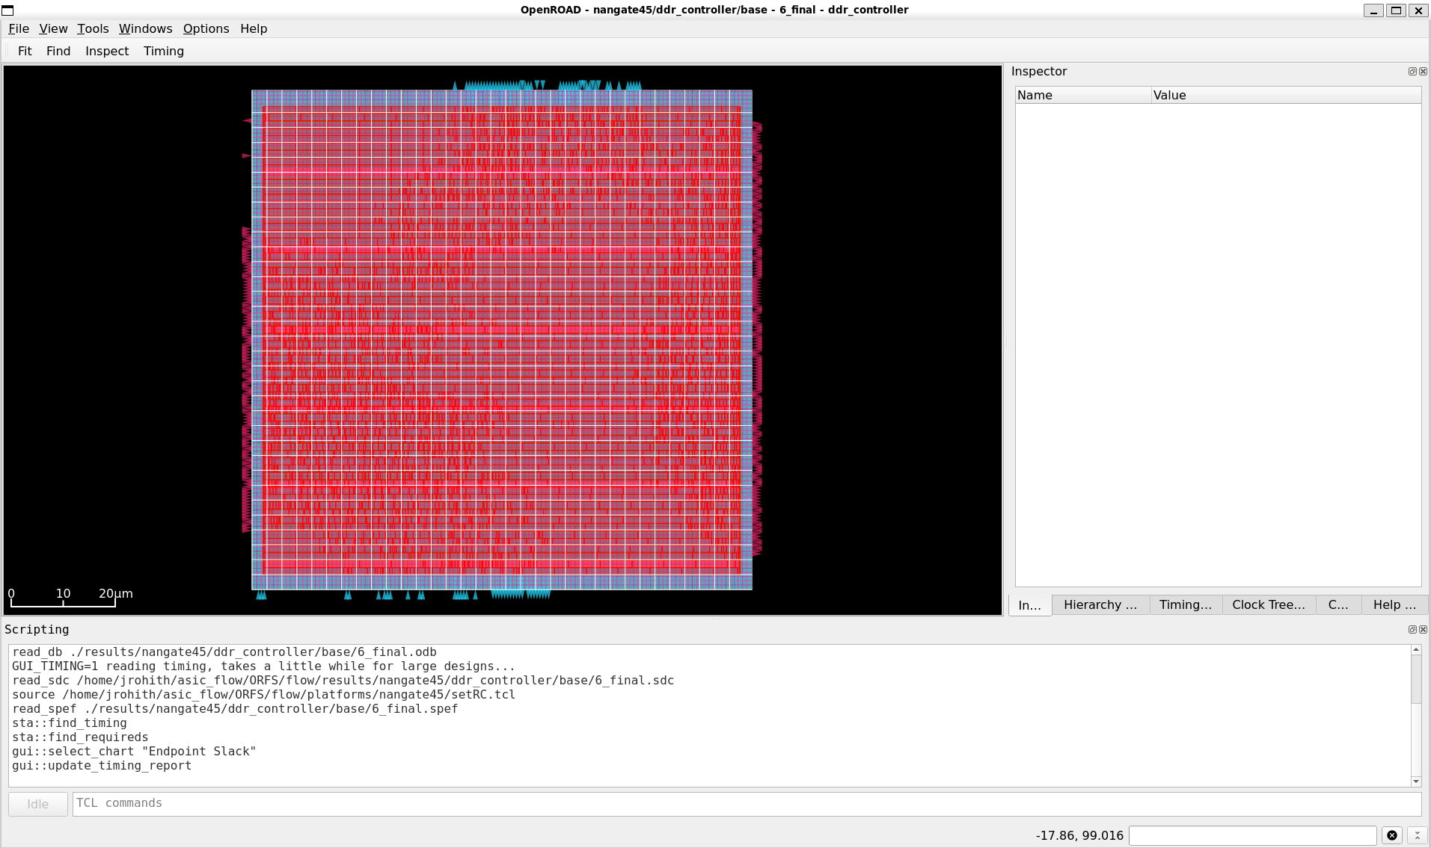
Vivado 2025.2 Synthesis — Full DDR3L + ECC Top
ECC board RTL
+ MIG / Clock IP
Vivado 2025.2
Synthesis
Mapped FPGA
netlist
ecc_arty_ddr_top.dcp
(synth_1)
PASS
Full-top synthesis result
The complete ecc_arty_ddr_top hierarchy elaborated successfully, including ecc_example_top, the ECC AXI master, self-test controller and SECDED encoder/decoder. The MIG IP was synthesized out-of-context first and its DCP was resolved by the top-level run.
Output checkpoint: arty_ecc25.runs/synth_1/ecc_arty_ddr_top.dcp.
Notes:
SAY: The integrated design was synthesized in Vivado 2025.2 for xc7a100tcsg324-1. The MIG IP synthesis run completed first and generated mig_7series_0.dcp. The main synth_1 run then elaborated ecc_arty_ddr_top, the replacement arty_clock_wiz_v25, ecc_example_top, mig_7series_0, ecc_mig_selftest, ecc_mig_axi_master and both SECDED modules. Vivado reported synth_design completed successfully and generated ecc_arty_ddr_top.dcp.
KEY TERMS: synth_design, out-of-context IP synthesis, DCP, hierarchy.
SIMPLE EXPLANATION: Vivado converted the complete RTL and IP hierarchy into an FPGA-mapped netlist checkpoint.

Slide 14
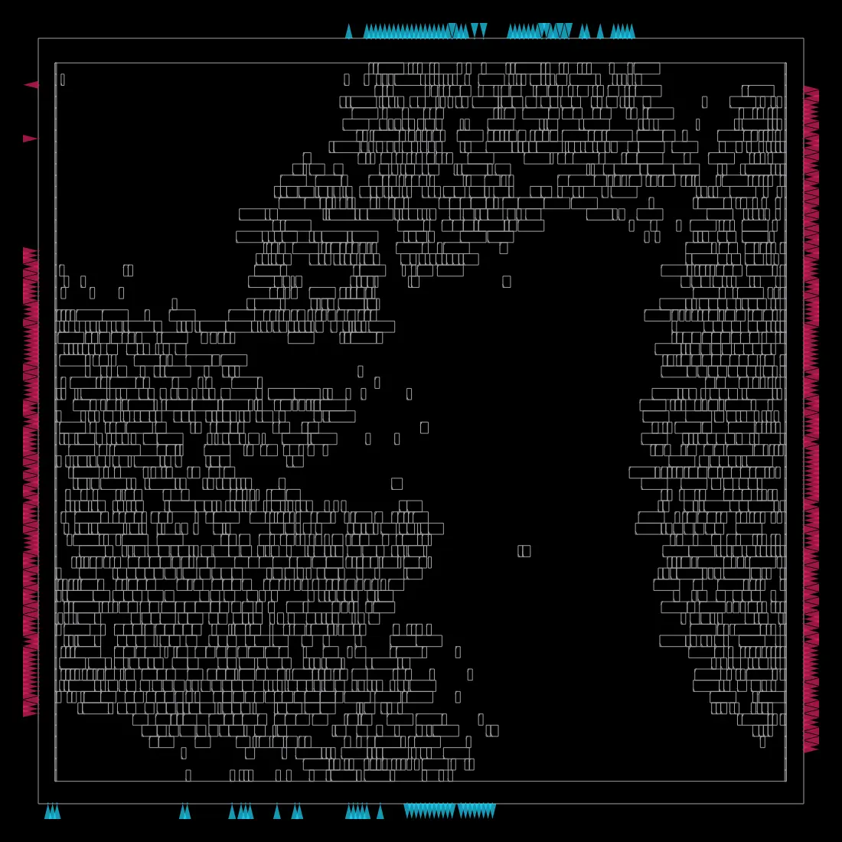
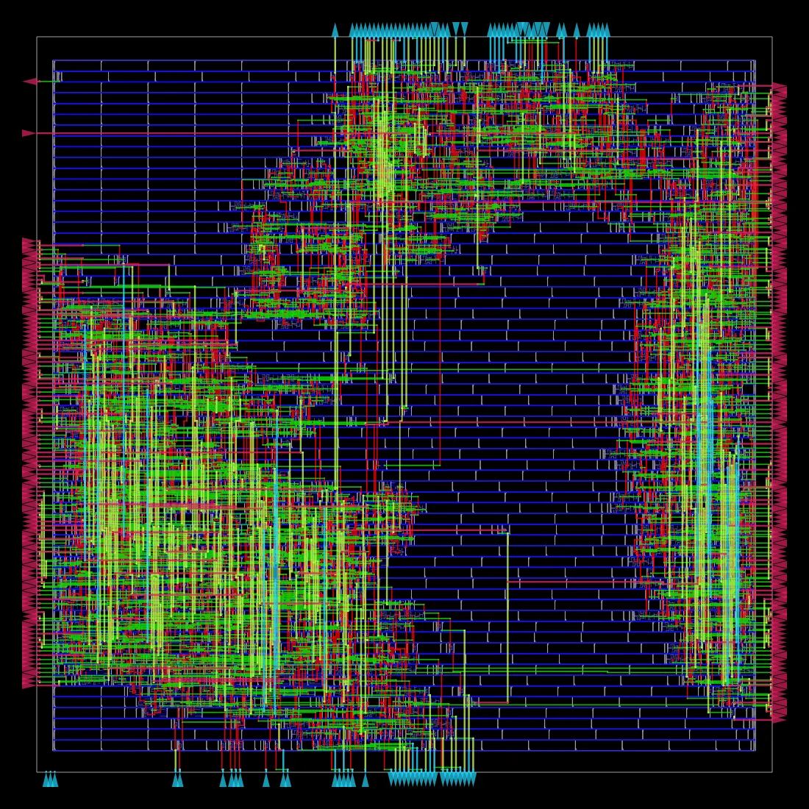
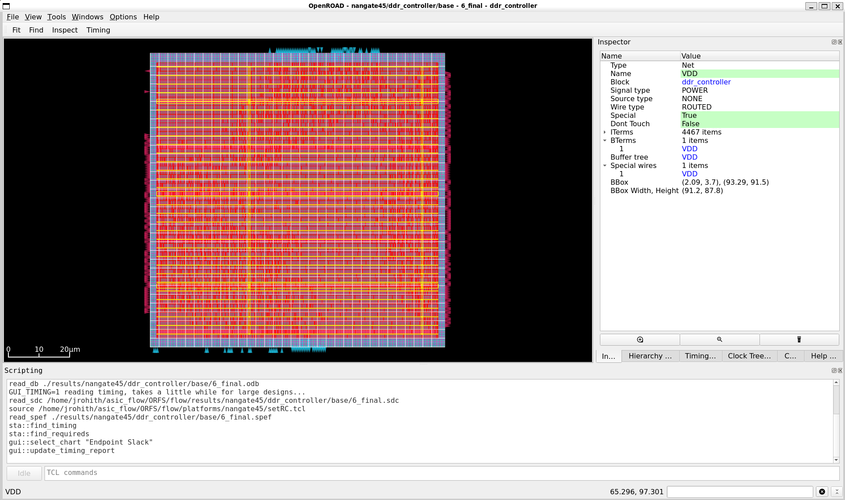
Vivado 2025.2 Implementation — Place, Optimize & Route
RTL + MIG
IP netlist
Synthesis
checkpoint
opt_design
place_design
Clock
placement
phys_opt_design
route_design
Timing +
DRC review
write_bitstream
Vivado implementation: route_design Complete
WNS +1.274 ns | TNS 0 ns
0 failing endpoints of 11,899 timing endpoints
Latest DRC: one remaining REQP-1709 warning (MIG PLL CLKOUT3 → BUFH). Final write_bitstream after the CFGBVS XDC update still needs confirmation.
Notes:
SAY: Vivado implementation completed the physical optimization, placement and routing stages for the integrated top. The latest project summary reports route_design Complete, WNS +1.274 ns, TNS 0 ns and zero failing endpoints across 11,899 endpoints. After setting CFGBVS to VCCO and CONFIG_VOLTAGE to 3.3 V in the board XDC, the implementation was rerun and the CFGBVS DRC warning cleared. One warning remains: REQP-1709 on MIG PLL CLKOUT3, whose load is a BUFH. We preserved the generated MIG topology rather than changing buffers without an AMD-supported reason. Verify write_bitstream completion for this post-XDC implementation.
KEY TERMS: placement, physical optimization, route_design, timing summary, DRC.
SIMPLE EXPLANATION: Vivado placed and routed the integrated design; timing passes, with one documented generated-MIG clock-buffer warning.

Slide 15
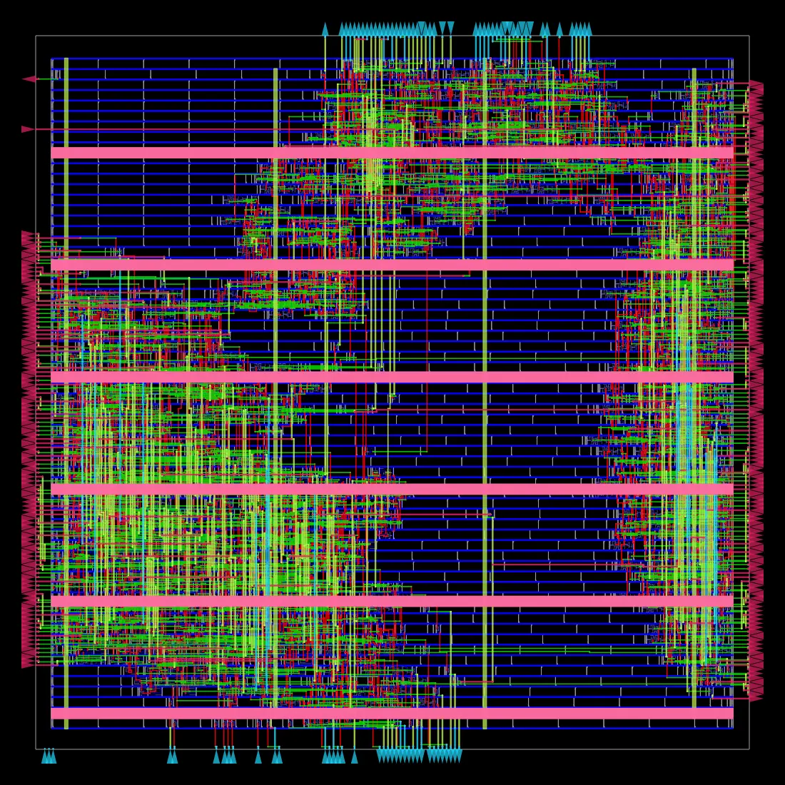
Vivado 2025.2 — Implementation & Timing Results
Metric | Vivado 2025.2 result
Target FPGA | xc7a100tcsg324-1
Full-top synthesis | Complete — DCP generated
Implementation | route_design Complete
Worst negative slack (WNS) | +1.274 ns
TNS / failing endpoints | 0 ns / 0 of 11,899
Implemented DRC | 1 warning — REQP-1709
Estimated on-chip power | 0.84 W (low confidence)
Positive WNS and zero TNS indicate the reported setup paths meet timing. The power value is an estimate with low confidence. The remaining REQP-1709 warning is in generated MIG clocking. Regenerate and confirm the bitstream after the CFGBVS constraint correction.
Vivado Project Summary — latest post-route report
Notes:
SAY: The full Arty A7-100T design targets xc7a100tcsg324-1. Vivado 2025.2 reports synthesis complete, implementation route_design complete, WNS +1.274 ns, TNS 0 ns and zero failing endpoints out of 11,899. The implemented power estimate is 0.84 W, but its confidence is low and it should not be treated as a measured board value. One DRC warning remains, REQP-1709, on the MIG PLL CLKOUT3 to BUFH path. The post-CFGBVS-fix bitstream must be confirmed before programming the board.
KEY TERMS: WNS, TNS, DRC, estimated power.
SIMPLE EXPLANATION: The design meets the current reported setup timing; one MIG clock-buffer warning remains documented.

Slide 16
What Has Actually Been Implemented? | Vivado Update — 11 Nov 2026
RTL Design
Simulation &
Verification
Vivado IP
Preparation
Vivado
Synthesis
Vivado Place /
Route
Bitstream &
Board Test
A. Verified RTL and behavioral ECC path
B. Current Vivado 2025.2 FPGA implementation — Arty A7-100T
Custom DDR-style controller simulation passed. SECDED tests: 5/5 clean patterns, 360/360 single-bit correction, 12,780/12,780 double-bit detection. ECC AXI behavioral integration passed calibration gating, 128-bit beat formatting, AW/W stalls, write/read and error-path checks. These are simulation results.
Project arty_ecc25; target xc7a100tcsg324-1; top ecc_arty_ddr_top. arty_clock_wiz_v25 and MIG IP are Up-to-date. MIG OOC synthesis and full-top synthesis passed; DCPs generated. Implementation route_design completed. WNS +1.274 ns; TNS 0 ns; zero failing endpoints. One REQP-1709 MIG PLL/BUFH warning remains.
CFGBVS DRC warning was cleared with CFGBVS=VCCO and CONFIG_VOLTAGE=3.3 V in the board XDC. The latest post-XDC write_bitstream completion still needs confirmation.
Still pending: program the final bitstream, verify physical DDR3L calibration and read/write, then demonstrate board-level ECC correction and double-error detection.
Notes:
STATUS: The current active FPGA project is arty_ecc25 in Vivado 2025.2. The top module is ecc_arty_ddr_top for xc7a100tcsg324-1. The replacement Clock Wizard arty_clock_wiz_v25 and MIG 7-Series IP are up-to-date. MIG out-of-context synthesis and main top synthesis completed; both DCPs were generated. Vivado place-and-route reached route_design Complete. The current timing summary reports WNS +1.274 ns, TNS 0 ns and zero failing endpoints. The CFGBVS warning was cleared by adding CFGBVS=VCCO and CONFIG_VOLTAGE=3.3 to the board XDC. One REQP-1709 warning remains on the generated MIG PLL CLKOUT3→BUFH path. The final bitstream after this XDC change and all physical board tests remain to be confirmed.
Keep the behavioral simulation results distinct from physical DDR proof. The board test remains pending: programming, calibration, memory read/write and real ECC fault injection.

Slide 17
Vivado DDR3L + SECDED ECC FPGA Architecture
Integrated top: ecc_arty_ddr_top | Arty A7-100T | XC7A100T-CSG324-1
Clock Wizard
arty_clock_wiz_v25
MIG 7-Series + ECC AXI
mig_7series_0 + AXI master + self-test
100 MHz board
oscillator
CLK100MHZ · pin E3
On-board
DDR3L memory
physical ddr3_* interface
clk_in1
166.666 MHz
clk_out1
sys_clk_i
200 MHz
clk_out2
clk_ref_i
locked → reset
locked
sys_rst
Status outputs
LED[0] reports MIG calibration; LED[1] reports MIG comparison error. LED[1] is not the SECDED corrected/uncorrectable flag.
init_calib_complete
DDR3 initialization / calibration done
ecc_test_done (internal)
tg_compare_error → LED[1]
Clock Wizard outputs: 166.666 MHz MIG system clock and 200 MHz IDELAY reference. ECC master stores the 72-bit codeword in WDATA[71:0] of a 128-bit AXI beat. The physical DDR bus remains x16.
Notes:
SAY: The 100 MHz board oscillator on E3 feeds the replacement arty_clock_wiz_v25 IP. It generates the 166.666 MHz MIG system clock and 200 MHz reference clock. Its locked output controls the active-low MIG reset. The integrated ecc_example_top contains mig_7series_0, the custom ECC AXI master, the SECDED logic and a calibration-gated self-test. The MIG drives the physical x16 DDR3L interface. The ECC master places the 72-bit codeword in the lower bits of a 128-bit AXI beat. LED0 reports MIG calibration and LED1 reports the MIG comparison-error signal; LED1 is not a SECDED status indicator. ecc_test_done is internal in the current wrapper.
TRANSITION: The Vivado flow used to implement this top.

Slide 18
Vivado 2025.2 — Integrated FPGA Build Flow
Project setup → IP generation → MIG synthesis → full-top synthesis → implementation → timing/DRC → bitstream
Open project
arty_ecc25.xpr
Confirm target
xc7a100tcsg324-1
Validate IP
Clock Wizard v25 + MIG
Generate IP outputs
MIG + Clock Wizard
1
2
3
4
Review timing / DRC
WNS +1.274 ns
Run implementation
place + route
Run full-top synthesis
synth_1
Create MIG OOC run
synthesize MIG DCP
8
7
6
5
Generate bitstream
write_bitstream
Vivado 2025.2 completed MIG synthesis, full-top synthesis and route_design. One REQP-1709 warning remains. Confirm write_bitstream after the CFGBVS XDC change before programming.
Notes:
SAY: This is the current FPGA implementation flow. Open arty_ecc25.xpr in Vivado 2025.2 and confirm the exact XC7A100T part. The original Clock Wizard revision 19 was replaced with the 2025.2 catalog revision 17 instance arty_clock_wiz_v25. Check MIG status, regenerate both IP output products, create and run the MIG out-of-context synthesis run, and confirm mig_7series_0.dcp. Set ecc_arty_ddr_top as the top and verify the board XDC, including CFGBVS=VCCO and CONFIG_VOLTAGE=3.3. Run main synthesis, then implementation through placement and routing, review timing and DRC, and finally generate the bitstream.
The full-top synthesis and route_design have completed. The latest write_bitstream after the XDC correction must still be checked.

Slide 19
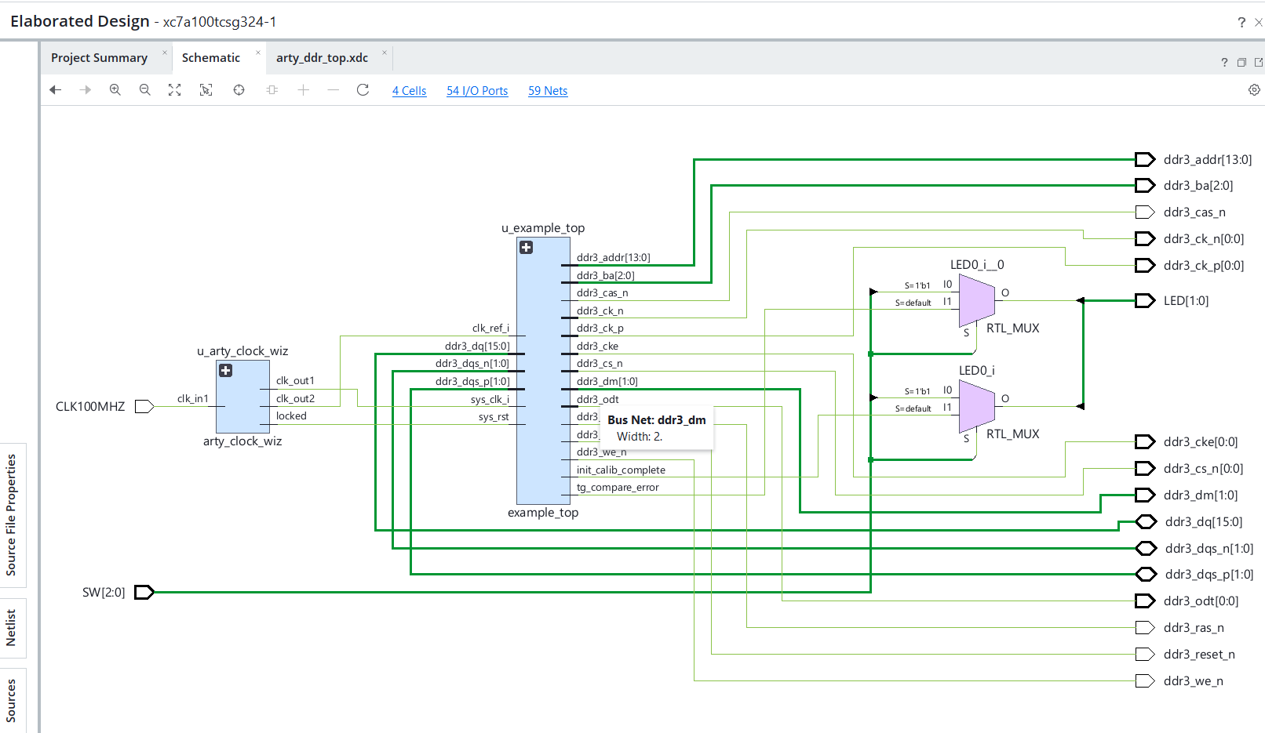
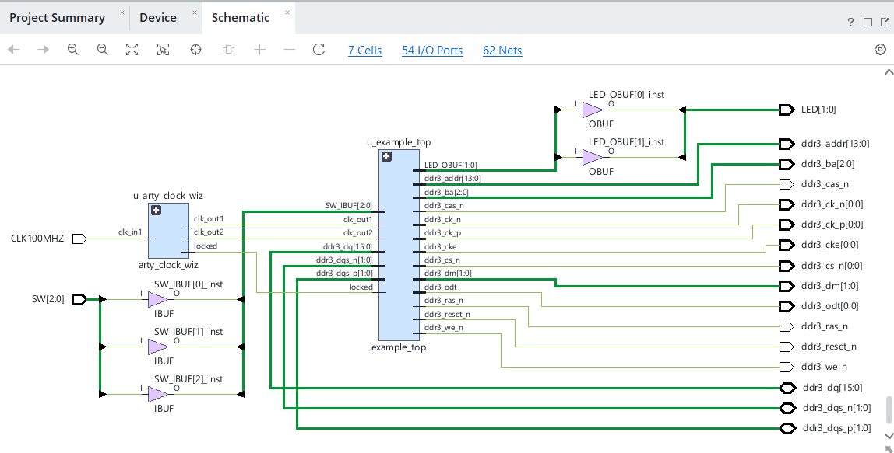
Vivado 2025.2 — Integrated RTL / IP Hierarchy
ecc_arty_ddr_top
arty_clock_wiz_v25
ecc_example_top
mig_7series_0
ecc_mig_axi_master
+ SECDED
ecc_mig_selftest
Top-level: ecc_arty_ddr_top
Clock: arty_clock_wiz_v25
Board I/O: CLK100MHZ, SW[2:0], LED[1:0], DDR3L pins
Integrated subsystem: ecc_example_top
MIG: mig_7series_0
ECC path: ecc_mig_axi_master + ecc_secded
Self-test: ecc_mig_selftest
Notes:
SAY: The active Vivado top is ecc_arty_ddr_top. It instantiates the 2025.2 Clock Wizard and ecc_example_top. The ECC/MIG subsystem contains the MIG 7-Series IP, the custom single-outstanding AXI master, the SECDED encoder/decoder and a calibration-gated self-test controller. Vivado's synthesis log confirms that these RTL modules elaborated and that MIG and Clock Wizard IP stubs/checkpoints were resolved. This hierarchy is a synthesis result; actual DDR3L transactions and board ECC fault injection still require hardware validation.

Slide 20
Arty A7 Inputs | Integrated ECC-MIG Top
Input name | Width | FPGA pin | Purpose
CLK100MHZ | 1 bit | E3 | Physical 100 MHz board oscillator. Feeds the Clock Wizard.
SW[0] | 1 bit | A8 | Manually controls logical output LED[0] in test mode.
SW[1] | 1 bit | C11 | Manually controls logical output LED[1] in test mode.
SW[2] | 1 bit | C10 | Selects manual LED test mode or real MIG status monitoring.
input wire CLK100MHZ;
input wire [2:0] SW;
CLK100MHZ is a clock input, not a data input.
SW[0] and SW[1] are manual test controls, not DDR3 write data, ECC parity bits or error-injection signals.
SW[2] selects how the LED outputs behave.
The board has four slide switches; only SW0, SW1 and SW2 are used. SW3 is unused.
DDR3 commands, addresses and data are handled by the MIG 7-Series instance inside the current integrated ECC-MIG top.
These are the inputs of the current integrated ecc_arty_ddr_top board wrapper. SW[2] selects manual LED test mode or MIG status mode.
CLK100MHZ
pin E3
Clock Wizard
MIG clocks
SW[2:0]
A8, C11, C10
LED-selection
logic
LED[1:0]
Notes:
The active ecc_arty_ddr_top wrapper uses CLK100MHZ on E3 and SW[2:0] on the Arty A7 board pins recorded in the XDC. SW2 selects status mode or manual LED mode; SW0 and SW1 are LED test inputs only. They are not DDR write data, ECC parity bits or error-injection controls. DDR commands, addresses, DQ and DQS are handled by the generated MIG IP. These are the inputs in the current Vivado project.

Slide 21
Arty A7 Outputs | Integrated ECC-MIG Top
Logical status outputs
DDR3 physical-interface ports (generated by the MIG)
Output | Status-mode signal | Meaning
LED[0] | init_calib_complete | ON: MIG reports DDR3 initialization and calibration complete.
LED[1] | tg_compare_error | ON: traffic generator has asserted its comparison-error signal.
Signal | Meaning
ddr3_addr[13:0] | Memory address
ddr3_ba[2:0] | Bank address
ddr3_ras_n, ddr3_cas_n, ddr3_we_n | Command / control
ddr3_reset_n, ddr3_cke, ddr3_cs_n, ddr3_odt | Reset and memory operating controls
ddr3_ck_p, ddr3_ck_n | Differential DDR3 clock pair
ddr3_dm[1:0] | Data mask
ddr3_dq[15:0] | Bidirectional data bus (inout)
ddr3_dqs_p[1:0], ddr3_dqs_n[1:0] | Differential data strobes (inout)
LED[0] = init_calib_complete. LED[1] = tg_compare_error. These are MIG status outputs, not SECDED correction or uncorrectable-error flags.
Physical LED mapping
Active XDC: LED[0] → F6 (RGB LED 0 green); LED[1] → G3 (RGB LED 1 red). These are RGB channels, not standard user LEDs H5/J5.
Address/command signals go to memory; DQ and DQS are bidirectional. MIG inside ecc_example_top drives the board DDR3L interface. SW0–SW2 only select LED test/status behavior. Physical DDR/ECC testing remains pending.
Notes:
LED0 is driven by init_calib_complete and turns on when MIG DDR initialization/calibration completes. LED1 is driven by tg_compare_error and indicates a MIG data-comparison error. It is not the SECDED single-bit or double-bit status. The self-test completion signal ecc_test_done is internal in the current top-level wrapper and is not directly displayed on an LED. DDR address, command, clock, DQ and DQS ports are the generated MIG physical interface.

Slide 22
Switch-to-LED Logic | Integrated ECC-MIG Top
assign LED[0] = SW[2] ? SW[0] : init_calib_complete;
assign LED[1] = SW[2] ? SW[1] : tg_compare_error;
Tested truth table (Arty A7)
SW2 | SW1 | SW0 | LED[1] | LED[0]
ON | OFF | OFF | OFF | OFF
ON | OFF | ON | OFF | ON
ON | ON | OFF | ON | OFF
ON | ON | ON | ON | ON
SW2 OFF (0): real MIG status
LED[0] = init_calib_complete
LED[1] = tg_compare_error
SW2 ON (1): manual LED test mode
LED[0] follows SW0
LED[1] follows SW1
The RTL retains the manual LED mux for board I/O checks. The earlier manual LED test belongs to a separate board baseline; repeat it with the final ECC-MIG bitstream.
The prior baseline test does not validate the integrated ECC-MIG design. Physical validation of this bitstream is still pending.
Notes:
The board wrapper retains the manual LED test mux. When SW2 is low, LED0 displays MIG calibration and LED1 displays the MIG comparison-error output. When SW2 is high, SW0 and SW1 drive the LED outputs for manual I/O checks. The truth table describes the RTL mapping. Prior physical testing of this switch/LED function was done on a separate MIG baseline, so repeat the check with the final ECC-MIG bitstream before claiming current hardware validation.

Slide 23
Where Are the Data and ECC Bits? | Integrated MIG AXI Path
WRITE: custom ECC AXI master to MIG
64-bit payload
SECDED encoder
72-bit codeword
AXI WDATA[71:0]
[127:72] = 0
WRITE
MIG AXI
RDATA[127:0]
72-bit codeword
[71:0]
SECDED decoder
64-bit payload
+ ECC status
READ
64 payload + 7 Hamming parity + 1 overall parity = 72-bit codeword. One-bit errors are corrected; two-bit errors are detected.
PHYSICAL MEMORY INTERFACE: MIG 7-Series PHY → Arty A7 on-board DDR3L (x16)
AXI user interface
MIG controller + PHY
DDR3L DQ/DQS
x16 physical bus
Self-test completion
(ecc_test_done)
is internal
calib_complete → LED[0]
tg_compare_error → LED[1]
Behavioral ECC + AXI integration passed in simulation. Vivado synthesis and place-and-route passed for the integrated MIG + ECC top. Physical DDR3L data transactions and board-level ECC fault injection remain unverified.
Notes:
UPDATED DATA-PATH EXPLANATION: The custom ECC AXI master accepts a 64-bit payload, encodes it into a 72-bit SECDED codeword, places that codeword in WDATA[71:0] of one 128-bit AXI beat and drives the upper 56 bits low. On reads, it extracts the 72-bit codeword from the MIG AXI read-data beat and decodes it back to 64-bit payload plus ECC status. The MIG controller/PHY converts the AXI user transactions to the physical x16 DDR3L interface. The RTL is integrated in the Vivado top and has passed synthesis and place-and-route. Simulation results and FPGA implementation do not replace physical board read/write and fault-injection evidence.

Slide 24
ECC AXI Bridge: Full Behavioral Integration Results
Custom ECC master + self-test controller verified against a 128-bit behavioral AXI RAM model — not physical DDR3L.
ECC self-test controller
Waits for calibration input; issues a test write and read
ECC AXI master + SECDED
64-bit payload encoded to 72-bit SECDED codeword
128-bit AXI RAM model
AW/W stalls, read/write responses and protocol checks
→
→
AXI beat format
WDATA[71:0] = ECC codeword
WDATA[127:72] = 56 zero bits
One 16-byte (128-bit) AXI beat
FULL ECC + AXI BEHAVIORAL INTEGRATION — PASS
Calibration gating and self-test write/read round trip: PASS
128-bit AXI beat formatting and protocol assertions: PASS
Integrated single-bit correction and double-bit detection: PASS
Independent AW and W channel stalls exercised; test finished normally
SECDED EXHAUSTIVE REGRESSION
Clean payload patterns: 5 / 5
Single-bit fault cases: 360 / 360
Double-bit fault cases: 12,780 / 12,780
Zero failures reported
Important: the AXI RAM is a behavioral test model. These results do not demonstrate physical DDR3L operation or board-level ECC correction.
DDR3-Style Memory Controller + SECDED ECC | Digital System Design
24

Slide 25
Vivado 2025.2 Implementation on the Arty A7-100T FPGA
Target: xc7a100tcsg324-1 | Integrated MIG + SECDED ECC top | route_design Complete
VIVADO FLOW — VERIFIED
Clock Wizard v25 (Rev 17): Up-to-date
MIG 7-Series IP (Rev 2): Up-to-date
MIG out-of-context synthesis: Complete; mig_7series_0.dcp generated
Main ecc_arty_ddr_top synthesis: Complete; ecc_arty_ddr_top.dcp generated
Implementation: placement and routing completed
CFGBVS warning cleared using CFGBVS=VCCO and CONFIG_VOLTAGE=3.3 V in board XDC
POST-ROUTE RESULTS
WNS: +1.274 ns
TNS: 0 ns
Failing endpoints: 0 of 11,899
DRC: 1 warning (REQP-1709; MIG PLL CLKOUT3 → BUFH)
Estimated on-chip power: 0.84 W (low confidence)
Latest write_bitstream after CFGBVS correction: completion not yet confirmed
Project: C:/Users/vrnsr/arty_ddr_fpga/v25ecc/arty_ecc25.xpr | Top: ecc_arty_ddr_top
The post-CFGBVS route completed. The prior bitstream was generated before the final XDC correction; regenerate and verify the latest .bit before board programming.
This is the integrated MIG + ECC FPGA design, not a standalone LED-only test. Board-level DDR calibration, read/write and physical ECC fault tests are still pending.
DDR3-Style Memory Controller + SECDED ECC | Digital System Design
25
Notes:
The current Arty A7-100T Vivado 2025.2 build is the integrated ECC-MIG design, not a standalone LED-only project. The Clock Wizard v25 and MIG IP report Up-to-date. MIG out-of-context synthesis and full-top synthesis completed successfully and both DCP checkpoints were generated. Implementation reached route_design Complete. Post-route timing reports WNS +1.274 ns, TNS 0 ns and zero failing endpoints among 11,899 endpoints. The power estimate is 0.84 W with low confidence. CFGBVS was set to VCCO and CONFIG_VOLTAGE to 3.3 V in the board XDC, clearing that warning. The remaining DRC warning is REQP-1709 on the generated MIG PLL CLKOUT3→BUFH path. The post-CFGBVS write_bitstream step must be confirmed; then program the board and validate real DDR3L and ECC behavior.

Slide 26
Current Status, Remaining Validation & Conclusion | 11 Nov 2026
CURRENT LIMITATIONS
NEXT STEPS
CONCLUSION
One generated-MIG DRC warning remains (REQP-1709: PLL CLKOUT3 → BUFH) | Latest route_design completed; WNS +1.274 ns, TNS 0 ns, 0 failing endpoints | Post-CFGBVS write_bitstream completion still needs confirmation | No physical board programming, DDR3L calibration/read/write or physical ECC fault injection has been demonstrated.
Confirm write_bitstream Complete! after the CFGBVS XDC correction | Program Arty A7-100T using Hardware Manager | Verify DDR3L calibration and known-pattern write/read | Observe ECC self-test completion via internal debug/ILA or an added status output | Perform controlled single-bit correction and double-bit detection tests | Archive timing, DRC and hardware evidence.
SECDED RTL and ECC + AXI behavioral integration passed simulation | Vivado 2025.2 MIG and Clock Wizard IP are up-to-date | MIG OOC synthesis and integrated top synthesis passed | Integrated full-top place-and-route completed | WNS +1.274 ns; TNS 0 ns; zero failing endpoints | One documented REQP-1709 warning remains | Physical board validation is the final milestone.
RTL → Simulation → Vivado IP + Synthesis → Place & Route → Final bitstream → Physical DDR3L + ECC validation pending
Thank You | Questions?
Notes:
UPDATED STATUS (11 Nov 2026): The custom SECDED RTL and ECC AXI behavioral integration are verified in simulation. The integrated top ecc_arty_ddr_top was opened in Vivado 2025.2 for xc7a100tcsg324-1. The Clock Wizard was recreated as arty_clock_wiz_v25 (catalog Rev 17), MIG 7-Series IP reports Up-to-date, MIG out-of-context synthesis completed and generated mig_7series_0.dcp, and full-top synthesis completed and generated ecc_arty_ddr_top.dcp. Place-and-route reached route_design Complete. Timing: WNS +1.274 ns, TNS 0 ns, zero failing endpoints. The CFGBVS warning was corrected with CFGBVS=VCCO and CONFIG_VOLTAGE=3.3 V. One DRC warning remains: REQP-1709 because MIG PLL CLKOUT3 drives a BUFH. Do not alter generated MIG clock buffers without vendor-supported analysis. Confirm the latest write_bitstream after the XDC correction. Physical board programming, DDR3L calibration/read/write, and board-level single-/double-bit ECC fault demonstration remain pending.

