Slide 1
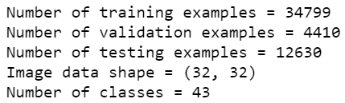
Dataset
Traffic Sign Recognition
German Traffic Sign Dataset (GTSRB) contains 43 types of different traffic signs. The images are in RGB format (3 channels).
Distribution of train data is not balanced for all the classes.
Data Preprocessing
From [1] it is mentioned that the model accuracy improves when gray data is used. In pipeline code, the RGB images are converted to gray images using OpenCV library.
Augmentation
To balance the training set, it is extended by flipping the images to output an augmented dataset. The weighted sampler creates a balanced dataset by taking equal number of samples (20000 samples per class) from each class in the training set.
Transformations are performed over the augmented data. The tensor is converted to a PIL image, then rotate the images for the specified degree and apply Random affine transformation to keep the image center invariant.

Slide 2
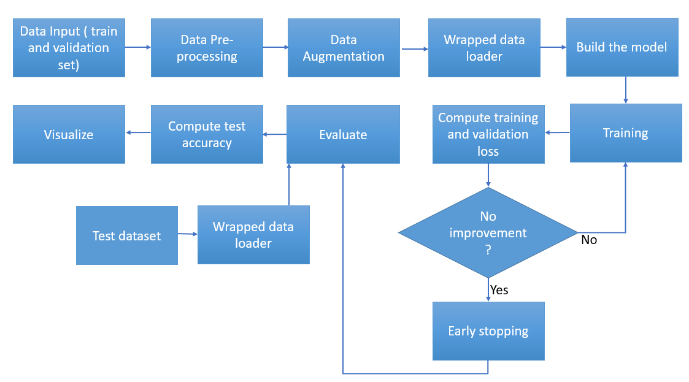
Pipeline Workflow
Traffic Sign Recognition
Wrapped dataloader is used to batch the dataset and load on to the device.
Fig 1. Workflow Diagram

Slide 3
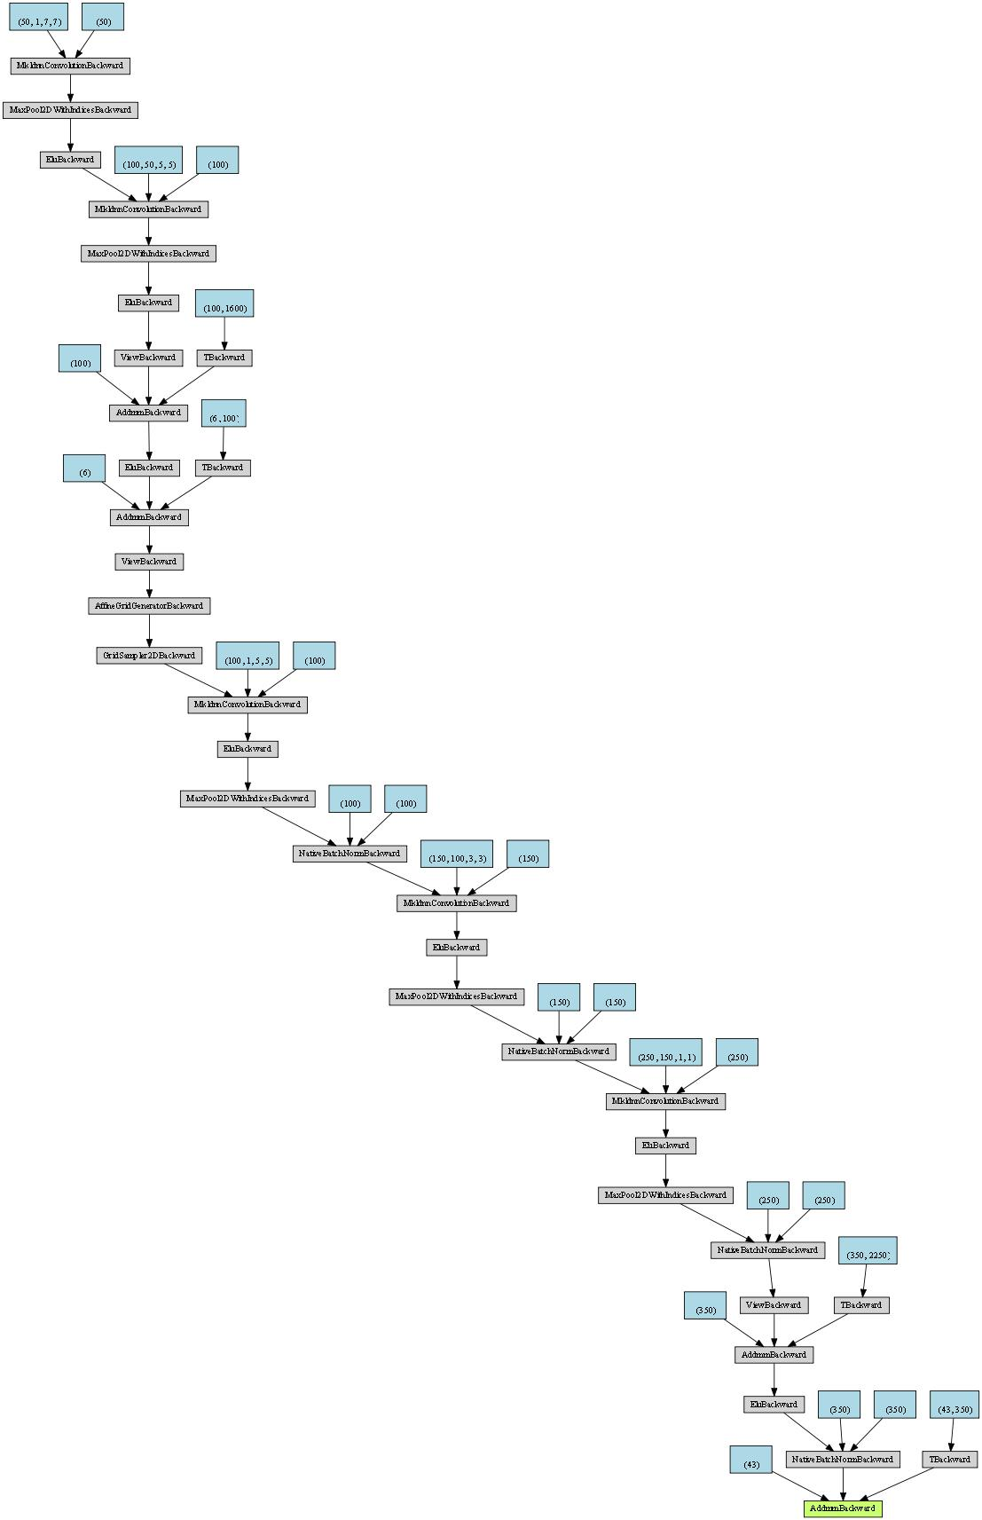
Experiment 1 (Network with STN)
Traffic Sign Recognition
Hyperparameters
Image input = (32,32)
Batch size = 64
Epoch = 100
Patience = 10 (for early stopping)
Learning rate = 0.0001
Optimizer = Adam
Loss = Cross entropy loss
Fig 2. Network Architecture of the model with STN

Slide 4
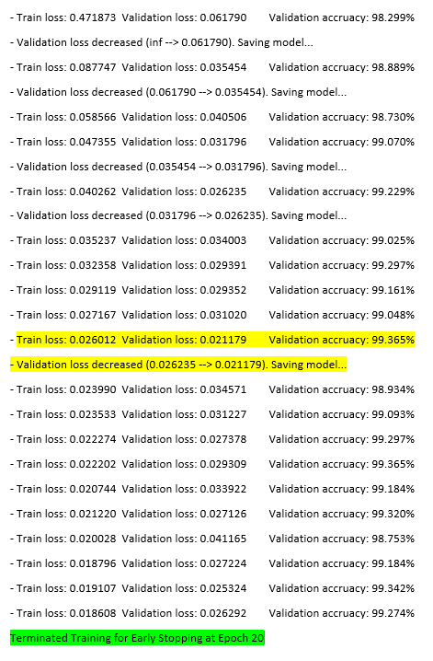
Traffic Sign Recognition
Training
The model with spatial transformer network (STN) has the best possible validation accuracy as 99.365% during 10th epoch. It is a stage where, the training loss is also decreased to 0.026012.
Early stopping is done as a regularization technique to run the model for 10 more iterations to prevent overfitting [2]. The training of the network converges at epoch 20. Note: Overfitting = Prediction accuracy of trained network is very high on training dataset but poor performance on validation data.
Fig 3. Training log

Slide 5
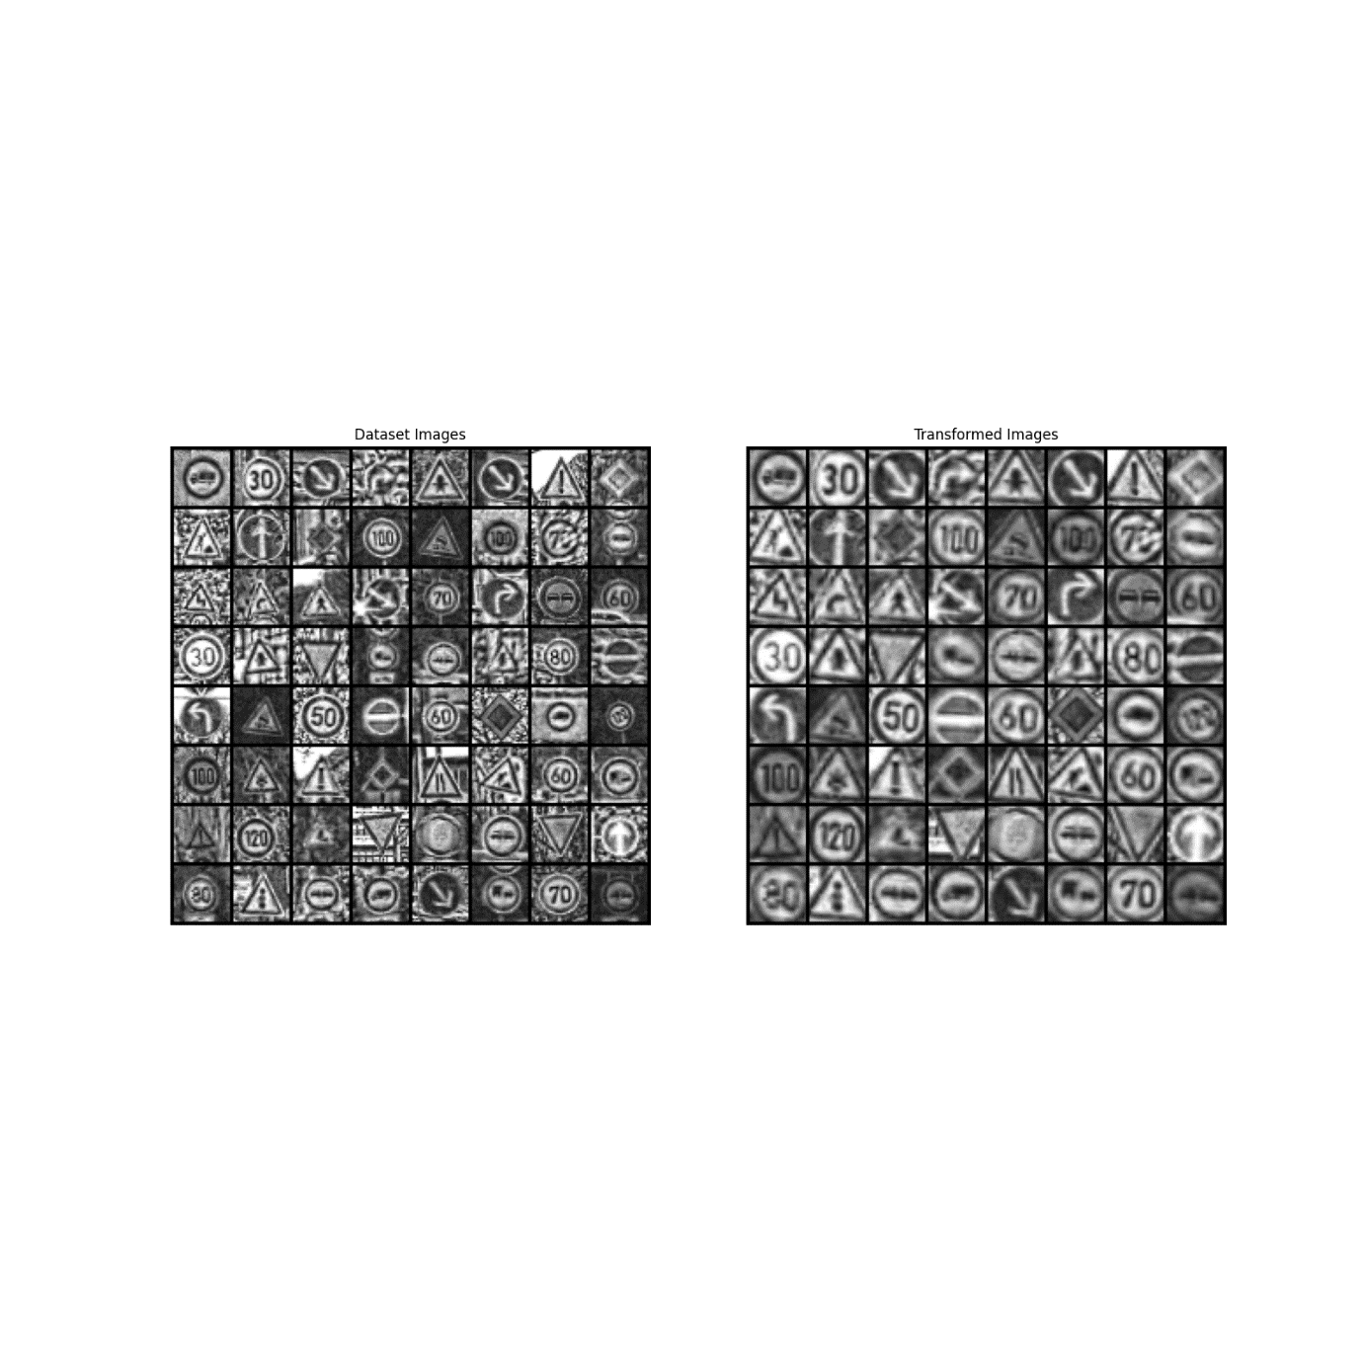
Traffic Sign Recognition
Testing
Evaluated the trained model using the test dataset and it results in overall test accuracy of 98.907% for a Test loss value of 0.035336.
STN layer is able to predict the images which are zoomed out, tilted and distorted. But it also fails in cases where the images have poor aspect ratio.
a) A batch of input traffic sign
b) Transformed batch at the STN layer output
Fig 4. Output of STN layer for the given input

Slide 6
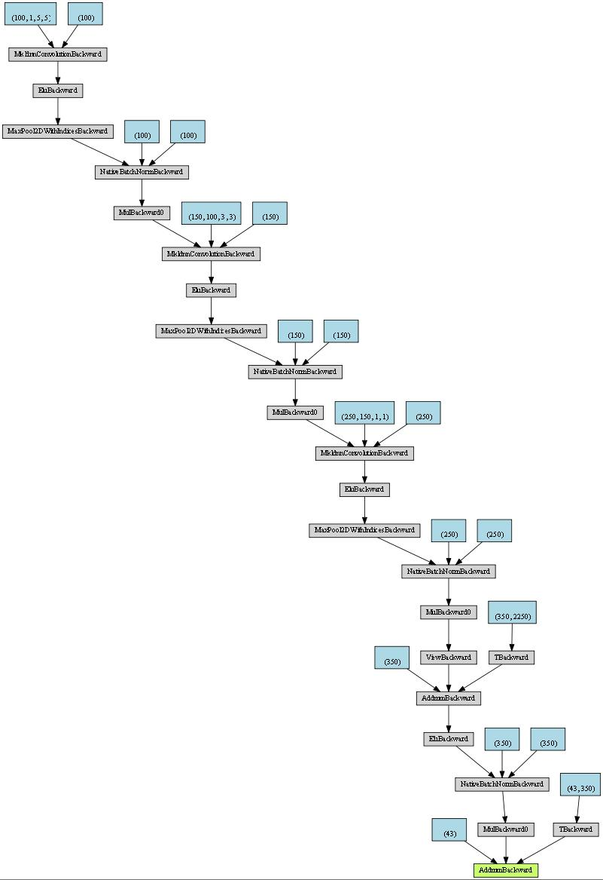
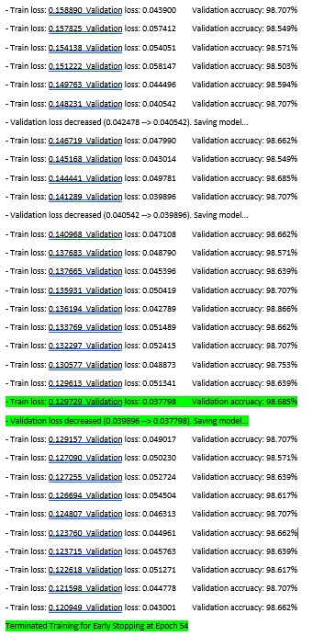
Experiment 2 (Network without STN)
Traffic Sign Recognition
Training
The model (without STN) have same hyperparameters as mentioned earlier. The train log is shown below.
The model converges with a validation accuracy of 98.686% for a validation loss of 0.037798 at epoch 44. The model is early stopped at epoch 54.
Testing
The model is able to give only 98.527% test accuracy with a test loss of 0.045270.
Fig 6. Training log
Fig 5. Network Architecture of the model without STN

Slide 7
Traffic Sign Recognition
Analysis from Experiment 1 and 2
From the table and graph it is inferred that the model with STN has higher trainable parameters but it converges faster compared to the model without STN.
Table 1. Comparison Detail
Detail | Network with STN | Network without STN
No of trainable parameters | 1268449 | 980143
Total number of epochs | 20/100 | 54/100
Test accuracy | 98.91% | 98.53%
Fig 7. Training curve over validation set

Slide 8
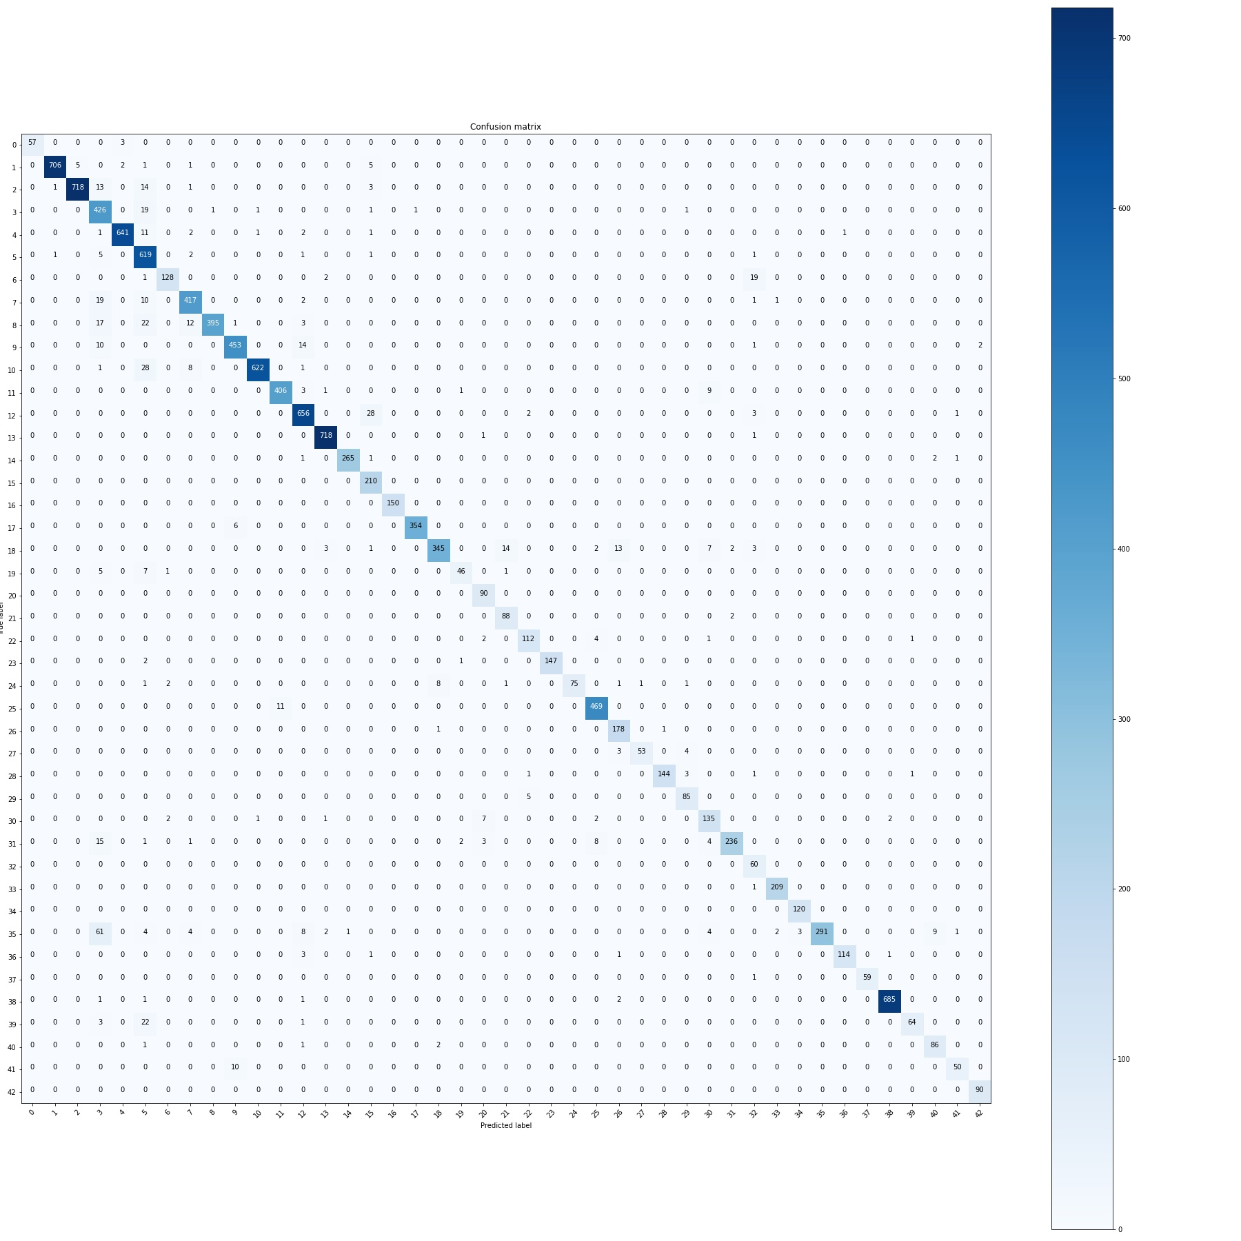

Traffic Sign Recognition
Evaluation
The confusion matrix of model without STN proves that the model fails in the case if the input images are zoomed out and distorted, shown in figure 9.
From the confusion matrix in figure 8, the model has better prediction rate compared to figure 9. But it is observed that classes 0 to 8 (related to speed-limits) have higher misclassification counts.
Fig 8. Confusion matrix for network with STN
12450 /12630 samples are predicted correctly
Fig 9. Confusion matrix for network without STN
12400/12630 samples are predicted correctly

Slide 9
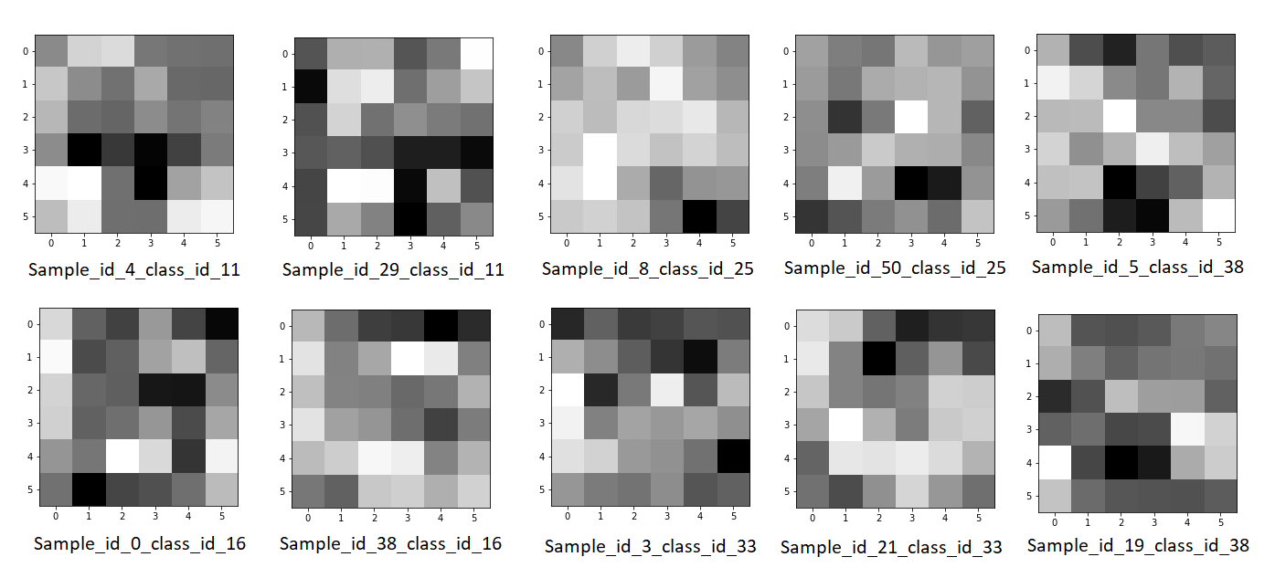
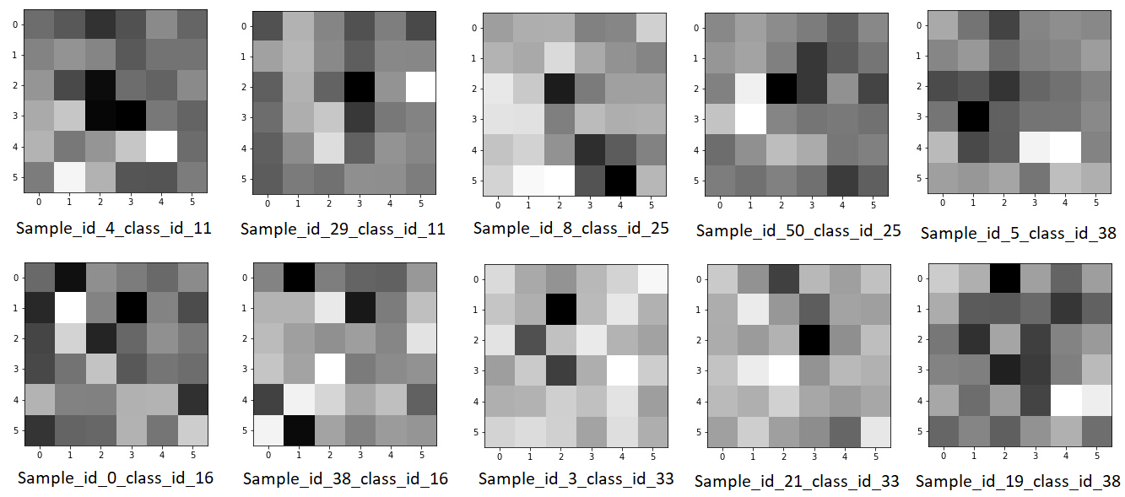
Experiment 3
Traffic Sign Recognition
Selected 10 images from 5 different classes from the test dataset.
Conv3 layer has 250 activation maps for both the models, the first activation map for each of the selected test image is visualized for both the experiments. It shows how the layer learns the image features.
Fig 10. First activation map for the model with STN
Fig 11. First activation map for the model without STN

Slide 10
Challenges and Possibilities
Traffic Sign Recognition
Setup was the major challenge. Notebook with intel i5 8th Gen CPU core doesn’t support to run this pipeline. It throws “kernel is dead” error in the middle of training.
Visualizing activation function.
Possible analysis approach
Visualize the output transformed data of the network without STN
Analyze the gradients of the layer Conv3 for models trained from experiments 1 and 2. Gradcam.visualize() could be used to create visualizations.
This classification task can be further evaluated using metrics like Precision, Recall and F1 score.
Training with variable learning rate and batch size.
Hyperparameter tuning with Auto-ML frameworks (example: auto-sklearn, ML-Plan etc.,).

Slide 11
References
Traffic Sign Recognition
P. Sermanet and Y. LeCun, "Traffic sign recognition with multi-scale Convolutional Networks," The 2011 International Joint Conference on Neural Networks, San Jose, CA, 2011, pp. 2809-2813, doi: 10.1109/IJCNN.2011.6033589.
Gavrilov, Andrei & Jordache, Alex & Vasdani, Maya & Deng, Jack. (2018). Preventing Model Overfitting and Underfitting in Convolutional Neural Networks. International Journal of Software Science and Computational Intelligence. 10. 19-28. 10.4018/IJSSCI.2018100102.
GitHub - wolfapple/traffic-sign-recognition: Built and trained a deep neural network to classify traffic signs, using PyTorch. The highlights of this solution would be
data preprocessing, trained with heavily augmented data and using Spatial Transformer Network.

