Slide 1
Occlusion Handling in Behavior Planning using Imitation Learning
Janaranjani Palaniswamy
Supervisor: Stoll Martin
Monthly Status Update - 20.12.2021

Slide 2
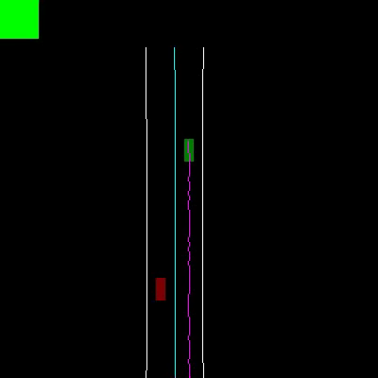
Project Objective
To implement an occlusion handling algorithm using object filters and observe the policy crash.
Update the training data using occlusion algorithm.
Extension of IDM to adapt the new data.
Add visibility layer to grid data and perform hyperparameter tuning using AutoML.
Further steps: learn object detections in occluded area, non geo-fixed occlusions, and comparison with different neural network architectures.

Slide 3
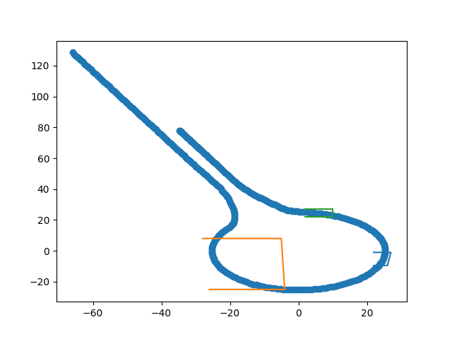
Progress
Literature work on base papers.
Familiarized with the code base through bug fixes.
Defined occlusion zones for the roundabout scenario.
Implemented an object filter class to generate filtered rollout.
Adapting the environment using object filter to occlude the defined zones.

Slide 4
Next Monthly Forecast Plan
Further Steps
Evaluate the occlusion algorithm through policy crash.
Generate new training data using occlusions.
Training and evaluation of the policy with new dataset.
Adapt the IDM to the new data

Slide 5
Comments
Further Steps
Timeline finish by May mid
Next meeting ablation stdy and Expert adapt

