Slide 1
Occlusion Handling in Behavior Planning using Imitation Learning
Janaranjani Palaniswamy
Supervisor: Stoll Martin
Monthly Status Update - 17.3.2022

Slide 2
Month Forecast
KPI definition
Refining new model if required
Generate new dataset and train the policy
Added visibility layer to the grid data
Hyperparameter optimization
Ablation Study (two datsets and two policy models)
Enhance policy model if required.
Add-ons
Redefine trigger zones
Bugfix – spawn vehicles only in active occlusion zones

Slide 3
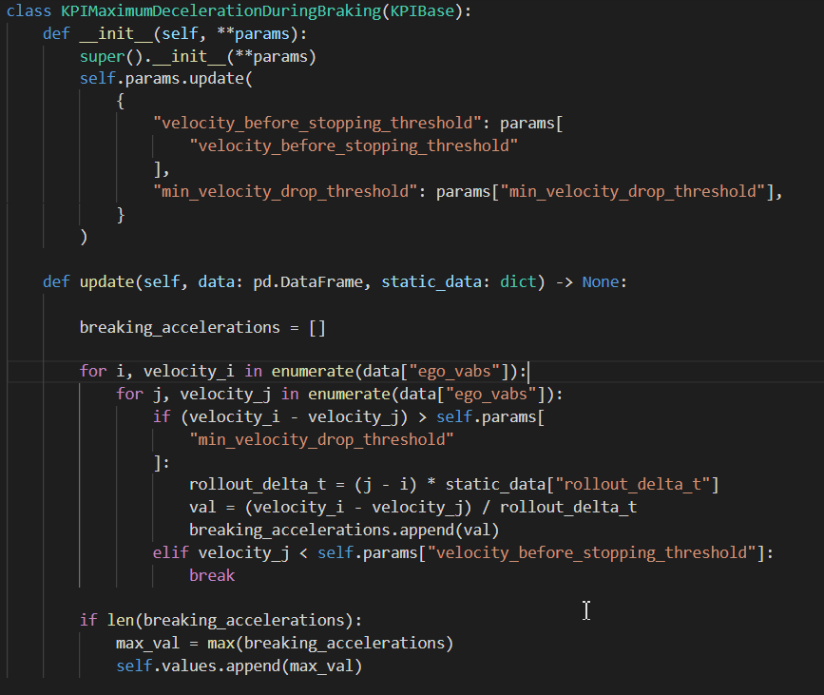
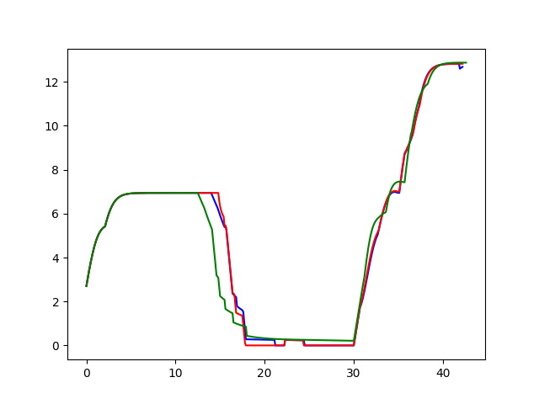
Progress
KPI definition
Maximum deceleration during braking (m/s^2)
Algorithm:
For every timestep i, and pick j
such that v[i] - v[j] > param (e.g. 6 m/s)
For all pairs (i, j), calculate average acceleration
and pick the maximum value.
Baseline
Limited visibility
Full IDM
Velocity of IDM models

Slide 4
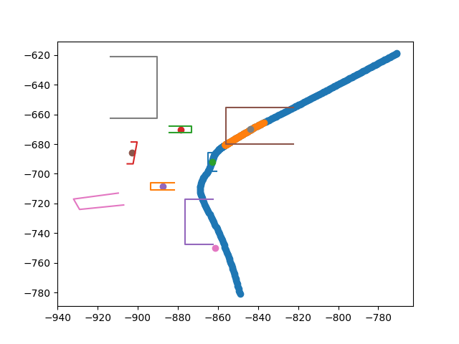
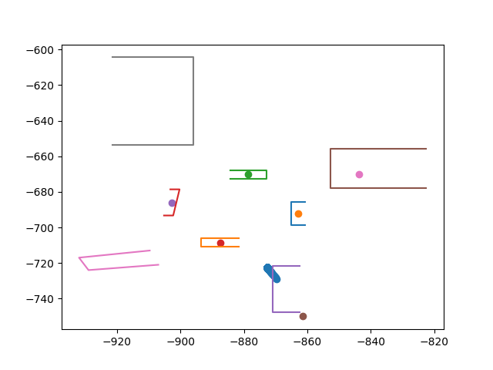
Progress
Refined trigger zones & Full-Idm model.
Success ratio of full-idm model was lower than baseline and limited visibility idm.
On analysis refined trigger zones to move little away from roundabout.
Spawn vehicles only for the active occlusion zones in full-idm.
Previous trigger zones
New trigger zones
Note: Purple and Grey zones

Slide 5
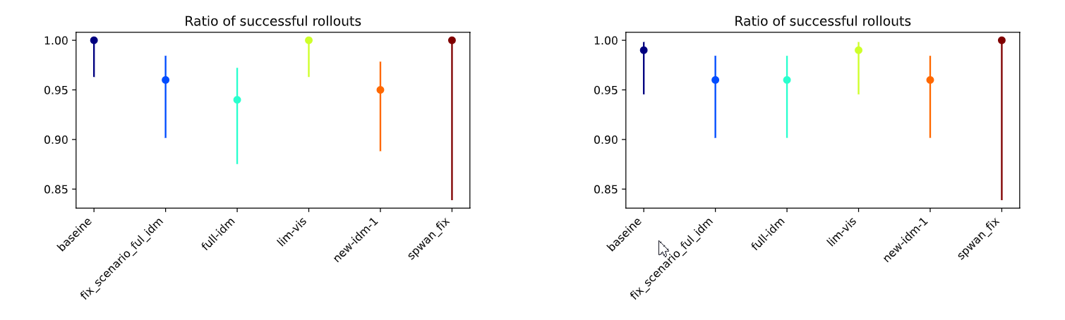
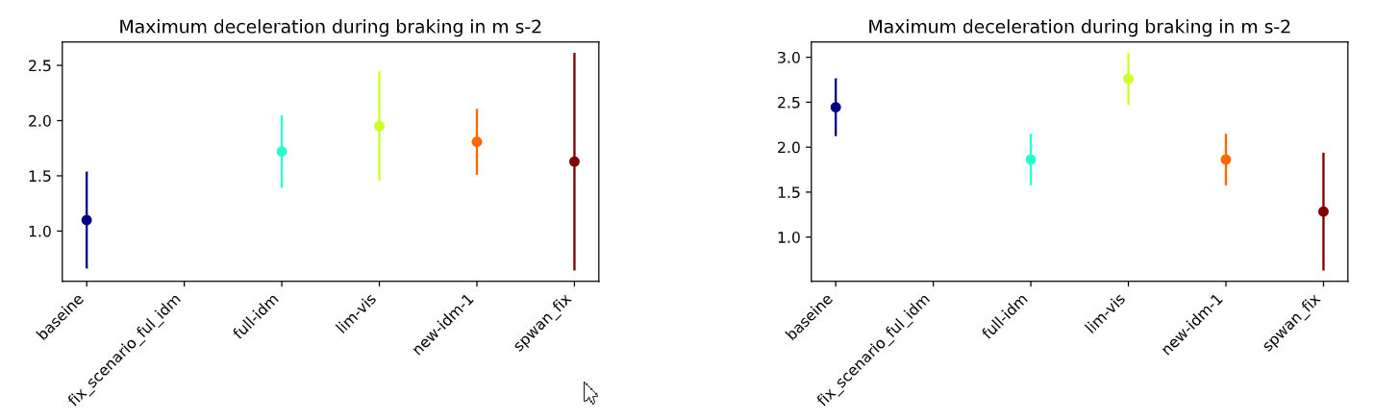
Observations – Problem with previous IDM config
Progress
For empty scenario, the full-idm model stops in the trigger area.
Slightly moved the trigger zone away from roundabout.
Scenario_layeredmap_empty
Scenario_layeredmap_yielding
Note:
full-idm (green) -> faulty trigger zone
new-idm-1 (orange) -> level 1 trigger zone refine
fix_scenario_ful_idm (blue) -> level 2 trigger zone refine
spwan_fix (brown) -> Refined trigger zone + spawn vehicles

Slide 6
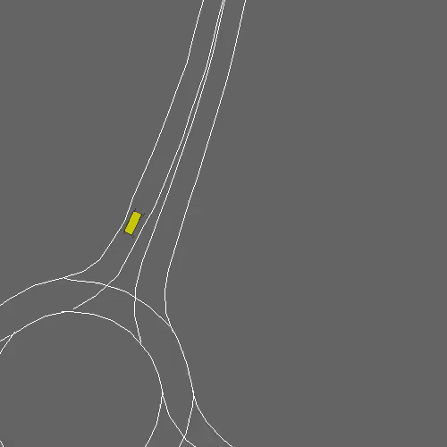
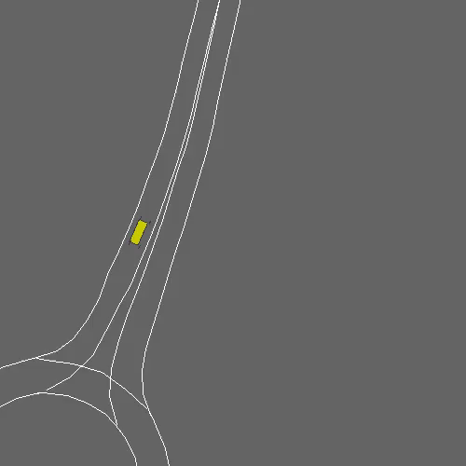
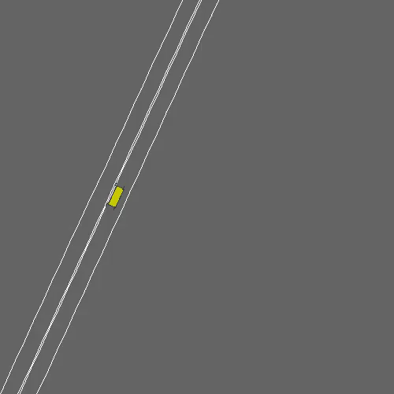
Observations – IDM_scenario_empty
Progress
For empty scenario, the full-idm model outside in the trigger area.
Resolved by making spawn vehicles only in active occlusion zone. (put videos from same map scenario)
full-idm
fix_scenario_ful_idm
spwan_fix
Failed rollout with old IDM config
Failed rollout with refined trigger zone
Success rollout after spawn fix - IDM

Slide 7
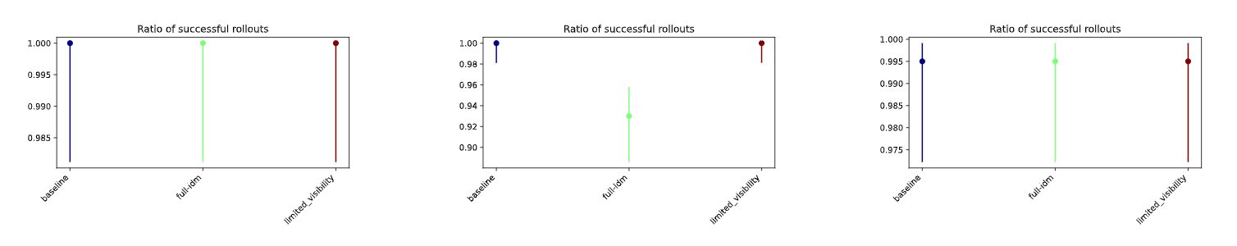
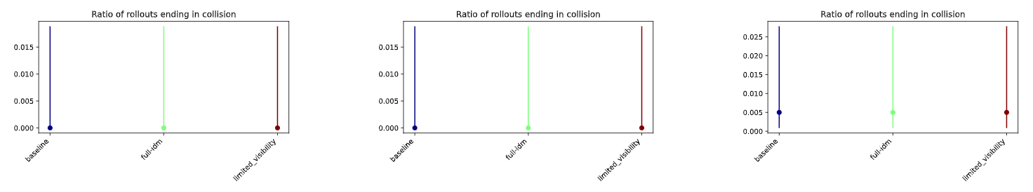
Observations – Ablation Study
Progress
Scenario_layeredmap_empty
Scenario_layeredmap_general
Scenario_layeredmap_yielding
PLAI (bosch.com)

Slide 8
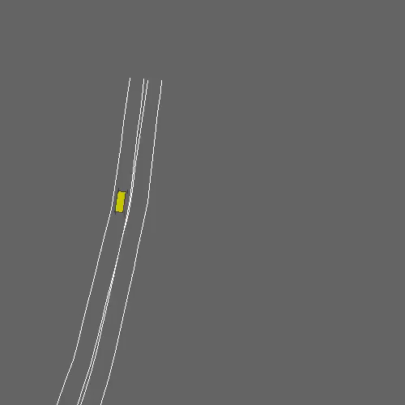
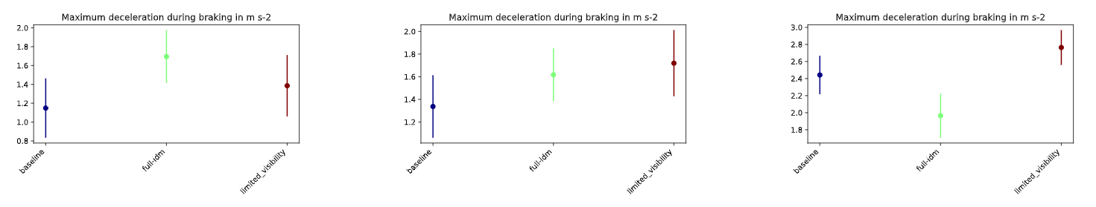
Observations – Ablation Study
Progress
Scenario_layeredmap_yielding
Scenario_layeredmap_empty
Scenario_layeredmap_general
Scenario_layeredmap_yielding
Full-IDM model
PLAI (bosch.com)

Slide 9
Generate new dataset
Progress
Generated two kinds of datasets
Default dataset | Object_filter dataset
features_generator_config -> NoObjectFilter | features_generator_config ->FixedOcclusionZonesObjectFilter

Slide 10
Policy training and evaluation
Progress
Trained the policy (FlexibleCnnBackboneWaypointsDetectionHead)
Config | No_filter policy | Filter policy
Training | Default dataset | Object_filter dataset
Evaluation (Env_config) | NoObjectFilter | FixedOcclusionZonesObjectFilter

Slide 11
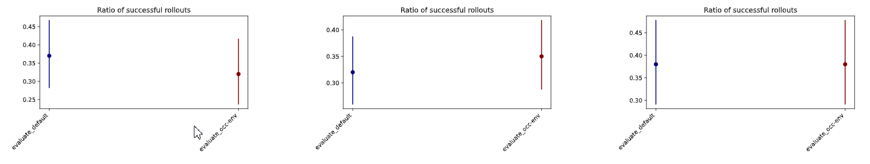
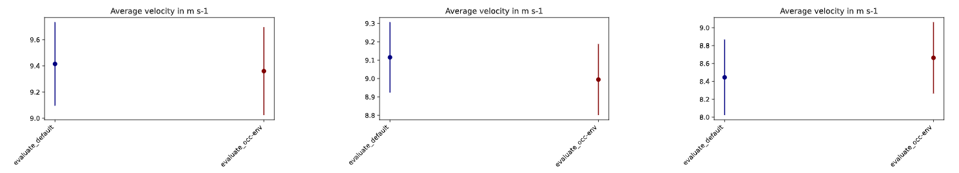
Observations – No_Filter policy evaluation
Progress
Scenario_layeredmap_empty
Scenario_layeredmap_general
Scenario_layeredmap_yielding

Slide 12
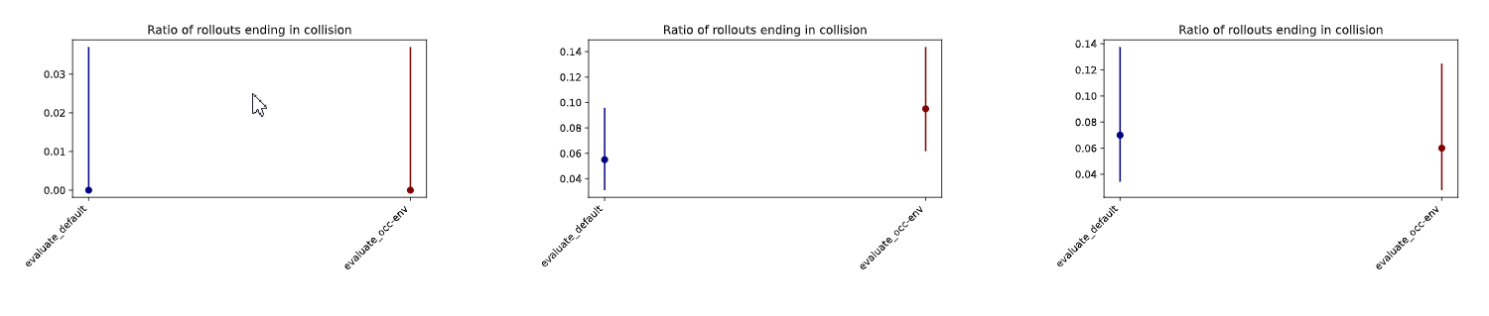
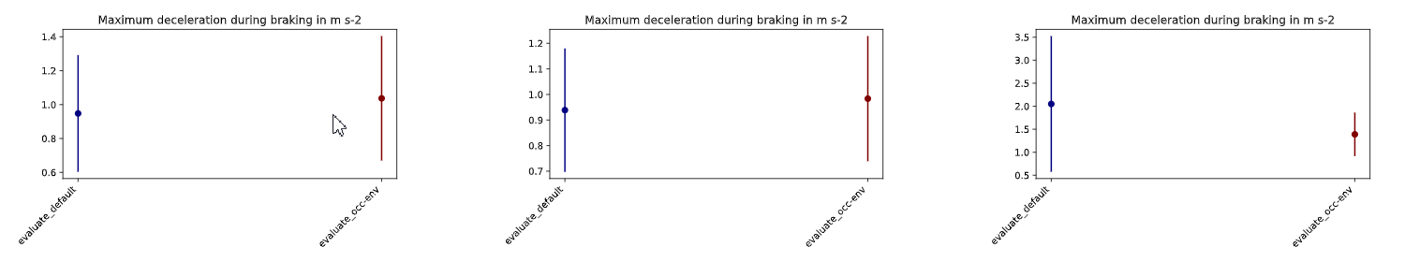
Observations – No_Filter policy evaluation
Progress
Scenario_layeredmap_empty
Scenario_layeredmap_general
Scenario_layeredmap_yielding
PLAI (bosch.com)

Slide 13
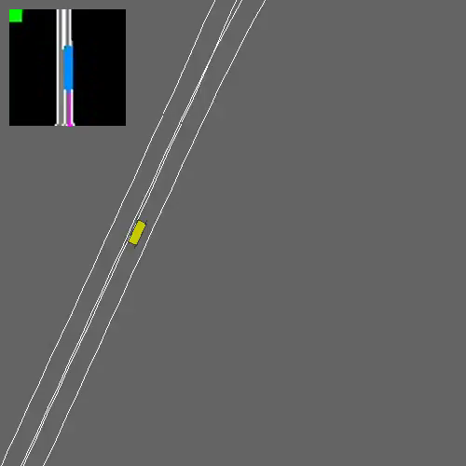
Observations – No_Filter policy evaluation
Progress
Scenario_layeredmap_yielding
Evaluation occlusion env

Slide 14
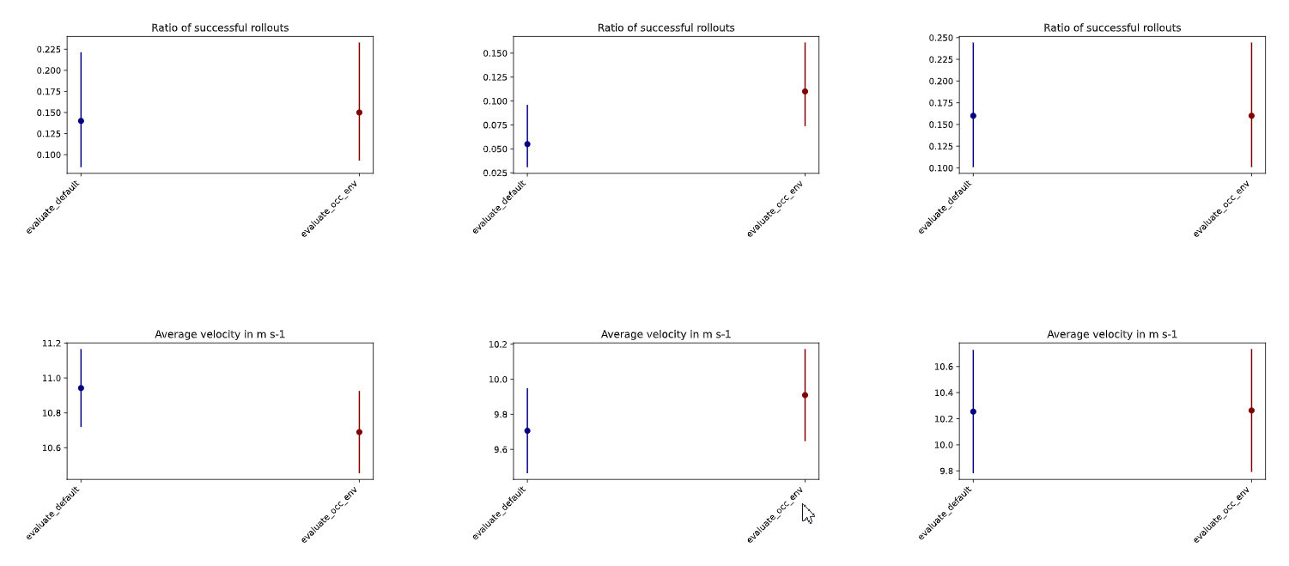

Observations – Filter policy evaluation
Progress
Scenario_layeredmap_empty
Scenario_layeredmap_general
Scenario_layeredmap_yielding
PLAI (bosch.com)

Slide 15
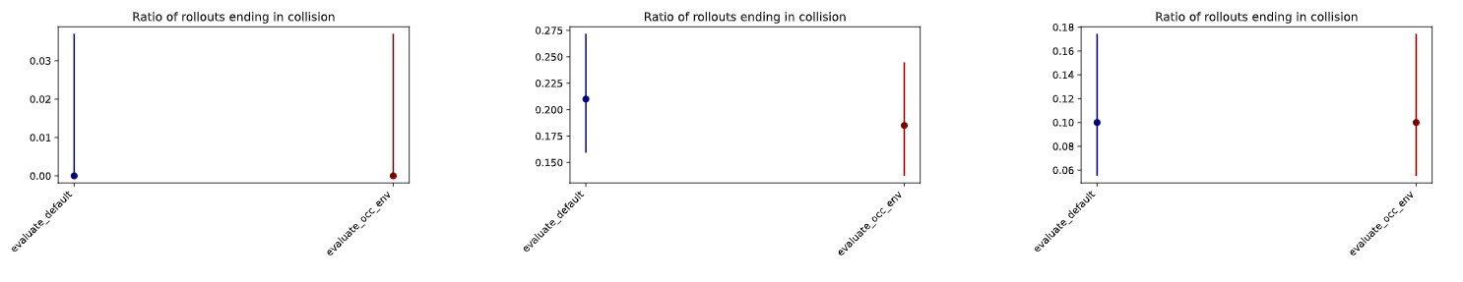
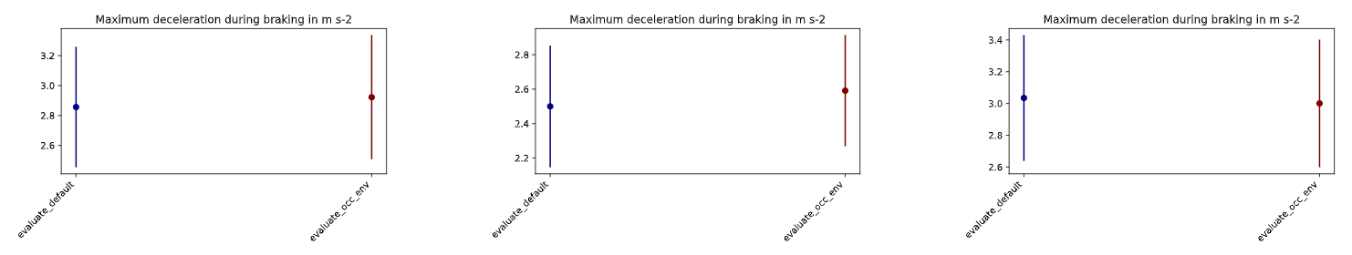
Observations – Filter policy evaluation
Progress
Scenario_layeredmap_empty
Scenario_layeredmap_general
Scenario_layeredmap_yielding
PLAI (bosch.com)

Slide 16
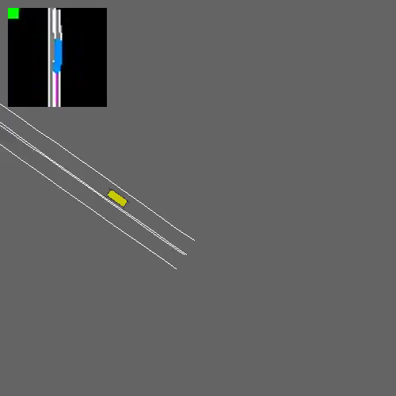
Observations – Filter policy evaluation
Progress
Scenario_layeredmap_yielding
Scenario_layeredmap_yielding
Evaluation default env
Evaluation occlusion env

Slide 17
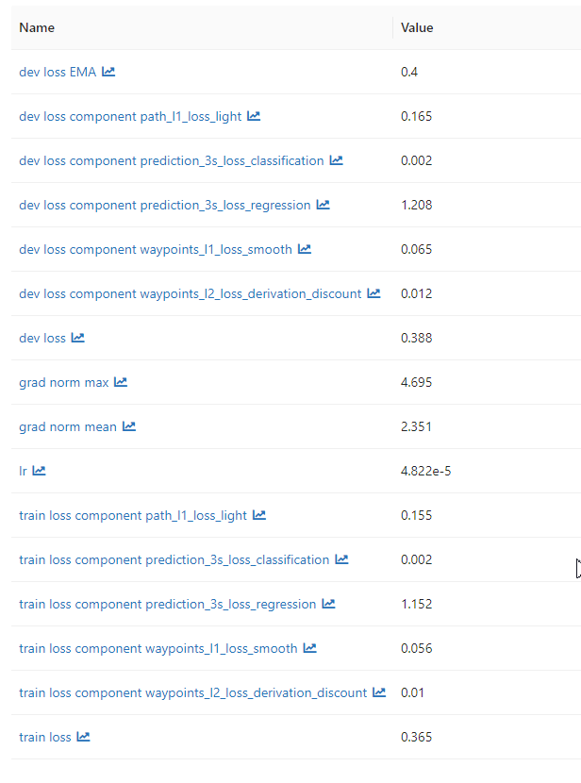
Observations – Metrics – No_Filter policy
Progress

Slide 18
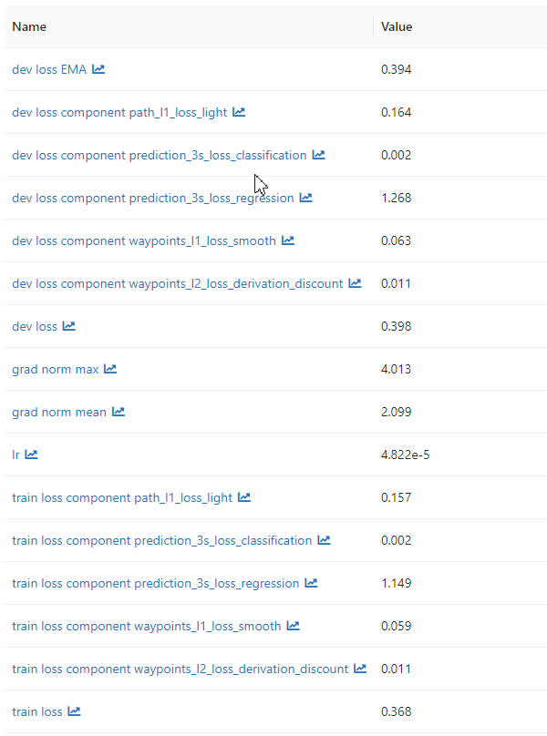
Observations – Metrics – Filter policy
Progress

Slide 19
Next Monthly Forecast Plan
Further Steps
Added visibility layer to the grid data
Include object filter as an additional layer in the grid data
Paint the occluded areas as grey
Policy training with visibility layer
Hyperparameter optimization
Ablation Study of Policy model
two datsets: fixed object filter and no object filter
two policy models: with and without visibility layer
Enhance policy model if required

