Slide 1
ConvNext Model EvaluationS 6/5

Slide 2
Information
Policy model used = ConvNext_base, features 1
BaseRoll_filterData
Rollouts from default IDM, dataset with object filter config
BaseRoll_filterVisData
Rollouts from default IDM, dataset with object filter and visibility layer
extendedRoll_filterData
Rollouts from new IDM model, dataset with object filter config
extendedRoll_filterVisData
Rollouts from new IDM model, dataset with object filter and visibility layer

Slide 3
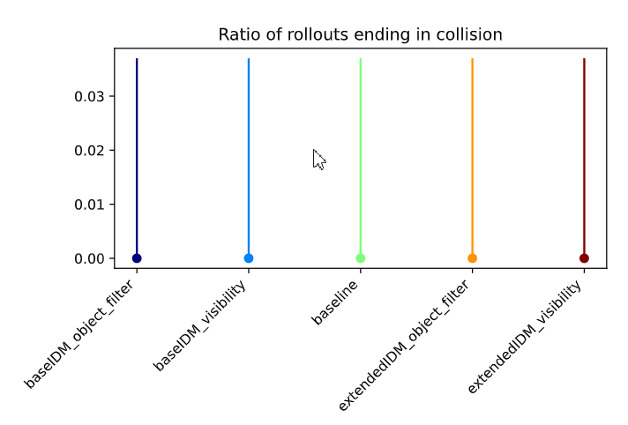
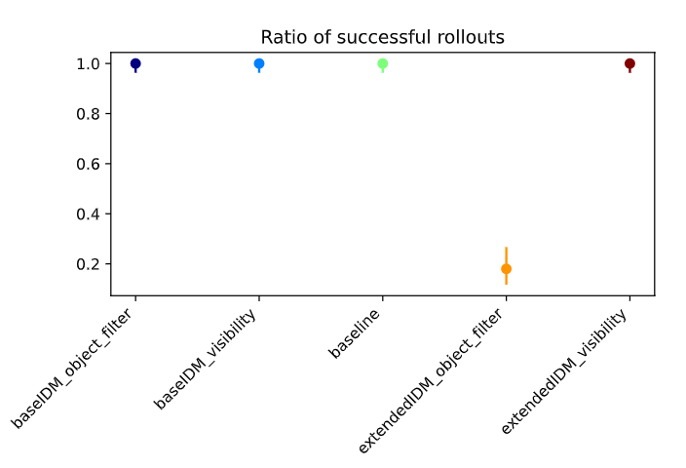
Empty
Policy models in default env

Slide 4
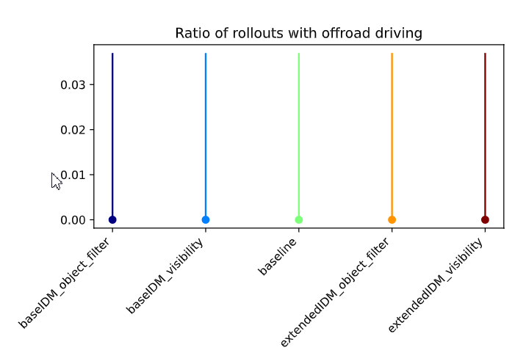
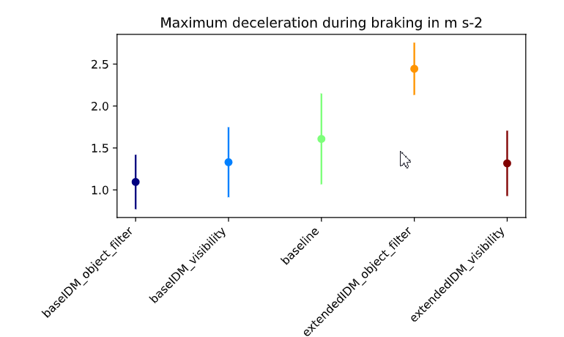
Empty
Policy models in default env

Slide 5
Default
Policy models in default env
baseIDM_object_filter
All success (ref 23)
baseIDM_visibility
sucesss
Baseline
success
extendedIDM_object_filter
Got stuck
extendedIDM_visibility
success

Slide 6
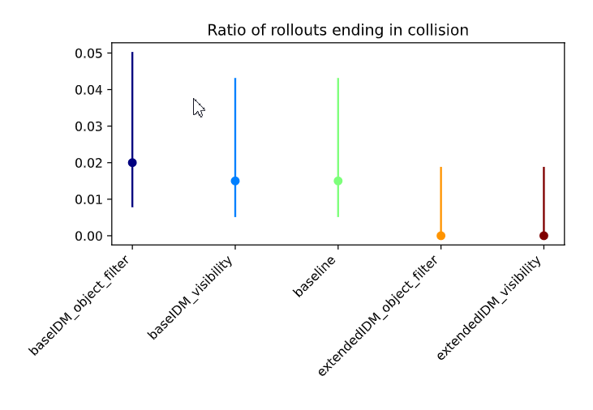
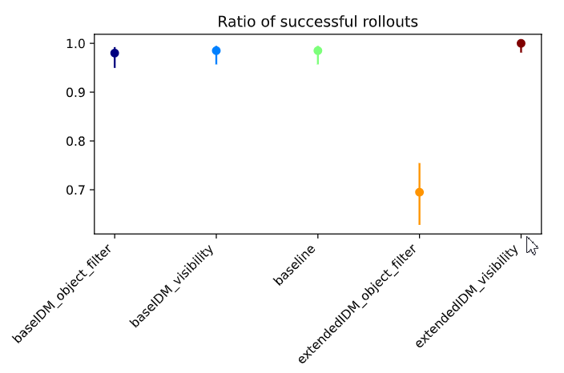
General
Policy models in default env

Slide 7
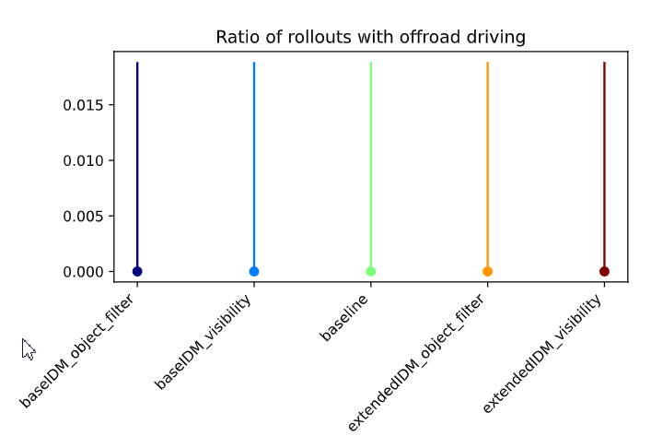
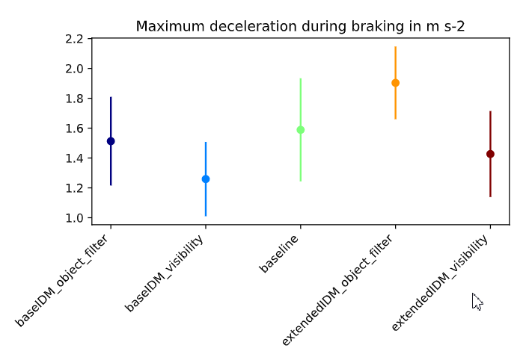
General
Policy models in default env

Slide 8
General
Policy models in default env
baseIDM_object_filter
Yielding preceeding = collides (181, 77)
baseIDM_visibility
Failure = cannot handle traffic after 2nd or 3rd participant (177, 64)
Baseline
Failure case same (129, 151)
extendedIDM_object_filter
Got stuck (117)
extendedIDM_visibility
success

Slide 9
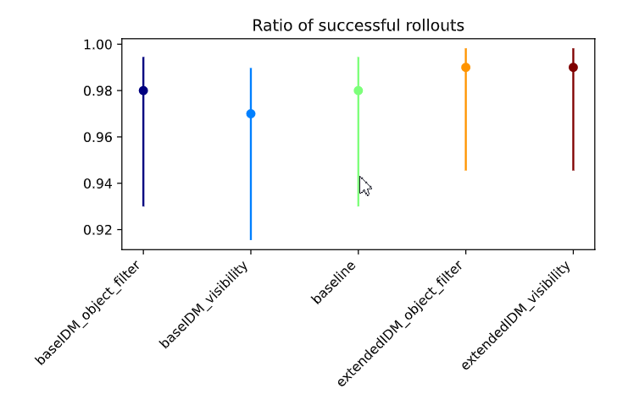
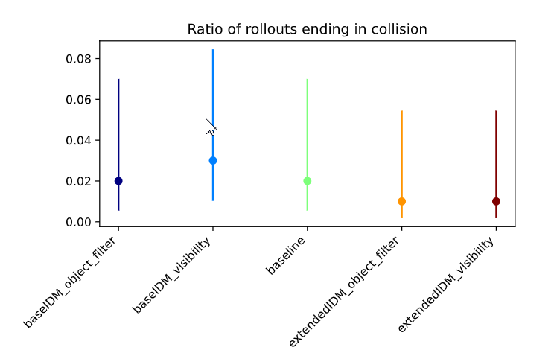
Yielding
Policy models in default env

Slide 10
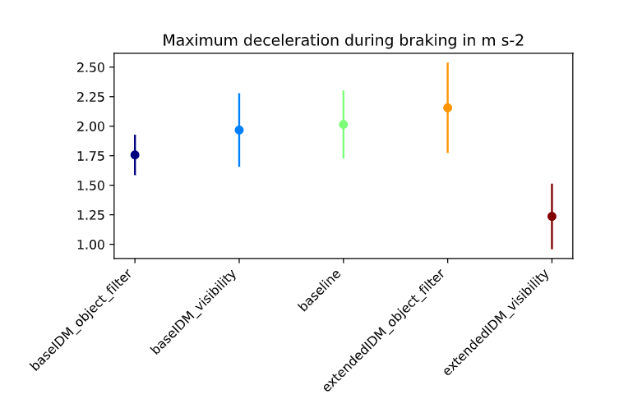
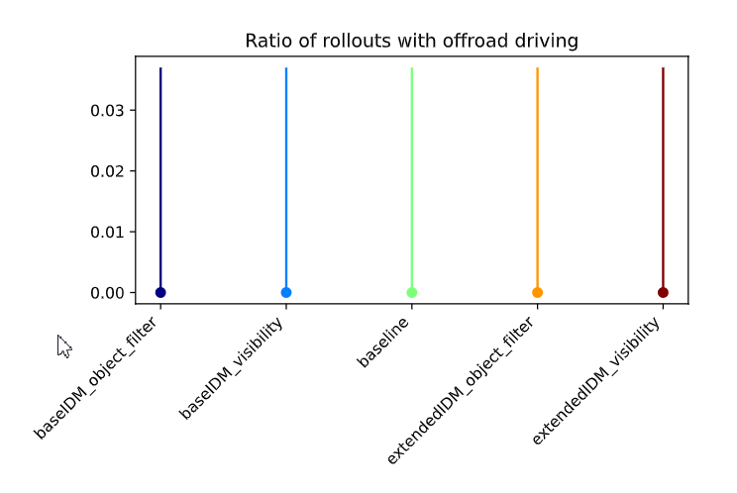
Yielding
Policy models in default env

Slide 11
Yielding
Policy models in default env
baseIDM_object_filter
Collides with 2nd veh (7)
baseIDM_visibility
Collides with last vehicle(11
Baseline
Collides with last vehicle
extendedIDM_object_filter
Time out
extendedIDM_visibility
Time out

Slide 12
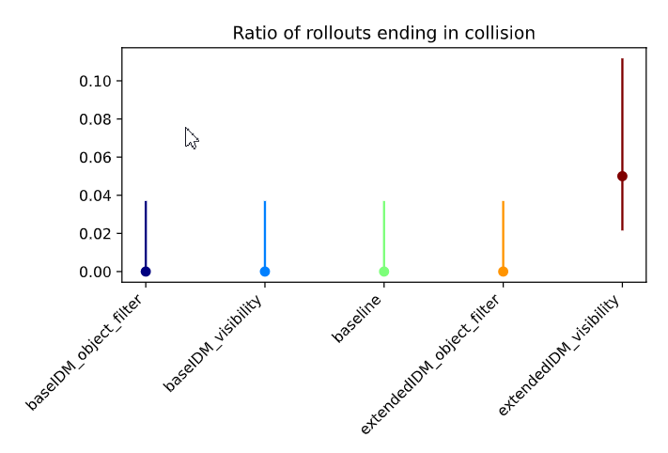
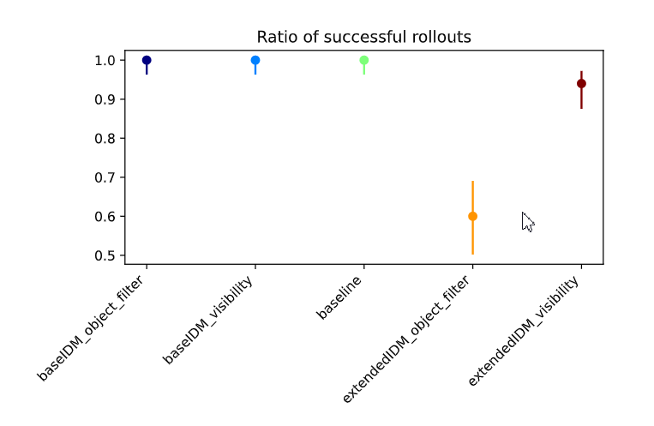
Yielding Preceeding
Policy models in default env

Slide 13
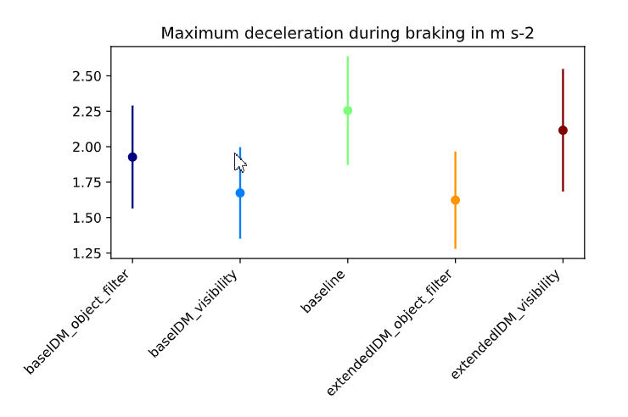
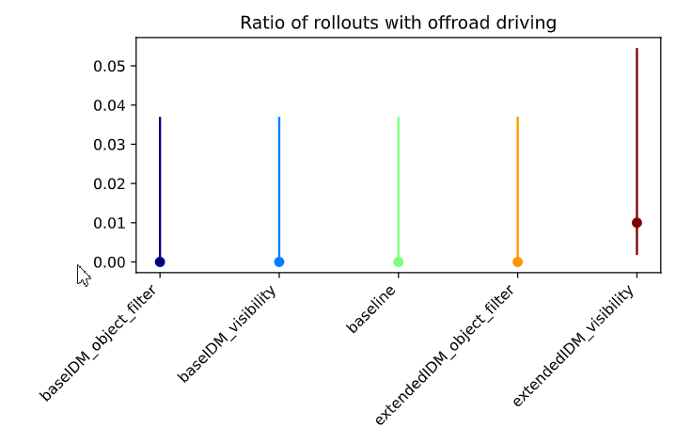
Yielding Preceeding
Policy models in default env

Slide 14
ConvNext Policy In Occlusion Env

Slide 15
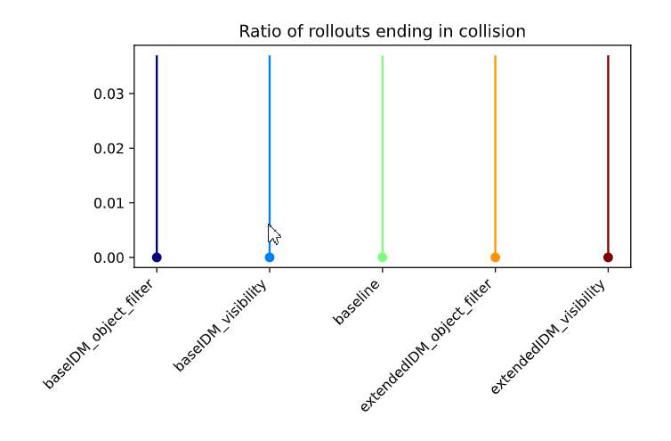
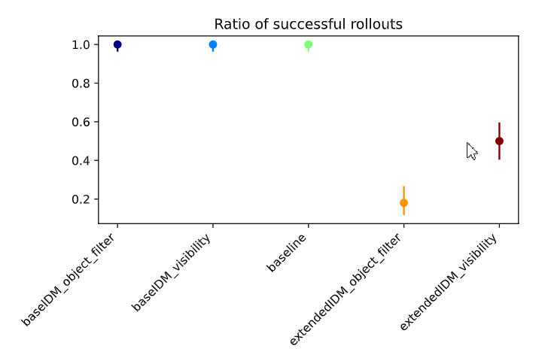
Empty
Policy models in Occlusion Env

Slide 16
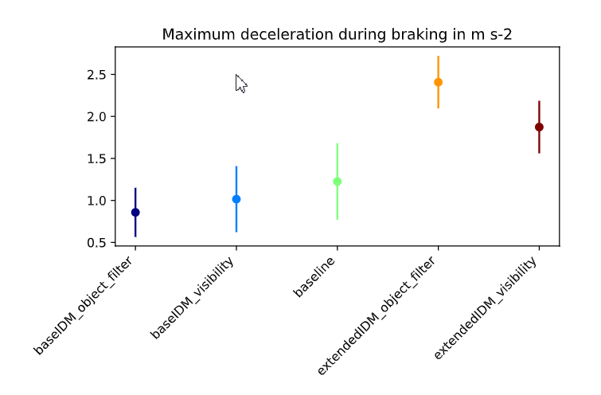
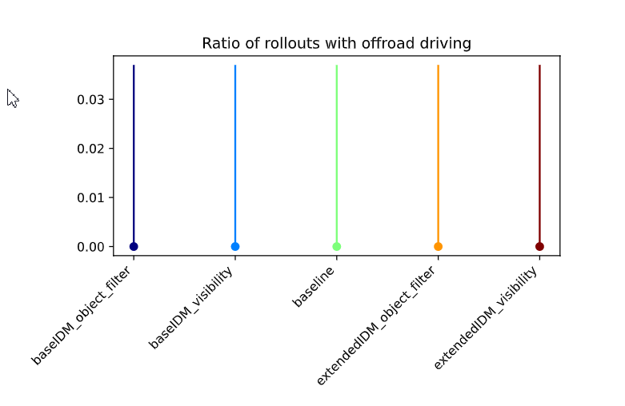
Empty
Policy models in Occlusion Env

Slide 17
Empty
Policy models in Occ env
baseIDM_object_filter
success
baseIDM_visibility
success
Baseline
success
extendedIDM_object_filter
stuck
extendedIDM_visibility
stuck

Slide 18
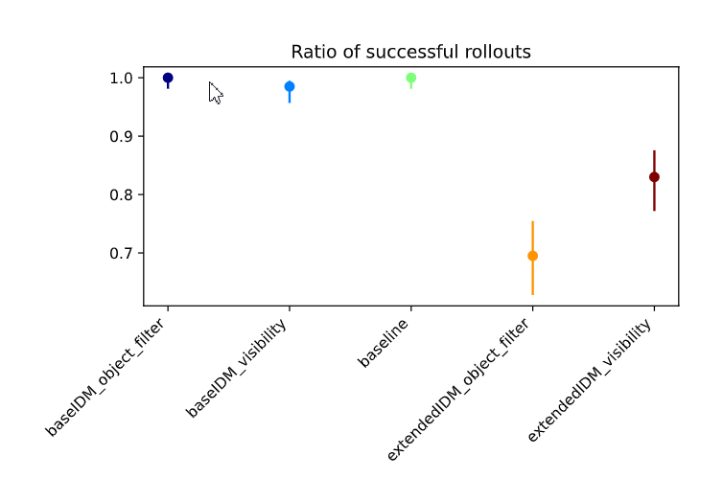
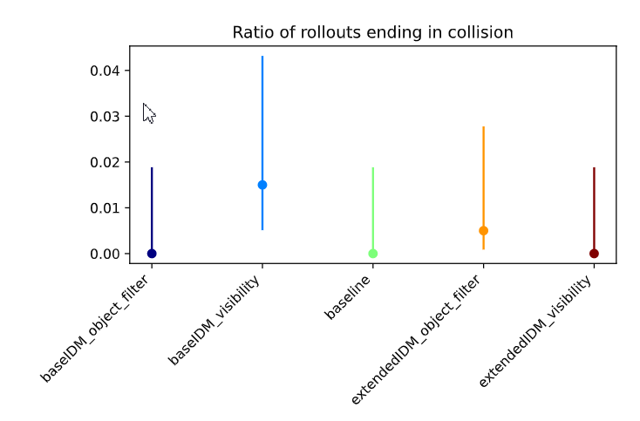
General
Policy models in Occlusion Env

Slide 19
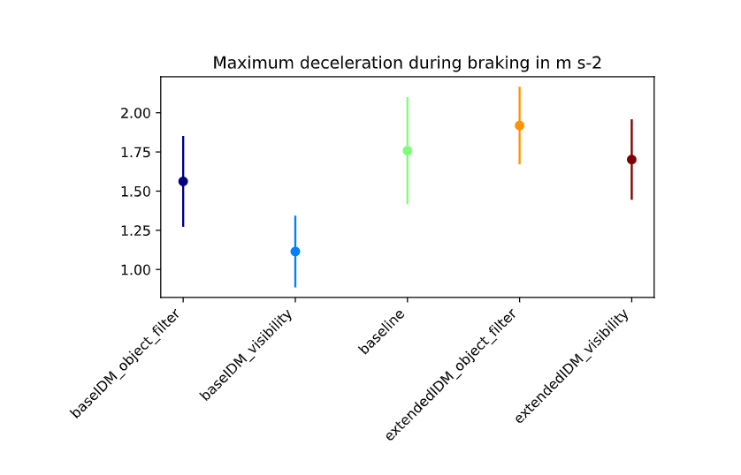
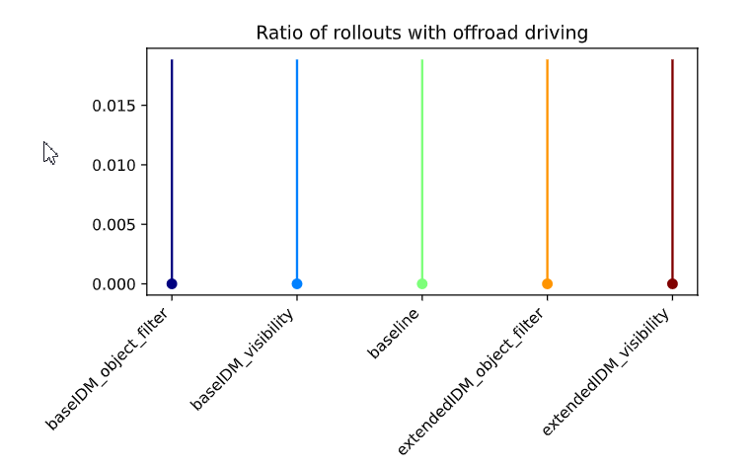
General
Policy models in Occlusion Env

Slide 20
General
Policy models in Occ env
baseIDM_object_filter
success
baseIDM_visibility
Collides with last traffic and other lane traffic (106, 197)
Baseline
success
extendedIDM_object_filter
Stuck (131, 150)
extendedIDM_visibility
Stuck in trigger zone

Slide 21
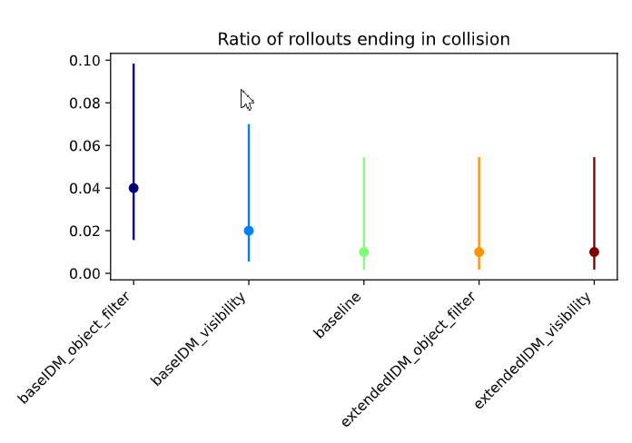
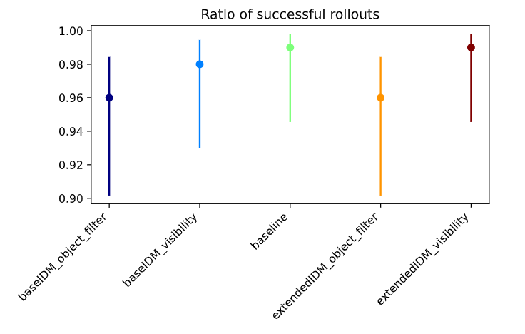
Yielding
Policy models in Occlusion Env

Slide 22
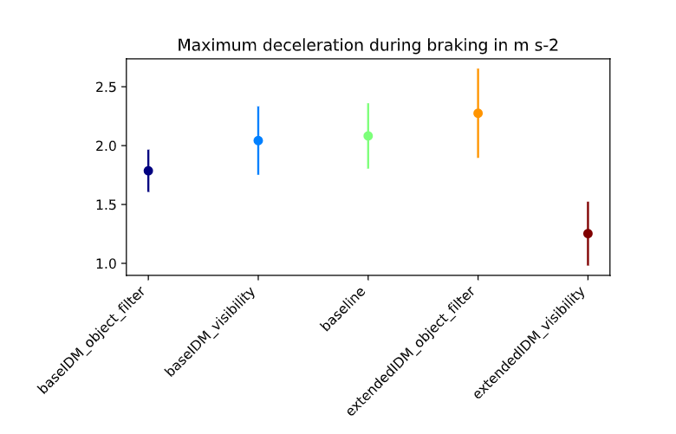
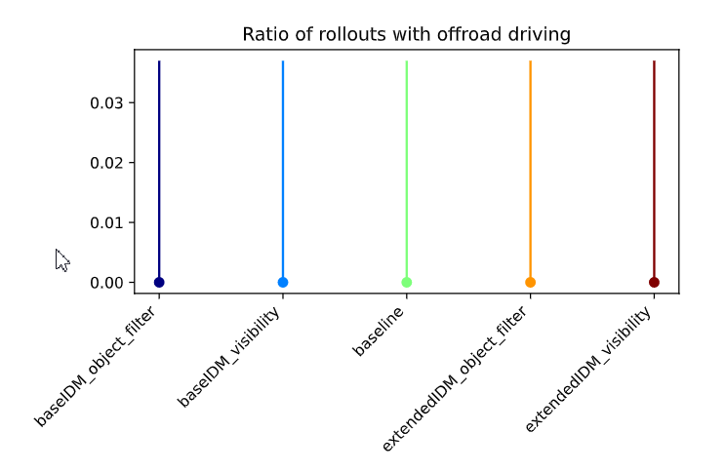
Yielding
Policy models in Occlusion Env

Slide 23
Yielding
Policy models in Occ env
baseIDM_object_filter
Collides with traffic
baseIDM_visibility
Collides with traffic
Baseline
success
extendedIDM_object_filter
Stuck in trigger zone
extendedIDM_visibility
success

Slide 24
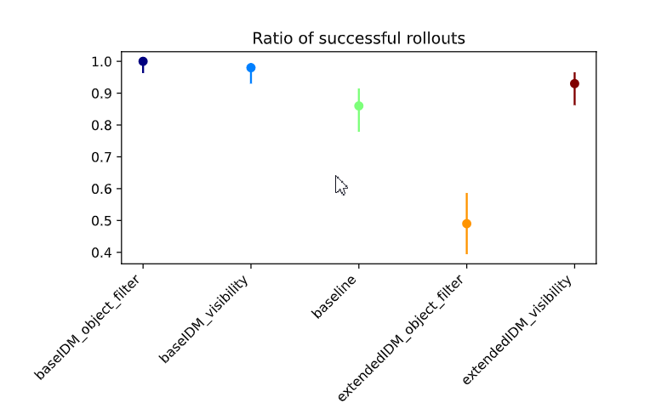
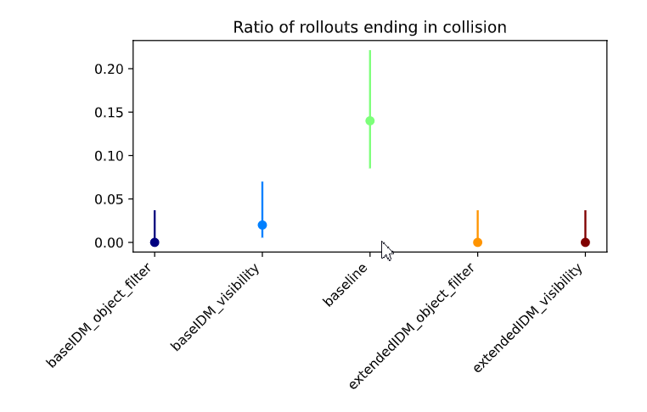
Yielding Preceeding
Policy models in Occlusion Env

Slide 25
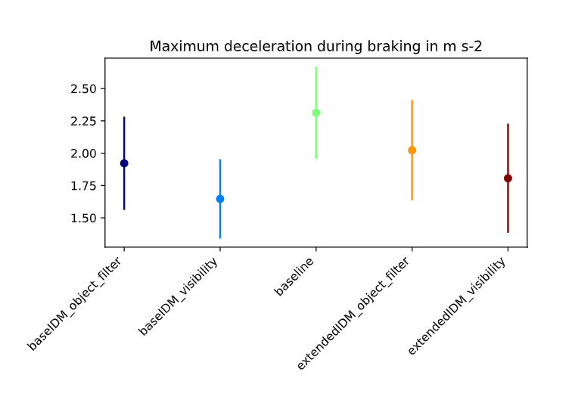
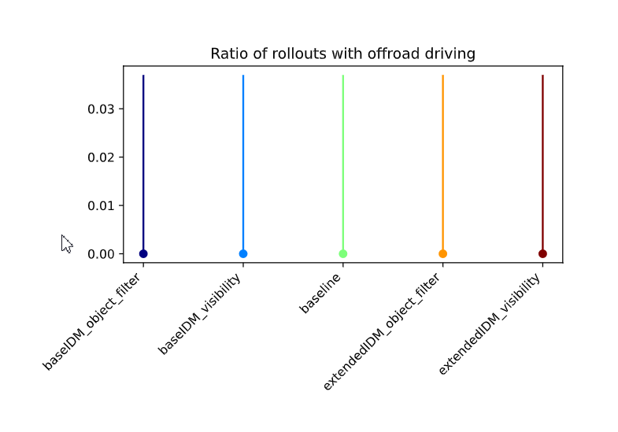
Yielding Preceeding
Policy models in Occlusion Env

Slide 26
Policy model Training Curves

