Slide 1
Efficientnet Model EvaluationS 26/4

Slide 2
Information
Policy model used = EfficientNet_b2, features 2
BaseRoll_filterData
Rollouts from default IDM, dataset with object filter config
BaseRoll_filterVisData
Rollouts from default IDM, dataset with object filter and visibility layer
extendedRoll_filterData
Rollouts from new IDM model, dataset with object filter config
extendedRoll_filterVisData
Rollouts from new IDM model, dataset with object filter and visibility layer

Slide 3
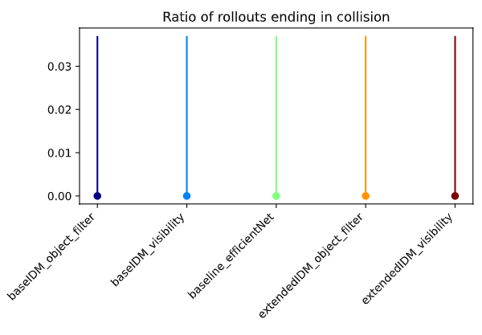
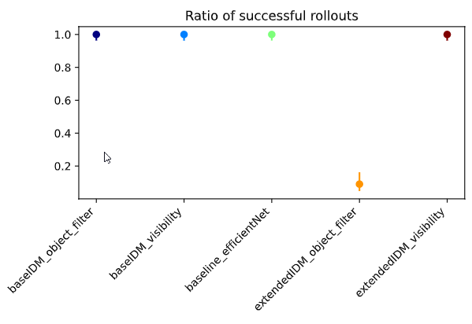
Empty
Policy models in default env

Slide 4
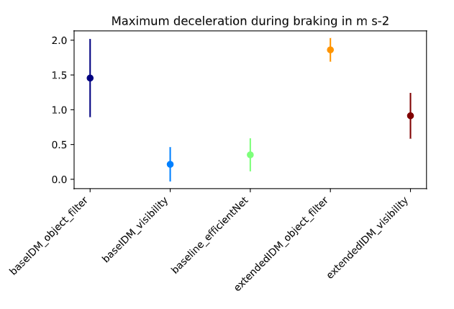
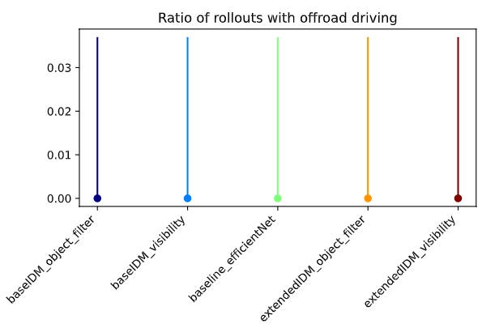
Empty
Policy models in default env

Slide 5
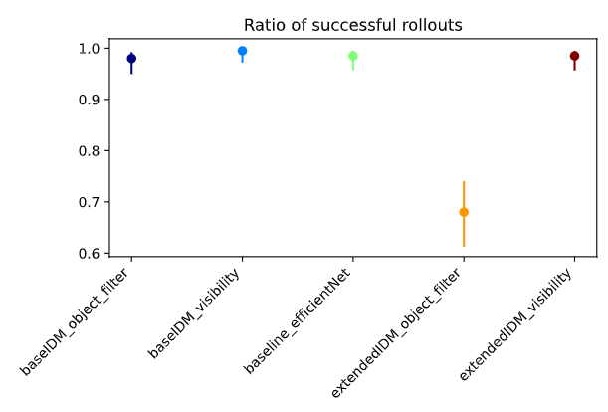
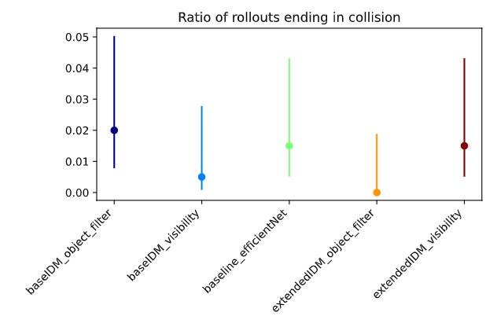
General
Policy models in default env

Slide 6
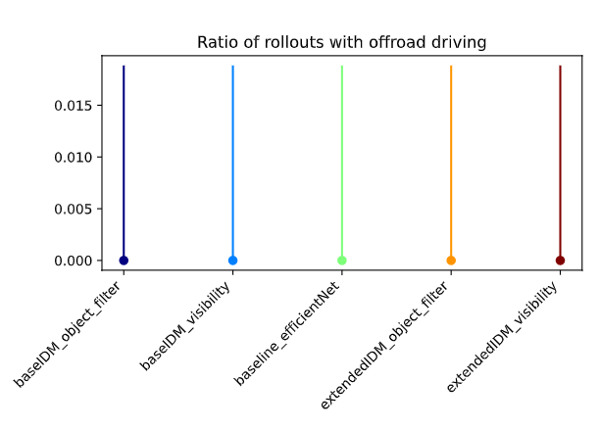
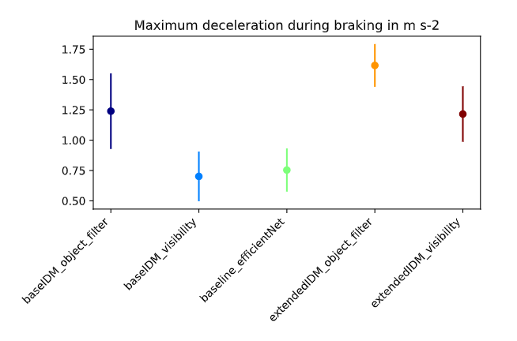
General
Policy models in default env

Slide 7
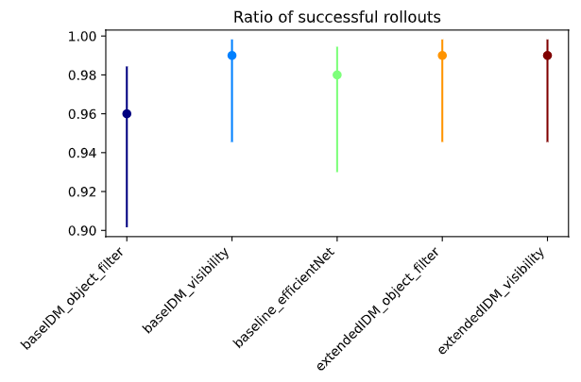
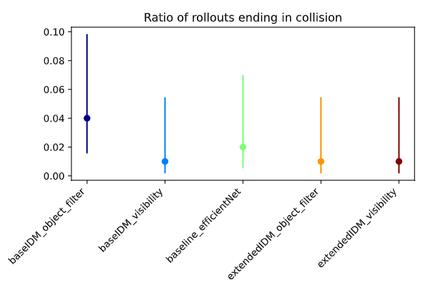
Yielding
Policy models in default env

Slide 8
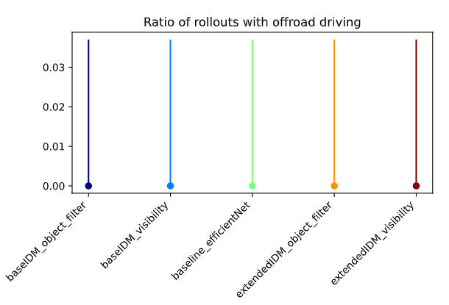
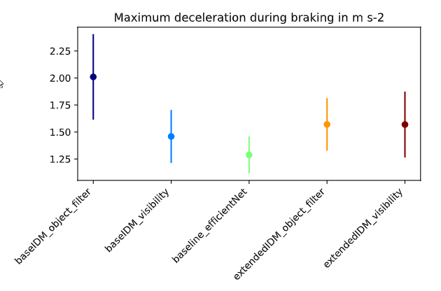
Yielding
Policy models in default env

Slide 9
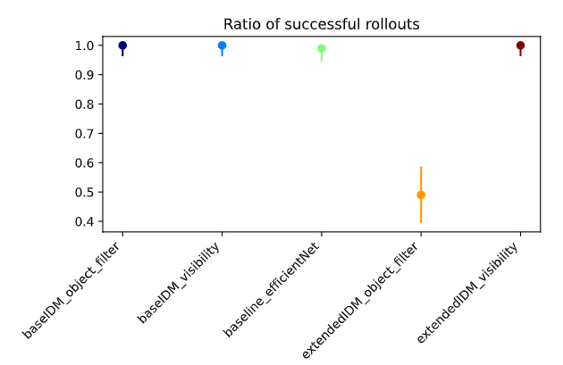
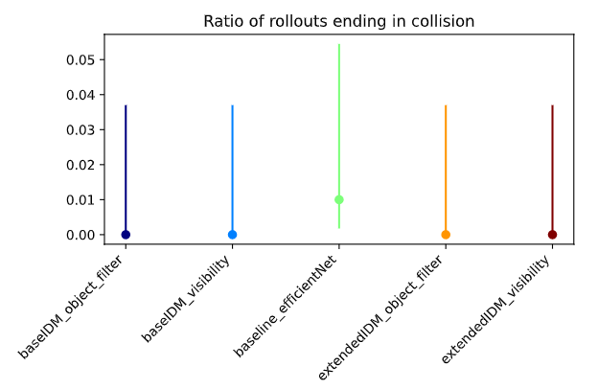
Yielding Preceeding
Policy models in default env

Slide 10
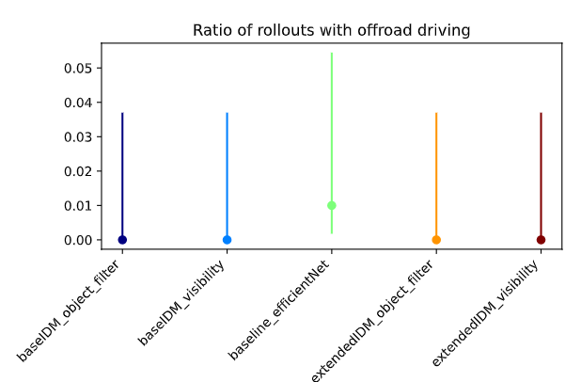
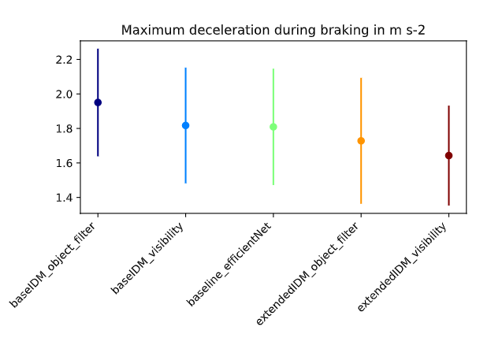
Yielding Preceeding
Policy models in default env

Slide 11
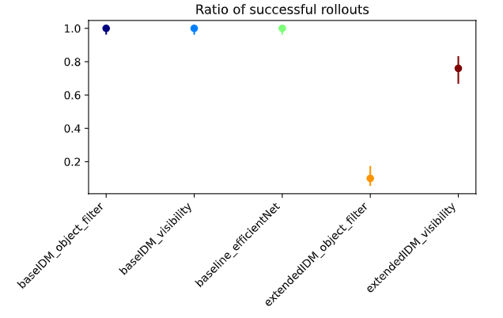
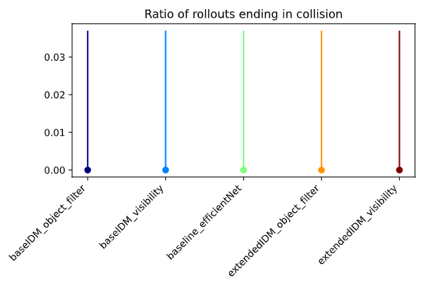
Empty
Policy models in Occlusion Env

Slide 12
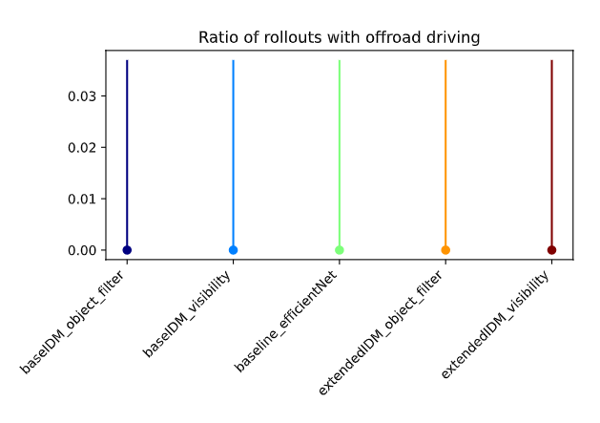
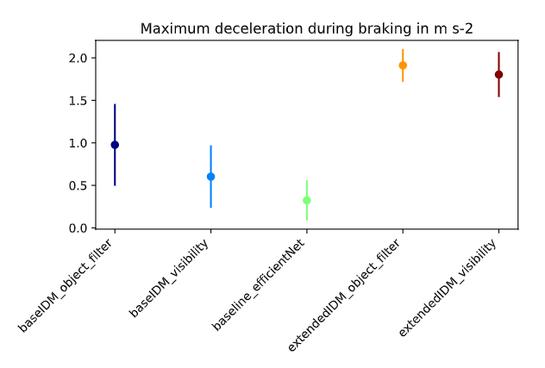
Empty
Policy models in Occlusion Env

Slide 13
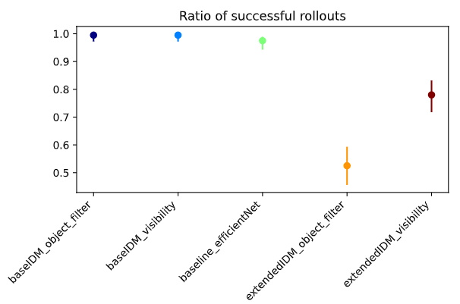
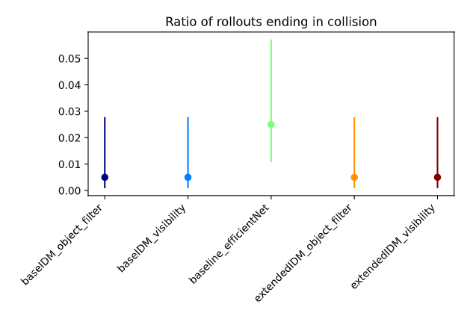
General
Policy models in Occlusion Env

Slide 14
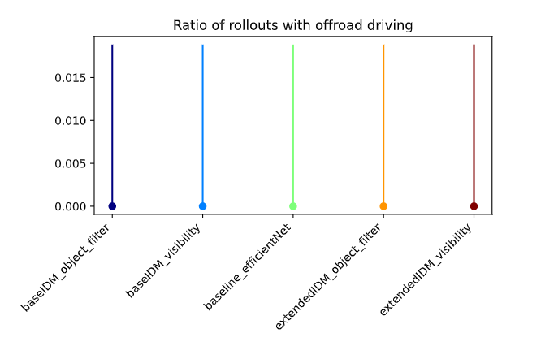
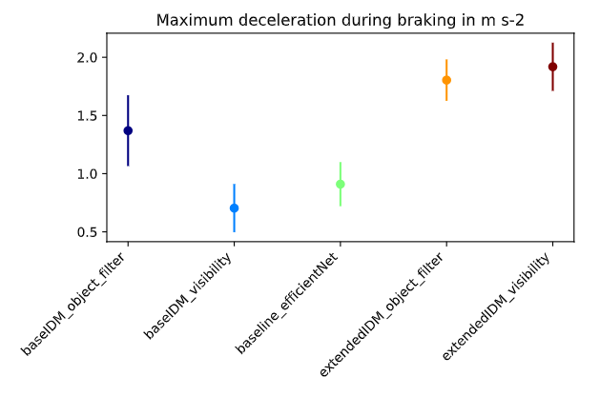
General
Policy models in Occlusion Env

Slide 15
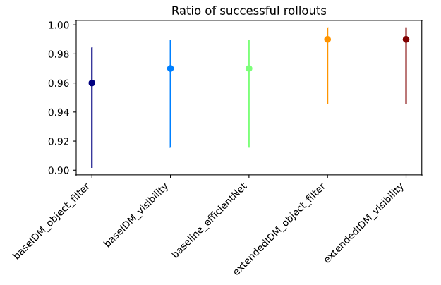
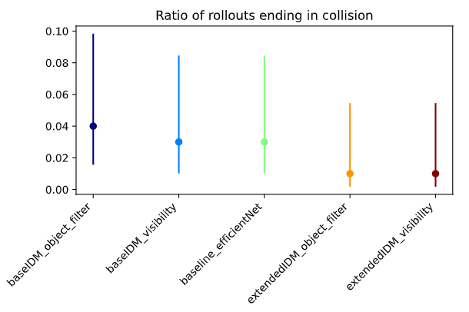
Yielding
Policy models in Occlusion Env

Slide 16
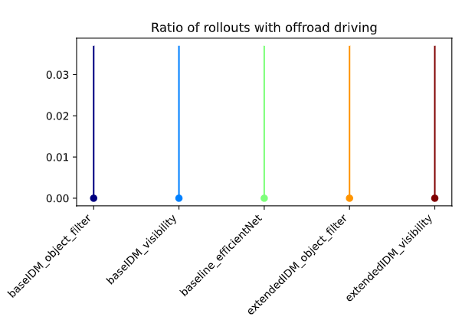
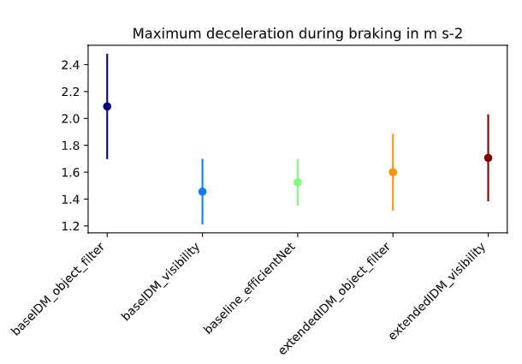
Yielding
Policy models in Occlusion Env

Slide 17
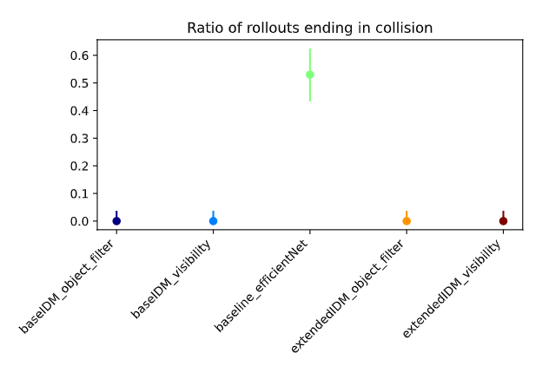
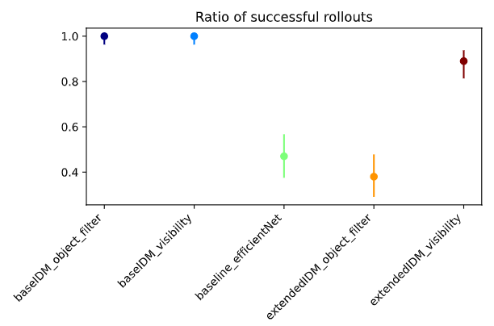
Yielding Preceeding
Policy models in Occlusion Env

Slide 18
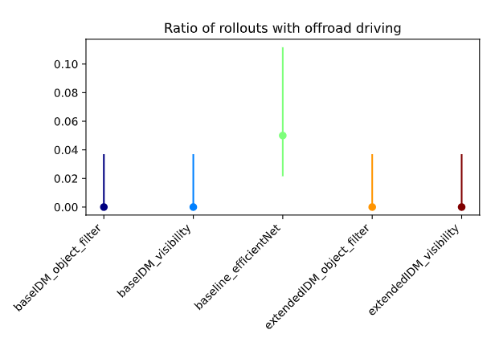
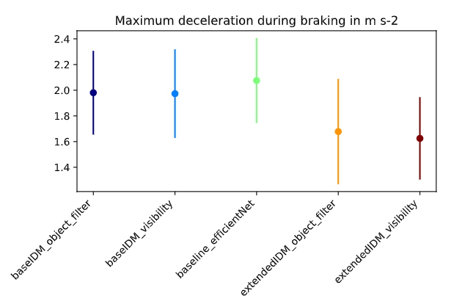
Yielding Preceeding
Policy models in Occlusion Env

