Slide 1
IDM and creepy Idm Ablation Study

Slide 2
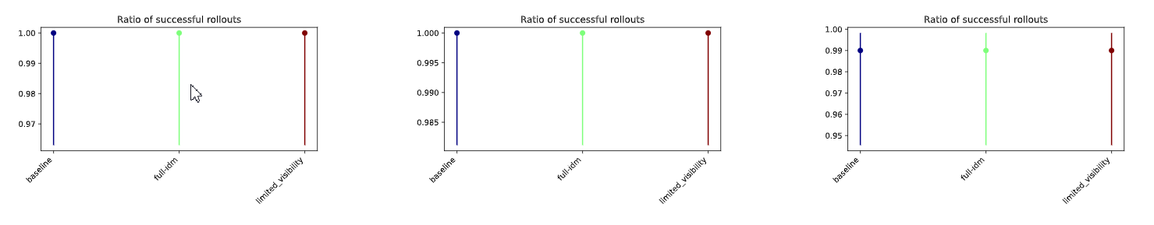
Expert ablation study
Scenario_empty
Scenario_general
Scenario_yielding

Slide 3
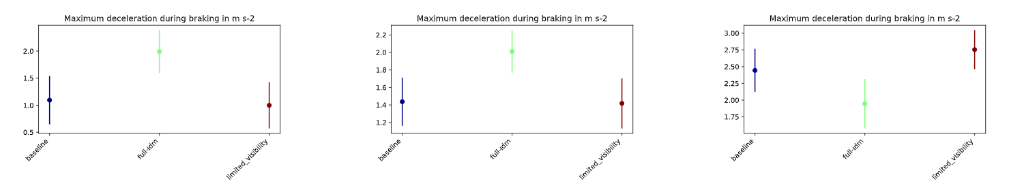
Expert ablation study
Scenario_empty
Scenario_general
Scenario_yielding

Slide 4
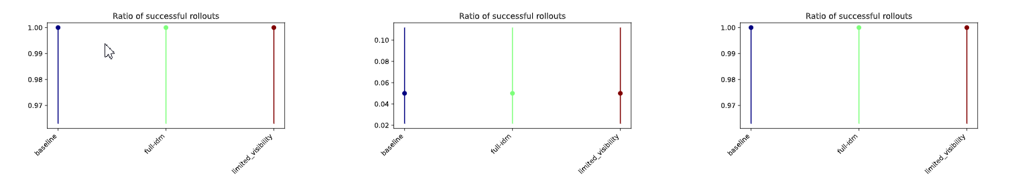
Expert ablation study
Offroad_no_cars
Offroad_with_cars
Offroad_with_cars_ignored_by_idm

Slide 5
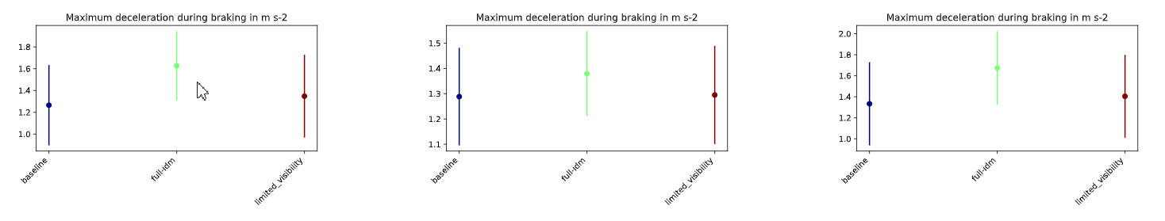
Expert ablation study
Offroad_no_cars
Offroad_with_cars
Offroad_with_cars_ignored_by_idm

Slide 6
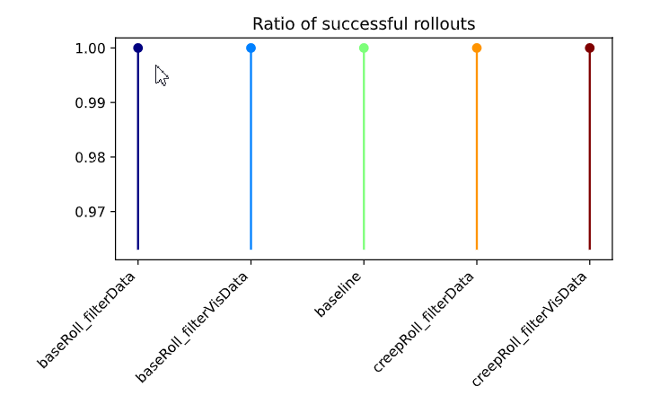
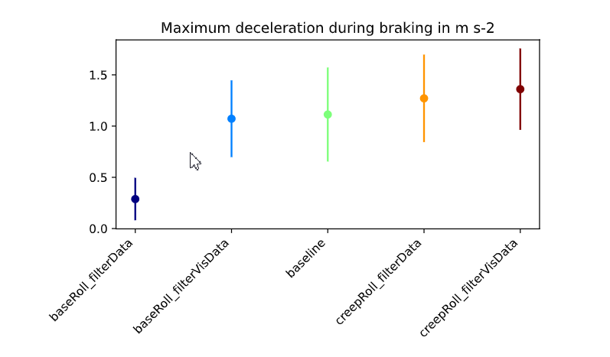
Empty
Policy models in default env
PLAI (bosch.com)

Slide 7
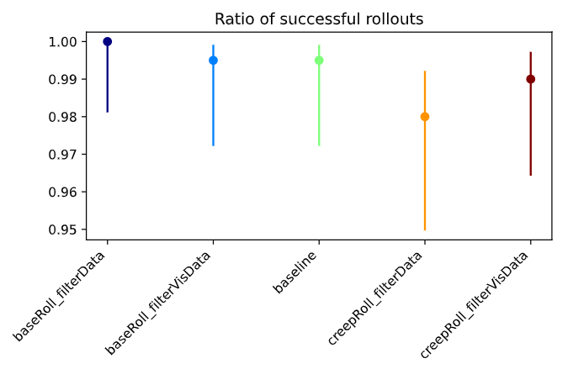
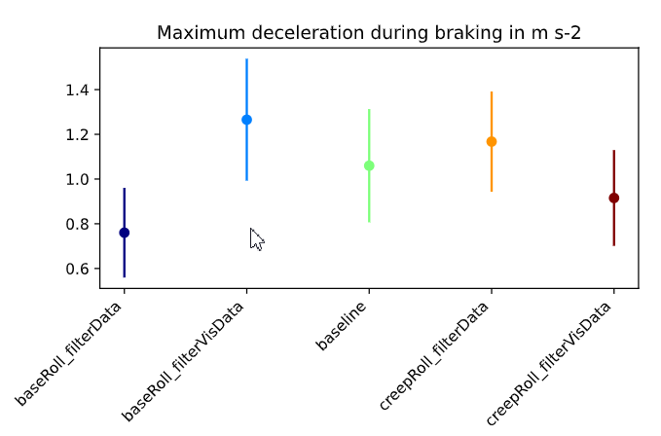
General
Policy models in default env

Slide 8
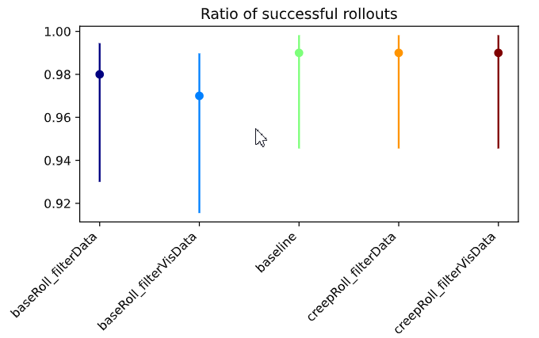
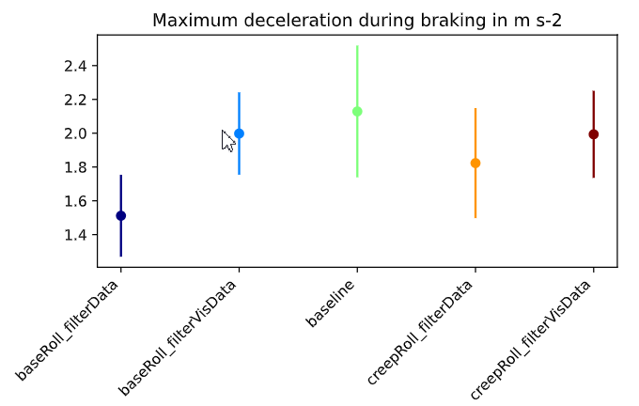
Yielding
Policy models in default env

Slide 9
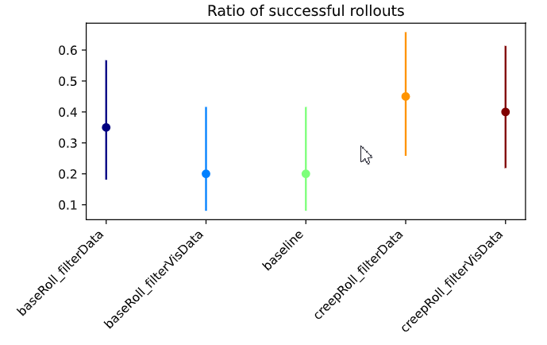
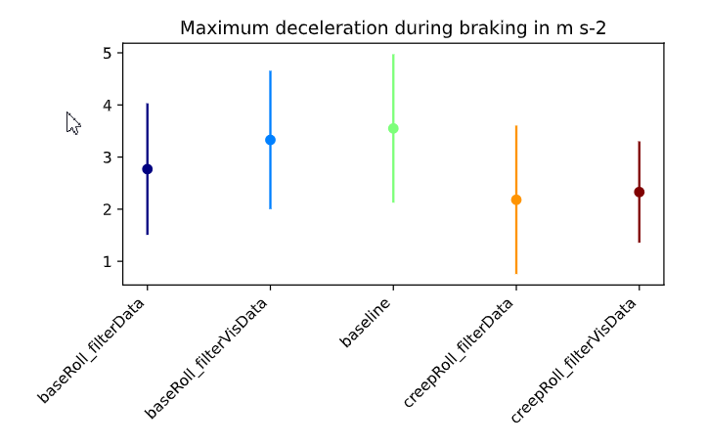
Real Data
Policy models in default env

Slide 10
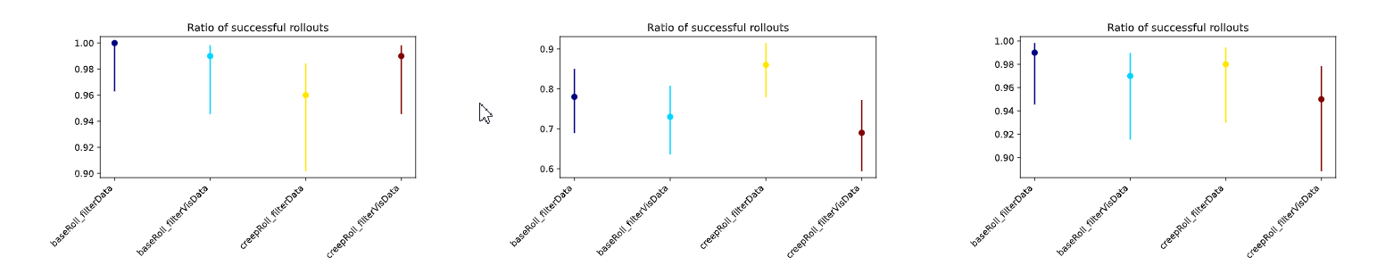
Offroadparked Cars
Policy models in default env

Slide 11
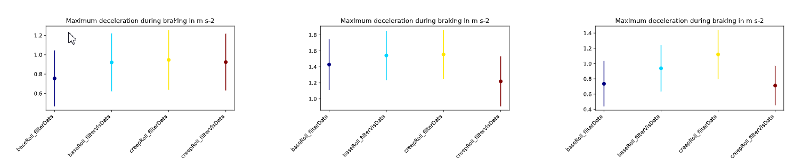
Offroadparked Cars
Policy models in default env

Slide 12
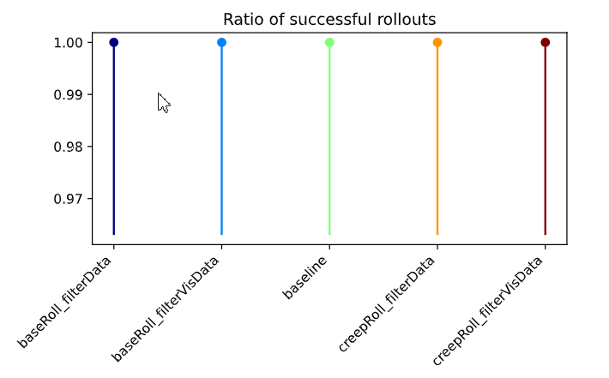
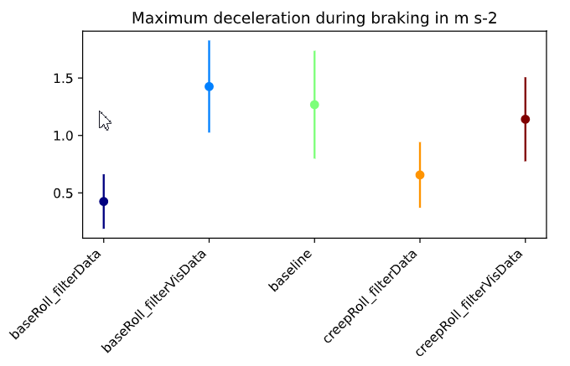
Empty
Policy models in Occlusion Env

Slide 13
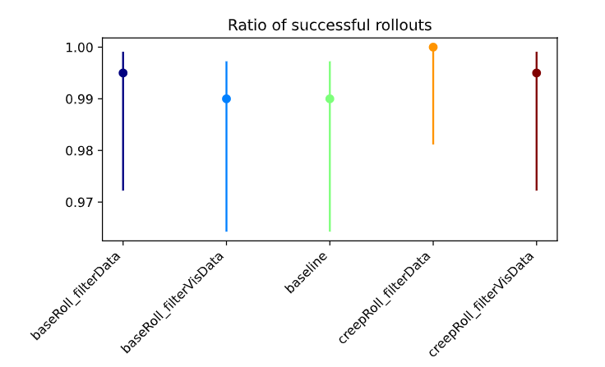
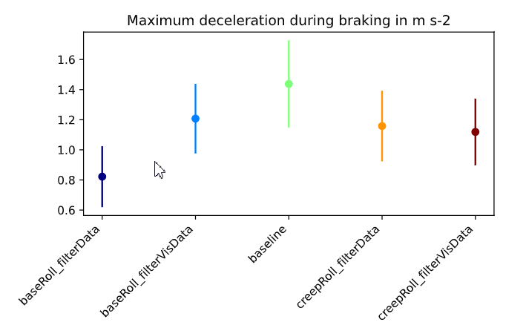
General
Policy models in Occlusion Env

Slide 14
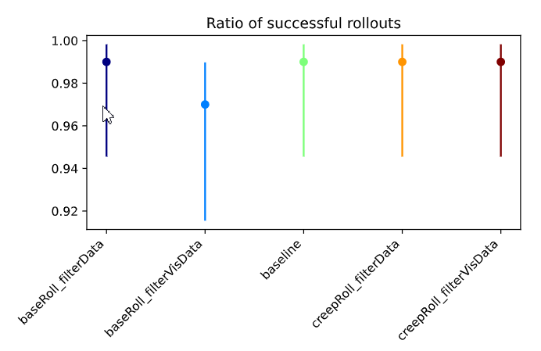
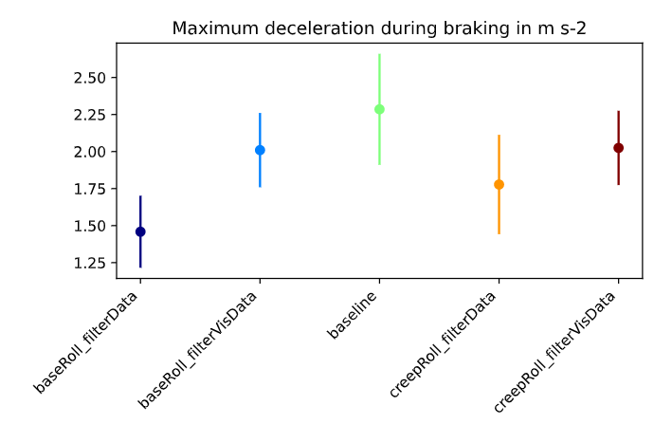
Yielding
Policy models in Occlusion Env

Slide 15
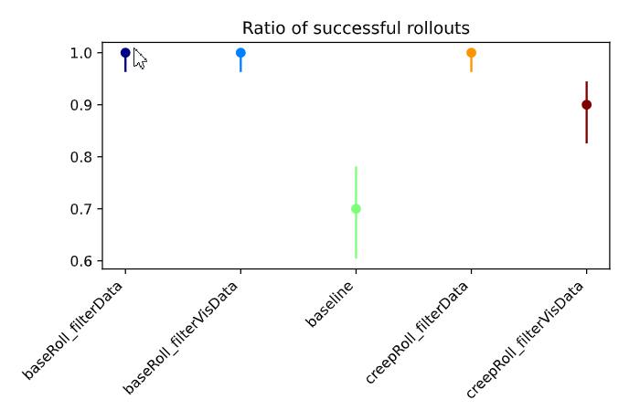
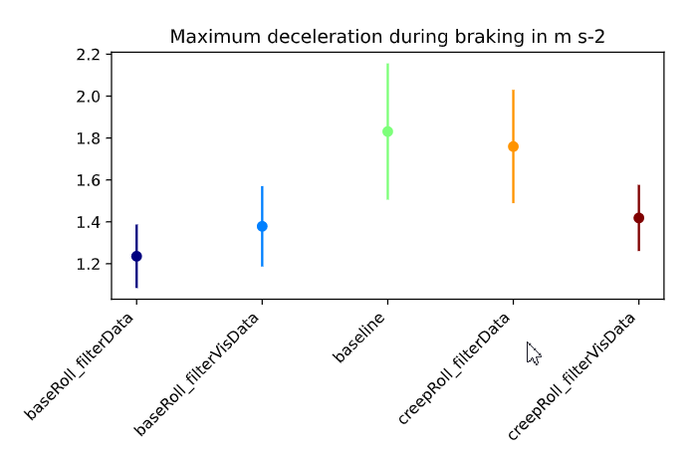
Yielding Preceeding
Policy models in Occlusion Env

Slide 16
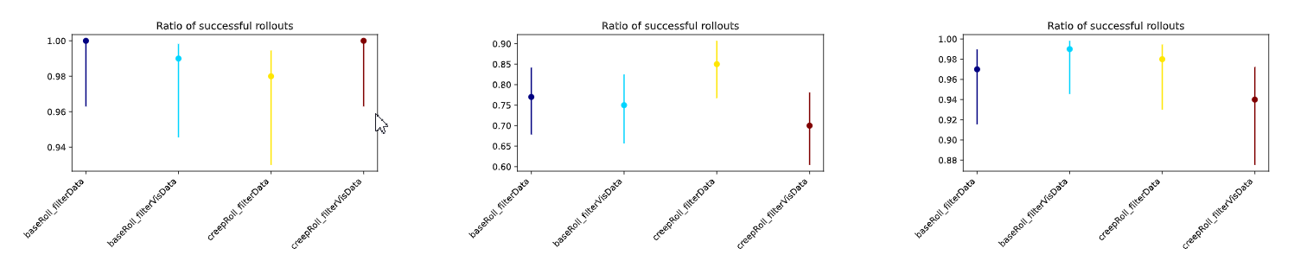
Offroadparkedcars
Policy models in Occlusion Env

Slide 17
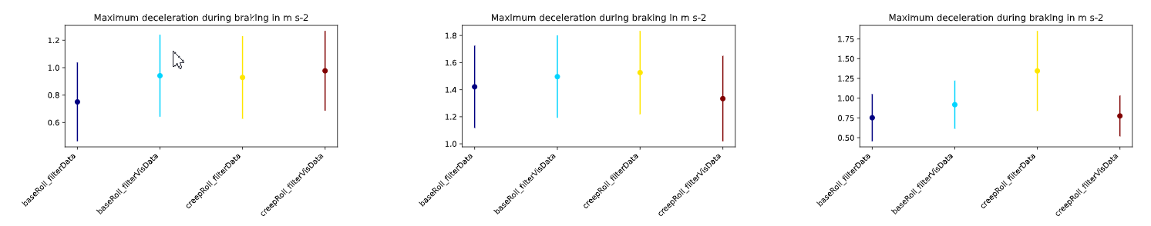
Offroadparkedcars
Policy models in Occlusion Env

