Slide 1

RAJEEV GANDHI MEMORIAL COLLEGE OF ENGINEERING & TECHNOLOGY (AUTONOMOUS) DEPARTMENT OF CSE (DATA SCIENCE)
DOMAIN:
Object Detection in Images and Videos Using OpenCV
- A Comparative Study of Deep Learning and Traditional Computer Vision Techniques
TEAM MEMBERS: UNDER THE GUIDANCE OF:
J. Janardhan – 22091A3248 Dr. K. Rangaswamy
P. Venkata Swathi – 22091A32G7 Associate Professor
Dept of CSE(DS)

Slide 2
ABSTRACT
This project aims to develop a unified object detection system capable of processing both images and videos.
The system integrates state-of-the-art models such as YOLOv8, Faster R-CNN, and SSD to analyze trade-offs between detection accuracy and speed.
A Streamlit-based dashboard offers an intuitive interface for real-time testing and performance evaluation.

Slide 3
OBJECTIVES
Detect and classify multiple objects in images and videos.
Compare deep learning-based models (YOLOv8, Faster R-CNN, SSD).
Build a real-time dashboard using Streamlit and OpenCV.
Evaluate performance using mAP, precision, recall, and FPS metrics.
Analyze trade-offs between detection speed and accuracy.

Slide 4
Literature survey
Title | Author & Year | Algorithms Used | Metrics | Objectives / Findings | Drawbacks
YOLOv8: A Real-Time Object Detection Model | Ultralytics, 2023 | YOLOv8 (Single-Stage CNN) | mAP, FPS, Precision, Recall | • Detects multiple objects in real time.• High accuracy and speed.• Efficient for large-scale datasets. | • Requires GPU for better performance.• Limited accuracy for very small objects.
Faster R-CNN for Object Detection | Ren et al., 2015 | CNN + Region Proposal Network | mAP, IoU | • Achieves high precision with RPN.• Effective for complex scenes and multiple objects. | • Slower compared to single-stage models.• High computational cost.
SSD: Single Shot MultiBox Detector | Liu et al., 2016 | CNN-based Single Stage Detector | mAP, FPS | • Good balance between accuracy and speed.• Lightweight for embedded systems. | • Performance drops for small objects.• Less accurate than two-stage models.

Slide 5
System Architecture & Core Technologies
Dashboard & User Interface:
Built with Streamlit for a responsive and interactive user experience
Deep Learning & Model Implementation:
PyTorch and Torchvision provide the foundational frameworks for deep learning models
Data & Image Processing:
OpenCV
NumPy

Slide 6
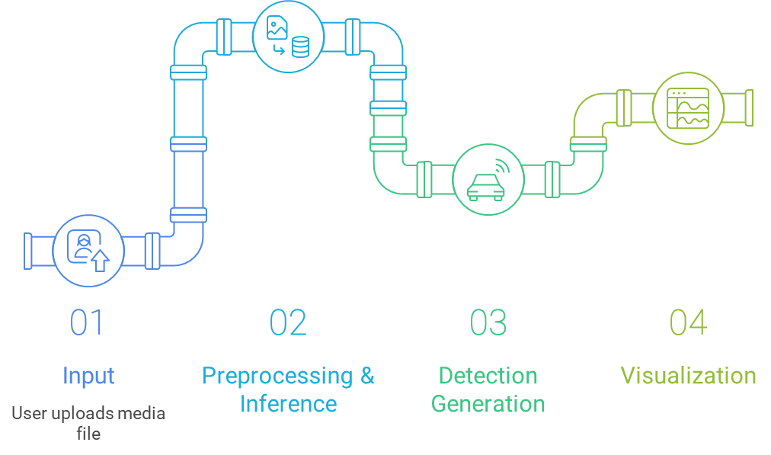
System Workflow for Image and Video Processing

Slide 7
EXISTING MODEL
Uses Traditional Computer Vision techniques such as:
Haar Cascade Classifier
HOG + SVM (Histogram of Oriented Gradients with Support Vector Machine)
SURF / ORB feature detection
Implemented using OpenCV.
Works well only for simple, predefined objects (e.g., faces, cars).
Limitations:
Fails with background noise or complex scenes.
Cannot handle multiple object classes simultaneously.
Low scalability and no real-time adaptability.

Slide 8
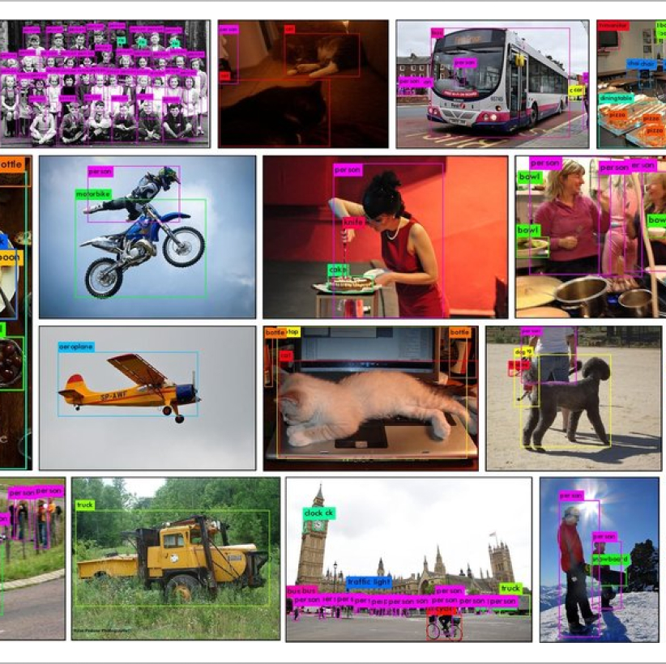
DATASET
COCO (Common Objects in Context)
Key Details:
Classes: 80 categories
Format: JPEG images with annotations
Resolution: 640×640 (standard for YOLOv8)

Slide 9
PROPOSED MODEL
Employs Deep Learning-based detection models:
YOLOv8 (You Only Look Once)
Faster R-CNN
SSD (Single Shot Detector)
Frameworks: PyTorch, Torchvision, OpenCV
Integrated in a Streamlit dashboard for real-time image/video processing.
Advantages:
High accuracy and speed (real-time detection).
Works across diverse datasets (COCO, Pascal VOC).
Supports both image and video inputs.
User-friendly visualization and performance metrics (mAP, FPS).

Slide 10
Performance Evaluation
Effectiveness Metrics:
mAP (mean Average Precision)
Precision & Recall.
Speed Metric:
FPS (Frames Per Second)

Slide 11
Challenges Encountered
Model Size Management:
Handling size difference between various models, such as YOLO-Large versus YOLO-Nano.
Performance Optimization:
Continuously balancing demands of high accuracy and fast inference time.
Deployment Hurdles:
Overcoming issues related to memory constraints and performance differences between GPU and CPU environments.

Slide 12
Future Enhancements
Object Tracking
Instance Segmentation
Advanced Analytics
Cloud & Mobile Deployment
Future work aims to make the system faster, smarter, and deployable on real-world platforms for advanced object detection and tracking applications.

Slide 13
Conclusion
Successfully developed a fully functional and interactive object detection dashboard.
The system supports multiple models, including YOLOv8 and various Torchvision architectures.
It delivers real-time inference on user-uploaded images and videos through a user-friendly interface

Slide 14
Thank You!

