Slide 1
Superstore Sales Analysis – Advanced Excel Project
Janarthanan M | Data Analyst

Slide 2
Project Overview & Objectives
Analyze sales transaction data to extract insights
Identify top-performing products and channels
Evaluate discount and shipping impact
Build an interactive Excel dashboard

Slide 3
Data Description & Preparation
Dataset: 10,000+ rows with fields like Order Date, Ship Mode, Sales, Profit, Discount
Cleaned duplicates and blanks, validated data integrity
Formatted date fields, currency columns, and prepared for PivotTable analysis
Structured for advanced Excel features including dashboarding

Slide 4
Key Metrics Calculation
Adjusted Sales = Sales * (1 - Discount)
Total Revenue, Total Discounts
Average Order Value (AOV) = Total Sales / Number of Orders
Profit Margin = Profit / Sales
Key figures (example values):
• Total Adjusted Sales: ₹2,500,000
• Average Discount: 11.2%
• Total Orders: 1,200
• Total Quantity Sold: 3,450
• Profit Margin: 18.6%

Slide 5
Pivot Tables & Charts
Used PivotTables to summarize:
- Sales by Category, Region, Segment
- Quantity by Sub-Category
- Sales trends (monthly/quarterly)
Visualized using bar charts, line charts, and slicer-controlled filters

Slide 6
Dashboard Overview
• Interactive Excel dashboard components:
- KPI Cards (Total Sales, Orders, Avg Discount, Profit Margin)
- PivotCharts: Sales by Category, Region, and Time
- Slicers: Category
- Automatic refresh with macros and a clean layout

Slide 7
What-If Analysis & Goal Seek
Goal Seek estimated quantities to hit Adjusted Sales targets
Scenario Manager simulated different revenue outcomes:
- 10% sales growth
- 5% discount reduction
- Combined strategy impact
Helped assess decision scenarios using Excel models

Slide 8
Macros & Automation
Macros automated repetitive tasks:
- Refresh all PivotTables and charts
- Format dashboard automatically
- Buttons for instant updates
• Improved efficiency and reduced manual workload

Slide 9
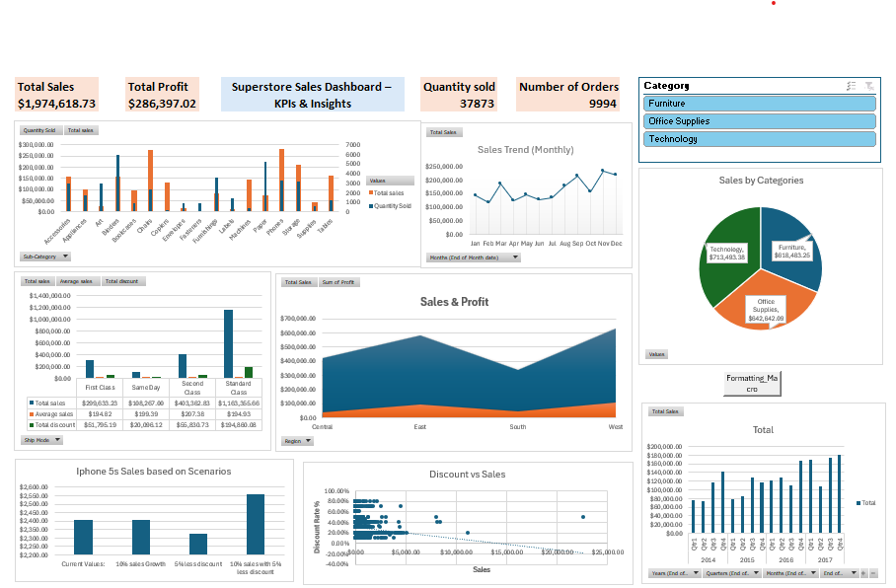

Slide 10
Insights & Recommendations
Technology generated highest revenue; Office Supplies highest volume
Discounts beyond 15% didn’t boost sales much
East region consistently outperformed others
Recommendations:
- Cap discounts at 10-15%
- Focus on high-revenue segments and bundle low-margin items
- Leverage dashboard for ongoing decision support

Slide 11
Conclusion
Excel tools helped uncover actionable business insights
Dashboard offers dynamic filtering and visual performance tracking
Next Steps:
- Use for monthly reviews
- Expand with forecasting or Power BI integration
Thank you! Questions are welcome.

