Slide 1
Grab Your Time
Team 19
Yaxi Li Xinyi Li Juntao Li
Notes:
Hi everyone, this is team 19. Our team members are Xinyi and Juntao. I am Yaxi Li. I would like to go through our project .

Slide 2
Background of our project
Manage time of one’s project can always be a pretty hard task for a lot of people.
We plan to build a time tracking web app for user to manage their time.
User can manage different projects.
Our app can record and reflect his/her time/effort spent on different projects, and major milestones/achievements along the way.
This records can visualize user’s time.

Slide 3
Functionality
Users can set individual project and their estimate starting time and ending time for this project.
Manager of a team project can set a team project. Separate the team project into sub-projects, then assign different sub-tasks and the corresponding goal to the member of this project.
When the estimate time of a project start, our project will notify the user then record their effort.
We will generate report for different people on different projects.
Notes:
In our app, we define 2 different type of projects: individual project and team project.

Slide 4
Our Plan for this sprint
UI Design
Login/Signup Module
Dashboard module
Profile module
Navigation module
Deploy
Design Database

Slide 5
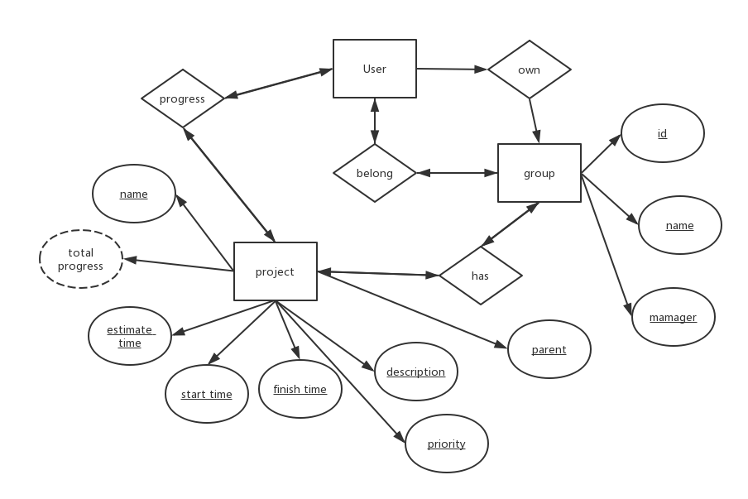

Slide 6
Next Step
Inbox Module
Inbox notification module
Groups module
Projects module
Profile module
Find bugs and modify previous work

