Slide 1
What is Port
Port is not a physical connection
It’s a logical connection that’s used by program and service to exchange information
Port has a unique number ranging from 0-65535
Common port:
80 and 443: Webpage
21: FTP
25: SMTP

Slide 2
Port number and IP address
Port number is always associated by IP address
Syntax: <IP Address>:<Port>
IP address: 32 digit address assigned to any system who is going to be in network

Slide 3
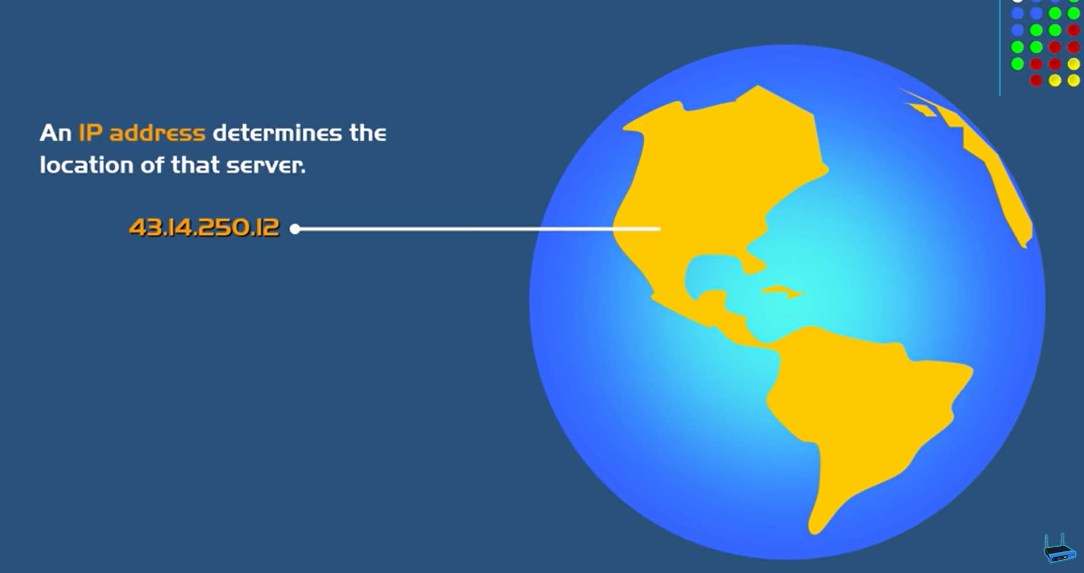
IP Address
IP address is a 32 digit address which used to identify the location.

Slide 4
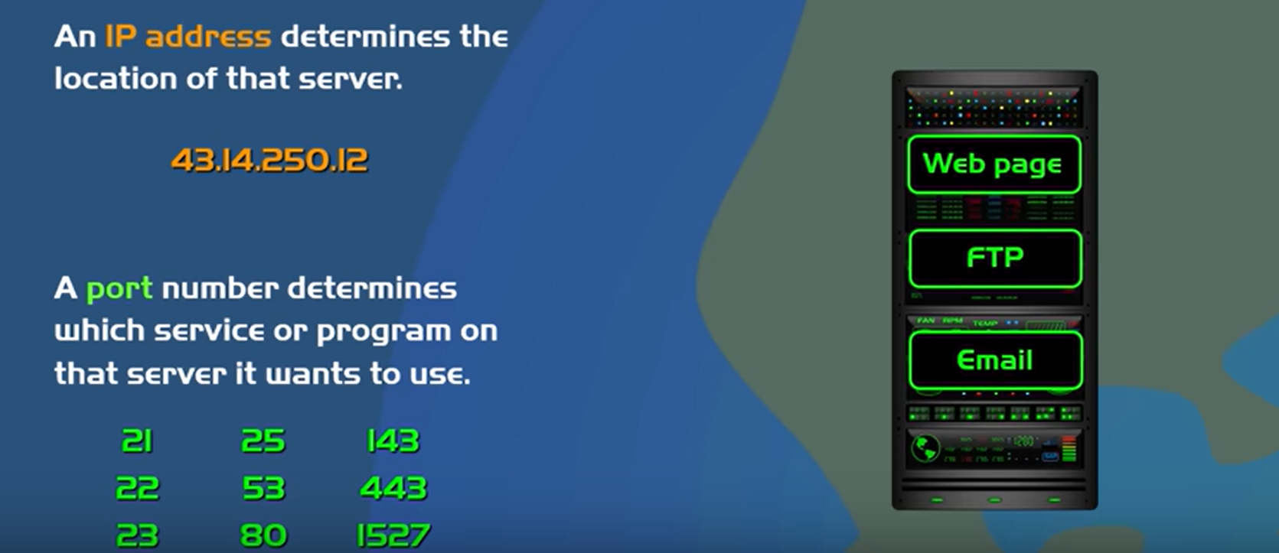

Slide 5
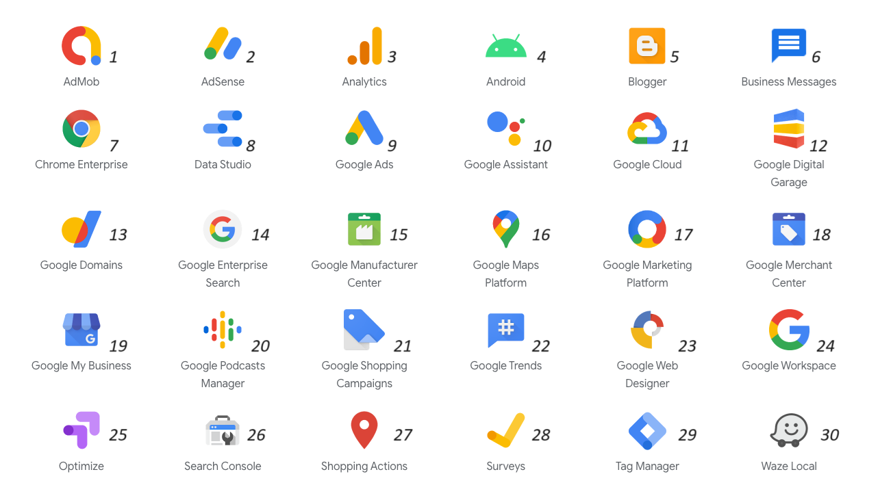

Slide 6
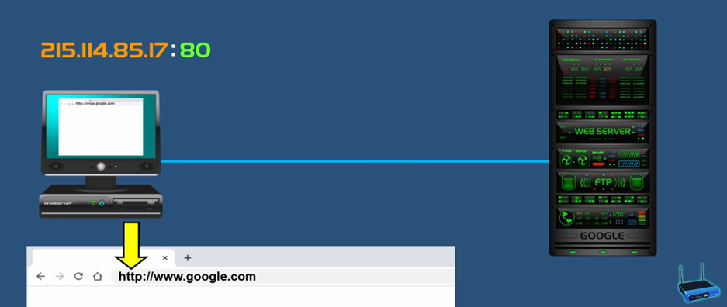

Slide 7
Netstat -n
The netstat command generates displays that show network status and protocol statistics. You can display the status of TCP and UDP endpoints in table format, routing table information, and interface information.

Slide 8
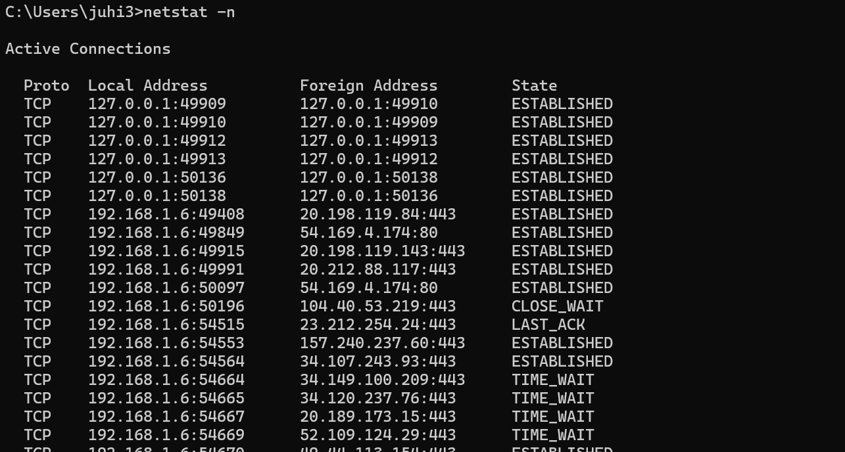

Slide 9
Local Address vs Foreign Address
Local Address is your host ip address. Foreign Address is the ip address of the system to which connected.

