Slide 1
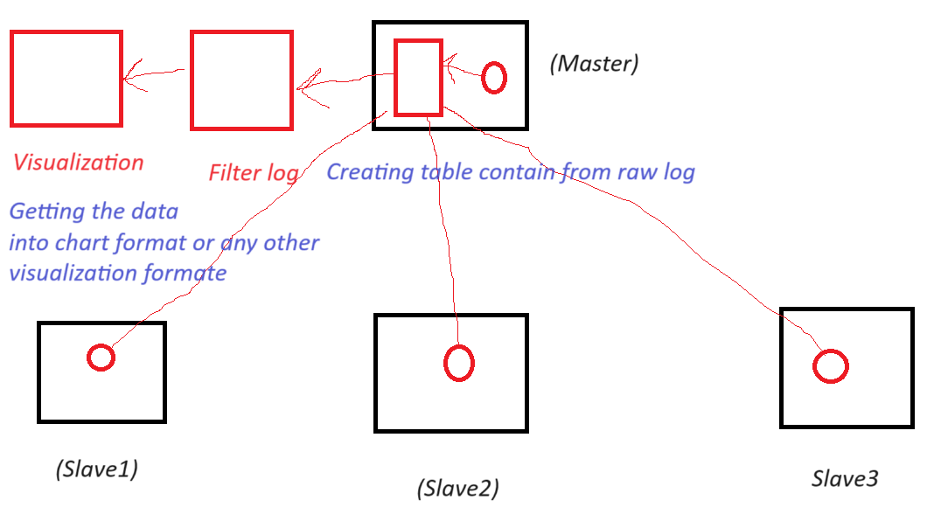

Slide 2
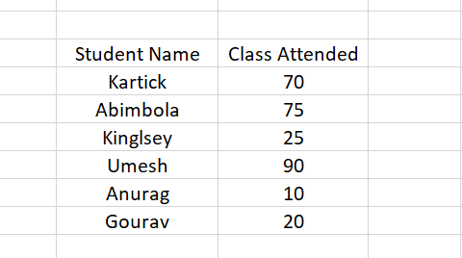

Slide 3
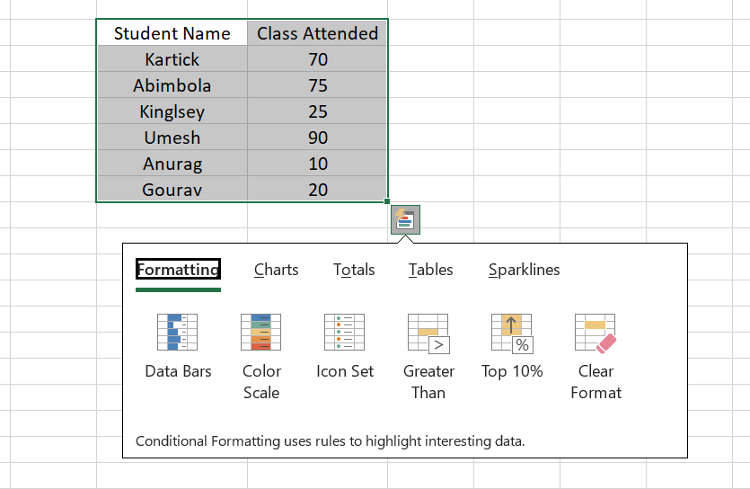

Slide 4
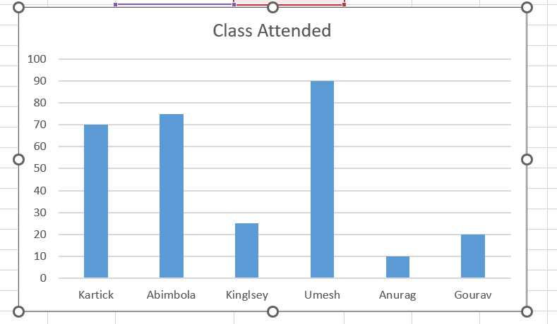

Slide 5
Monitoring tool
Splunk
ELK
Grafana

Slide 6
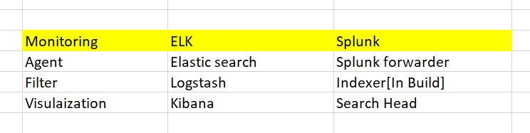
Comparison between monitoring tools

Slide 7
Search icon in monitoring
Query/visualization

Slide 8
Dashboard
It represent live data in filtered formate
Example: I want to display name of topper and marks

