Slide 1


RoadReady – A Car Rental Platform
An Online Car Rental, Reservation, and Management System
Mentored by : Mr. Javeed Mohammed Husnuddin
Presented by: Jancy. A

Slide 2
Technology Stack
Frontend: React.js
Backend: Java Spring Boot
Database: MySQL
Authentication: JWT
Other Tools: Swagger, Docker, AWS/Azure for deployment

Slide 3




Introducing RoadReady: Your Digital Car Rental Solution
RoadReady is a comprehensive, web-based platform designed to revolutionize the car rental experience. We empower businesses with seamless management tools and provide customers with an intuitive, efficient reservation process.
Effortless Car Renting
Simplified Booking Management
Browse and book vehicles with real-time availability.
Track, modify, and confirm reservations seamlessly.
Secure Payment Processing
Integrated Customer Reviews
Integrated and protected payment gateways.
Build trust with transparent feedback systems.

Slide 4
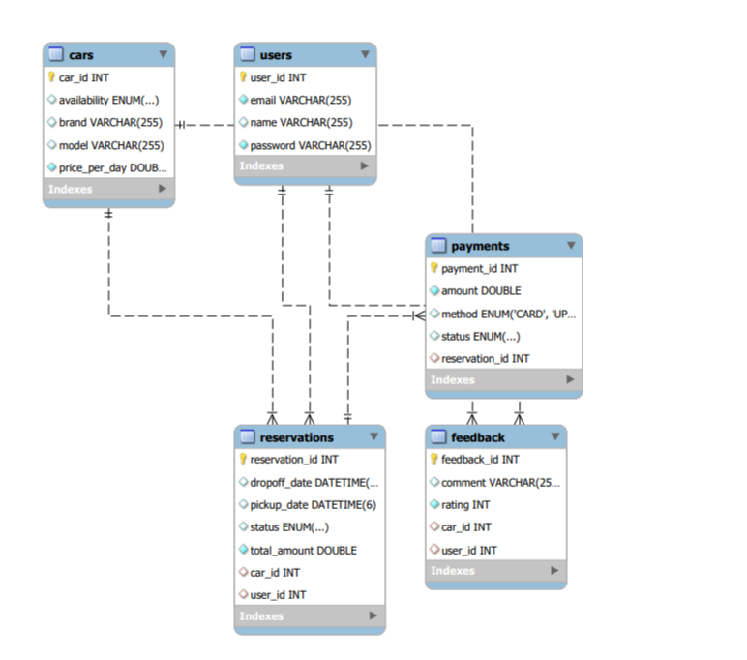
ER Diagram :

Slide 5
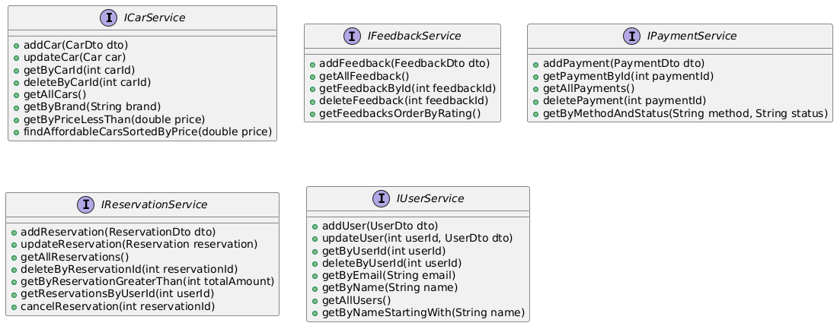
Class Diagram :

Slide 6
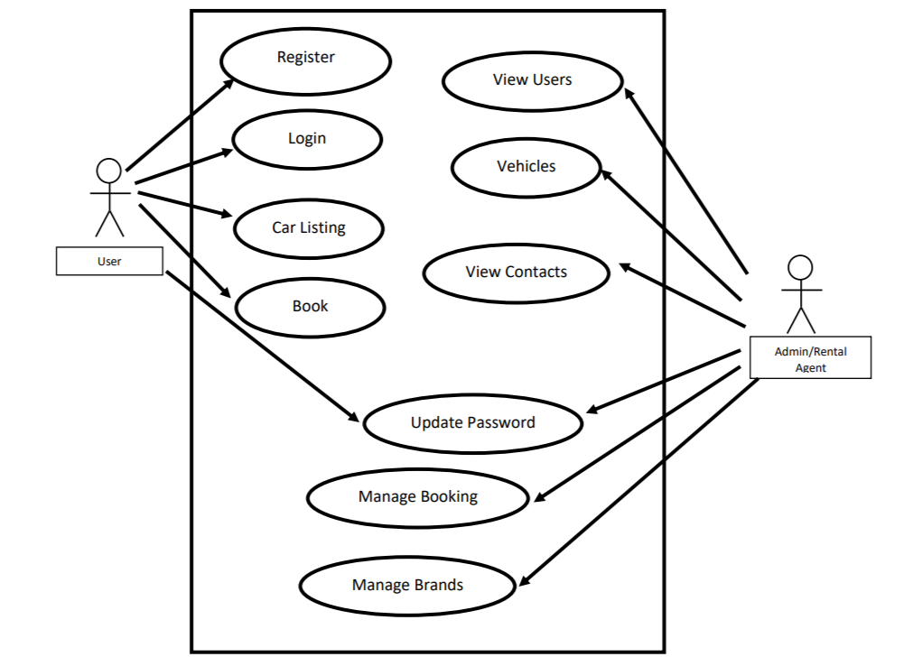
Use Case Diagram :

Slide 7
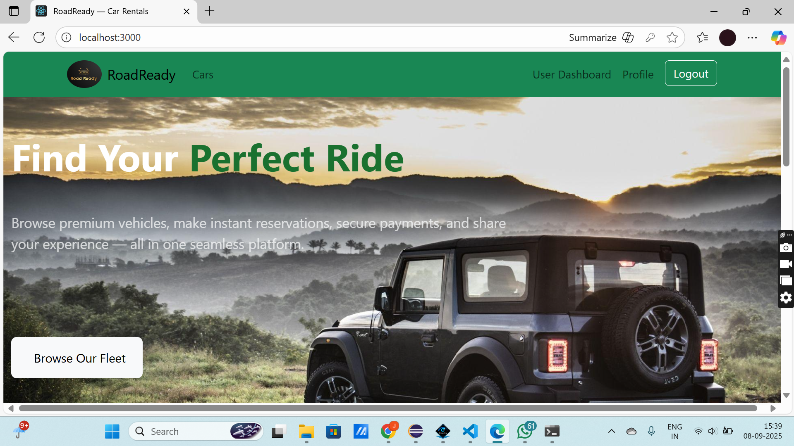
Home Page :

Slide 8
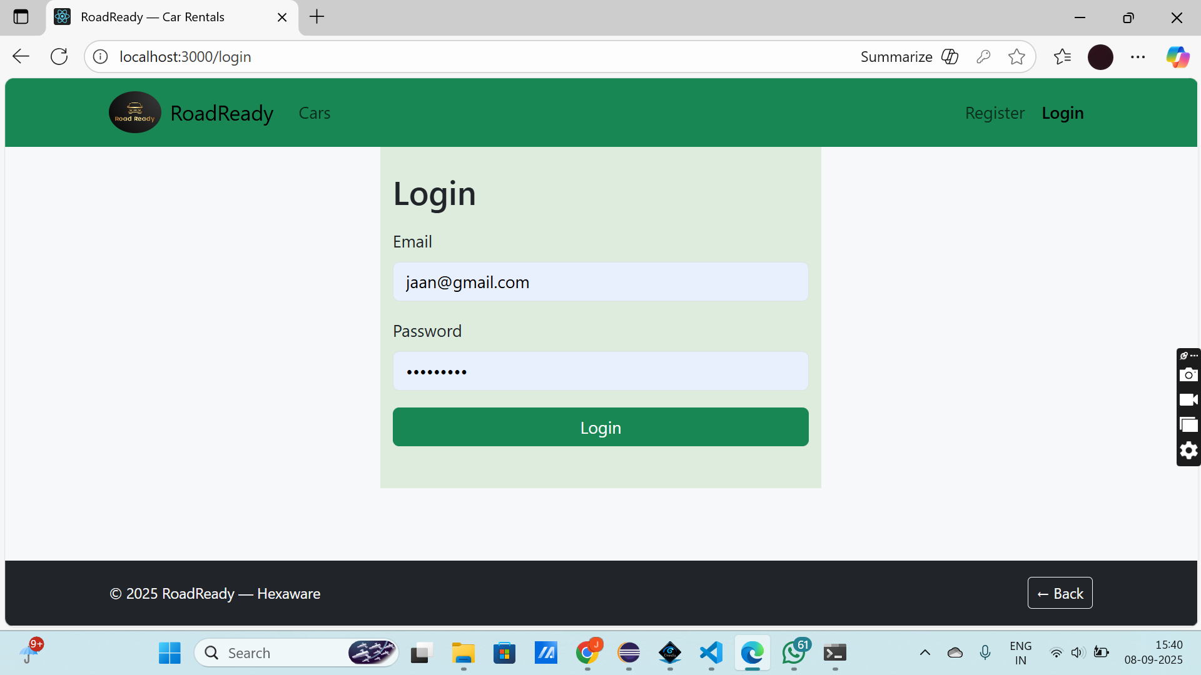
Login Page :

Slide 9
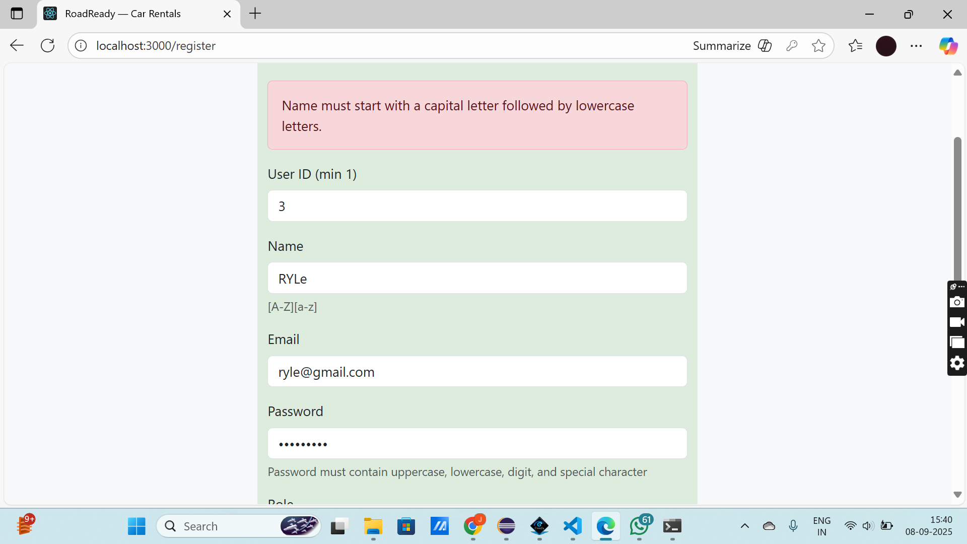
Registration form with validations :

Slide 10
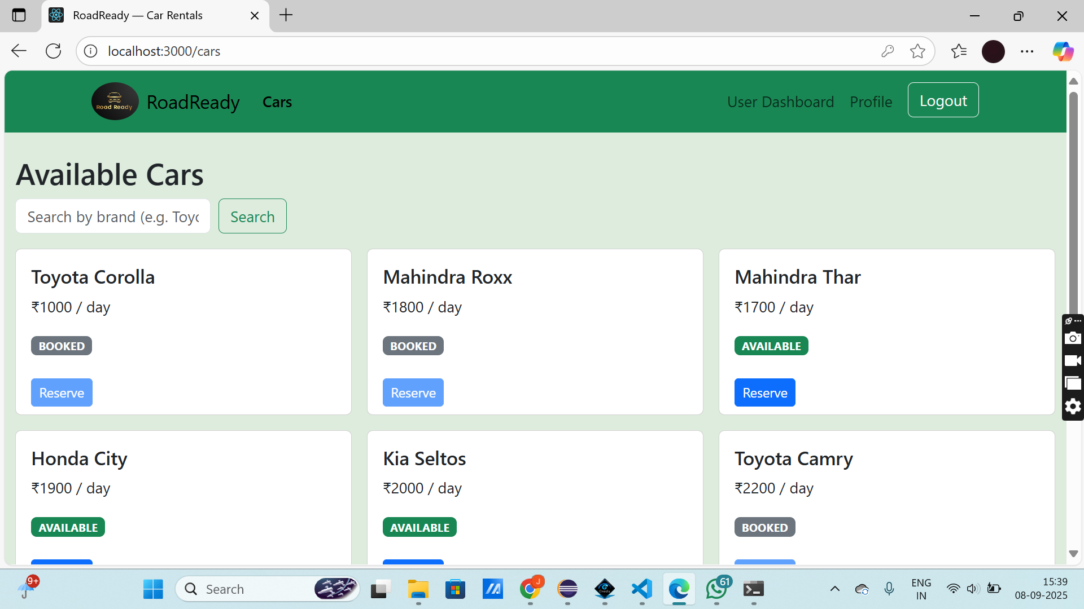
Car Listing :

