Slide 1
REGISTRATION WEBSITE

Slide 2
SCOPE AND LIMITATION
Scope
Our website is able to Create a new record, Read a record, Update record and also delete record in the database.
Our website is a responsive website, it can be view on different sizes of screen.
Limitation
Our website is not yet able to read a single record, it can only read all record in the database.

Slide 3

Landing page

Slide 4
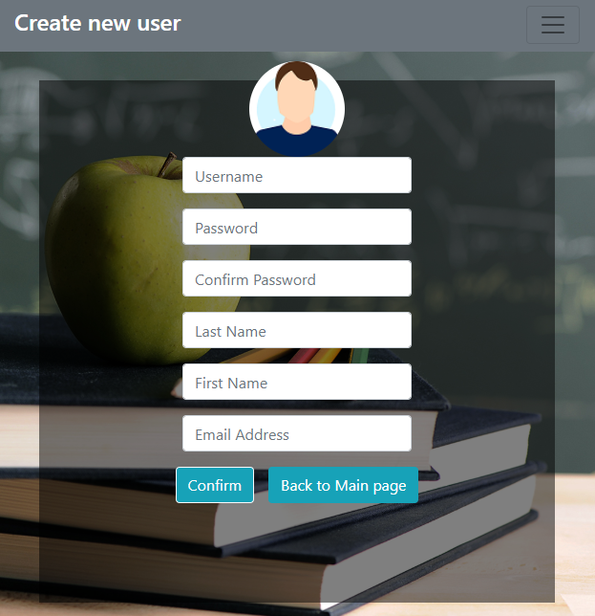
Add new user form

Slide 5
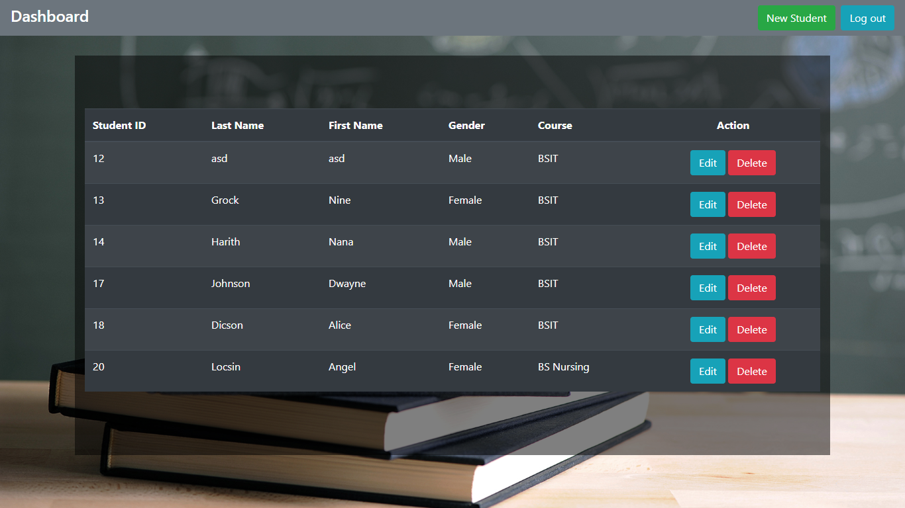
Dashboard Page

Slide 6
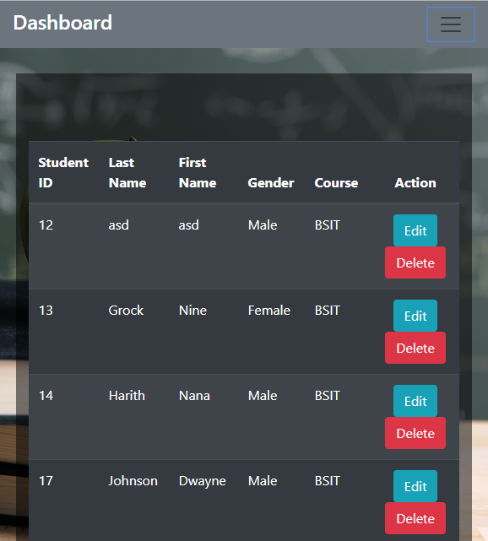
Dashboard Page

Slide 7
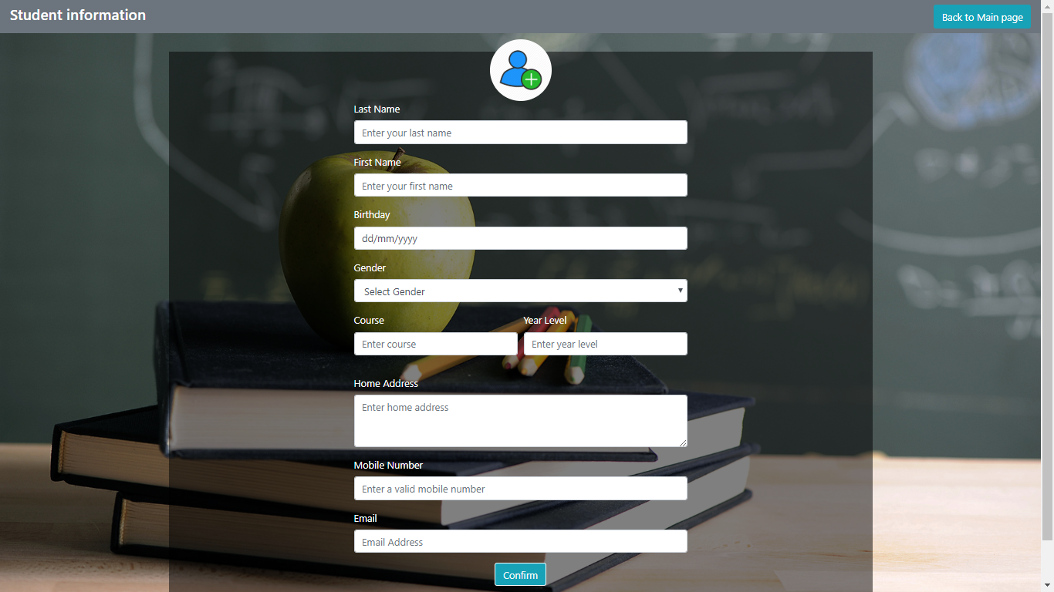
Student information form

