Slide 1
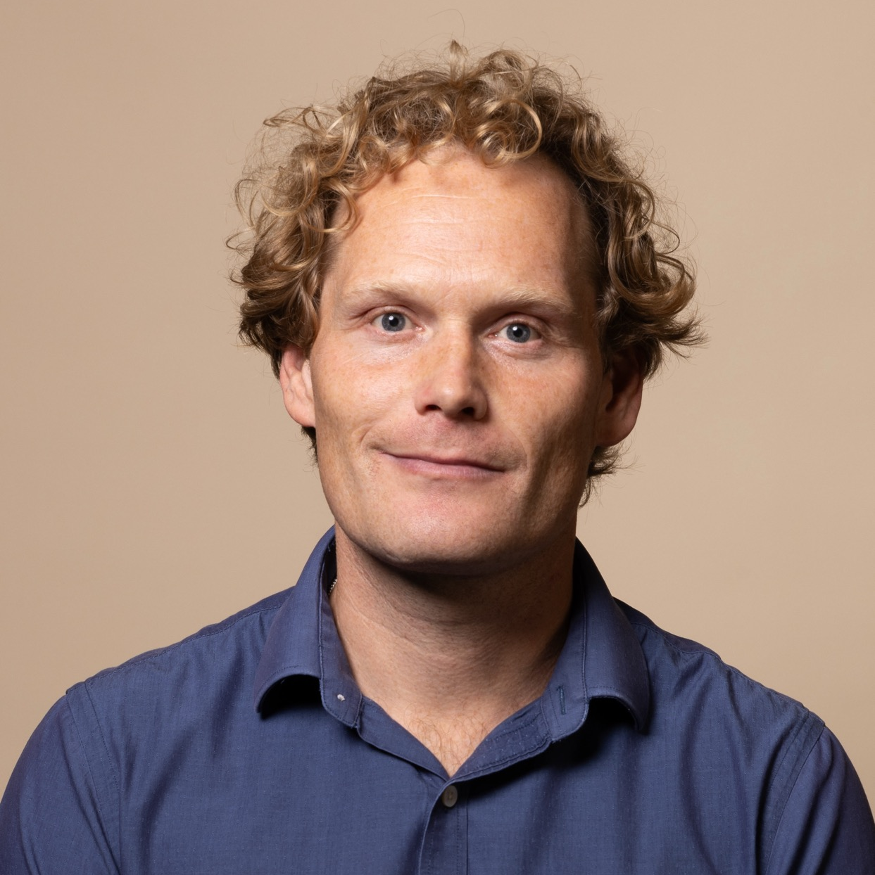
Jan Werth
Brief Introduction Dr. Jan Werth is an enthusiastic expert in the fields of signal processing and machine learning. He brings extensive experience in the medical field, electronics development, as well as in the logistics and railway industry. There, in addition to hands-on development, he has demonstrated outstanding skills in team leadership and budget responsibility. His excellent communication completes his profile.
Professional Career 2024 – Eraneso Analytics Germany GmbH: Lead Data Scientist 2021 - 2024Eraneos Analytics Germany GmbH: Senior Data Scientist 2019 - 2021PHYTEC Messtechnik GmbH: Lead Data Scientist 2014 - 2018Philip Research: Scientist
Project Experience (Excerpt) 2024 – 2024DB Systel GmbH: Railway 2021 - 2023DB Cargo AG: Logistics
Lead Data Scientist Eraneos Germany
Focus Areas
AI & Data Science
Team Leadership
Medical Research
Computer Hardware
Healthcare
Transport & Logistics
Data & AI Practice
Degree
Certificates Dr.-Ing. |
MSc in Electrical Engineering & Information Technology (ETIT) |
Languages German (Native language)
English (Fluent in Negotiation)
French (Basic Knowledge)

