Slide 1
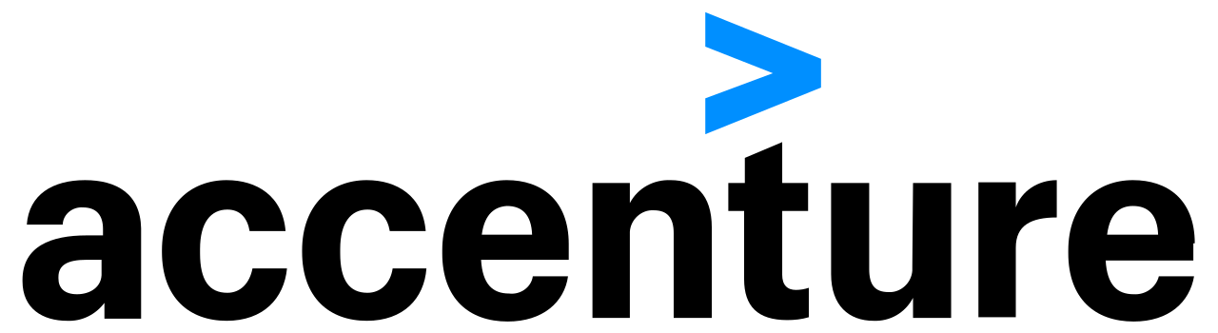

WHEN YOU HAVE 5
TEAM 1
Team 1

Slide 2
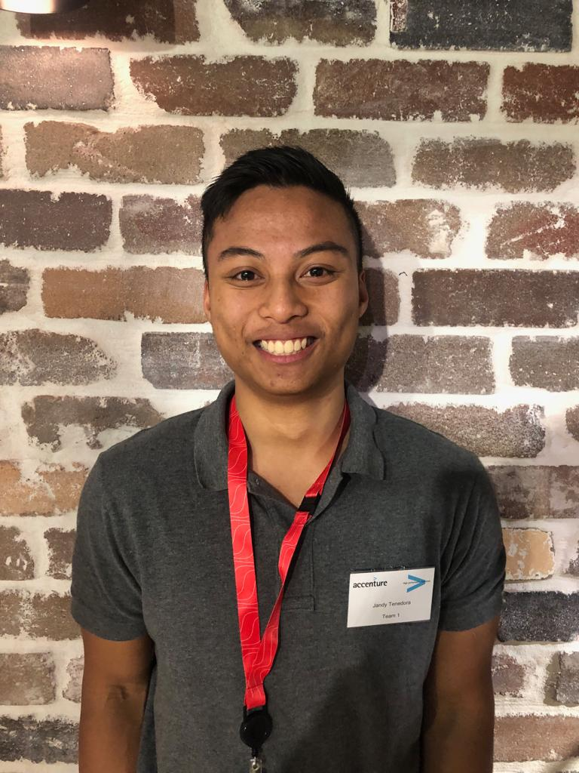
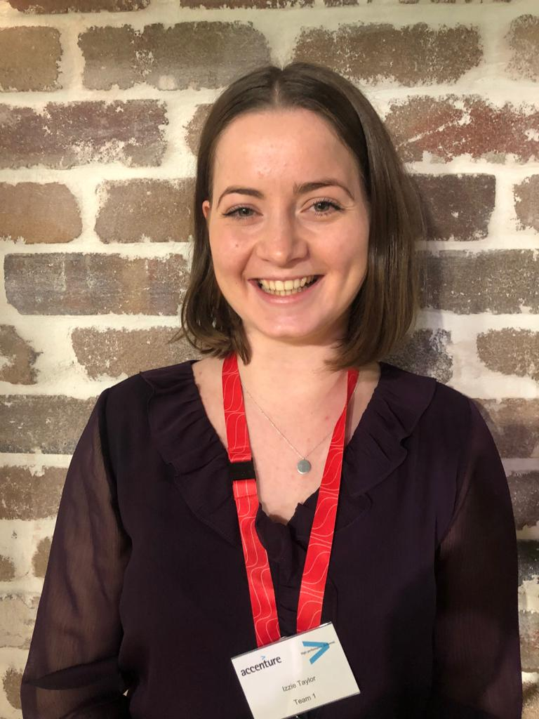
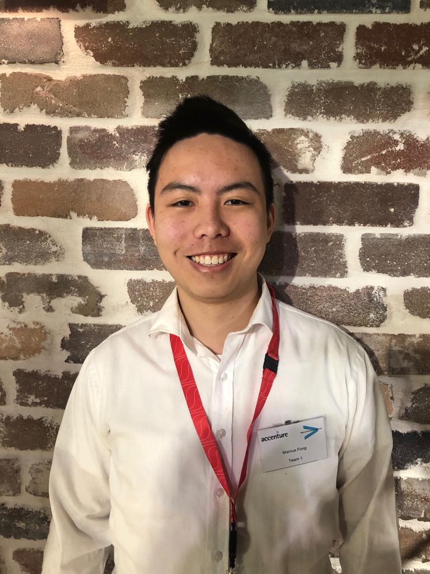
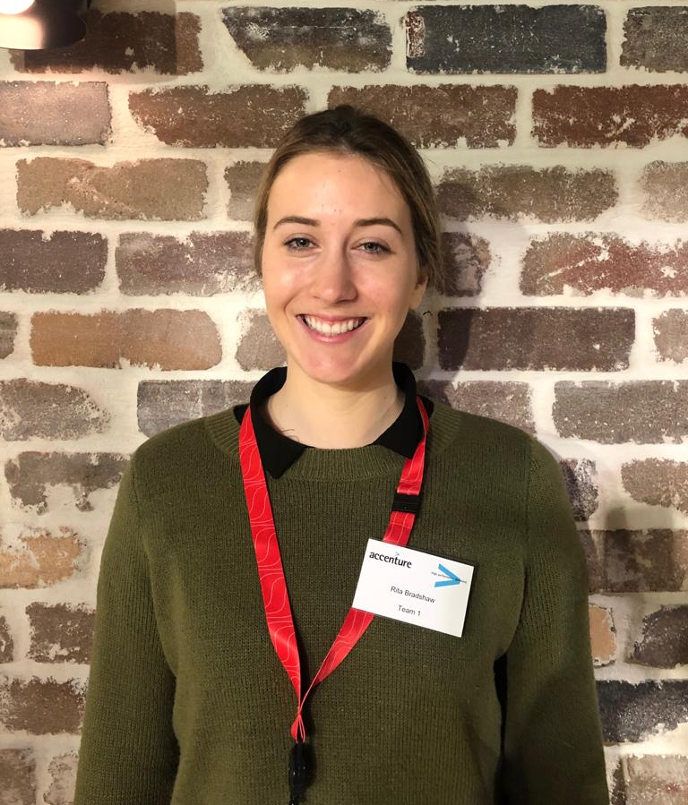
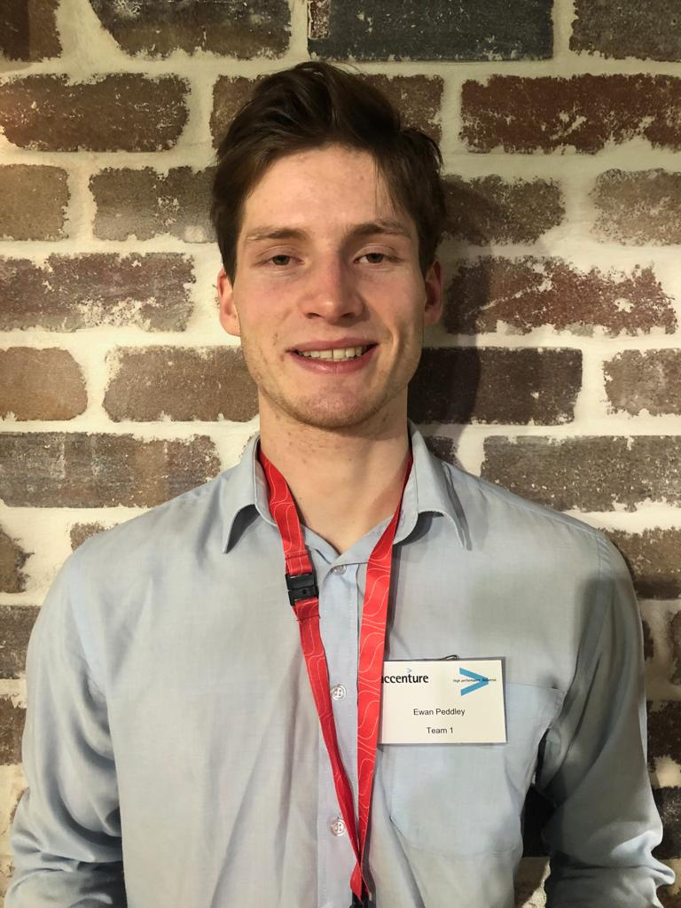
OUR CREATIVE TEAM
Jandy Tenedora
Izzie Taylor
Marcus Fong
Rita Bradshaw
Ewan Peddley

Slide 3
THE BUSINESS PROBLEM
THE BUSINESS PROBLEM
Mandatory tasks and training exists.
HR has to email people to ask them to do these tasks.
Employee don’t do them
HR has to chase them
Employee has to spend time finding relevant emails for links to tasks...

Slide 4
THE BUSINESS PROBLEM
Communication
Employees
HR
Not completing mandatory tasks
Time wasted chasing employees
Employees
HR

Slide 5
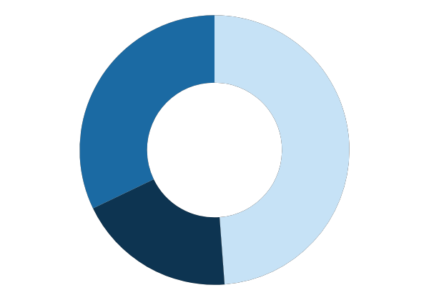
THE COST
> 1500 mins
Time consumed by both Employees and HR per fortnight
> $32,000
Administrative workload
Monetary losses
Employee wellbeing
5 minutes per
employee
$50 per hour
Cascading effect
Cost to the Business
Incomplete tasks will lead to a “domino” effect
New forms that are constantly added will increasingly reduce productivity
> 3000 forms
A vast amount of forms that need to be completed. Massive admin workload

Slide 6
PROJECT REQUIREMENTS
What we needed to consider for our solution
Our goals:
Improve overall compliance
Reduce lost time in follow-up work
Input Considerations:
Use cases
Clear visualizations
Links to actions
Accuracy of data reported on
Time constraints
Response times

Slide 7
OUR JOURNEY
Success
Planning
Teamwork
Ideas

Slide 8
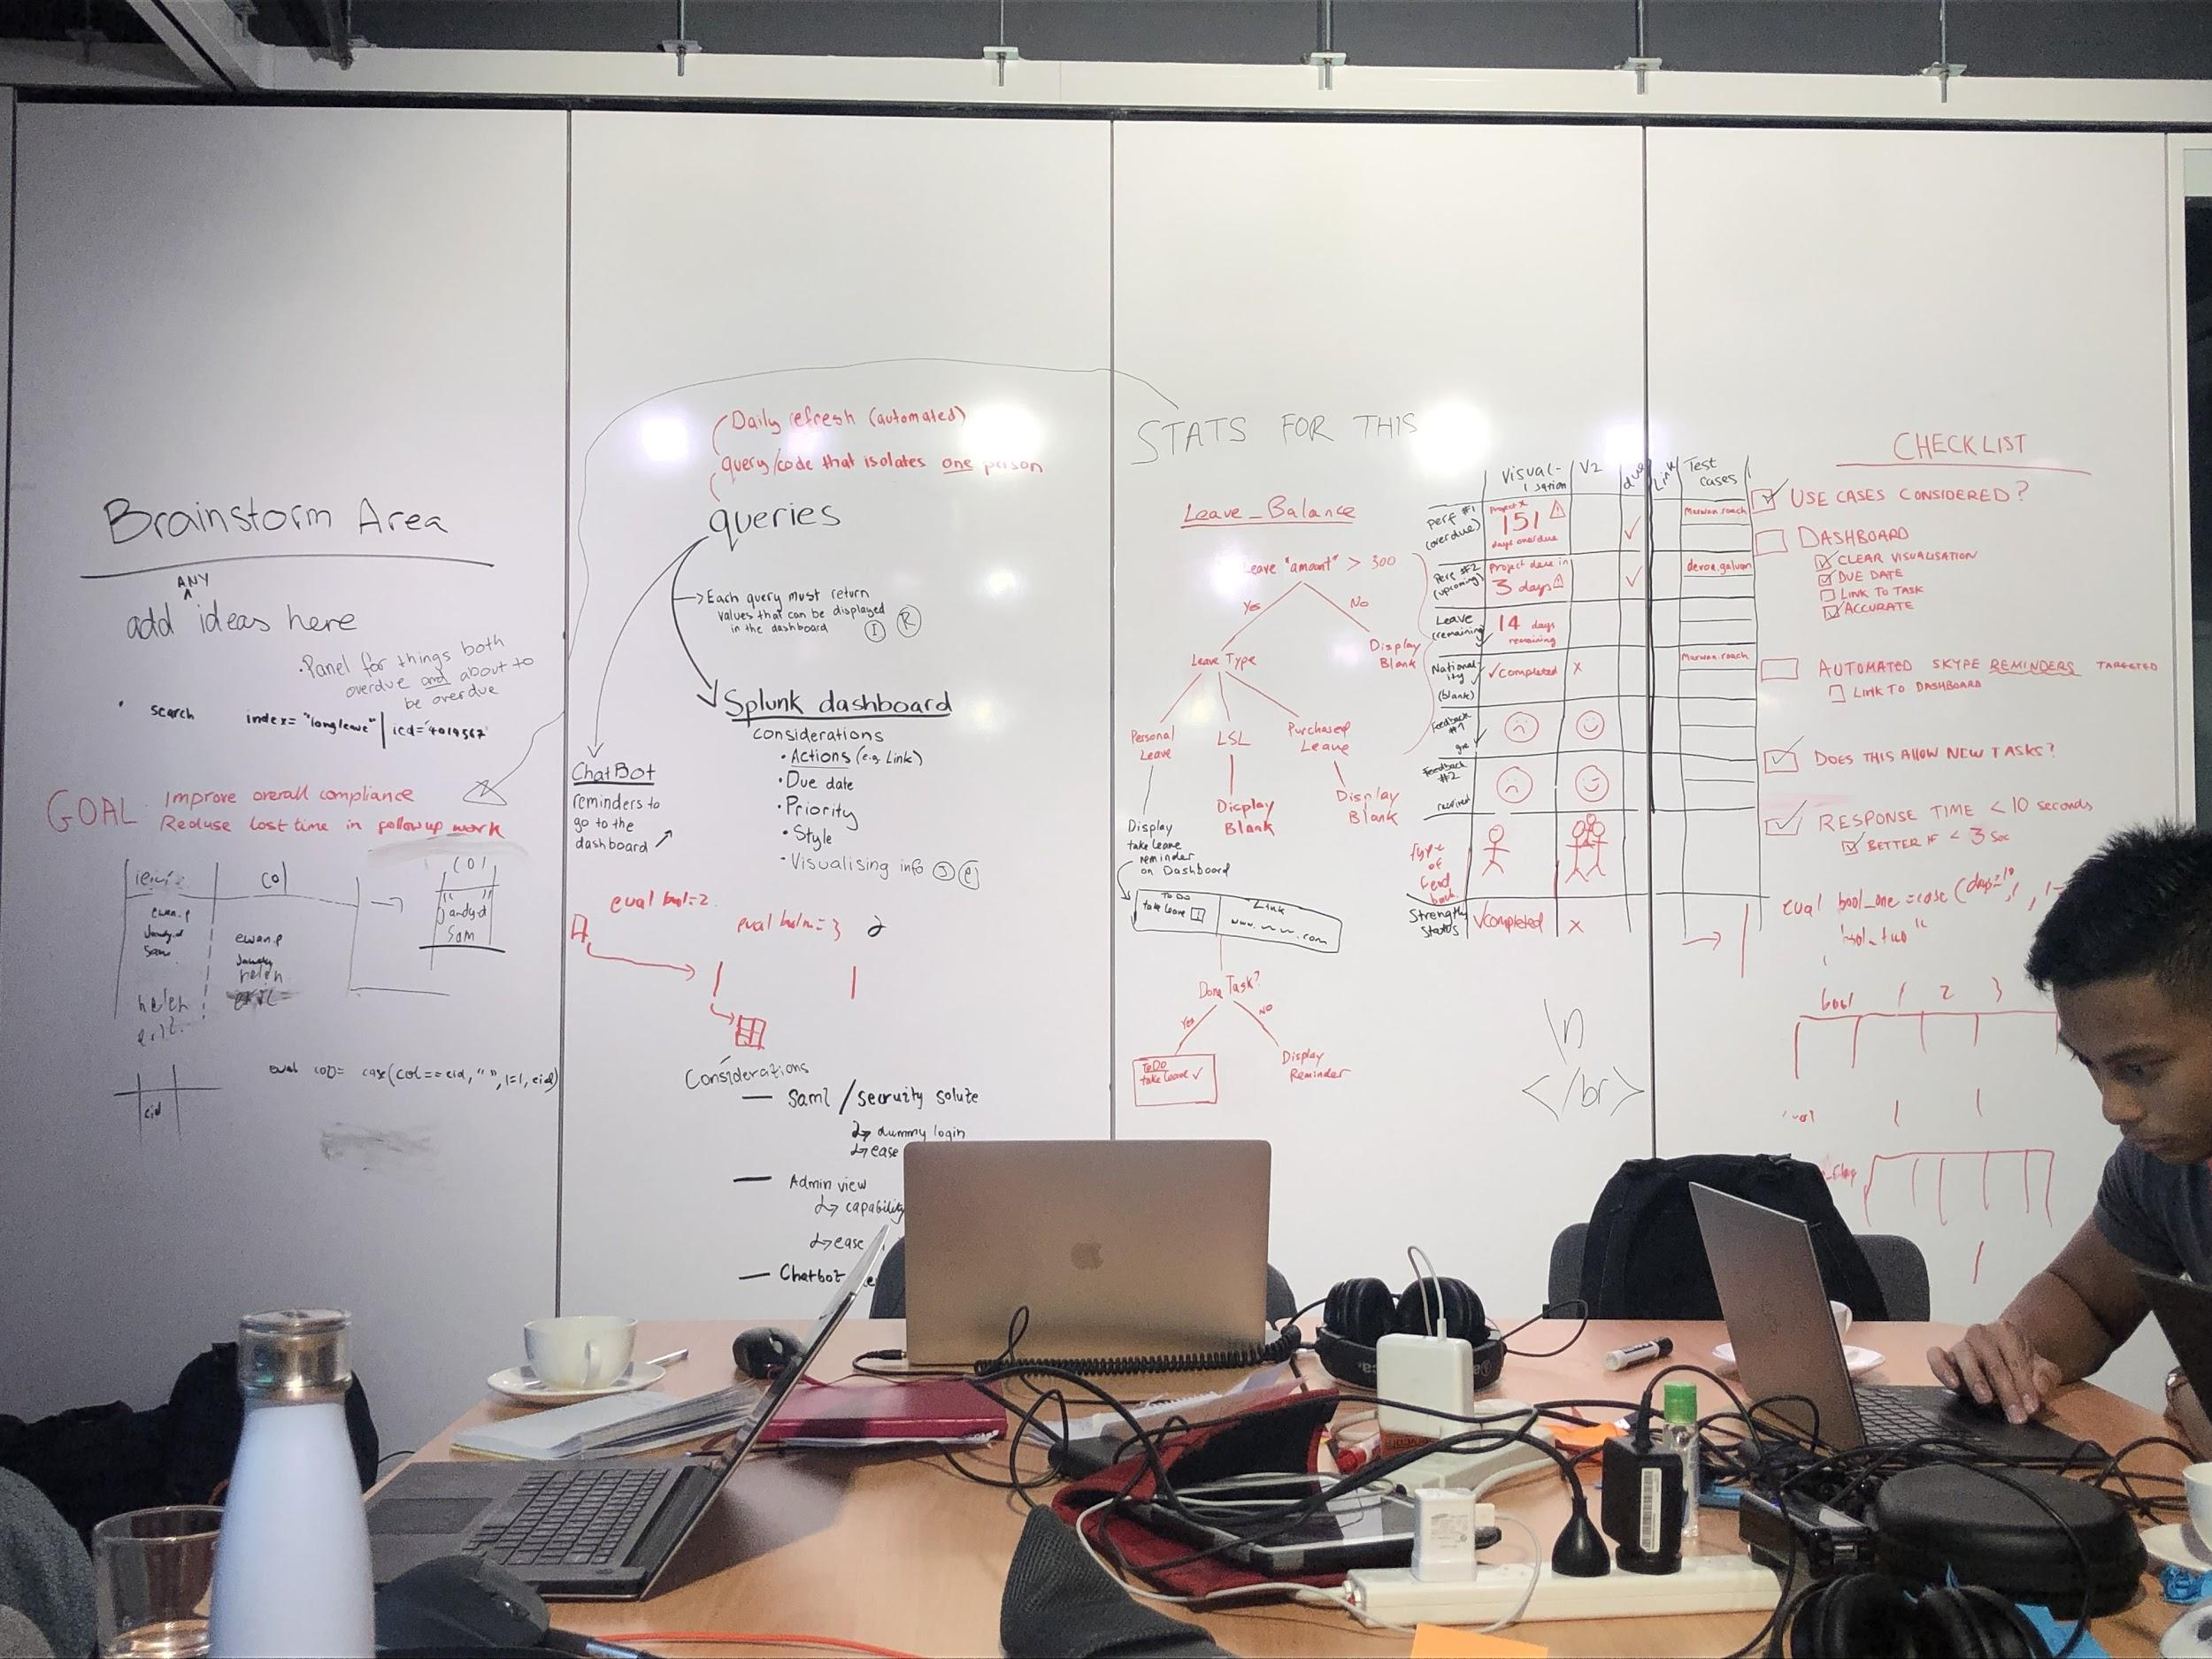

Slide 9
OUR SOLUTION
Proposed timeline of events
Tasks Incomplete
Dashboard
Data forwarded to splunk reports employee has over 3 tasks that need attending to
Intuitive user interface alerts user which tasks to complete
Tasks updated
Chatbot
Chatbot sends message, prompting employee to the dashboard
Data gets updated and forwarding process begins again
Start
Finish

Slide 10


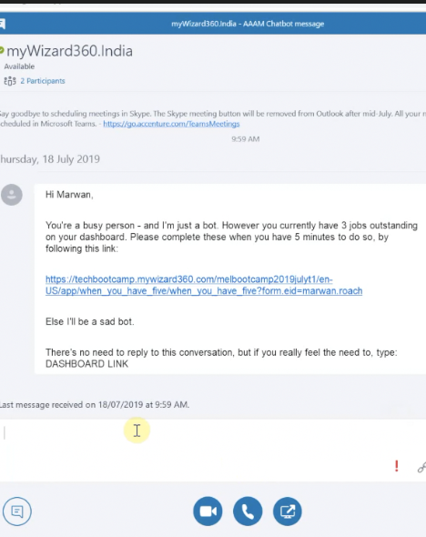
Our Chatbot
Streamlining Tasks
Queries check employees for overdue tasks
Alerts employees when their number of due tasks breach thresholds set by HR
Interactive conversation with employee is started

Slide 11
Demo 1

Slide 12


Slide 13
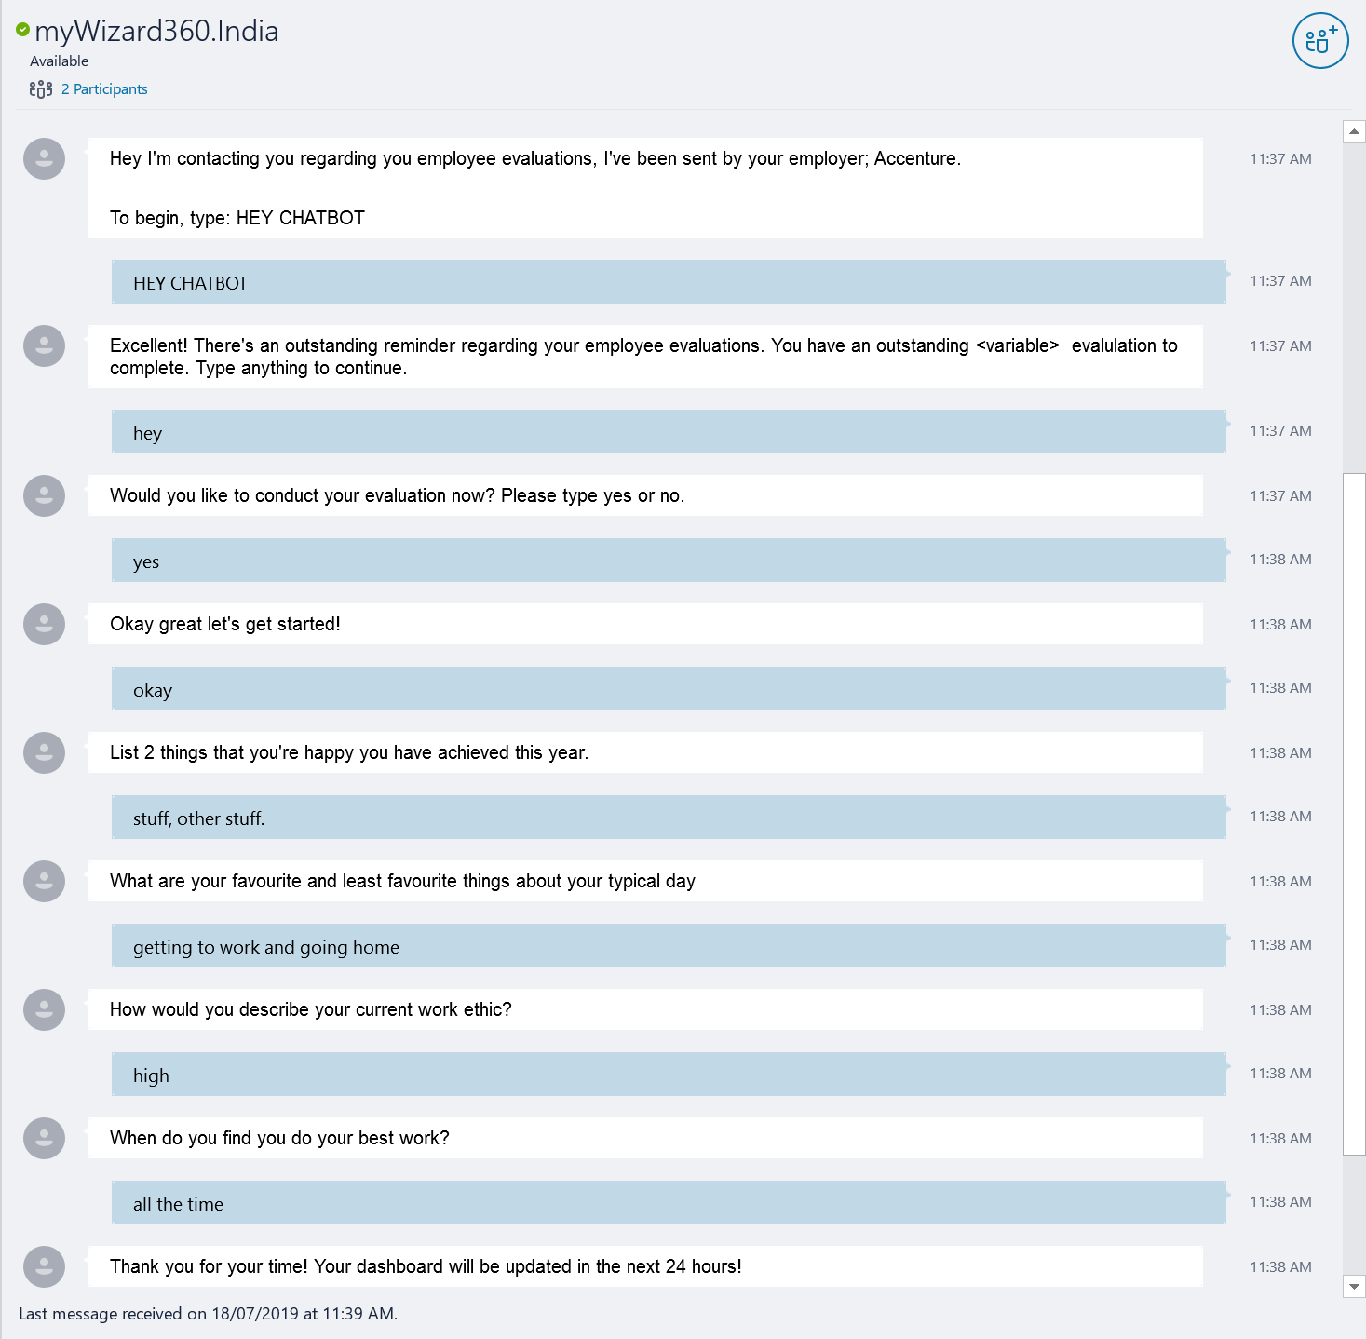

Slide 14

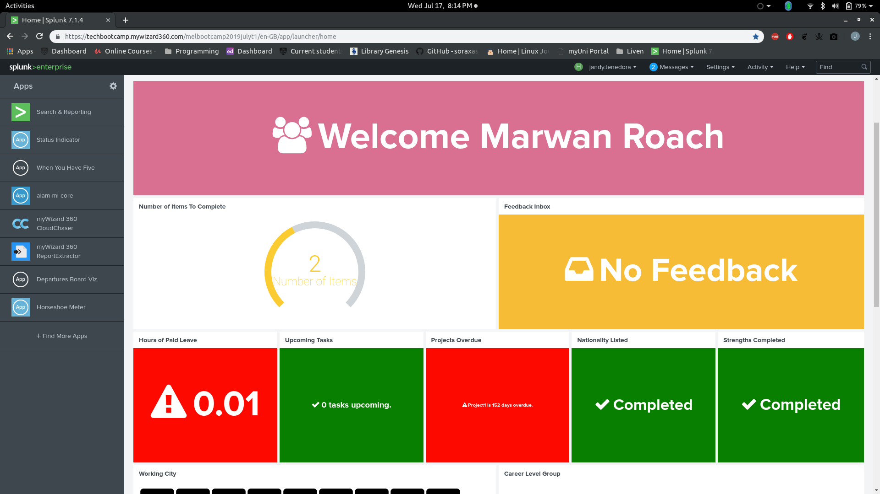
Employee Dashboard
Intuitive Design
Progress Bar
Feedback Inbox
Gauge meter to show how many items out of 5 need action
Inbox containing feedback from their colleagues
Panels for each task
Panels linked to forms
Variable panels which use employee data to let the user know which tasks are yet to be completed
On a single click, employees will be redirected to fill out the appropriate form

Slide 15

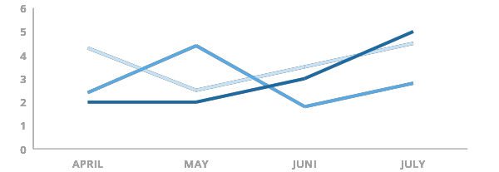
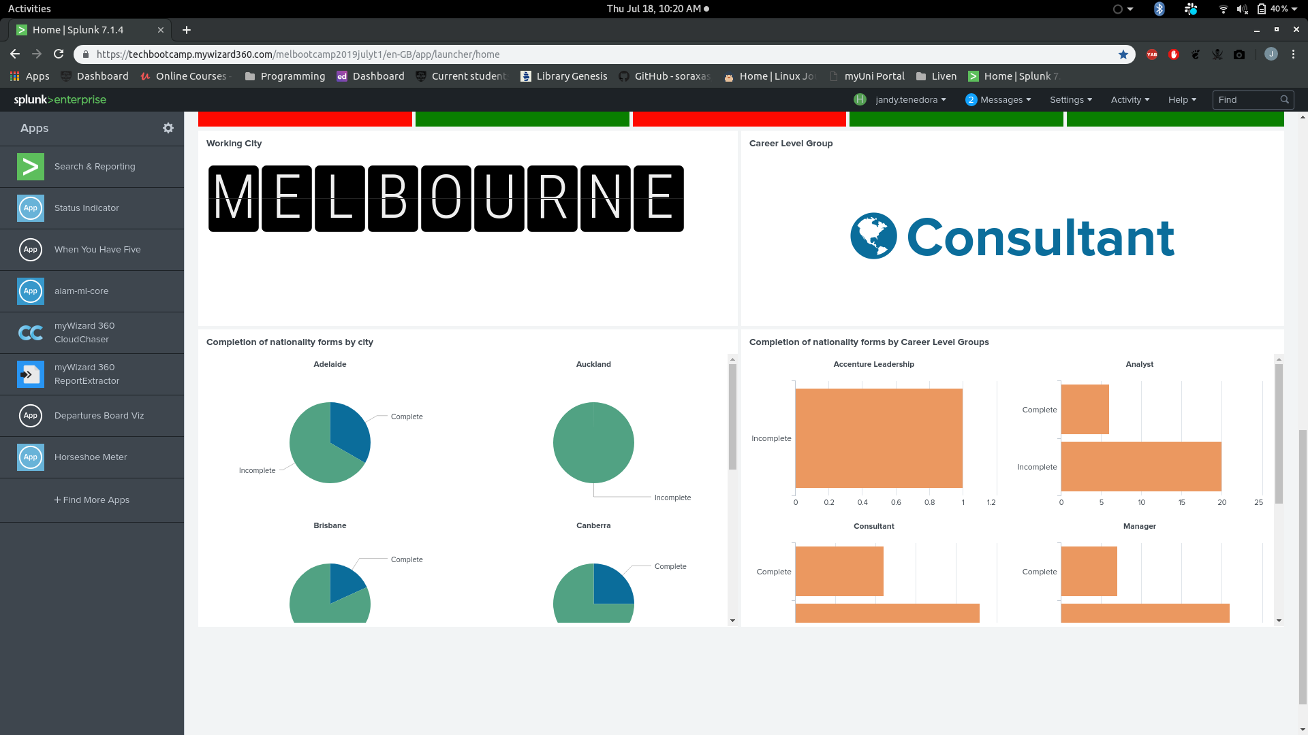
Employee Dashboard
Comparative statistics
Comparison by city and occupation
Stats of task completion by city and occupation added to motivate employees by urging a sense of competition

Slide 16
Demo 2

Slide 17
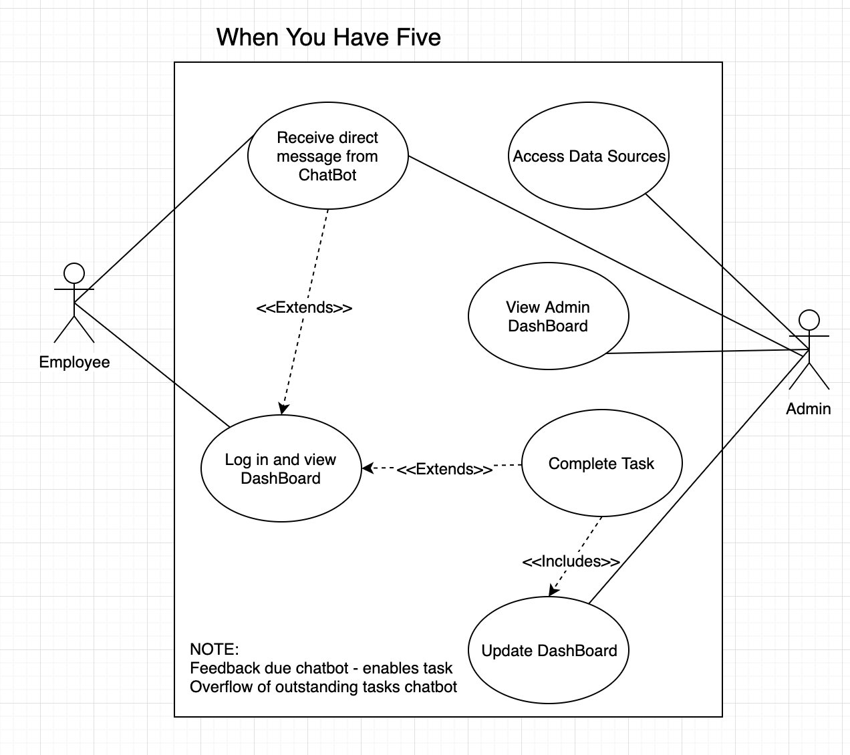
Solutions Architecture
Seeing the bigger picture
Chatbot
Dashboard
Splunk
Administrator
Employee
Actors: Employee, Administrator
Use cases: Receiving direct messages, accessing data sources, viewing administration dashboard, completion of tasks, updating dashboard, log in
Notes:
By making use of “use-case diagrams”, our team has been able to get a top down view of our system: seeing the bigger picture - taking a step back and understanding how all our use cases will flow and come together to deliver the best product for our client. Our information system has two main actors: the employee and the administration. As you can see from our use-case diagram, the employee will be interacting with both the chatbot when they receive a reminder AND the dashboard when they log in to view their tasks. On the other hand, the Administration team can interact with the data sources for backend handling, view the admin dashboard for overall statistics on response amongst employees and can update employee dashboards and add new tasks.

Slide 18
ISSUES AND CHALLENGES FACED
Overcoming hurdles
Teamwork
Chatbot
Solution Architecture
Productivity
Interacting with the data fabric
Utilising each member’s skills to work efficiently
Technical difficulties in Splunk and Cloud-chaser
Conceiving an architecture to account for the dynamic capabilities of the application
Issues with maintaining productivity, solving creative disagreements
Developing Splunk queries, tailored to the current needs
Notes:
There were a few hurdles to overcome during the development process before delivering our final product today. Most of us being new to Splunk, a common challenge was learning the syntax and query language in order to interact with the data fabric. Our team was mostly up to speed on the language after the first day and the next challenge came to applying our knowledge to provide a clean and intuitive user interface for employees. After some tweaking and adjustments, we have been able to put together a simple design that any user would be able to navigate with ease.
Productivity and workflow is key to development of any information system. We needed to determine which design features were the most important and prioritise our workflow such that the main components get completed on time. Solutions Architecture. The importance of getting a top-down view of our solution was a very important aspect which drove our workflow and productivity. By designing use-case diagrams and descriptions, we were able to gain a clear understanding of the business problem and the various tasks to be completed.
Chatbot. The main challenge here was learning how to use Cloudchaser and rivescript. The technical aspects of connecting up the chatbot such that it is integrated into our systems architecture was a hurdle to overcome. However, after some testing and learning, we were able to successfully implement a chatbot that will redirect users directly to their upcoming tasks.
Teamwork is very important aspect to put together any group project. By getting to know our team members, we were able to isolate the core strengths amongst our group and therefore, we were able to streamline our productive efficiency.

Slide 19
FUTURE EXTENSIONS
62
Forecasting future needs and requirements
Scalability
Management Setting
Can easily add more features to the dashboard as more tasks become mandatory and require monitoring
Options for an administrator to filter results on desired variables
Future Enhancements
Real-Time Data Streams
Incorporating AI and Machine Learning to improve chatbot features
Use Splunk’s indexing feature so we can use most recently available data
Notes:
Scalability: We want to make sure that our system can support a growing company that has an increasing amount of employees. We also want a system that can be easily edited and flexible so that if new forms are added to the business, they can also be easily transferred to our application.
Future Enhancements: In future iterations of our design, we can implement more data insights for both employees and admin. By using machine learning, AI and data analytics, we can show more information to both incentivise task completions by employee and draw useful insight for HR to isolate employees response rates.
Management Setting: We want the administration team to easily access the statistics and information for employees. A more insightful and powerful admin settings can really improve the efficiency of our design.
Real-Time Data: We hope that in the future we can get updates on data in real time rather than the daily refresh of data we have now. This will mean that the data administration and employees access are always up-to-date and accurate.

Slide 20
Any Questions?

