Slide 1

CRYPTOCOIN

Slide 2
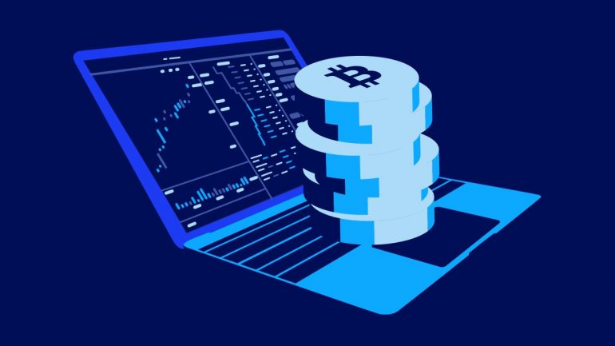
MOTIVATION
crypto currencies are the future assets.
Over the past few years, cryptocurrency has grown exponentially because of its attractiveness to people looking to use this alternative money.
They're decentralized (no banks!), anonymous
and electric, they've got the potential to
change the world.

Slide 3
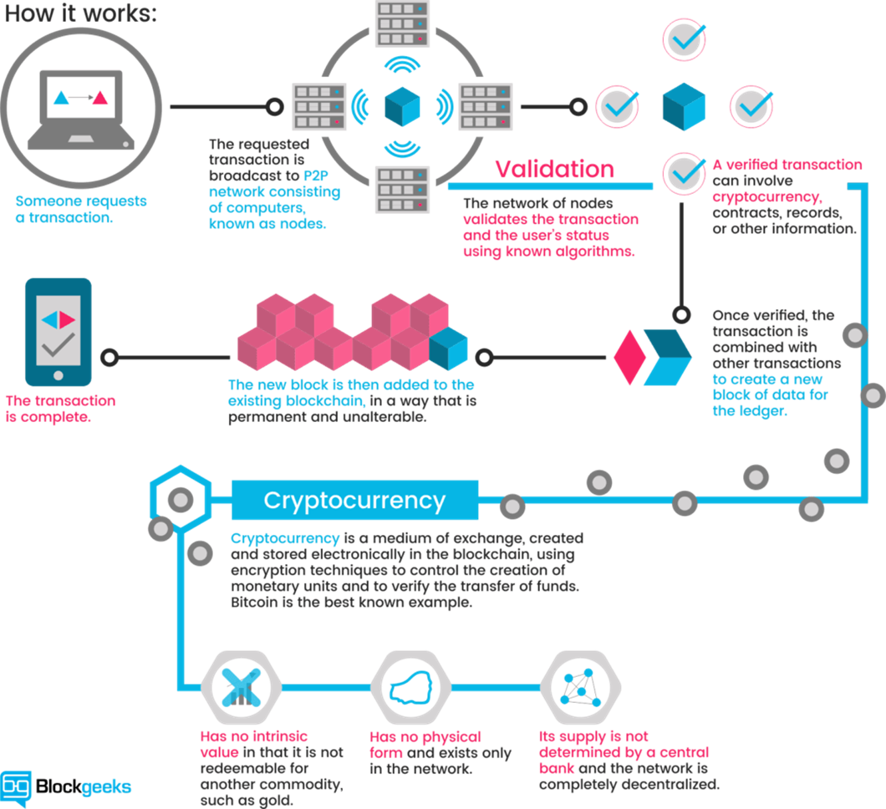

Slide 4

USES:
Ethical business practices
Digital World
Going green
Decentralized
Fast and Secure

Slide 5
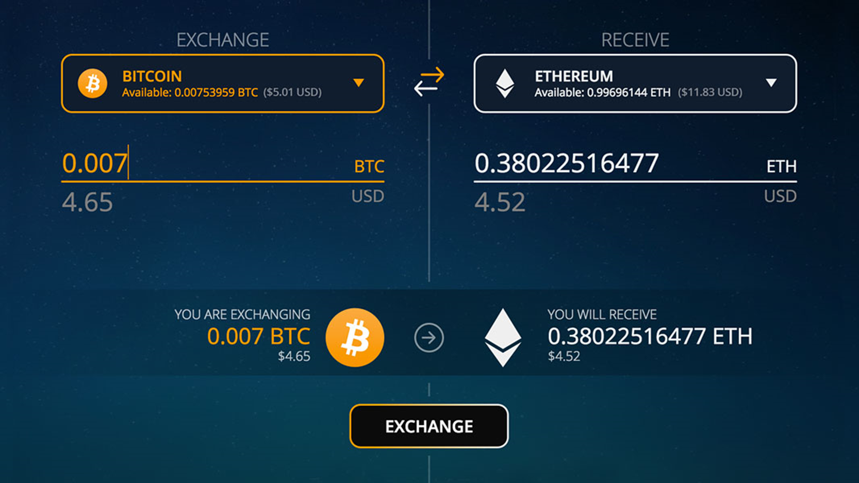
USE CASE:
This site gives you all the latest streaming pricing data in the world of cryptocurrencies.
Latest News Articles
Returns news articles from the providers that Crypto Compare has integrated with.
Allow customers to trade
cryptocurrencies for other assets,
such as conventional
money, or to trade between
different digital currencies.

Slide 6






Server
External API
Website
Database
User

Slide 7
Technologies Used -
Front End- HTML,CSS,JavaScript,Bootstrap
Framework - Django
Database - MySQL

