Slide 1
git

Slide 2

******* HOW GIT WORKS *******

Slide 3
HOW GIT WORKS
working directory: Dateien auf der Festplatte.
Enthält "modified" files
staging area (= index): Datei im git-Verzeichnis, welche Informationen darüber speichert, welche Änderungen in den nächsten Commit reifließen werden.
Enthält: "staged" files.
git repository: Dateien, die im git repository gesichert wurden. Diese sind eher schwierig durch Zufall zu entfernen.
Enthält: "commited" files

Slide 4
DOWNLOADING FILES
Lokale Kopie eines github repository erzeugen:
git clone https://github.com/Jane333/test1.git
Oder neues, leeres repository anlegen:
git init
Alle Dateien / Änderungen aus dem remote repository runterladen:
git pull

Slide 5
UPLOADING FILES
Neue Datei zum git repository hinzufügen (in die “staging area”):
git add file1.txt
Datei entfernen:
git rm file1.txt
Datei umbenennen / verschieben:
git mv file1.txt

Slide 6
UPLOADING FILES
Alle Veränderungen der “getrackten” Dateien in die “staging area” hinzufügen UND sofort commiten:
git commit -am "I just added some files..."
Commit nach github hochladen. Tut das Gleiche wie git push origin master:
git push
Alternativ: ALLE Dateien in die staging area hinzufügen:
git add .
Staged files commiten:
git commit -m "I just added some files..."
Commit hochladen:
git push

Slide 7
RESOLVING CONFLICTS
Szenario:
Person A erzeugt commits und pusht sie.
Person B macht aber keinen pull, sondern erzeugt eigene commits (lokal), und versucht dann, sie zu pushen.
Person B bekommt nun den error:
"Updates were rejected because the remote contains work that you do not have locally. You may want to first integrate the remote changes (e.g., 'git pull ...') before pushing again."
Also muss Person B einen pull machen... Bei dem pull kommt jedoch dieser Fehler:
"CONFLICT (content): Merge conflict in .... Automatic merge failed; fix conflicts and then commit the result."

Slide 8
RESOLVING CONFLICTS
Nun muss man die Konflikte per Hand auflösen. Das geht mit einem mergetool, z.B. kdiff3:
git mergetool --tool=kdiff3
Gewünschte Änderungen manuell auswählen, speichern. Damit ist die Konfliktauflösung abgeschlossen (lokal). Diese konfliktfreie Version möchte man also hochladen:
git commit -am "some message"
git push

Slide 9
RETURNING TO PREVIOUS COMMITS
git checkout <old_commit_ID> # zum Zustand bei old_commit_ID zurückkehren. Z.B.:
git checkout c9cda6dc4fd35bf4640f534af4a507f1092fcbce # dies führt zu einem "detached HEAD" state. Lösung: neuen branch erzeugen.
git checkout master # in die Gegenwart zurückkehren
oder:
git reset --hard <old_commit_ID> # Arbeitsverz. UND HEAD zum älteren commit zurückkehren
git reset --hard <new_commit_ID> # Zurück in die Gegenwart. Vorsicht! Hierzu braucht man die new_commit_ID, diese wird jedoch von git log nicht mehr angezeigt. Lösung: aufschreiben oder mittels git reflog finden.

Slide 10
OTHER USEFUL COMMANDS
git status # Ist alles ok? Auf welchem branch bin ich?
git log # Was sind die letzten commit messages and commit IDs?
git log origin/branch2 # Wie sieht der Log von "branch2" auf github aus?
Damit mehrere Menschen in das gleiche github repository pushen können: 1 Person legt das repo an un fügt alle anderen als “collaborators” hinzu.

Slide 11
BRANCHING
# create new branch:
git branch <new_branch_name>
# go to this new branch:
git checkout <new_branch_name>
# go back to the old branch "master":
git checkout master
# list all existing branches:
git branch

Slide 12
BRANCHING
# Delete the specified branch. This is a “safe” operation in that Git prevents you from deleting the branch if it has unmerged changes.
git branch -d <branch>
# Force delete the specified branch, even if it has unmerged changes. This is the command to use if you want to permanently throw away all of the commits associated with a particular line of development.
git branch -D <branch>
# While on branch master, merge branch <new_branch_name> into master. This will grab all the commits from <new_branch_name> and merge them into master (changing master and leaving new_branch_name unaffected):
git merge <new_branch_name>

Slide 13
STASHING
Scenario:
You made some changes in your working directory, have not commited them yet, and want to pull the newest commits from github. But, your local changes stand in the way. Simply stash them away temporarily:
git stash
pull the github commits:
git pull
and then get your stashed changes back, on top of the github commits:
git stash pop

Slide 14
REBASE vs. PULL
Purpose of both: merging two branches that have 'diverged' (each of them has commits the other one does not have).
Difference: rebase results in a linear history, pull will let you see that the commits came from two different branches.

Slide 15
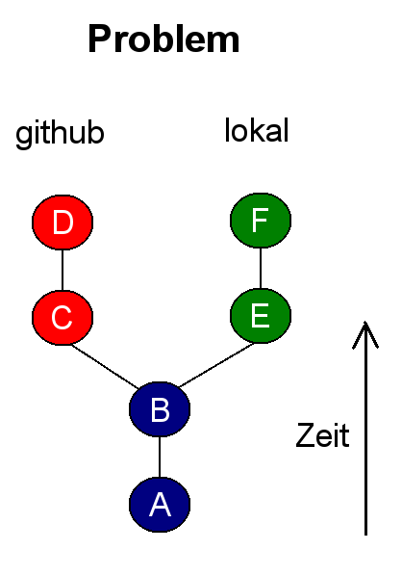
REBASE vs. PULL

Slide 16
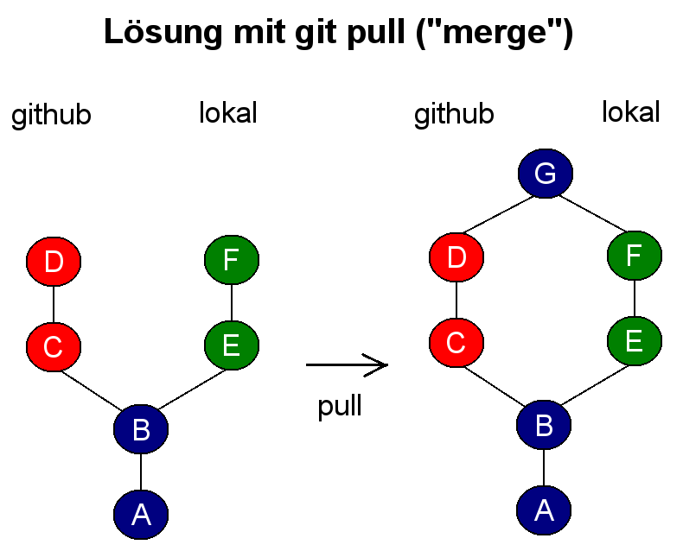
REBASE vs. PULL

Slide 17
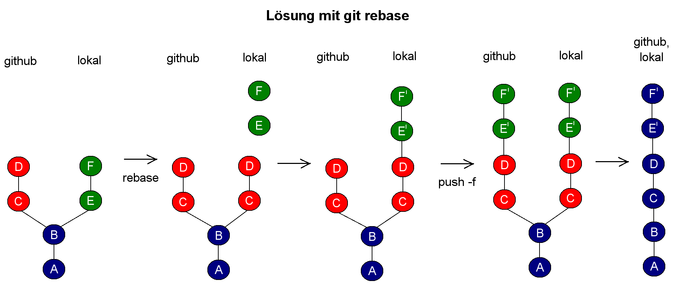
REBASE vs. PULL

Slide 18
PULL
This fetches all the remote commits to you and merges them with your stuff. if repo_name == origin and branch_name == master, they do not need to be specified:
git pull <repo_name> <branch_name>
Now you have both your own commits and those from github, nicely merged. You need to get them all to github, because after a pull, github still doesn't have YOUR commits.
git push

Slide 19
REBASE
Fetch all changes from remote repository:
git fetch --all
stashes away your commits, downloads remote commits from github, puts them on top of the commits you and github had in common, gets your commits that have been stashed away and puts them on top of the github commits:
git rebase <repo_name>/<branch_name>
now you need to upload your nicely linear commits from your local repo back to github. The force (-f) option is necesarry because a rebase changes commit IDs:
git push -f

Slide 20
PULL REQUESTS
- What are they good for?
- You are working on a software project. For that purpose, you forked the software project repository. Now you are done and want the professor to integrate your fork into the master branch of the software project. So you make a pull request, and the prof accepts it.
- How do I make them?
- Go to github, to your fork, and look for anything read reads "Pull Requests". Keep clicking until it says the pull request has been submitted.

Slide 21
GLOSSARY
HEAD
You can think of the HEAD as the "current branch". When you switch branches with git checkout, the HEAD revision changes to point to the tip of the new branch. (HEAD always points to the tip of the branch you are currently in)
You can see what HEAD points to by doing:
cat .git/HEAD
In my case, the output is:
ref: refs/heads/master
It is possible for HEAD to refer to a specific revision that is not associated with a branch name. This situation is called a detached HEAD. Any checkout to a specific commit ID will get you there.

Slide 22
GLOSSARY
ORIGIN
origin is the original remote repository, by convention it is the 'primary' centralized repository as well.
When a repository is cloned, it has a default remote called origin that points to your fork on GitHub, not the original repository it was forked from. To keep track of the original repository, you need to add another remote named for example 'upstream'.

Slide 23
GLOSSARY
REMOTE
When you clone your repo from github, the github repository is a "remote" of your local repository. You can add other remotes like this:
git remote add neues_upstream https://github.com/irgendein_github_name/ein_github_repo.git
or display all existing remotes like this:
git remote -v

