Slide 1
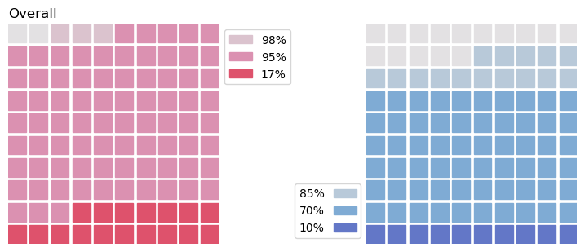
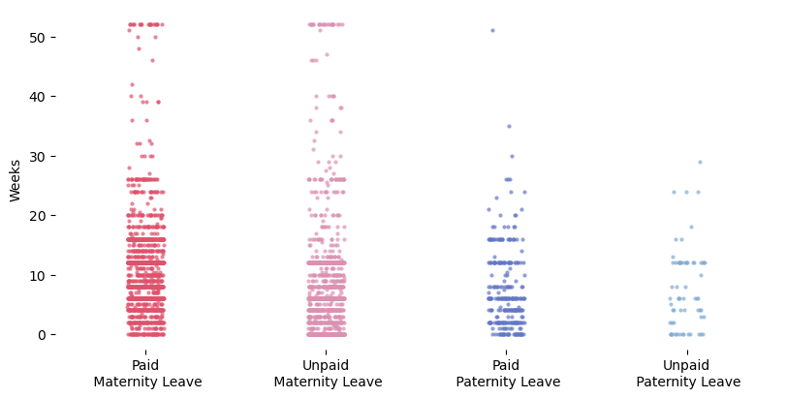
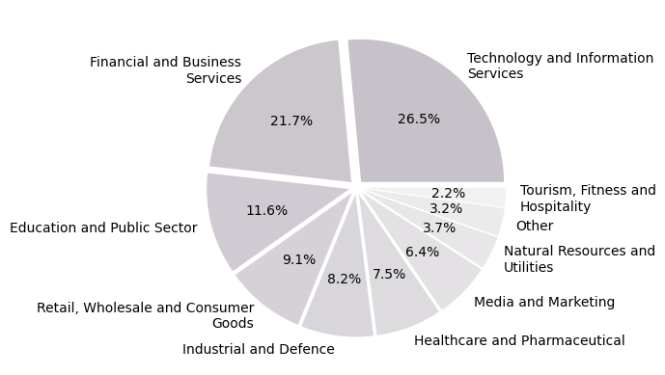
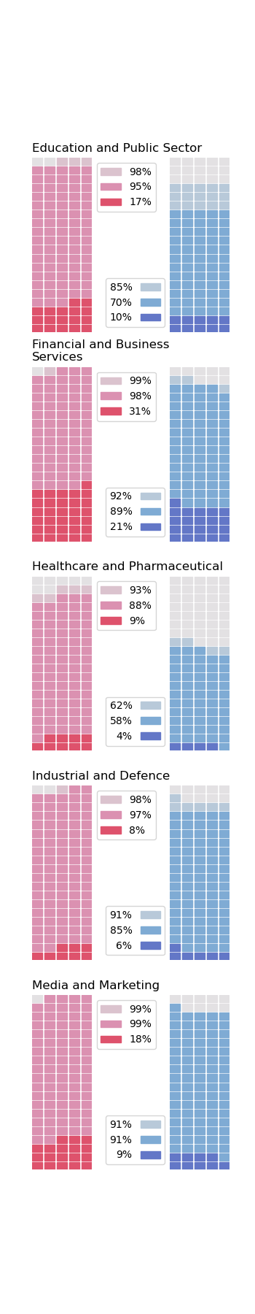
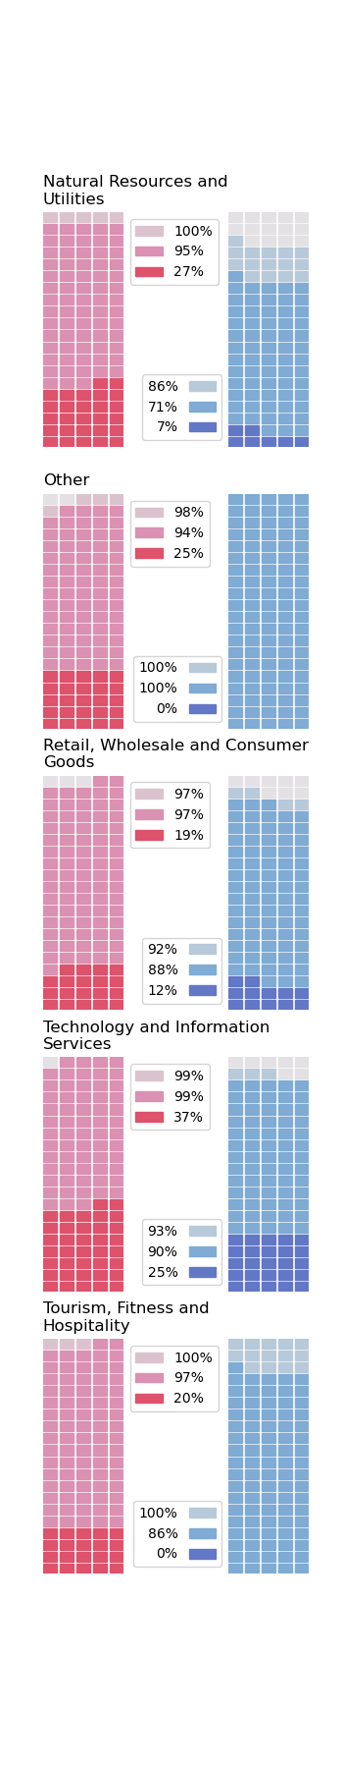
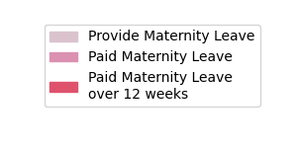
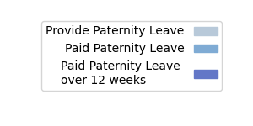
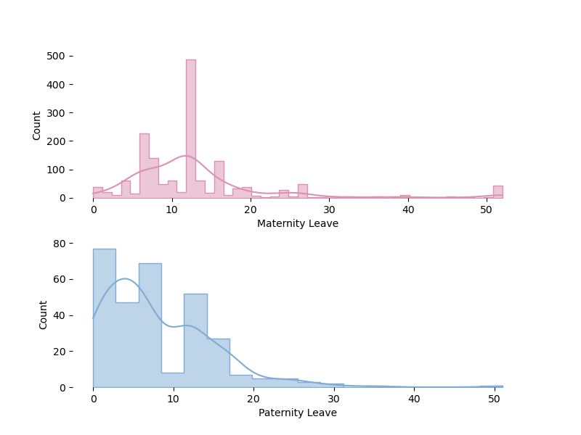
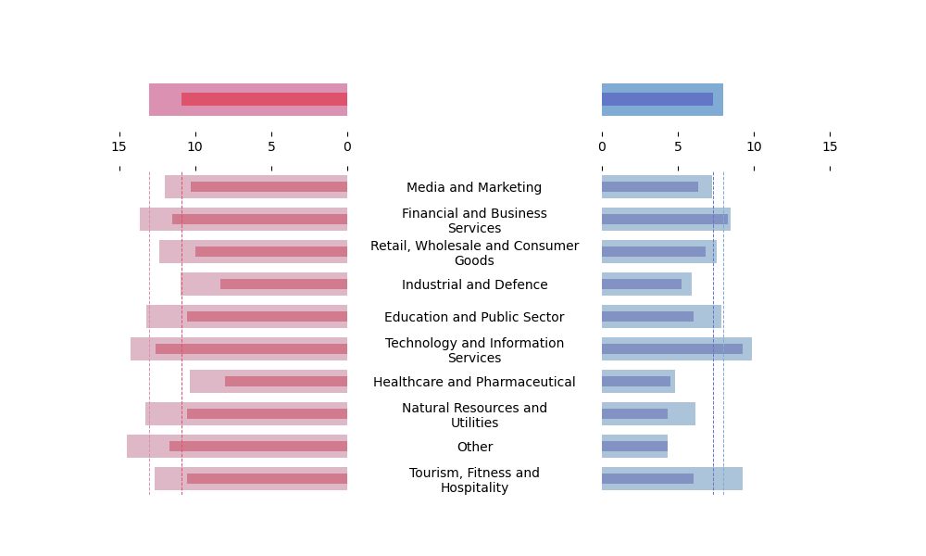
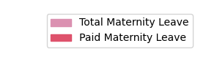
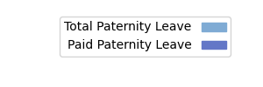
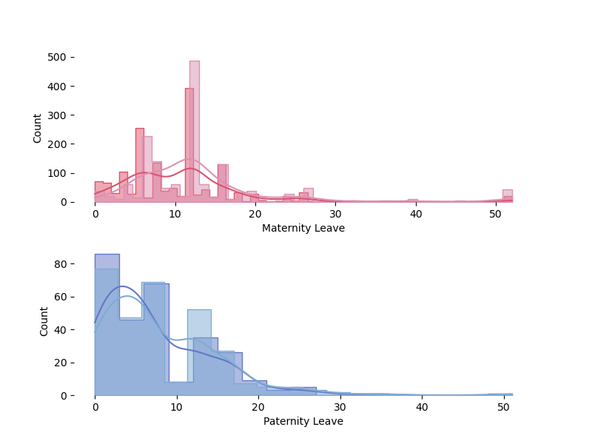
Maven Family Leave Challenge
Shares of Types of Parental Leave
Industry Shares in the Survey
All Data by Type of Leave
only 1 company
provides
paternity leave with the length of 51 weeks
64 companies
provided information about unpaid paternity leave
The survey includes 1601 companies in 10 different industries
Distribution of Parental Leave Duration
12 – 13 weeks
is the most common length of provided maternity leave
52 weeks
is the longest maternity leave
Average Duration Of Parental Leave
13 weeks vs 8 weeks
on average provide companies for maternity and paternity leave , respectively
Healthcare and Pharmaceutical is an industry with the smallest share of companies, which provide paid parental leave
75% companies provide less than 12 weeks for paternity leave
Men in Technology and Information Services and Financial and Business Services will more likely get a paid paternity leave for more than 12 weeks than in other industries
Total Parental Leave Duration vs Paid Parental Leave Duration
The comparison shows that KDE of paid leaves shifts to the right in both cases

