Slide 1


Software as a service (Saas)
UC-Berkeley
Strategic Computing and Communications Technology
Group D
Fong Hui
Yun Kyung Jung
Yijia Li
Roxana Hernandez

Slide 2
Who is the most successful provider of Saas?

Slide 3
Salesforce.com
Founded in 1999
Annual growth rate is over 80%
Went to IPO in 2004

Slide 4
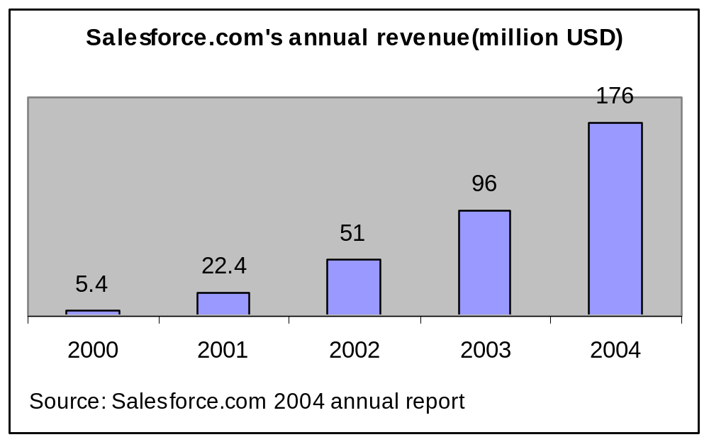

Slide 5
What happened here?

Slide 6
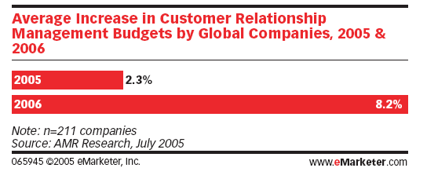
Software Market Trend
Large enterprises:
Notes:
Global Companies’ planning changes to their CRM budgets: 5000+employees 50%; 1000~5000 63%
US SMBs’ planned spending on CRM applications over the next 2 years. (Significant investment 23%, 37% slight increase)

Slide 7
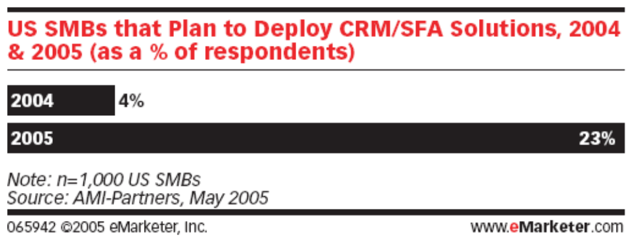
Software Market Trend(Continue)
Small-to-medium businesses:

Slide 8
Software Market Trend(continue)
Business Trend
  Smaller package with flexible coupled component
  Cost effective
  Easily deployed, reconfigured and updated
  Standardized industrial application
Traditional enterprise Software
  Delivered as a large package
  Charge high license fee
  High deployment and maintenance fee
Notes:
In general, users have to spend $9 on deployment and maintenance fee per dollar spent on license fee

Slide 9
Web Services
Characteristic of Web Services
  Provide interoperability between various software application
  Standard interface on server
  Enable to run on disparate platforms
Benefit of Web Services
  Allow to share business logic, data and processes as services
  Reduce the software purchasing cost
  Form the technical foundation for software as service business model
Notes:
Increase the flexibility to allow users to choose only the components needed.

Slide 10

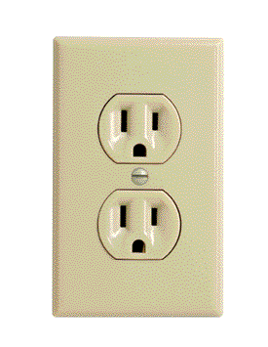
Software as a service (Saas)
Traditional Software
On-Demand Utility
Plug In, Subscribe
Pay-per-Use
Build Your Own

Slide 11
Comparison of business model
Traditional packaged software
Software as a serivce
Designed for customers to install, manage and maintain.
Designed from the outset up for delivery as Internet-based services
Architect solutions to be run by an individual company in a dedicated instantiation of the software
Designed to run thousands of different customers on a single code

Slide 12
Traditional packaged Software
Software as a serivce
Infrequent, major upgrades every 18-24 months, sold individually to each installed base customer.
Frequent, "digestible" upgrades every 3-6 months to minimize customer disruption and enhance satisfaction.
Version control
Upgrade fee
Fixing a problem for one customer fixes it for everyone
Streamlined, repeatable functionality via Web services, open APIs and standard connectors
May use open APIs and Web services to facilitate integration, but each customer must typically pay for one-off integration work.

Slide 13
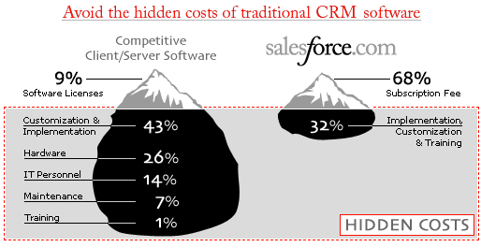
Hidden Cost

Slide 14
What’s the Challenge for Saas?

Slide 15
Challenge One:
Switching Cost
Solution?
Make customer happy!
Other……?

Slide 16
Challenge two:
Limited flexibility
Solution?
Make everything customizable
Application Exchange platform
Others….?

Slide 17
Challenge three:
security and privacy
Solution?
be careful and professional as much as they can?

Slide 18
What kind of software is more amenable to be provided as a service?

Slide 19
Applicability of Saas
Enterprise Software Application
  Perform business functions
  Organize internal and external information
  Share data among internal and external users
  The most standard type of software applicable to Saas model
  Example: Saleforce.com CRM application, Siebel On-demand application
Notes:
One of the typical examples is Salesforce.com’s CRM application for communication industry, which standardizes sales processes and customer services. About 30 companies, including AOL and Nokia, are current users of this on-demand software application.

Slide 20
Applicability of Saas(Continue)
Single-User software application
  Organize personal information
  Run on users’ own local computer
  Serve only one user at a time
  Inapplicable to Saas model
    Data security issue
    Network performance issue
  Example: Microsoft office suite

Slide 21
Applicability of Saas(Continue)
Infrastructure software
  Serve as the foundation for most other enterprise software application
  Inapplicable to Saas model
    Installation locally is required
    Form the basis to run other application
  Example: Window XP, Oracle database

Slide 22
Applicability of Saas(Continue)
Embedded Software
  Software component for embedded system
  Support the functionality of the hardware device
  Inapplicable to Saas model
    Embedded software and hardware is combined together and is inseparable
  Example: software embedded in ATM machines, cell phones, routers, medical equipment, etc
Notes:
An embedded system is a special-purpose computer system, which is completely encapsulated by the device it controls.
Most of the time, the hardware manufacturer has to provide embedded software when they sell hardware to users.

