Slide 1
WorldCat Navigator
& the future of library services on the Web
ALA
24 January 2009
Katie Birch
John F. Helmer

Slide 2
Overview
The current state of library services,
particularly resource sharing
Introduction to WorldCat Navigator
Results with the Orbis Cascade Alliance
The future of networked library services
Q&A

Slide 3
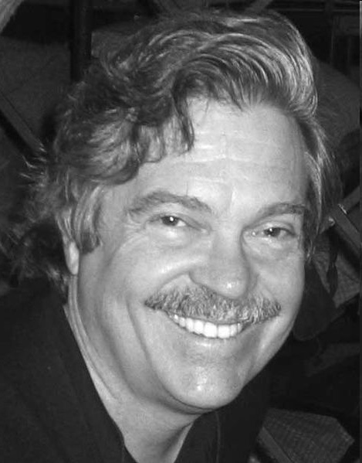
Where are we going?
The best way to predict the future
is to invent it.
~ Alan Kay
Computer scientist, known for his early pioneering work on object-oriented programming and graphical user interface design.

Slide 4
YouTube - j r hartley

Slide 5

Choice
“Increasingly the mass market is turning in to a mass of niches. That mass of niches has always existed, but as the cost of reaching it falls – it’s suddenly becoming a cultural and economic force to be reckoned with.... many of these kinds of products have always been there, just not visible or easy to find.”
- Chris Anderson, The Long Tail

Slide 6




Timeline…
1980’s
1990’s
2000’s
2010’s
Stand alone ILS
Dial-up service
OPAC
Web enabled OPAC
Licensed content
Consortia sysems
OpenURL resolvers
Federated search
Electronic resource management
Web 2.0/3.0
Cloud computing
New paradigm:
networked library services

Slide 7
How resource sharing often works today
The players:
Libraries
Users
Partners
Data
Academic
Public
School
Single library
Library group
Consortia
State library
National library
Corprate library
Global libraries
ILS vendors
ILL vendors
Publishers
Aggregators
Search engines
Study sites
Social sites
MashUps
Coders
Bloggers
Catalog
Content
Local data
Holdings
Policies
Procedures
History
Management
Kids
Young students
Students
Teachers
Researchers
Parents
Job seekers
Readers
etc., etc.

Slide 8
How resource sharing often works today
The process:
Book vendors
Local Library
Print
eContent
Local OPAC
User
Digital
Group catalog
ILL search
Link vendors
Publishers
Hosts
Search engines
Social sites
Blogs
Library Group
Global
Libraries

Slide 9
How library services often work today
Book vendors
Local Library
Print
eContent
Local OPAC
User
THIS IS A MESS
Digital
Group catalog
ILL search
Link vendors
Publishers
Hosts
Search engines
Social sites
Blogs
Library Group
Global
Libraries

Slide 10

The result…

Slide 11
How resource sharing often works today
The goal:
Libraries
Data
Users
Partners

Slide 12
What Navigator does…
Discovery
Seamless search
Real-time availability
Local branding
Group relevancy results
Navigator Request Engine
Request management based on policies
Uses real time availability to build smart unlimited lender strings
Single interface for consortia and ILL requests
Libraries
Data
Users
Partners
Cooperation with
ILS vendors and integration with ILLiad

Slide 13
What Navigator does…
Staff Interface
2-becomes-1
Libraries
Patron Interface
3-becomes-1
Data
Circulation Integration
The data working harder
Users
Partners

Slide 14
Circulation integration details
Place hold
NRE Received action – Bib record & patron update
NRE Shipped action - Check out items
NRE Returned action - Check in items
Renew items
Cancel requests

Slide 15
Efficiency gains with Navigator Request Engine
Time
savings
Without NRE
205 seconds x
1,481 items per month
= 84.33 hours
With NRE
170 seconds x
1,481 items per month
= 69.93 hours
ILL staff
14.4 hours
per month
Without NRE
105 seconds x
1,481 items per month
= 43.19 hours
With NRE
55 seconds x
1,481 items per month
= 22.63 hours
Library staff
20.56 hours
per month
Total time savings: 420 hours per year
Source: MNLink

Slide 16

WorldCat Navigator Meeting at ALA Midwinter 2009
Orbis Cascade Alliance
and WorldCat Navigator
John F. Helmer
Executive Director
Orbis Cascade Alliance

Slide 17
Overview
Orbis Cascade Alliance
WorldCat Navigator
Timeline & process
What works, what doesn’t work (yet)
Final thoughts
Notes:
Orbis Cascade Alliance
www.orbiscascade.org

Slide 18
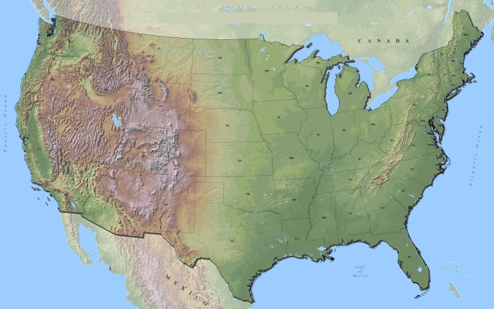
Membership, programs,
& strategic agenda
Oregon & Washington
Private & Public, 2-year & 4-year
Colleges, Universities, Community colleges
Members serving 600 – 42,000 students (FTE)
Notes:
Orbis Cascade Alliance
www.orbiscascade.org

Slide 19
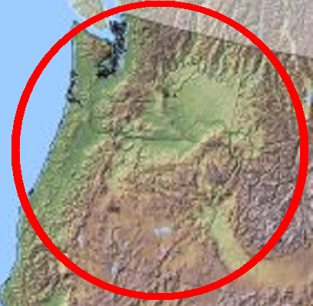
36 Members
Central Oregon Comm. College
Central Washington University
Chemeketa Community College
Clark College
Concordia University
Eastern Oregon University
Eastern Washington University
George Fox University
Lane Community College
Lewis & Clark College
Linfield College
Mt. Hood Community College
Oregon State University
Oregon Health & Science Univ.
Oregon Institute of Technology
Oregon State University
Pacific University
Portland Community College
Portland State University
Reed College
Saint Martin’s College
Seattle Pacific University
Seattle University
Southern Oregon University
The Evergreen State College
University of Oregon
University of Portland
University of Puget Sound
University of Washington
Walla Walla College
Warner Pacific College
Washington State University
Western Oregon University
Western Washington University
Whitman College
Willamette University
7
Puget Sound
5
Eastern
20
Willamette Valley
2
Central
Cascade Range
2
Southern
Notes:
Orbis Cascade Alliance
www.orbiscascade.org

Slide 20
Major Programs
Conferences & Workshops
  ARL/ACRL Institute on Scholarly Communication
  (Portland, December 1-3, 2008)
Cooperative Collection Development
  YBP agreement
  Distributed Print Repository
Courier Service
  250 libraries served through 76 dropsites in Oregon, Washington, & Idaho
  400,000 packages per year
Digital Services
  Summit search engine, digital collections, institutional repositories, etc.
Notes:
Orbis Cascade Alliance
www.orbiscascade.org
Here is where we’ll spend some time

Slide 21
Major Programs
Electronic Resources
  62 libraries in Oregon, Washington, Idaho, Hawaii
  Databases, ejournals, ebooks, etc.
Northwest Digital Archives
  31 libraries and archives in Oregon, Washington, Idaho, Montana, and Alaska
  EAD finding aids, union database, digital content
Summit Resource Sharing System
  36 academic institutions in Oregon and Washington
  9.2 million unique titles, 28.7 million items
  INN-Reach 1993-2008
  All members use III Millennium ILS
  Very popular service …
Notes:
Orbis Cascade Alliance
www.orbiscascade.org
Here is where we’ll spend some time

Slide 22
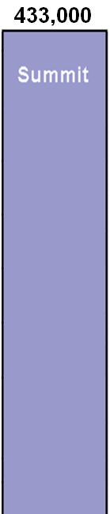
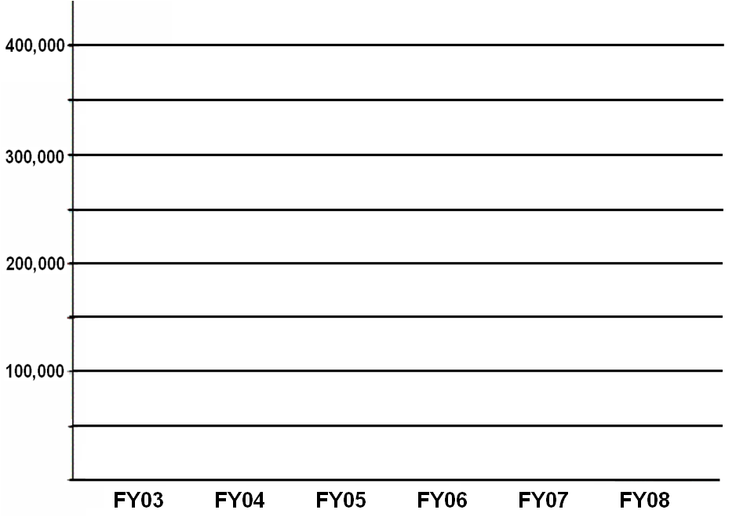
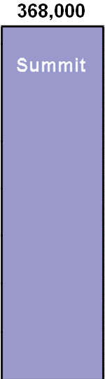



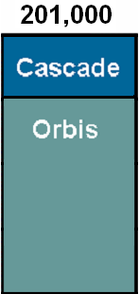
Summit Fulfillments: FY03-08
Notes:
Orbis Cascade Alliance
www.orbiscascade.org

Slide 23
Strategic Agenda
“Moving to the Network Level” – April 2006 Retreat
Regional Library Services Center
Cooperative Collection Development
Digital Services Program
Northwest Digital Archives
ARL/ACRL Institute on Scholarly Communication
Next Generation Systems
  Data Harvesting
  Discovery: Aquabrowser, Encore, Endeca, Local development, WorldCat Local, Primo, etc.
  Resource Sharing Systems
  Integrated Library Systems (ILS)
Notes:
Orbis Cascade Alliance
www.orbiscascade.org
Here is where we’ll spend some time

Slide 24
WorldCat Navigator
Discovery
  Group Catalog on the WorldCat.org platform
  Option for member libraries to implement WorldCat Local
Delivery
  Navigator Request Engine based on Virtual Document eXchange (VDX)
  New: III Circulation gateway; Availability; Streamlined workflow
Integrated solution
Notes:
Orbis Cascade Alliance
www.orbiscascade.org
Here is where we’ll spend some time

Slide 25
Timeline & process
2006
  October: Strategic Agenda formalized
2007
  March: first board-level consideration of WCLocal
  November: accelerated investigation of resource-sharing options

Slide 26
Timeline & process
2008
  March:
    “As a strategic initiative, the Orbis Cascade Alliance will contract with OCLC to pursue the development of a next generation technical platform for Summit.”
    Formation of Implementation Team and workgroups (Catalog, Circ & ILL, Technical, INN-Reach shut down)
  August 15: first expected delivery, circ gateway delayed by new technical challenges
  October 15: first delivery of WorldCat Navigator
  November: work out bugs, “train the trainer,” nine regional training sessions
  December 1: Summit moves from INN-Reach to WCNavigator
2009
  January: stress test of system, staff, and workflows under large volume of requesting

Slide 27
What works, what doesn’t work (yet)
Jan. 2009
 | Works now | Not yet
Discovery via group catalog | ✓
Pass-through search from Millennium* | ✓
Request | ✓
Patron notices | ✓
Manage requests | ✓
Load balancing | ✓
Tracking using item barcode |  | ✓
Availability visible to patrons | ✓
Circ gateway: place hold | ✓
Circ gateway: availability | ✓
Circ gateway: bib/item record creation | ✓
Circ gateway: renewal |  | ✓
* = developed by Orbis Cascade Alliance

Slide 28
What works, what doesn’t work (yet)
Jan. 2009
 | Works now | Not yet
ILL: Resolver – email to ILL dept* | ✓
ILL: Resolver – transfer to mgmnt system* | ✓
ILL: Integration with Illiad |  | ✓
ILL: Integration with WC Resource Sharing |  | ✓
ILL: end of rota transfer (“over the wall”) | workaround | ✓
Requesting part of a multipart item |  | ✓
Pick-up Anywhere | workaround | ✓
Visiting patron | workaround | ✓
Patron authentication | ✓
EZProxy patron authentication | ✓
Paging slips* | ✓
E-resource OpenURL resolver* | ✓
* = developed by Orbis Cascade Alliance

Slide 29
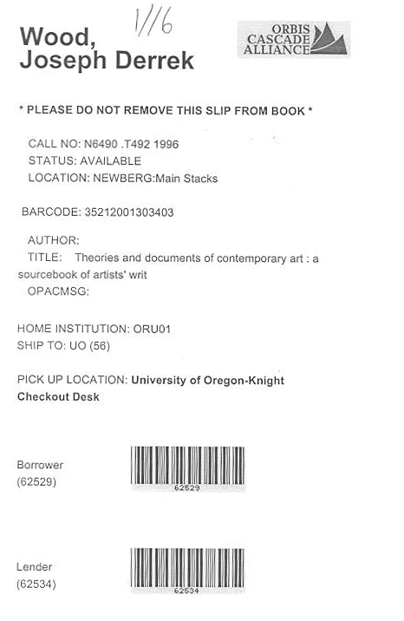
Paging slip

Slide 30
Final thoughts
Impact
  Resource sharing
  Human resources
Importance of Circulation
Consortial Borrowing philosophy
ILS and Resource Sharing as a utility
Notes:
Orbis Cascade Alliance
www.orbiscascade.org
Technical model
Central server connected to member local catalogs over internet
Continuously updated
All III
Ease of maintenance for library staff

Slide 31
Circ integration = Key to first-rate functionality and labor saving
Technical approaches
  Single platform
  Robust implementation of standards (e.g., NCIP)
  Workaround
  Complex workaround(s)
Better approaches to circ functionality?
Notes:
Orbis Cascade Alliance
www.orbiscascade.org
Here is where we’ll spend some time

Slide 32
Final thoughts
Impact
  Resource sharing
  Human resources
Importance of Circulation
Consortial Borrowing philosophy
ILS and Resource Sharing as a utility
Notes:
Orbis Cascade Alliance
www.orbiscascade.org
Technical model
Central server connected to member local catalogs over internet
Continuously updated
All III
Ease of maintenance for library staff

Slide 33
WorldCat Navigator Meeting at ALA Midwinter 2009
Orbis Cascade Alliance
and WorldCat Navigator
John F. Helmer
Executive Director
Orbis Cascade Alliance

