Slide 1
Clinical Decision Support Systems
Mohammed Saleem

Slide 2
Overview
Scope of Clinical Decision Support Systems
Issues for success or failure
Evaluation of Clinical Decision Support Systems
Computing techniques used to create DSS
Design Cycle for the development of DSS
Early AI/Decision Support Systems.
Open source Example

Slide 3
Scope of Clinical Decision Support Systems
Definition
Categories of CDSS
System Architecture
Advantages / Need for CDSS
Applications Areas
Disadvantages

Slide 4
Definition
A clinical decision-support system is any computer program designed to help health professionals make clinical decisions.
In a sense, any computer system that deals with clinical data or medical knowledge is intended to provide decision support.
Three types of decision-support function, ranging from generalized to patient specific.

Slide 5
Categories
Generating alerts and reminders
Diagnostic assistance
Therapy critiquing and planning
Image recognition and interpretation

Slide 6

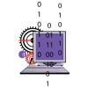











Knowledge Base
Event Monitor
Inference Engine
Clinical
Data
Repository
(CDR)
User
Recipient(s)
Notifier

Slide 7
Tools for Information Management
Examples:
  Hospital information systems
  Bibliographic retrieval systems (PubMed)
  Specialized knowledge-management workstations (e.g. electronic textbooks, …)
These tools provide the data and knowledge needed, but they do not help to apply that information to a particular decision task (particular patient)

Slide 8
Tools for Focusing Attention
Examples:
  Clinical laboratory systems that flag abnormal values or that provide lists of possible explanations for those abnormalities.
  Pharmacy systems that alert providers to possible drug interactions or incorrect drug dosages
Are designed to remind the physician of diagnoses or problems that might be overlooked.

Slide 9
Tools for Patient-Specific Consultation
Provide customized assessments or advice based on sets of patient-specific data:
  Suggest differential diagnoses
  Advice about additional tests and examinations
  Treatment advice (therapy, surgery, …)

Slide 10
Alternative (more specific) Definition
Clinical decision support systems are active knowledge systems which use two or more items of patient data to generate case-specific advice.
Main components:
  Medical knowledge
  Patient data
  Case-specific advice

Slide 11
Characterizing Decision-Support Systems
System function
  Determining what is true about a patient (e.g. correct diagnosis)
  Determining what to do (what test to order, to treat or not, what therapy plan …)
The mode for giving advice
  Passive role (physician uses the system when advice needed)
  Active role (the system gives advice automatically under certain conditions)

Slide 12
Passive Systems
The user has total control:
  Requires advice
  Analyses the advice
  Accepts/Rejects the advice
Domain of use:
  Wide domain like internal medicine
    Examples: QMR, DXPLAIN
  Narrow domain
    Acute abdominal pain
    Analysis of ECG

Slide 13
Passive Systems (cont.)
Characteristics:
  Stand-alone
  Data entry:
    System initiative
    User initiative
  Consultation style
    Consulting model
    Critiquing model

Slide 14
Active Systems
The user has partial control
  System gives advice
  User evaluates the advice
  The user accepts/rejects the advice
Domain of use
  Limited domain
    Drug interactions
    Protocol conformance control
    Laboratory results warnings
    Medical devices control

Slide 15
Active Systems (cont.)
Characteristics
  Built-in/integrated with other system (e.g. laboratory information system, or pharmacy system)
Data entry
  By the user
  Related to the main application
Consultation style
  Critiquing model
Examples:
  HELP (advices and reminders, therapy)
  CARE (reminders)

Slide 16
Need for CDSS
Limited resources - increased demand
Physicians are overwhelmed.
  Insufficient time available for diagnosis and treatment.
Need for systems that can improve health care processes and their outcomes in this scenario

Slide 17
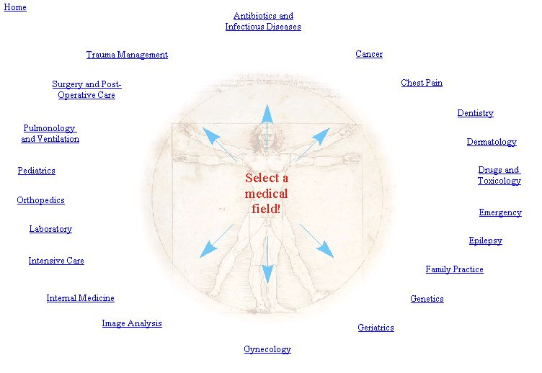
Application Areas

Slide 18
Possible Disadvantages of CDSS
Changing relation between patient and the physician
Limiting professionals’ possibilities for independent problem solving
Legal implications - with whom does the onus of responsibility lie?

Slide 19
Issues for success or failure
Evaluation of User Needs
Top management support
Commitment of expert
Integration Issues
Human Computer Interface
Incorporation of domain knowledge
Consideration of social and organisational context of the CDSS

Slide 20
Evaluation of Clinical Decision Support Systems
Criteria for success of CDSS
Aspects for consideration during evaluation

Slide 21
Criteria for a clinically useful DSS
Knowledge based on best evidence
Knowledge fully covers problem
Knowledge can be updated
Data actively used drawn from existing sources
Performance validated rigorously

Slide 22
Criteria for a clinically useful DSS (cont.)
System improves clinical practice
Clinician is in control
The system is easy to use
The decisions made are transparent

Slide 23
Aspects for Evaluation of a CDSS
The process used to develop the system
The systems essential structure
Evidence of accuracy, generality and clinical effectiveness
The impact of the resource on patients and other aspects of the health care environment

Slide 24
Computing techniques used to create DSS
Machine Learning and Adaptive Computing
  Inductive Tree Methods
  Case Based Reasoning
  Artificial Neural Networks
Expert Systems - Knowledge based Methods
  Rule based Systems

Slide 25
Design Cycle for the development of a CDSS
Planning Phase
Research Phase
System Analysis and conceptual phase
Design Phase
Construction phase
Further Development phase
Maintenance, documentation and adaptation

Slide 26
Early AI/Decision Support Systems.
De Dombal's system for acute abdominal pain (1972)
  developed at Leeds University
  decision making was based on the naive Bayesian approach
  automated reasoning under uncertainty
  designed to support the diagnosis of acute abdominal pain

Slide 27
Early AI/Decision Support Systems.
INTERNIST-I (1974)
  rule-based expert system designed at the University of Pittsburgh
  diagnosis of complex problems in general internal medicine
  It uses patient observations to deduce a list of compatible disease states
  used as a basis for successor systems including CADUCEUS and Quick Medical Reference (QMR)

Slide 28
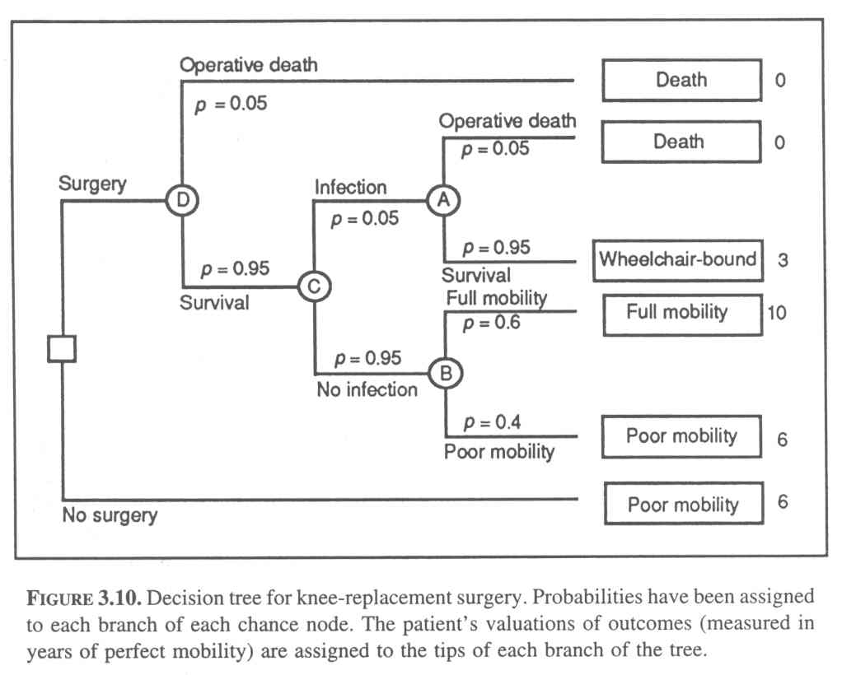
Example: Decision Tree 1

Slide 29
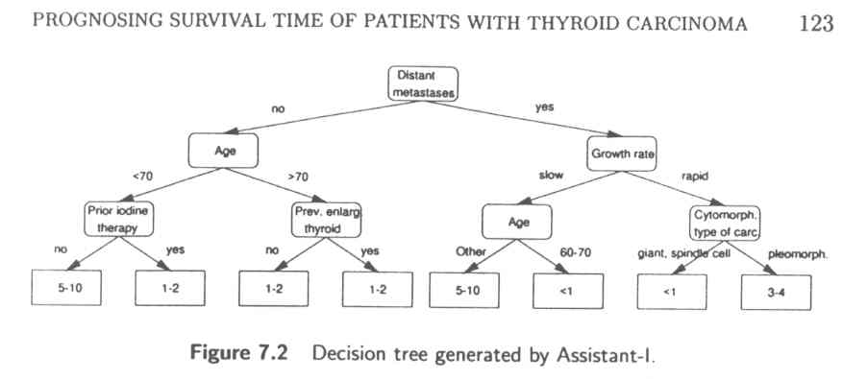
Example: Decision Tree 2

Slide 30
MYCIN (1976)
  rule-based expert system designed to diagnose and recommend treatment for certain blood infections (extended to handle other infectious diseases)
  Clinical knowledge in MYCIN is represented as a set of IF-THEN rules with certainty factors attached to diagnoses

Slide 31
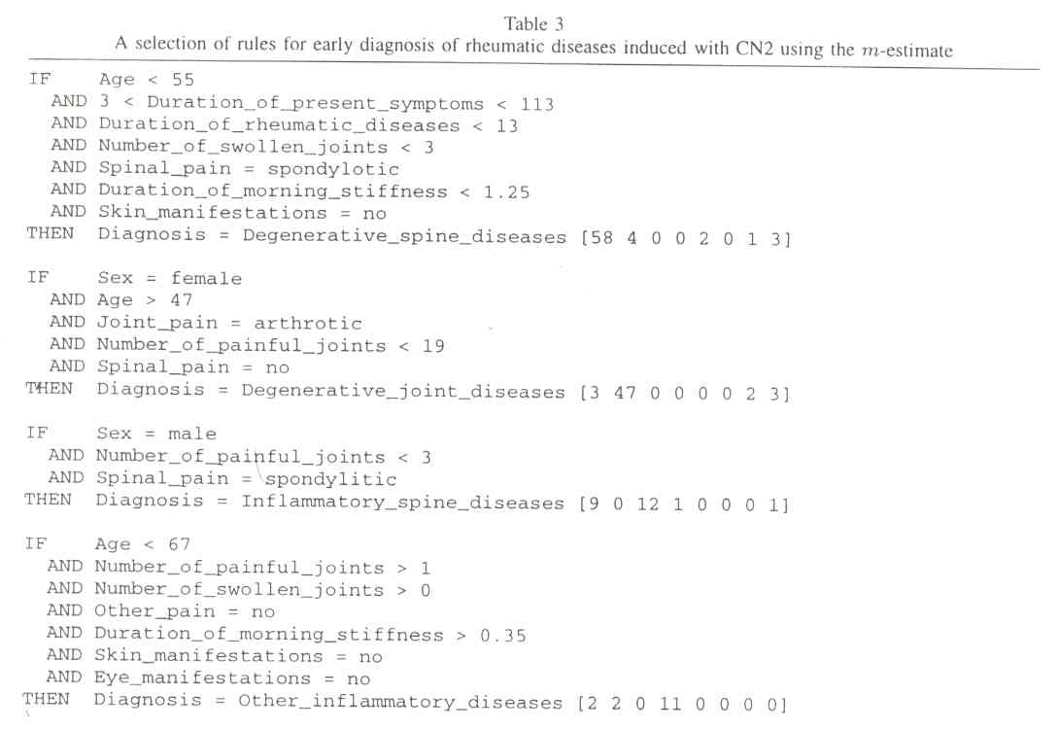
Example: Decision Rule 1

Slide 32
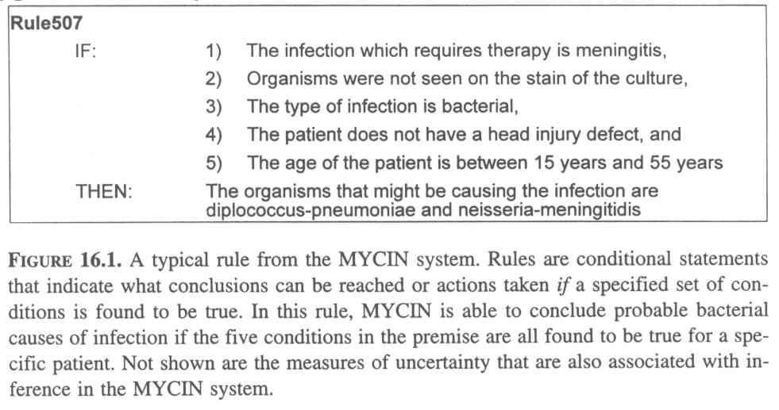
System MYCIN – a Decision Rule

Slide 33
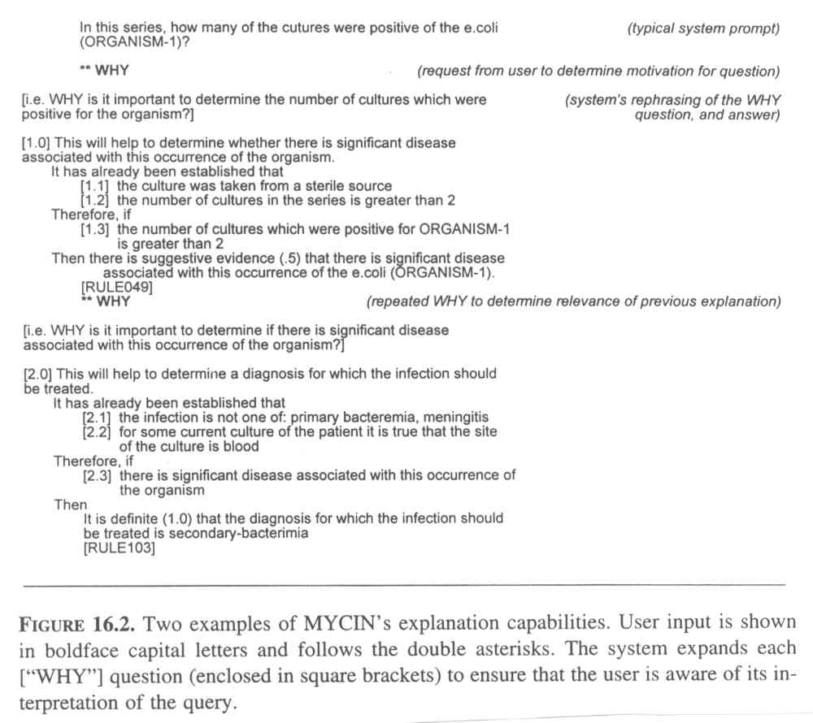
System MYCIN – Explanation Example

Slide 34
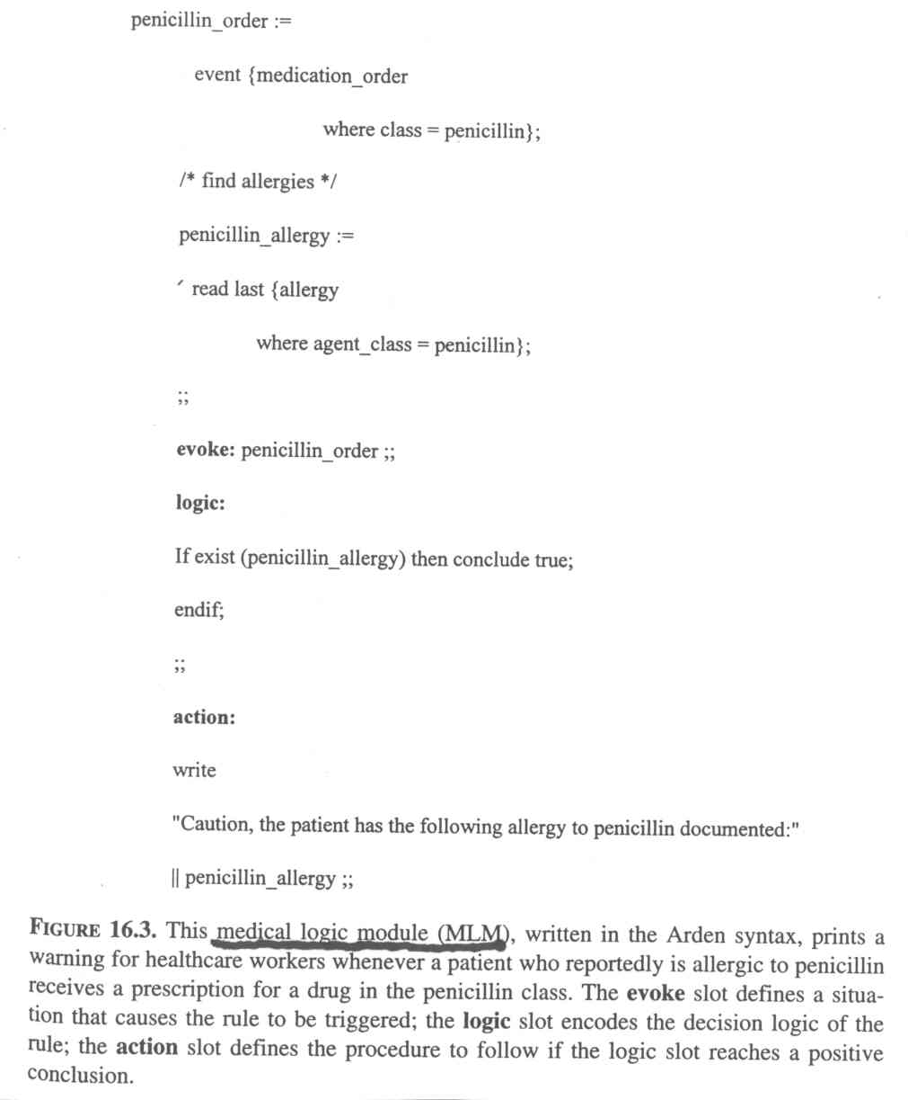
System HELP – MLM Example

Slide 35
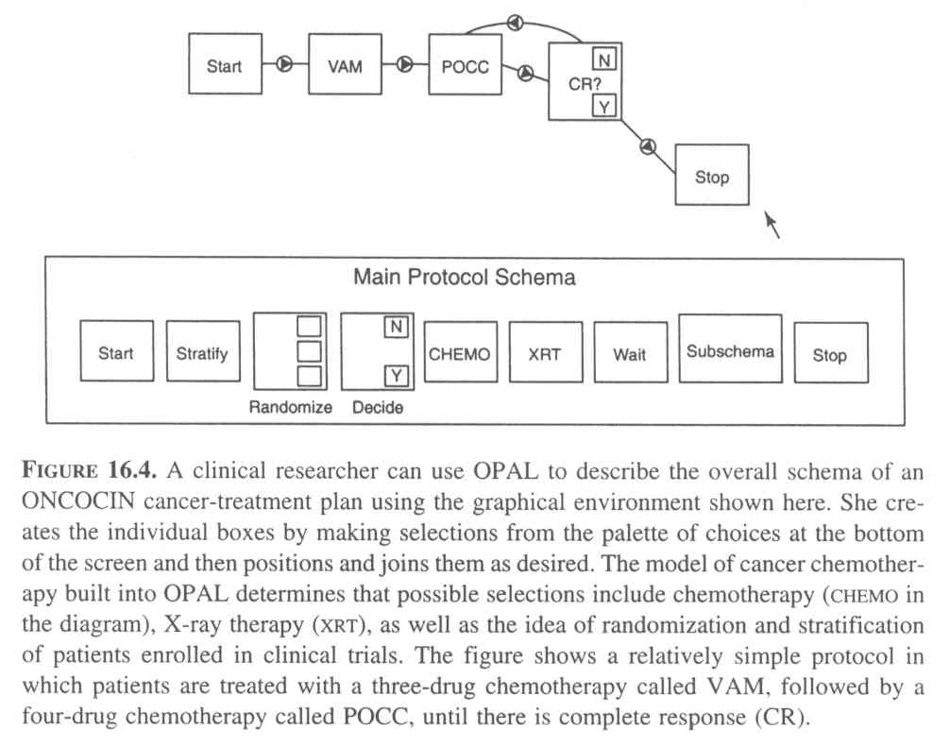
System ONCOCIN – Cancer-Treatment Protocol Example

Slide 36
Successful CDS Systems
DXplain
  uses a set of clinical findings (signs, symptoms, laboratory data) to produce a ranked list of diagnosis
  DXplain includes 2,200 diseases and 5,000 symptoms in its knowledge base.
  provides justification for why each of these diseases might be considered, suggests what further clinical information would be useful to collect for each disease.

Slide 37
Successful CDS Systems (cont.)
QMR Quick Medical Reference
  Based on Internist-1
  A diagnostic decision-support system with a knowledge base of diseases, diagnoses, findings, disease associations and lab information
  medical literature on almost 700 diseases and more than 5,000 symptoms, signs, and labs.
  frequency weight (FW)
  evoking strength (ES)

Slide 38
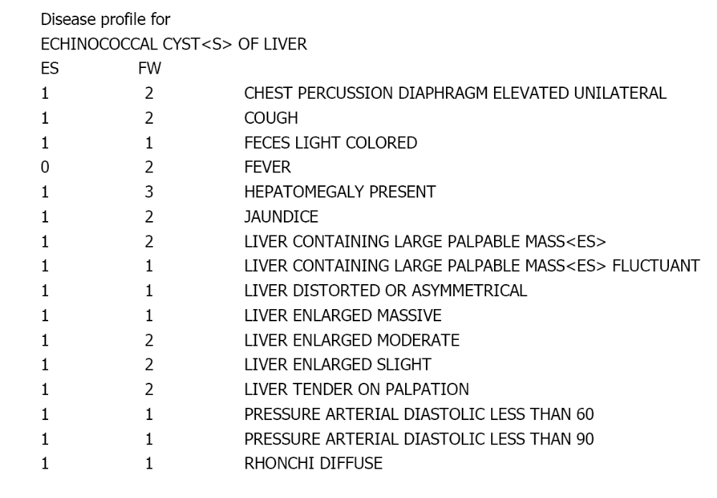

Slide 39
Open Source Medical Decision Support System

Slide 40
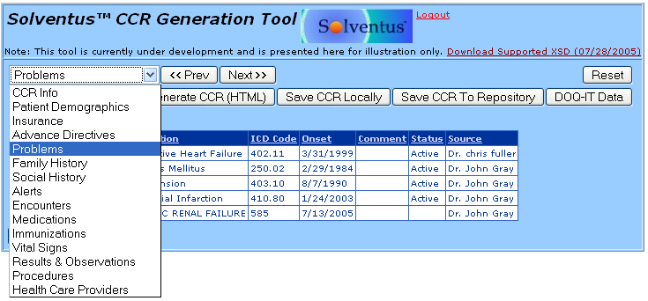
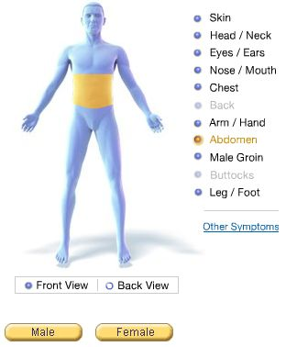
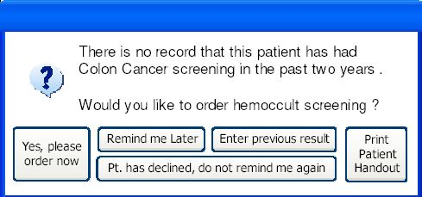
EMR/CIS/HIS (description of patient) + New Symptoms
Decision Support

Slide 41
Existing Medical DSS Systems
70 known proprietary DSS Systems.
  Only 10 of 70 geared towards General Practice.
  All require advanced technical knowledge.
  None allow source access to modify interface to Clinical. Information Systems (CIS).
  Only one is correctable/updateable by end user.
  Developed with little consideration of end users “..thus far the systems have failed to gain wide acceptance by physicians.”
Proprietary attempts to help physicians have failed.
  Cost to generate useful database outside reach of one company.

Slide 42
Proposed Solution
Clinical Decision Support System (DSS).
  Instant recommendations from an “expert”
  Improved care and accuracy of diagnoses.
    Reduce liability insurance premiums.
    Reduce the number of office visits to resolve conditions.
    Reduce the number of treatments attempted to resolve conditions.

Slide 43
Proposed Solution
Clinical Decision Support System (DSS).
  Allows verification of data not easily available for proprietary solutions.
  Allows updates in a timely and peer reviewable (e.g. Guideline International Network or NGC) manner.
  Integration is possible with EMR/CIS/HIS for record keeping and more detailed diagnoses based on regional statistics and past history.
  Reduction in the overall cost per man-hour.

Slide 44
Features of DSS
Describe Condition of Patient using Standards
  Standards approach eases interface with other systems, including proprietary systems.

Slide 45
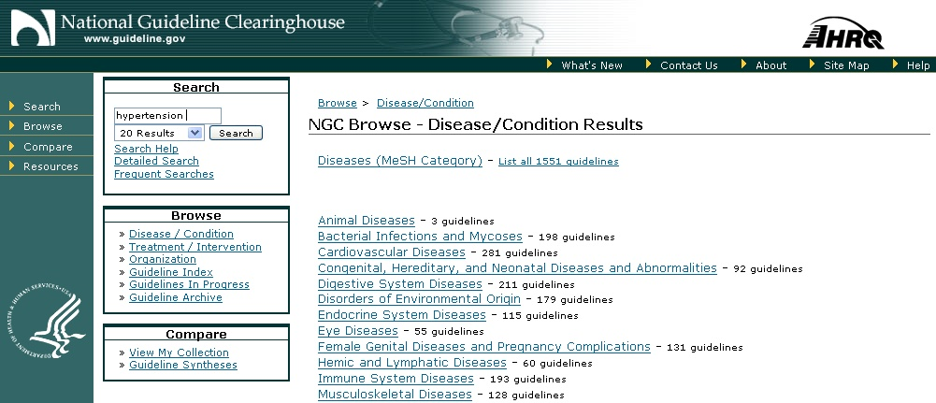
Features of DSS
Describe Clinical Guidelines and Diseases using Standards
  Several standards being considered for harmonization.
    GLIF3 has a lot of support.
  Standards approach eases interface with other systems, including proprietary systems.

Slide 46
Features of DSS
Simplified Graphical User Interface.
  Do for medical decision support systems what web browsers did for the internet, what GUI did for PC’s and PDA’s.
  Usable by anyone, including physicians, nurses and patients.
  Base on open-source info (e.g. visible human project.)

Slide 47
Issues
Privacy concerns/laws.
  No code shared with EMR/CIS/HIS.
  Patient identity not shared with DSS system.
Tremendous amount of data and rules must be incorporated into system.
  National Health Information Technology Coordinator created in 2004 to encourage/fund electronic health initiatives.
Resistance/job fears of clinicians
  Goal is to assist clinicians, not replace them.

Slide 48
Issues (cont.)
Clinical Trial Hurdles.
  Make recommendations, not diagnoses.
  Disclaimers regarding use.
All past efforts have failed to achieve common usage.
  Include end users (physicians, nurses, schedulers, IT departments) in the design decisions and testing.
  Iterative design approach (i.e. modify based on feedback.)

Slide 49
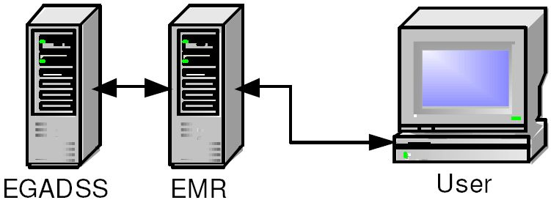


Existing Open Source Example
EGADSS system:
Interfaces with EMR/CIS only.
  - No direct symptom inputs.
Institutional support and funding.
Recommended Modifications:
Add GUI for patient/physician direct access.
Support development of Computer Interpretable Clinical Guidelines (CIG).

Slide 50
Where do we go from here?
Promote open source Computer Interpretable clinical Guideline (CIG) knowledge base development at the federal level with continuing maintenance from AHRQ.
  All 70+ proprietary efforts to develop knowledge bases have failed.
  AHRQ already maintains written clinical guidelines
  AHRQ represents the U.S. for international vetting of clinical guidelines.
  Funding opportunity in upcoming HIT legislation
Form IEEE study group on clinical interfaces and systems.
  Review past analyses of clinical interfaces.
  Work with doctors, nurses, hospitals, HMO’s, etc. to obtain input and feedback.
  Perform human factors studies, if warranted.
  Develop needs statement or software specification for clinical interfaces.

Slide 51
Sources
Perreault L, Metzger J. A pragmatic framework for understanding clinical decision support. Journal of Healthcare Information Management. 1999;13(2):5-21.
Musen MA. Stanford Medical Informatics: uncommon research, common goals. MD Comput. 1999 Jan-Feb;16(1):47-8, 50.
E. Coiera. The Guide to Health Informatics (2nd Edition). Arnold, London, October 2003.
EGADSS: http://www.egadss.org
OpenClinical: http://www.openclinical.org/dss.html
Whyatt and Spiegelhalter (http://www.computer.privateweb.at/judith/index.html)
OpenClinical (http://www.openclinical.org/home.html)
de Dombal FT, Leaper DJ, Staniland JR, McCann AP, Horrocks JC. Computer-aided diagnosis of acute abdominal pain. Br Med J. 1972 Apr 1;2(5804):9-13.
Solventus (http://www.solventus.com/aquifer)
Conversations with Dan Smith at ASTM
Agency for Healthcare, Research and Quality/AHRQ (http://www.ahrq.gov/ and http://www.guideline.gov)
WebMD (http://my.webmd.com/medical_information/check_symptoms)
http://www.cems.uwe.ac.uk/~pcalebso/UWEDMGroup/Documents/MDSS.ppt
http://www.healthsystem.virginia.edu/internet/familymed/information_mastery/Clinical_Decision_Making_in_3_Minutes_or_Less.ppt
http://www.phoenix.tc-ieee.org/016_Clinical_Care_Support_System/Open_CIG_9_19_sanitized.ppt

