Slide 1
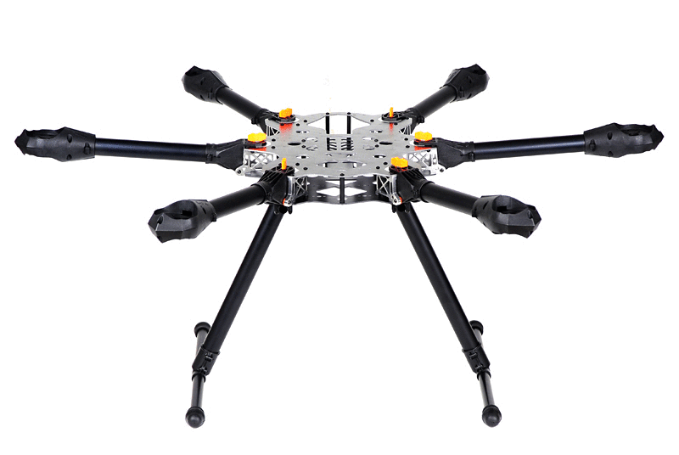

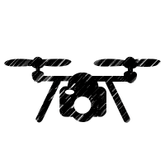


Physical Drone
ONBOARD COMPUTE
Simulated Drone
Autopilot
(px4, ardupilot,.)
Autonomous Navigation
Monitor
Autopilot
Flight Data
On board Data analysis and synthesis.
Predictive analytics.
(sensors, signals)
Flight Plan
Flight Data
Mission
Autonomous Navigation
telemetry, LTE, wifi
Simulated Environment
Dronalytics Server
Runtime Monitor
FAA, NOTAM, IASMS Hardware, Weather
Data manager
(uploads, queries)
EDGE SERVICES
Backend analytics
Dashboards

