Slide 1



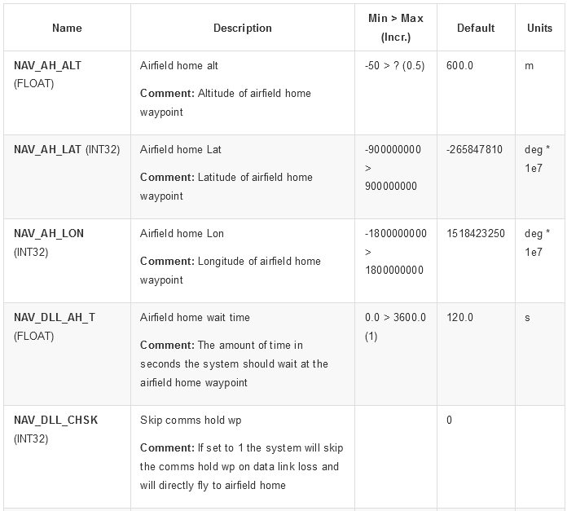
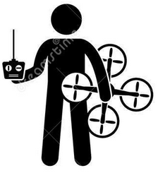
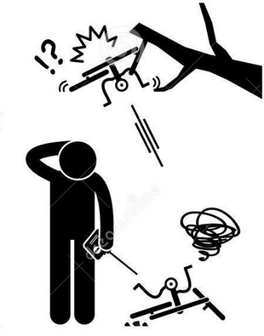










In-time Aviation Safety Management System
(IASMS)
Learned unsafe configurations
❺
❻
Collected datasets
UTM
Weather Services
LAANC
In-time time-series failure
detection and diagnostics
Learned indicator trends
❼
Runtime monitoring system
sUAS Environmental Awareness
sUAS Hardware and Features
PIC Human Factors
sUAS Runtime
❶
❷
❸
❹
Incident reports

