Slide 1


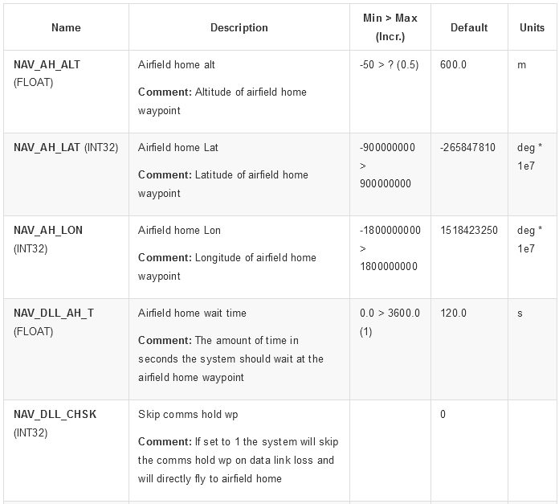
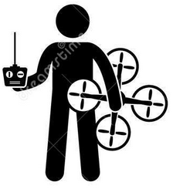

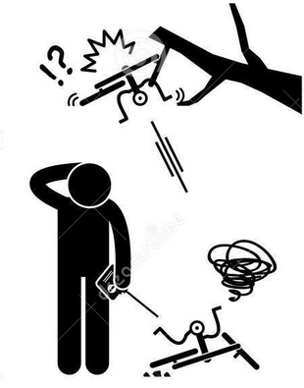




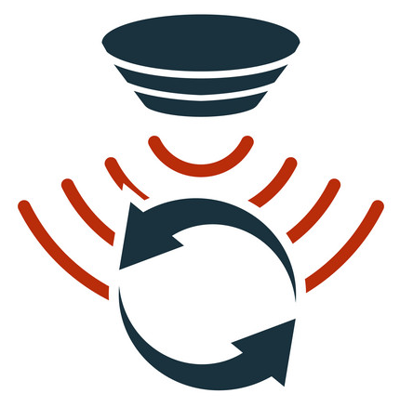







5
In-time Aviation Safety Management System (IASMS)
Runtime detection & diagnostics of anomalous flight patterns
Discovery & monitoring of unsafe feature interactions
Fault Trees, Safety Assurance Cases
4
UTM
Weather Services
LAANC
2
3
Research data sets
1
Runtime monitoring system
sUAS Environmental Awareness
sUAS Hardware and Features
PIC Human Factors
sUAS Runtime
Flight logs & annotated data

