Slide 1



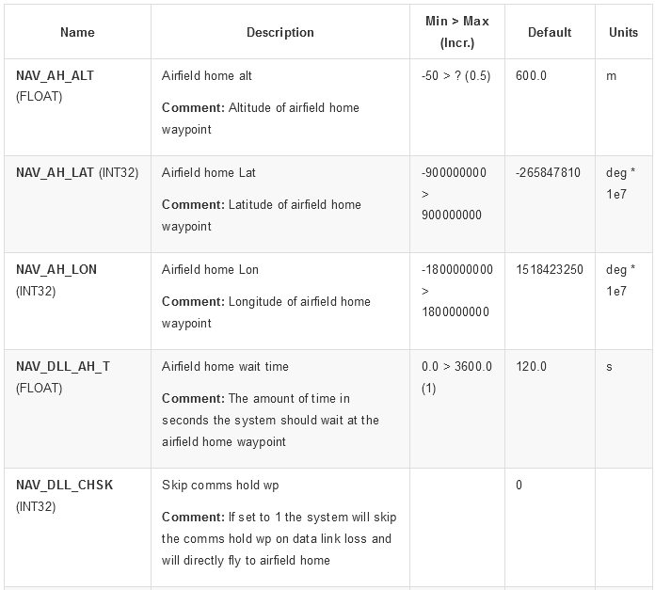






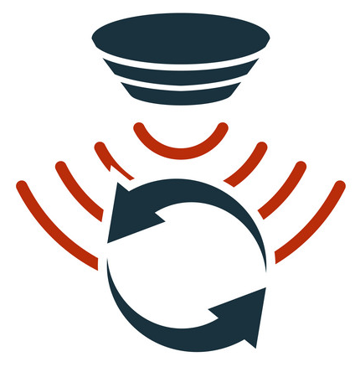







Supplemental Data Service Providers (SDSPs)
National Airspace System (NAS Data Sources)
NAS &
supporting services
Dronolytics:
on-board & off-board
SWIM
(FAA) Flight Information Management System
Aeronautical Info (AIXM)
Weather (WXXM)
Requests, Decisions
Operations, Deviations
Directives & Constraints
5
Flight Info (FIXM)
Low Altitude (LAXM)
Runtime detection & diagnostics of anomalous flight patterns
Discovery & monitoring of unsafe feature interactions
Fault Trees, Safety Assurance Cases
4
2
3
Research data
SWIM
1
GCS: Off-Board Dronolytics Runtime Monitoring
Onboard Dronolytics Runtime monitoring system
core Flight System (cFS)
sUAS Environmental Awareness
sUAS Hardware and Features
PIC Human Factors
sUAS Runtime
Flight logs & annotated data

