Slide 1
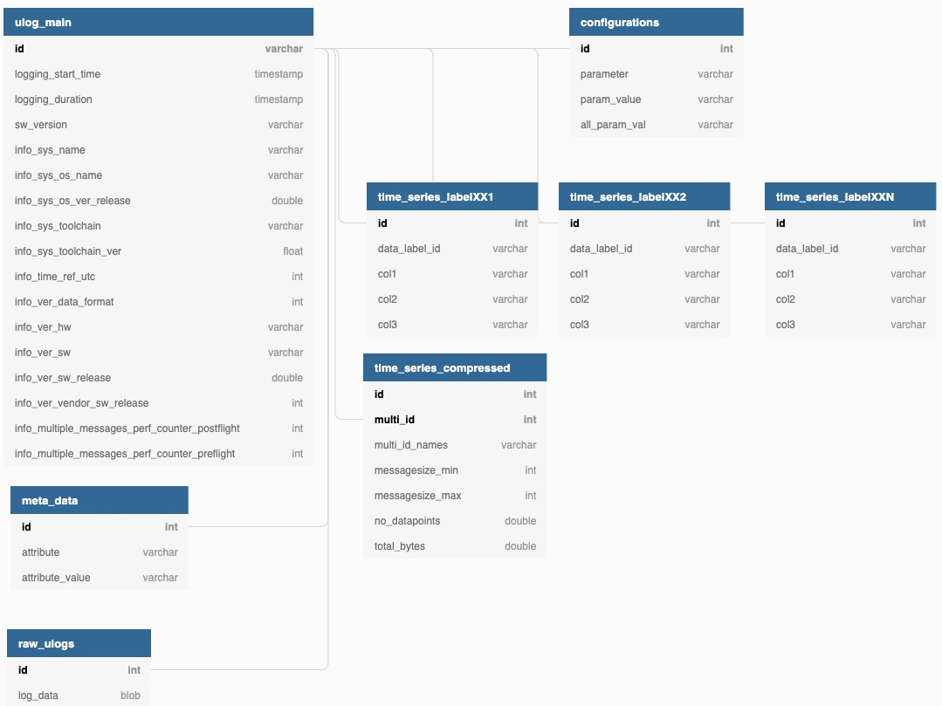
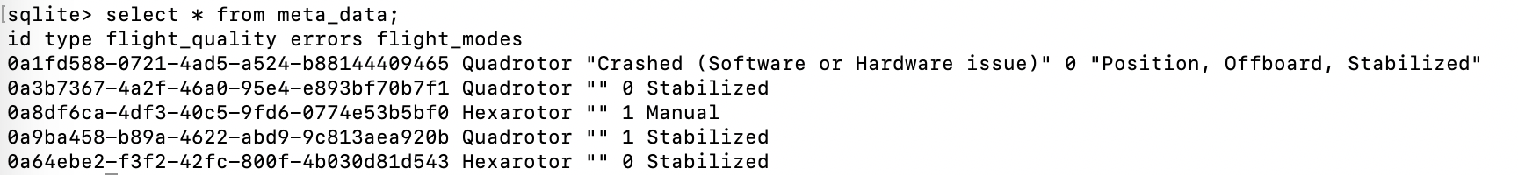
1
2
3
4
(a) Database Schema
(b) Example Records from meta_data Table

