Slide 1

7-Eleven Fuel Supply Half-year Report 2020
Jane Gou

Slide 2
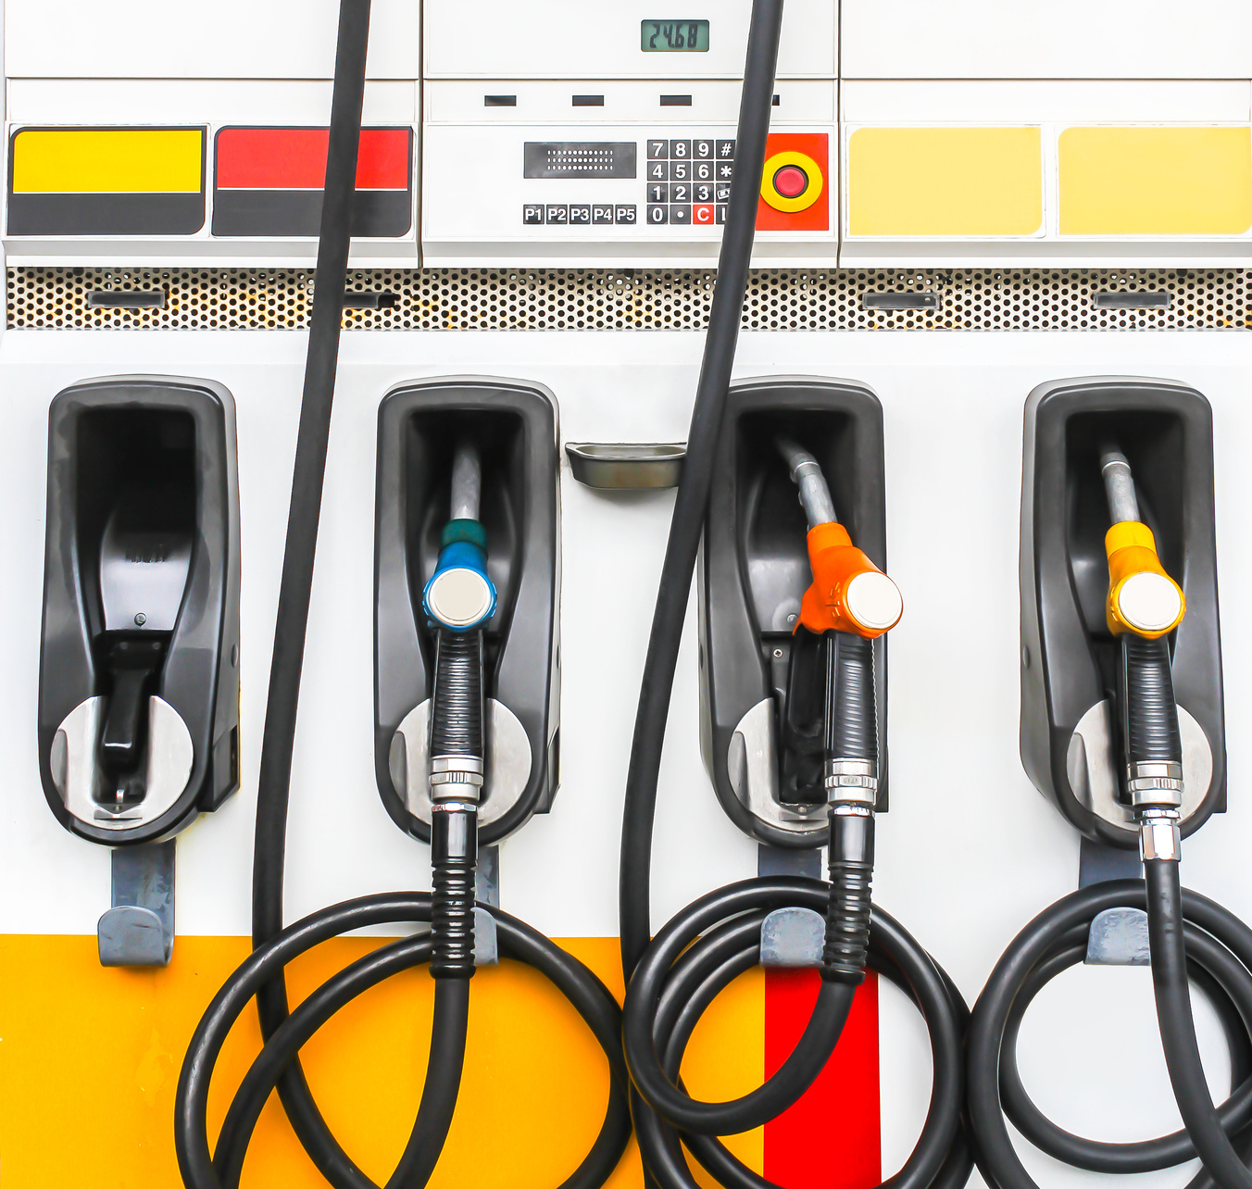
Contents
Industry review
Peak identify
Opportunities analysis
Summary

Slide 3
Purpose and data preparation

Slide 4
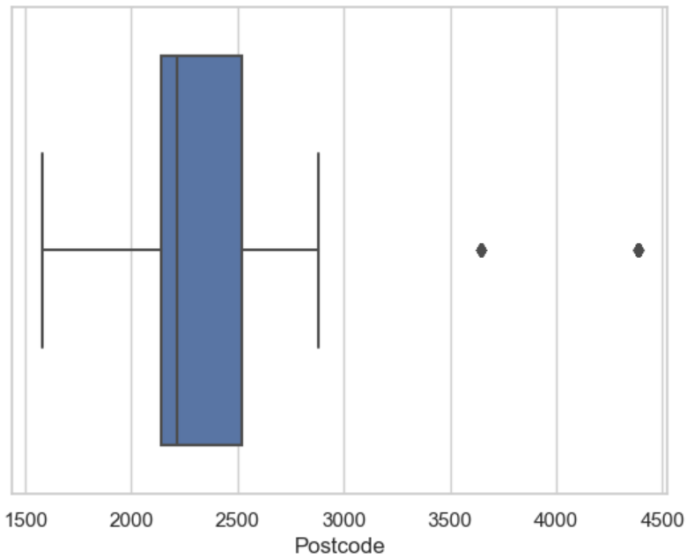
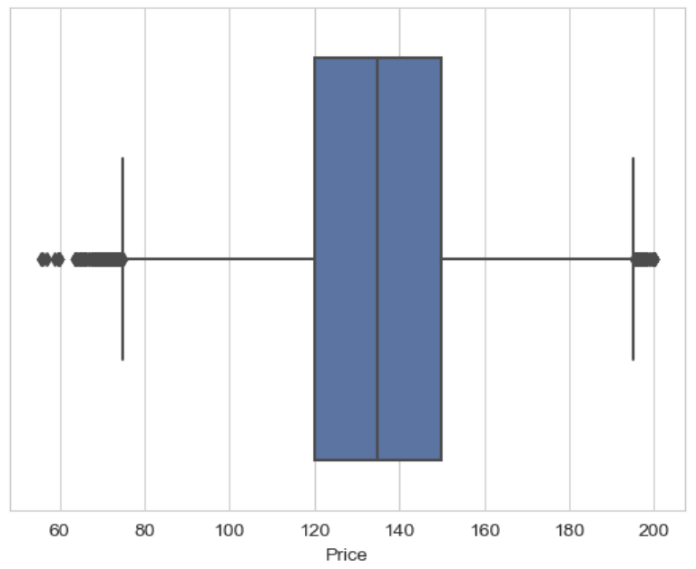
Outliers
Outliers in Postcode
Outliers in Price

Slide 5
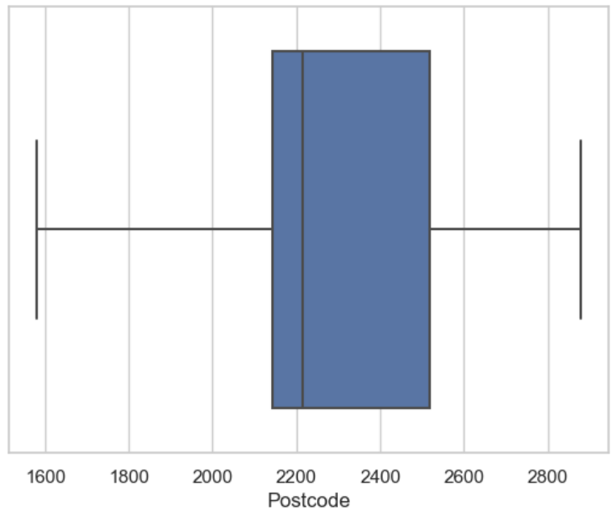
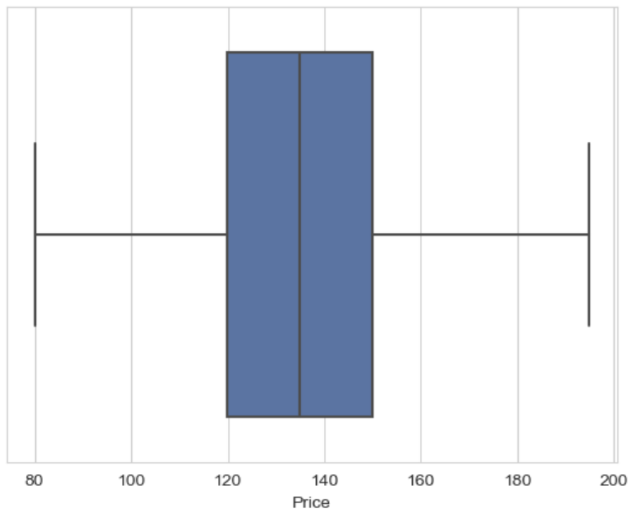
After cleaning
Postcode Range NSW
Price range 80- 186.9 AUD

Slide 6
What is the marketing position of us ?

Slide 7
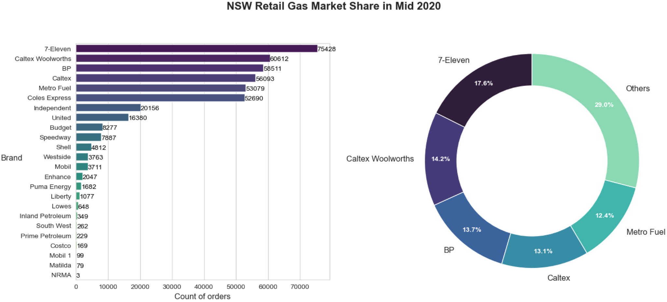
Marketing shares
Top 5 Brand

Slide 8
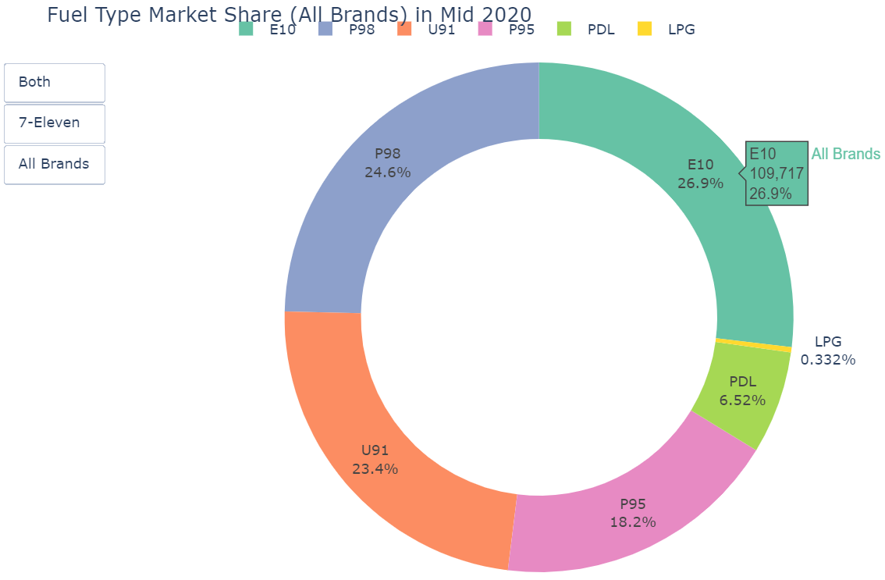
Bestseller in the industry

Slide 9
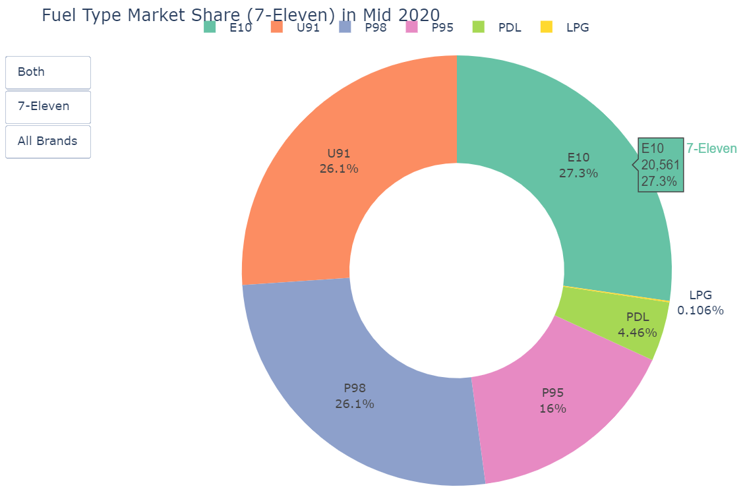
Bestseller in 7-Eleven

Slide 10
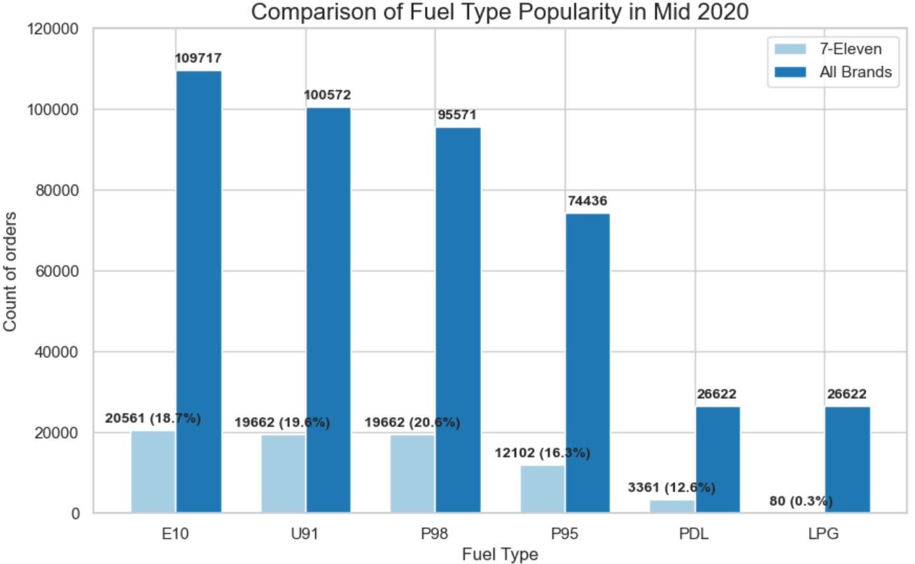
Marketing segmentation

Slide 11
When is the peak period?

Slide 12
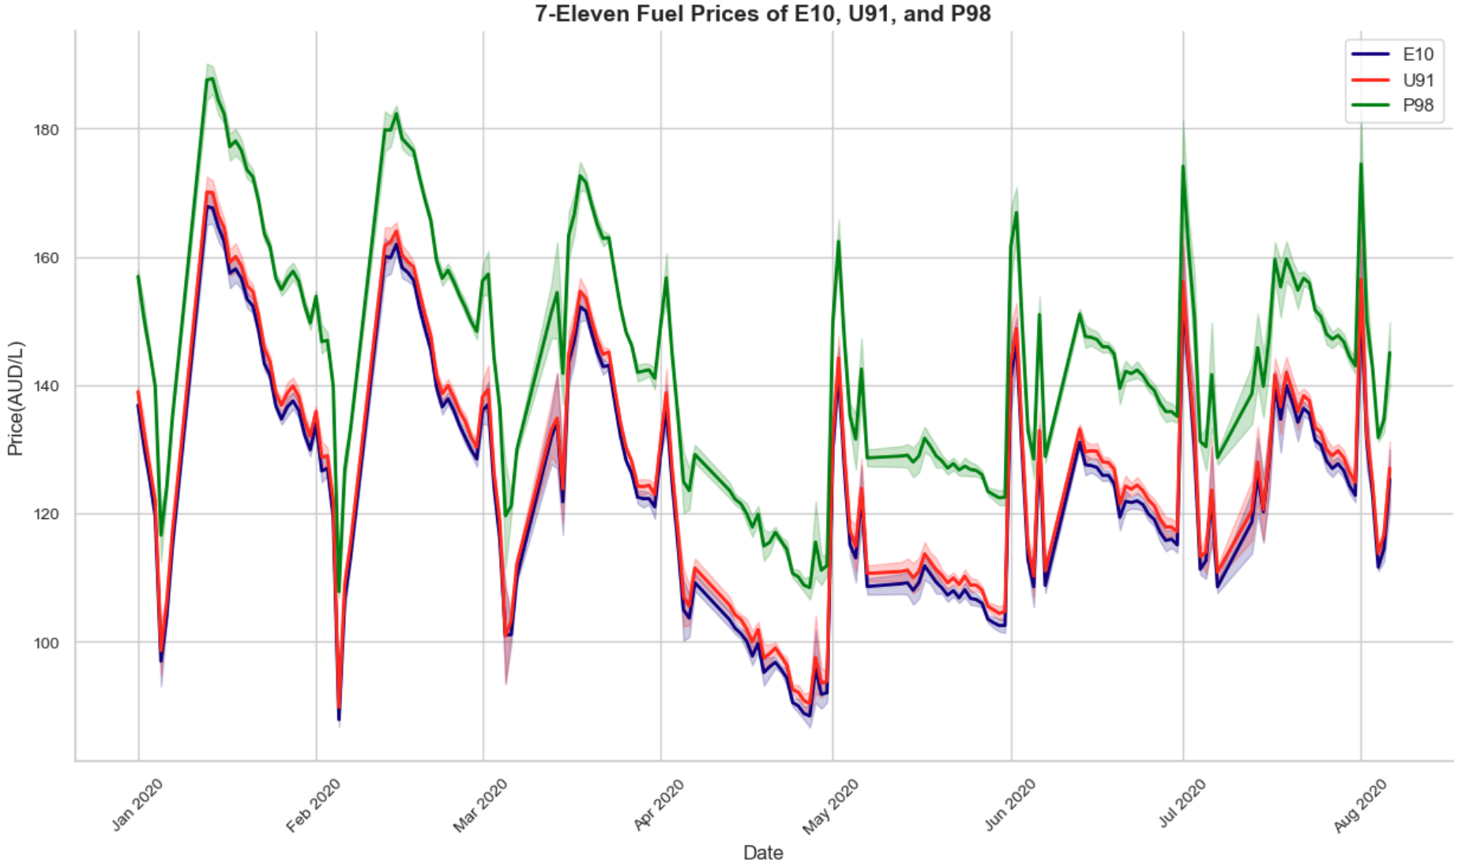
Seasonality

Slide 13
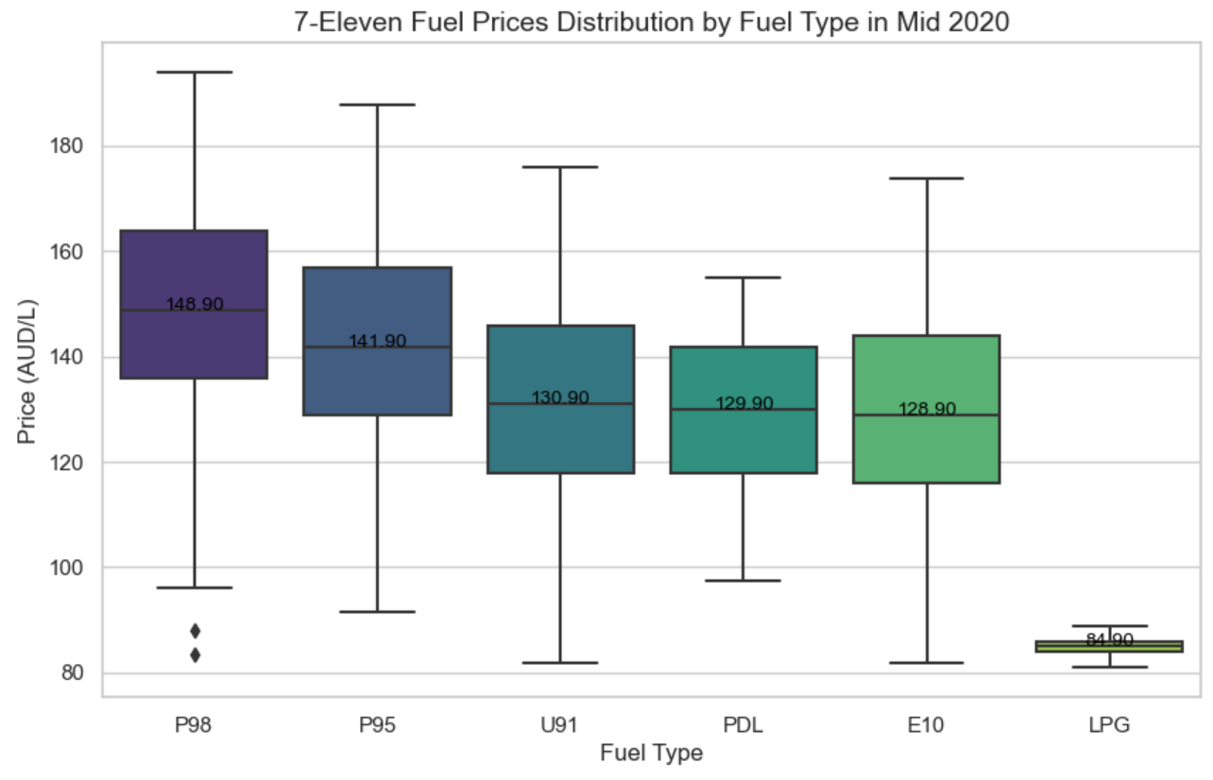
Fuel price distribution

Slide 14
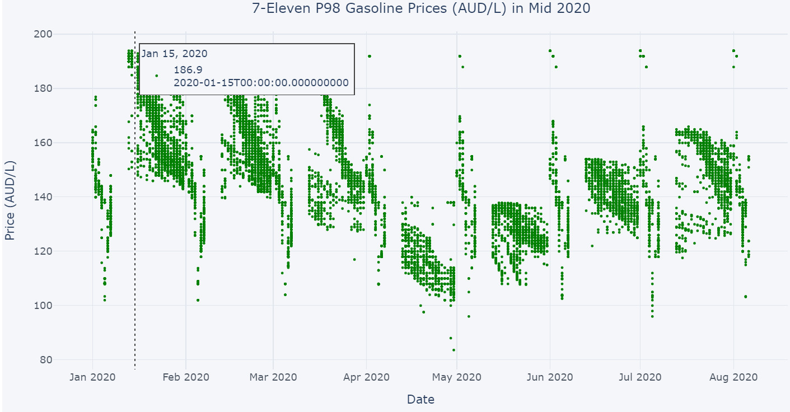
Peak period

Slide 15
How to improve our business？

Slide 16
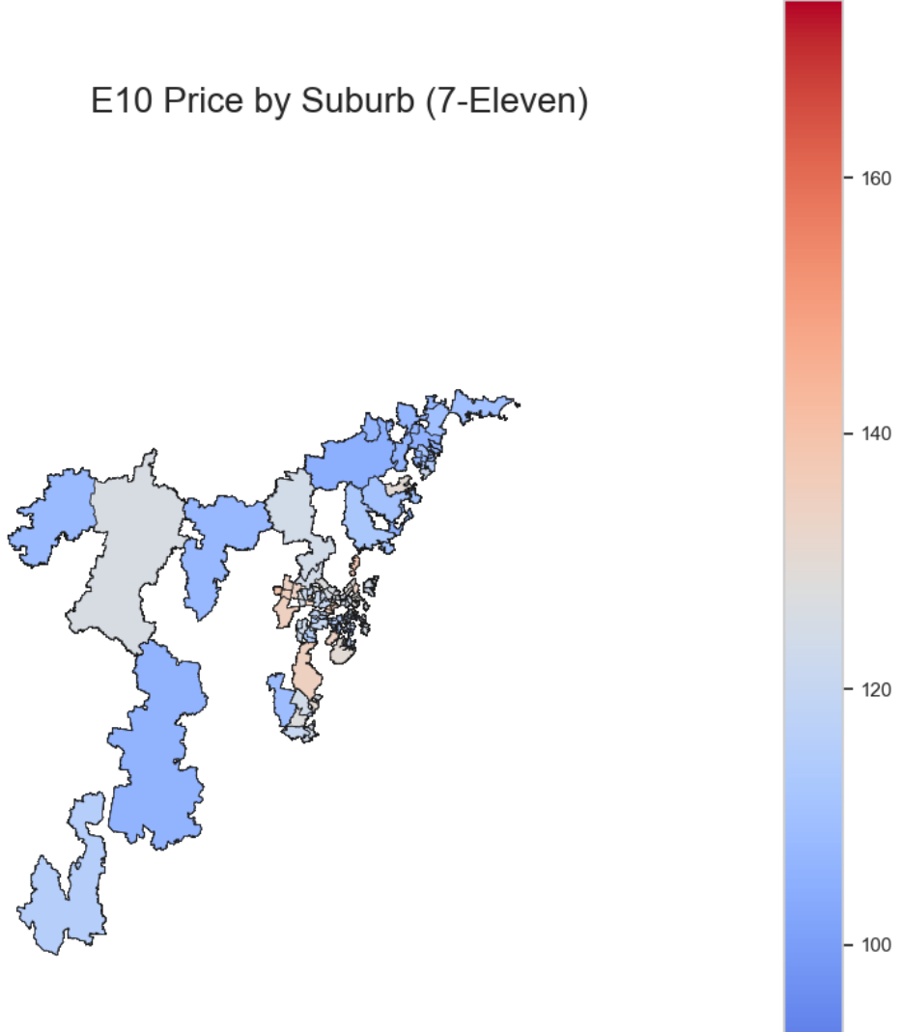
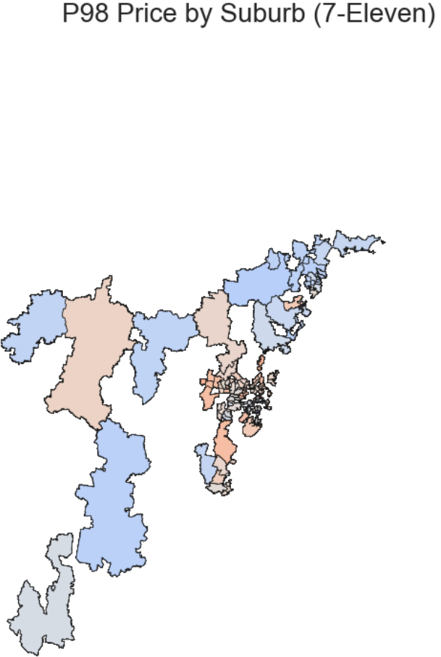
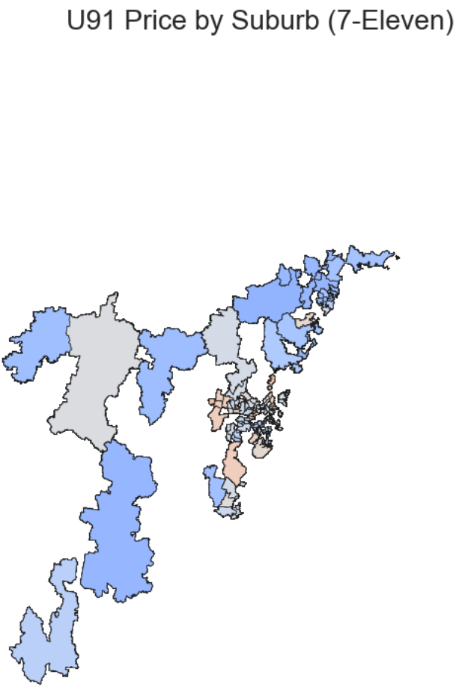
The priciest suburb

Slide 17
Potential feature
Octane is an index of the fuel’s resistance to burning. Higher octane numbers have more burning resistance than lower octane numbers.
For example, P98 has more burning resistance than U91...
Type | Octane
E10 | Premium unleaded petrol, octane rating 94.
U91 | Premium unleaded petrol, octane rating 91.
P98 | Premium unleaded petrol, octane rating 98.

Slide 18
7-eleven won the fuel market in half of 2020.
The middle of the month is the peak period.
Plumpton is the most expensive area.
Summary
Time and location limitations
Outliers limitations
Choropleth map lacks accuracy
Limitations

Slide 19
Thank you!
Hongjin Gou 510332280

