Slide 1

Lights, Camera, Microsoft: Navigating the Box Office Jungle
Jane Grigorenko
24/03/2024

Slide 2
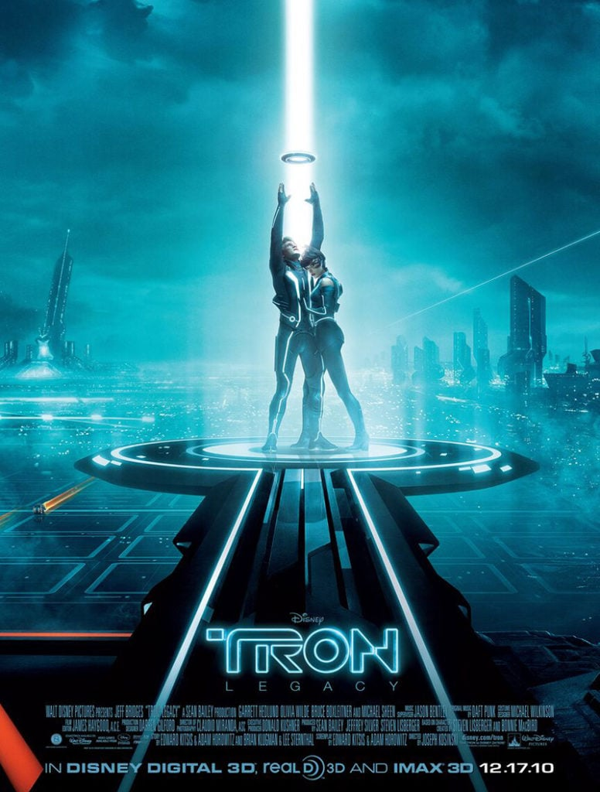
Introduction
Key recommendations from the exploratory analysis of historic film performance:
Focus on best profit-making genres:
Seek highest budgets from producers
Keep run time between 94 and 130 minutes

Slide 3
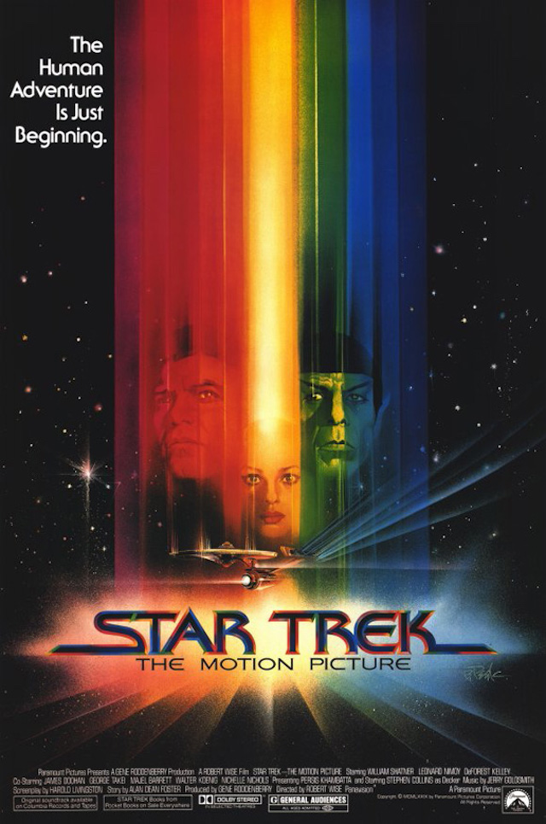
Outline
Business Objective
Data & Methods
Results
Conclusions

Slide 4

Business Objective
Enter the streaming market with lucrative new film releases

Slide 5
Data & Methods
Data sources include IMDB, Box Office Mojo and The Numbers
Combining data sets including genres, titles, running times, ratings, world-wide gross and budgets to get a holistic picture of the movie market

Slide 6
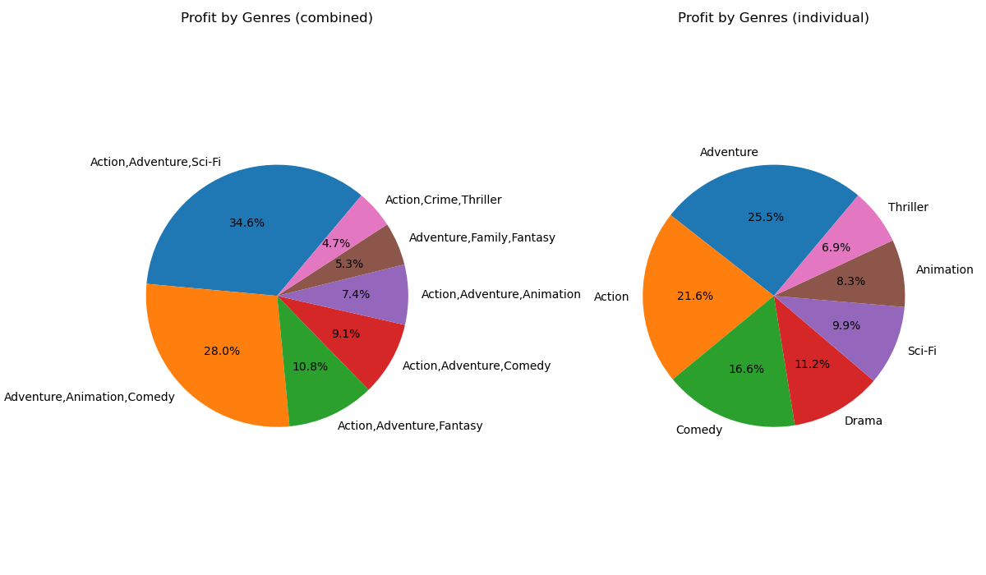
Results
The most profit-making genres appeared to be:
Action, Adventure, Sci-Fi
Adventure, Animation, Comedy
Action, Adventure, Fantasy

Slide 7
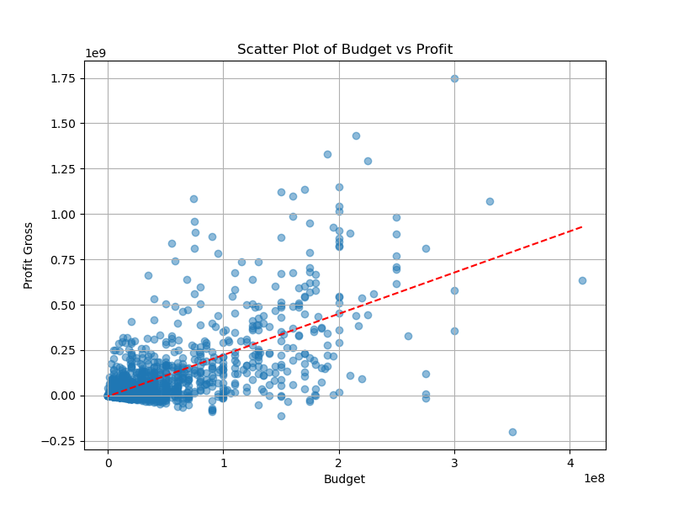
Results
There's a strong correlation (66%) between production budget and profit
This insight should be used as a leverage to negotiate for higher budgets from producers

Slide 8
Results
Genres | Mean | Median
Action, Adventure, Sci-Fi | 129.46 | 130.5
Adventure, Animation, Comedy | 93.96 | 93
Action, Adventure, Fantasy | 117.94 | 118
Average runtime for the top three profit making genres varies between 94 and 130 minutes

Slide 9
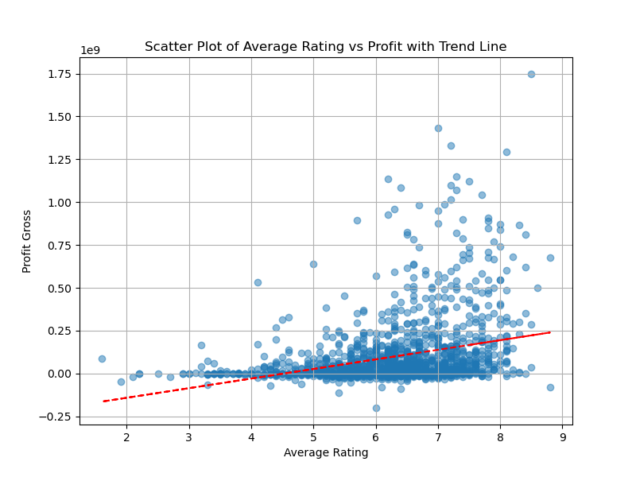
Results
Additional analysis shows limited impact of ratings on profit with the correlation being only 29%

Slide 10

Conclusions
Focus on best profit-making genres:
Action, Adventure, Sci-Fi
Adventure, Animation, Comedy
Action, Adventure, Fantasy
Seek highest budgets from producers
Keep run time between 94 and 130 minutes
Note:
While critically acclaimed films may receive high ratings, they may not always resonate with broader audiences or translate into higher returns

Slide 11

Thank You!
Email: grigorenko.jane@gmail.com
GitHub: https://github.com/JaneGrig
LinkedIn: linkedin.com/in/evgeniya-jane-grigorenko-47692211b

