Slide 1
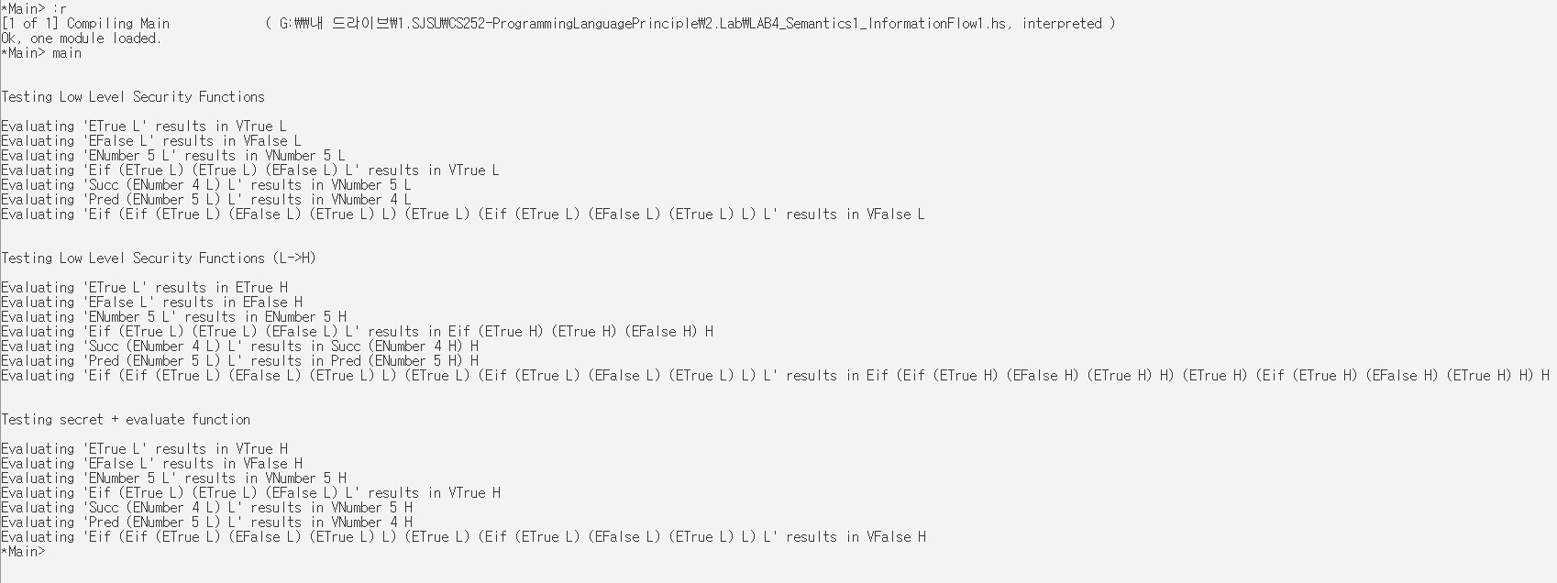
Lab4. Semantics 1 -- Information flow 1
Output of the program (evaluate + secret)
CS252 Fall 2019
Ji An Lee (014352715)
prog1 = ETrue L
prog2 = EFalse L
prog3 = ENumber 5 L
prog4 = Eif (ETrue L) (ETrue L) (EFalse L) L
prog5 = Succ (ENumber 4 L) L
prog6 = Pred (ENumber 5 L) L
prog7 = Eif (Eif (ETrue L) (EFalse L) (ETrue L) L) (ETrue L) (Eif (ETrue L) (EFalse L) (ETrue L) L) L
--Low Level Security Functions:
putStrLn $ "\n\nTesting Low Level Security Functions \n"
putStrLn $ "Evaluating '" ++ (show prog1) ++ "' results in " ++ (show $ evaluate prog1)
--High Level Security Functions:
putStrLn $ "\n\nTesting Low Level Security Functions (L->H) \n"
putStrLn $ "Evaluating '" ++ (show prog1) ++ "' results in " ++ (show $ secret prog1)
--High Level Security Functions + Evaluate:
putStrLn $ "\n\nTesting secret + evaluate function \n"
putStrLn $ "Evaluating '" ++ (show prog1) ++ "' results in " ++ (show $ evaluate (secret prog1))

Slide 2
Lab4. Semantics 1 -- Information flow 1
Output of the program (evaluate + secret)
CS252 Fall 2019
Ji An Lee (014352715)
Objective :
In addition to the previous lab (implement evaluate)…
The 'secret e' construct evaluates the expression e and marks the result as private ('H' for 'high').
Other constructs work in a similar manner, but they should also track whether their results are private (H) or public (L).
For example, `succ secret 3` should evaluate to 4^{H}, whereas `succ 3` should evaluate to 4^{L}.
Implementation :
data Exp = ETrue Level
| EFalse Level
| ENumber Integer Level
| Eif Exp Exp Exp Level
| Succ Exp Level
| Pred Exp Level
deriving Show
data Val = VTrue Level
| VFalse Level
| VNumber Integer Level
deriving Show
data Level = L
| H
deriving Show
evaluate :: Exp -> Val
evaluate (ETrue x)= (VTrue x)
evaluate (EFalse x) = (VFalse x)
evaluate (ENumber n x) = (VNumber n x)
evaluate (Succ (ENumber n x) _)= (VNumber (n+1) x)
evaluate (Pred (ENumber n x) _) = (VNumber (n-1) x)
evaluate (Eif cond expTrue expFalse x) = case (evaluate cond) of
(VTrue H) -> (evaluate expTrue)
(VFalse H) -> (evaluate expFalse)
(VTrue L) -> (evaluate expTrue)
(VFalse L) -> (evaluate expFalse)
_ -> error "Not a Bool"
secret :: Exp -> Exp
secret (ETrue _)= (ETrue H)
secret (EFalse _)= (EFalse H)
secret (ENumber n _) = (ENumber n H)
secret (Succ (ENumber n _) _) = (Succ (ENumber n H) H)
secret (Pred (ENumber n _) _) = (Pred (ENumber n H) H)
secret (Eif cond expTrue expFalse _) = (Eif (secret cond) (secret expTrue) (secret expFalse) H)
Design Explanation:
Example : ‘succ secret 3’ should evaluate to 4^{H}, whereas `succ 3` should evaluate to 4^{L}
In the given example above, input exp first goes through “secret” and then “succ (evaluate)”.
Since evaluate takes type Exp as input, whatever the result of secret must be a type of Exp.
Security level
Input
Output
Case 1) Low
Enumber 3 L
Evaluate : Succ
Vnumber 4 L
Security level
secret
Vnumber 4 H
Case 2) High
Enumber 3 L
Enumber 3 H

Slide 3
Lab4. Semantics 1 -- Information flow 1
Output of the program (evaluate + secret)
CS252 Fall 2019
Ji An Lee (014352715)
Testing Code :
prog1 = ETrue L
prog2 = EFalse L
prog3 = ENumber 5 L
prog4 = Eif (ETrue L) (ETrue L) (EFalse L) L
prog5 = Succ (ENumber 4 L) L
prog6 = Pred (ENumber 5 L) L
prog7 = Eif (Eif (ETrue L) (EFalse L) (ETrue L) L) (ETrue L) (Eif (ETrue L) (EFalse L) (ETrue L) L) L
main :: IO ()
main = do
--Low Level Security Functions ( Tests Case 1 when exp has security level L (Low) ):
putStrLn $ "\n\nTesting Low Level Security Functions \n"
putStrLn $ "Evaluating '" ++ (show prog1) ++ "' results in " ++ (show $ evaluate prog1)
putStrLn $ "Evaluating '" ++ (show prog2) ++ "' results in " ++ (show $ evaluate prog2)
putStrLn $ "Evaluating '" ++ (show prog3) ++ "' results in " ++ (show $ evaluate prog3)
putStrLn $ "Evaluating '" ++ (show prog4) ++ "' results in " ++ (show $ evaluate prog4)
putStrLn $ "Evaluating '" ++ (show prog5) ++ "' results in " ++ (show $ evaluate prog5)
putStrLn $ "Evaluating '" ++ (show prog6) ++ "' results in " ++ (show $ evaluate prog6)
putStrLn $ "Evaluating '" ++ (show prog7) ++ "' results in " ++ (show $ evaluate prog7)
--High Level Security Functions (Switching security level from L -> H) :
putStrLn $ "\n\nTesting Low Level Security Functions (L->H) \n"
putStrLn $ "Evaluating '" ++ (show prog1) ++ "' results in " ++ (show $ secret prog1)
putStrLn $ "Evaluating '" ++ (show prog2) ++ "' results in " ++ (show $ secret prog2)
putStrLn $ "Evaluating '" ++ (show prog3) ++ "' results in " ++ (show $ secret prog3)
putStrLn $ "Evaluating '" ++ (show prog4) ++ "' results in " ++ (show $ secret prog4)
putStrLn $ "Evaluating '" ++ (show prog5) ++ "' results in " ++ (show $ secret prog5)
putStrLn $ "Evaluating '" ++ (show prog6) ++ "' results in " ++ (show $ secret prog6)
putStrLn $ "Evaluating '" ++ (show prog7) ++ "' results in " ++ (show $ secret prog7)
--High Level Security Functions + Evaluate ( Tests Case 2 when exp has security level H (High) ):
putStrLn $ "\n\nTesting secret + evaluate function \n"
putStrLn $ "Evaluating '" ++ (show prog1) ++ "' results in " ++ (show $ evaluate (secret prog1))
putStrLn $ "Evaluating '" ++ (show prog2) ++ "' results in " ++ (show $ evaluate (secret prog2))
putStrLn $ "Evaluating '" ++ (show prog3) ++ "' results in " ++ (show $ evaluate (secret prog3))
putStrLn $ "Evaluating '" ++ (show prog4) ++ "' results in " ++ (show $ evaluate (secret prog4))
putStrLn $ "Evaluating '" ++ (show prog5) ++ "' results in " ++ (show $ evaluate (secret prog5))
putStrLn $ "Evaluating '" ++ (show prog6) ++ "' results in " ++ (show $ evaluate (secret prog6))
putStrLn $ "Evaluating '" ++ (show prog7) ++ "' results in " ++ (show $ evaluate (secret prog7))

