Slide 1
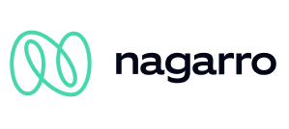
Product Studio
Presentation Name
01
A Note From Us
First and foremost, thank you for inviting us to submit a proposal for the UX/UI Design, Prototyping & Validation of the _____________ Project. At Nagarro, we believe that design has the power to simplify complex information, generate business results, and establish new and exciting connections with audiences. We are excited to contribute to the operational effectiveness of the _______________ project with innovative approaches that deliver impact. Our Product team has extensive experience in User Experience, User Interface Design, User Testing, and Validation, and we are thrilled to have the opportunity to help the __________ team bring its vision one step closer to reality. We are looking forward to learning more about this exciting journey __________ is embarking on, and we are ready to support you in achieving your strategic objectives. Thank you, Nagarro Team

Slide 2
A Note From Us
First and foremost, thank you for inviting us to submit a proposal for the UX/UI Design, Prototyping & Validation of the __________ Project. At Nagarro, we believe that design has the power to simplify complex information, generate business results, and establish new and exciting connections with audiences. We are excited to contribute to the operational effectiveness of the __________ project with innovative approaches that deliver impact.
Our Product team has extensive experience in User Experience, User Interface Design, User Testing, and Validation, and we are thrilled to have the opportunity to help ________ bring its vision one step closer to reality. We are looking forward to learning more about this exciting journey ____________ is embarking on, and we are ready to support you in achieving your strategic objectives. Thank you, Nagarro Team
Digital Design Strategy
Project Name
Month Year
© 2026

Slide 3
A Note From Us
First and foremost, thank you for inviting us to submit a proposal for the UX/UI Design, Prototyping & Validation of the _____________ Project. At Nagarro, we believe that design has the power to simplify complex information, generate business results, and establish new and exciting connections with audiences. We are looking forward to learning more about this exciting journey ___________ is embarking on, and we are ready to support you in achieving your strategic objectives. Thank you, Nagarro Team
Digital Design Strategy
Project Name
Month Year
© 2026

Slide 4
A Note From Us
First and foremost, thank you for inviting us to submit a proposal for the UX/UI Design, Prototyping & Validation of the _____________ Project. At Nagarro, we believe that design has the power to simplify complex information, generate business results, and establish new and exciting connections with audiences. We are excited to contribute to the operational effectiveness of the _______________ project with innovative approaches that deliver impact. Our Product team has extensive experience in User Experience, User Interface Design, User Testing, and Validation, and we are thrilled to have the opportunity to help the __________ team bring its vision one step closer to reality. We are looking forward to learning more about this exciting journey __________ is embarking on, and we are ready to support you in achieving your strategic objectives. Thank you, Nagarro Team
Digital Design Strategy
Project Name
Month Year
© 2026

Slide 5
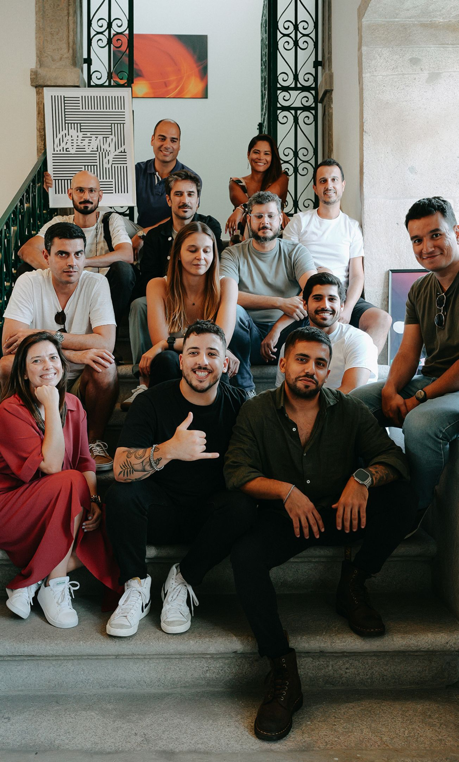
A Note From Us
First and foremost, thank you for inviting us to submit a proposal for the UX/UI Design, Prototyping & Validation of the _____________ Project. At Nagarro, we believe that design has the power to simplify complex information, generate business results, and establish new and exciting connections with audiences. We are excited to contribute to the operational effectiveness of the _______________ project with innovative approaches that deliver impact. Our Product team has extensive experience in User Experience, User Interface Design, User Testing, and Validation, and we are thrilled to have the opportunity to help the __________ team bring its vision one step closer to reality. We are looking forward to learning more about this exciting journey __________ is embarking on, and we are ready to support you in achieving your strategic objectives. Thank you, Nagarro Team

