Slide 1
Agile software development
Application management & support
Artificial intelligence
API management
Big data
Business intelligence
Business consulting
Cloud enablement & integration
CMS & portals
CRM
Data science
DevOps
Digital Marketing
Digital commerce
Embedded systems
Enterprise resource planning
Enterprise architecture
Identity & access management
Legacy modernization & transformation
Internet of things
Low code platforms
Metaverse
Mobile solution
Reality technologies
Security
Test engineering
UX/UI design
Virtual assistant
Digital Design Strategy
Project Name
Month Year
© 2026

Slide 2
Our
values
Client-centric
Agile
Responsible
Intelligent
Non-hierarchical
Global
Caring
Digital Design Strategy
Project Name
Month Year
© 2026

Slide 3
Our impact
Creating seamless experiences across every platform and product. Our comprehensive design process accelerates innovation, enabling rapid production while reducing costs.
Digital Design Strategy
Project Name
Month Year
© 2026

Slide 4

A global team united by a singular mission: transforming complex human problems into elegant solutions.
We work as an extension of your team, embedding designers who are carefully matched to your goals and ways of working, so they can contribute from day one.
Digital Design Strategy
Project Name
Month Year
© 2026

Slide 5

No single HQ. Many nations. Lots of diversity. One manifesto.
Digital Design Strategy
Project Name
Month Year
© 2026

Slide 6
Nagarro is a global leader in technology and human centered digital solutions.
25+
1000+
Years
Customers
9.5+
18,000+
Satisfaction
Colleagues
90%
40
Our clients need to become digital-first companies that compete through superior software platforms. Nagarro helps them transform, adapt, and build new ways into the future through an entrepreneurial, agile, and caring mindset.
Repeat Business
Countries
NA9
Public Listed Company
Digital Design Strategy
Project Name
Month Year
© 2026

Slide 7
Nagarro is a global leader in technology and human centered digital solutions.
Our clients need to become digital-first companies that compete through superior software platforms. Nagarro helps them transform, adapt, and build new ways into the future through an entrepreneurial, agile, and caring mindset.Our clients need to become digital-first companies that compete through superior software platforms. Nagarro helps them transform, adapt, and build new ways into the future through an entrepreneurial, agile, and caring mindset.
Digital Design Strategy
Project Name
Month Year
© 2026

Slide 8


Product Studio
Presentation Name
01
Nagarro is a global leader in technology and human centered digital solutions.
Our clients need to become digital-first companies that compete through superior software platforms.
Nagarro helps them transform, adapt, and build new ways into the future through an entrepreneurial, agile, and caring mindset.

Slide 9

Nagarro is a global leader in technology and human centered digital solutions.
Our clients
Our clients
Our clients
Nagarro helps them transform, adapt, and build new ways into the future through an entrepreneurial, agile, and caring mindset.
Nagarro helps them transform, adapt, and build new ways into the future through an entrepreneurial, agile, and caring mindset.
Nagarro helps them transform, adapt, and build new ways into the future through an entrepreneurial, agile, and caring mindset.
Digital Design Strategy
Project Name
Month Year
© 2026

Slide 10
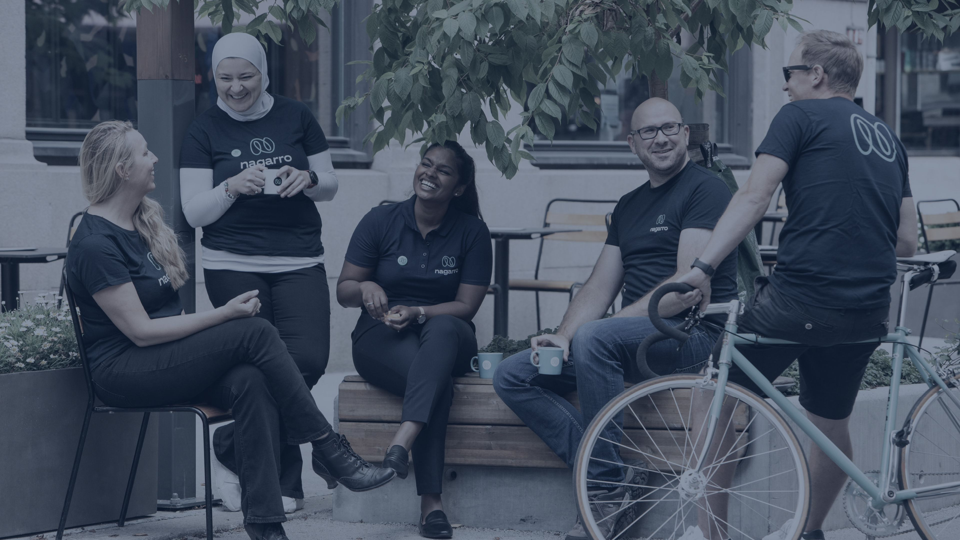

9.5
+
25+
Satisfaction
Years
At a Glance:
1000
+
Customers
$600M USD
17,000
+
32
Revenue
Countries
People

