Slide 1
Trusted by global brands
We help our clients transform innovative ideas into inspiring brands, amazing products and cutting-edge experiences that touch millions.
Digital Design Strategy
Project Name
Month Year
© 2026

Slide 2
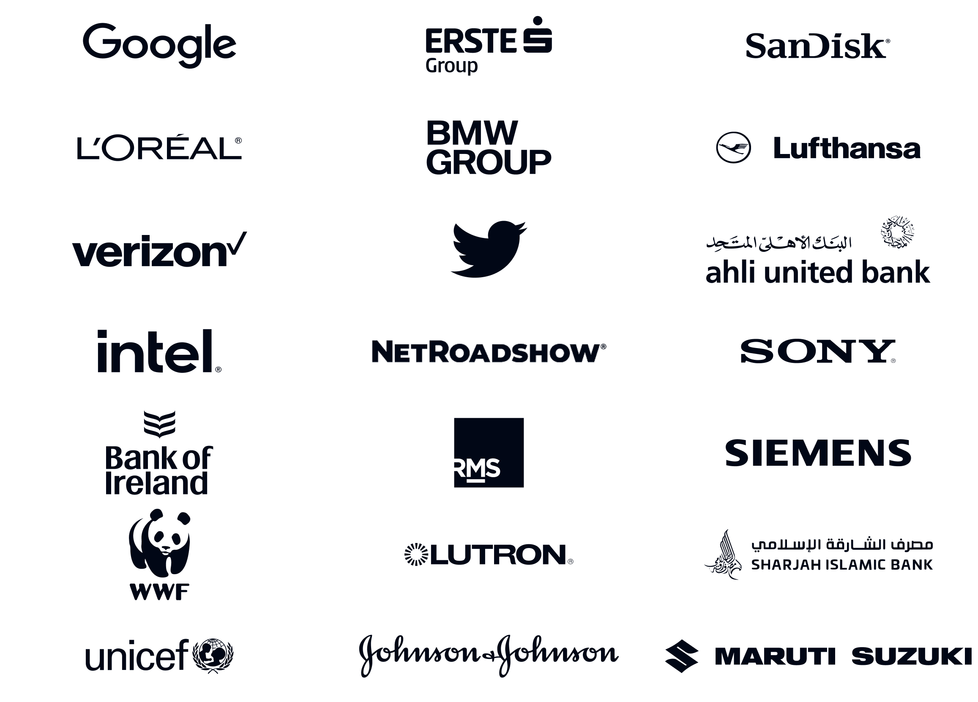
Trusted by global brands
We help our clients transform innovative ideas into inspiring brands, amazing products and cutting edge experiences that touch millions.
Digital Design Strategy
Project Name
Month Year
© 2026

Slide 3
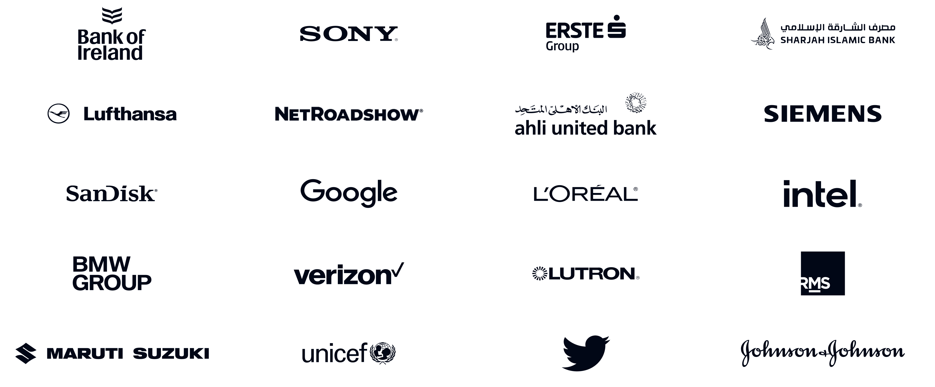
Digital Design Strategy
Project Name
Month Year
© 2026

Slide 4

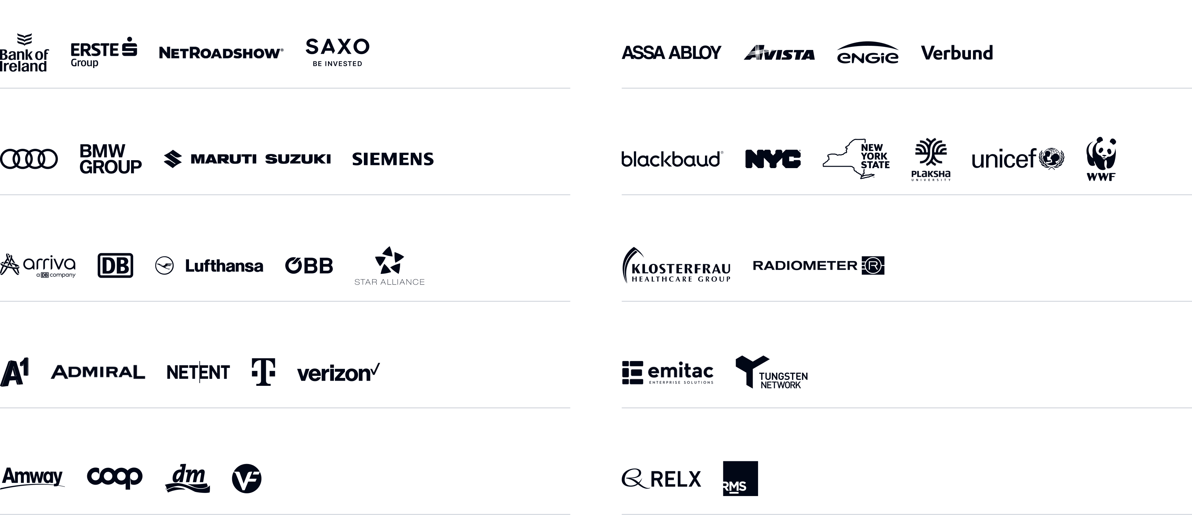
Working with the leaders in each industry
Financial Services and Insurance
Energy, Utilities and Building Automation
Automotive, Manufacturing and Industrial
Public, Non-profit and Education
Travel and Logistics
Life Sciences and Healthcare
Telecom, Media and Entertainment
Horizontal Tech
Retail and CPG
Management Consulting and Business Information
2 OF THE BIG 3 MANAGEMENT CONSULTING FIRMS

Slide 5

Trusted by:
Leading clients we work with in the Middle East region
Digital Design Strategy
Project Name
Month Year
© 2026

Slide 6
We have so much more to offer
We work with
In multiple areas
Across technology
INNOVATION
CONNECTED WORKFORCE
DIGITAL TRANSFORMATION
BUSINESS INTELLIGENCE
AI/ML
LOW CODE PLATFORMS
LEGACY MODERNIZATION
CUSTOMER EXPERIENCE DESIGN
EMPLOYEE SAFETY
AZURE, AWS, GOOGLE CLOUD, ALIBABA.COM
MICROSOFT
SAP
BUSINESS RESILIENCE
& MANY MORE…
SALESFORCE
SITECORE
IIOT & REALITY TECH
& MANY MORE…

Slide 7

Chances are we’ve met before…

Slide 8

We co-created flight planning software to calculate 30,000+ flights daily

Slide 9
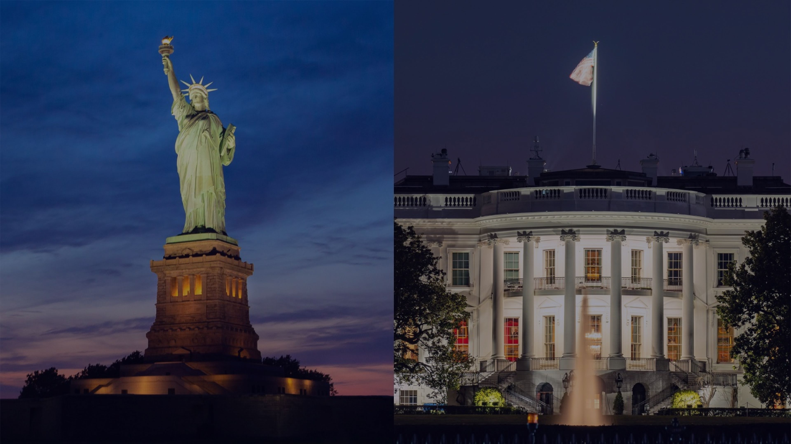
We built lighting control software that lights up the White House & Statue of Liberty

Slide 10
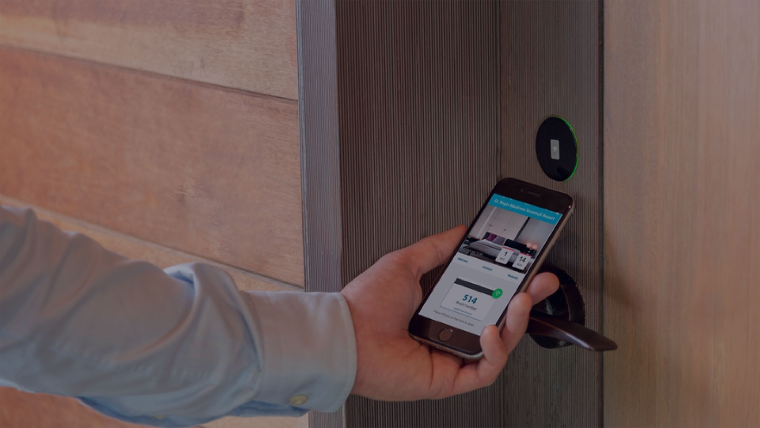
We work on door opening solutions for more than half of the world’s hotel rooms

Slide 11
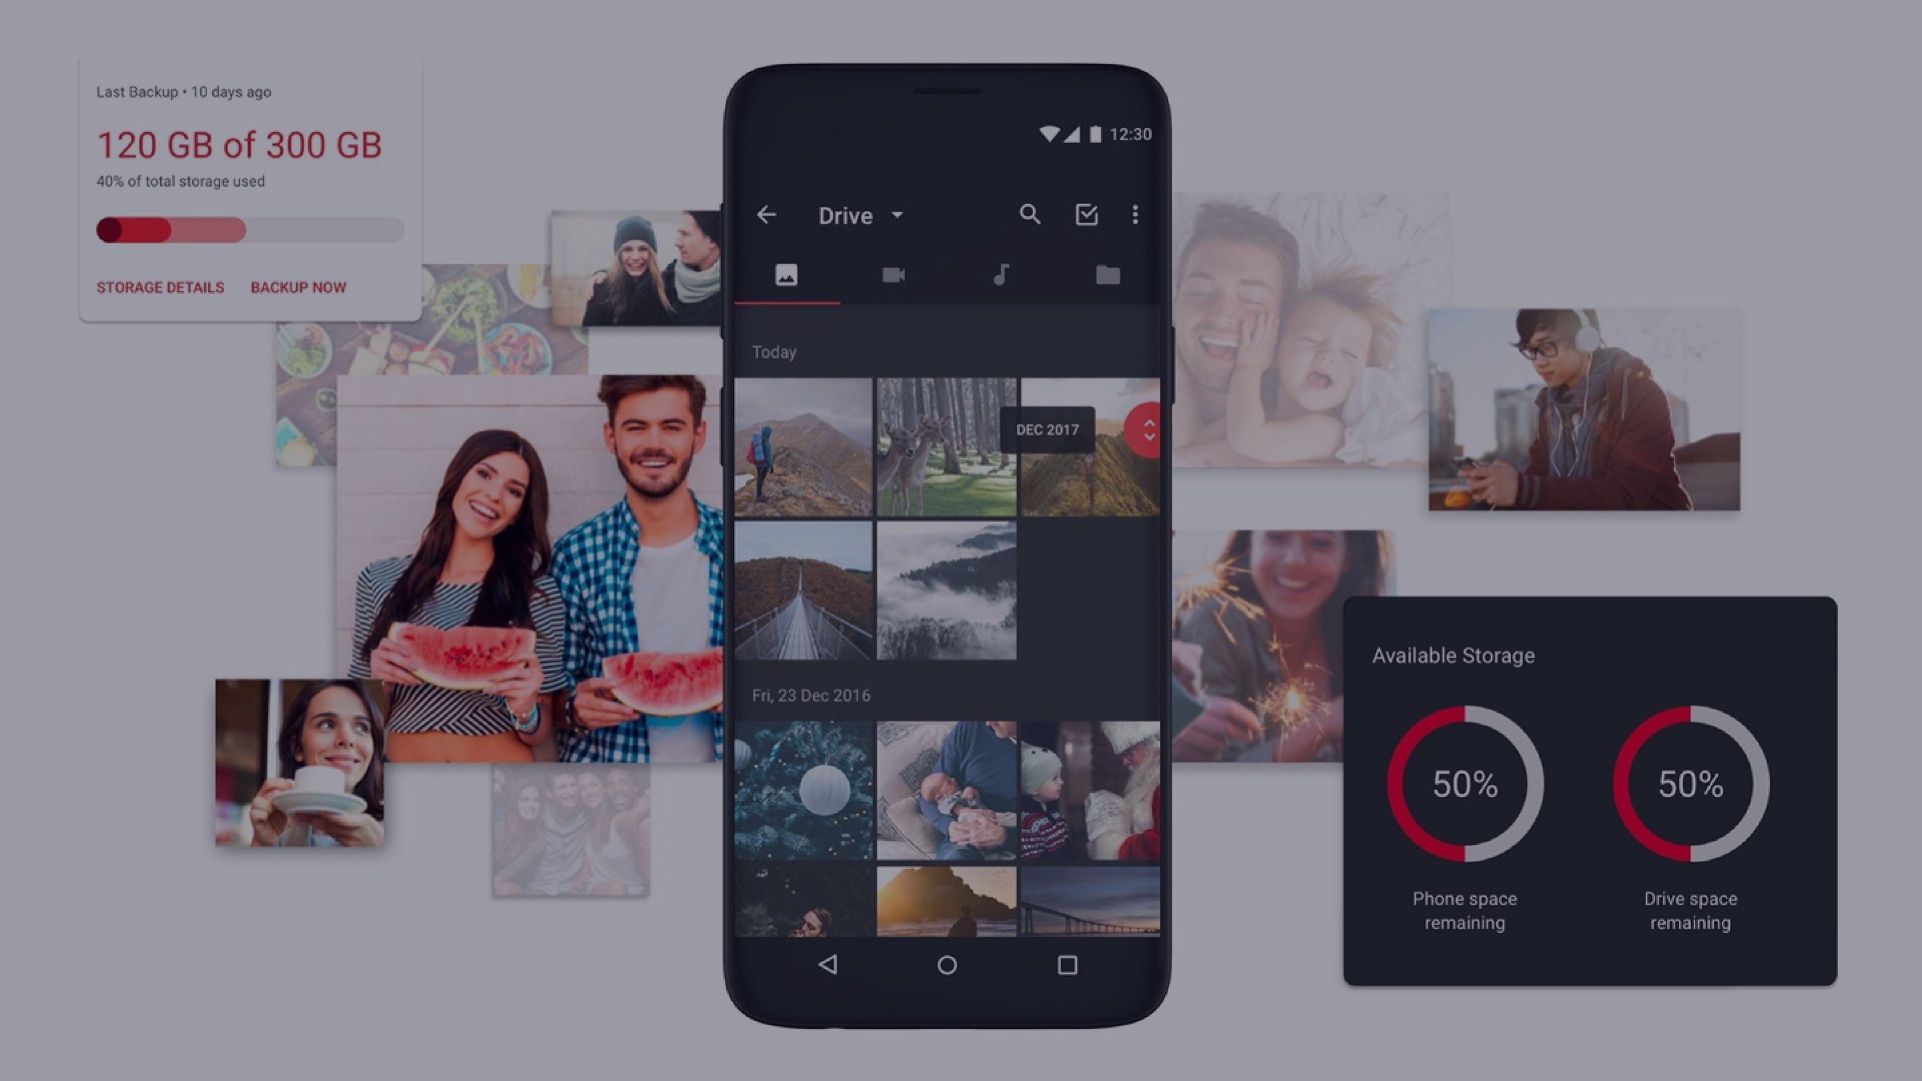
We delight users, at scale: We took this consumer app from 2.5 stars to 4.5, 4M+ customers served

Slide 12

A Partnership to Stay.
Digital Design Strategy
Project Name
Month Year
© 2026

Slide 13


What Our Clients Say About Us
“…Nagarro stands for competence and technology, for open and transparent communication, and for the ambition to develop a long-term partnership. …”​
“…Nagarro played a key role in onboarding our acquired entities across the globe to HID’s unified Oracle platform. Nagarro has been extremely agile and followed a customer-centric approach...”​
Dr. Thomas Wittmann​ CEO, Lufthansa Systems
Elizabeth Bayer Sr. Director - Global Application,​ HID Global​
“I wouldn’t recommend Nagarro to our competitors—but for any organization looking for an agile and experienced partner to navigate the complexities of digital transformation and innovation, I would recommend Nagarro100%…”
“…When Nagarro is given something, they own and run with it. When they deliver the solution, it’s not individual ownership but it’s the ownership from the company...”
Andreas Demetriou​ CIO of Alphamega​
Fawad Ahmed Director Data Analytics,​ Hood Industries
“...we are looking forward to continuing the development…I feel honored to be working in such a great team ”​
“We were looking for a technology partner to become an extension of our team. I would recommend Nagarro to any company looking for a true partner to help them evolve the digital platform…”
Gunther Machu Head of New Ventures Lab & Senior VP, Hoerbiger​​
Lea Volpe VP - Communications & Community Relations, Huber​
“We wanted our customers to self-service order information online. We have chosen Nagarro as an e-commerce partner around the world and had a wonderful experience working with them …”​
“…trusted relationship with Nagarro based on innovation, easy to work with, competency, problem-solving attitude and transparency…”
Jill Ullathorne Digital Director – Sales & marketing,​ Croda
Stéphane Mermilliod Vice President CPQ,​ Schneider Electric​
Digital Design Strategy
Project Name
Month Year
© 2026

