Slide 1

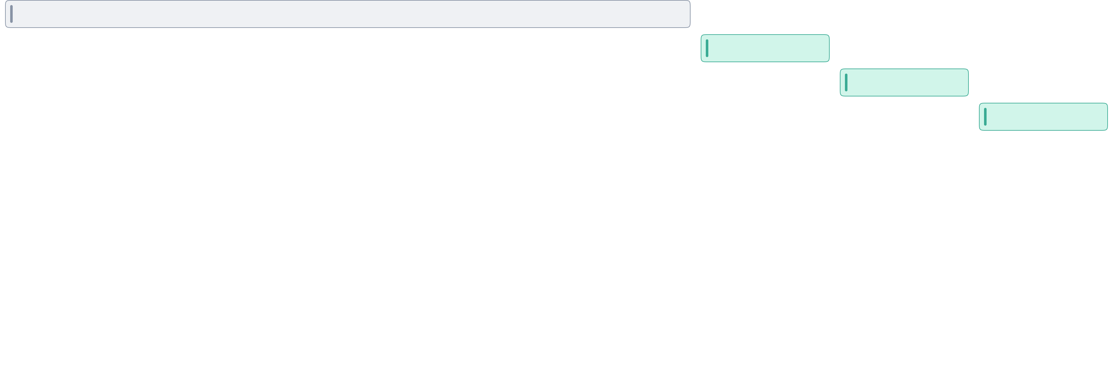
Week 1
Week 2
Week 3
Week 4
Week 5
Week 6
Week 7
Week 8
Workshop
Sprint 2
Sprint 3
Sprint 4
Digital Design Strategy
Project Name
Month Year
© 2026

Slide 2


Week 1
Week 2
Week 3
Week 4
Workshop
Project Steps / Points go here
Sprint 3
Digital Design Strategy
Project Name
Month Year
© 2026

Slide 3
Milestone Outputs & Dependencies
Milestone
What BRAND receives
Key dependencies
Approval outcome
M1
Product vision and direction, platform analysis findings, journey hypotheses and opportunity mapping, IA direction, UX principles, low-fidelity wireframes for priority journeys, initial usability testing results and UX metrics
Discovery inputs, access to current flows and analytics, existing design/assets, priority scope alignment, user-testing recruitment and scheduling, timely AJIO review and approval
IA, UX principles, and priority journeys are tested and formally approved
IM1
Frontend foundations ready: repo setup, token pipeline, theming approach, component structure, linting / CI checks, environment readiness, implementation approach aligned to the existing stack
M1 direction sufficiently stable, access to current frontend architecture, alignment with AJIO / vendor engineering, component model and token logic available, environment and pipeline access
Frontend foundations are established and ready to support implementation of approved journeys
M2
Designs for priority journeys across Android, iOS, mSite, and desktop, initial design direction and visual language, initial core UI components, updated testing insights for priority flows
M1 approved, platform constraints and responsive logic confirmed, alignment on what constitutes “core journeys,” timely design reviews, no major scope expansion after M1
Priority journeys are fully designed across platforms, validated, and approved
M3
Final UI direction, visual design system, storefront expressions, edge-case and extreme-case coverage, accessibility review at design stage, matured tokens and component definitions, usability evidence.
M2 approved, stable visual direction, storefront logic aligned, edge and exception scenarios confirmed, design system foundation sufficiently stable
Final UI and visual design system are approved for the core release scope
Digital Design Strategy
Project Name
Month Year
© 2026

Slide 4

Proposed Approach
MVP Kick-Off Timeline
Day 1
Day 2
Day 3
Day 4
Day 5
Project Context
Customer Journey Mapping
Stakeholder Interviews
Information Analysis
Understand and define project vision and main goals.
One to one or group conversations where we explore and discuss needs, challenges and overall requirements.
Gather and analyse generated information to document in Product Requirements Document
For the jobs identified develop a customer journey map to identify touch-points, challenges and opportunities.
Persona Mapping
MVP Feature Mapping
Define the main tasks target audience wants to get done.
Taking most priority features and creating user story mapping to define the scope of the MVP backlog.
Workflow Mapping
Jobs to be Done
Diagraming workflows of how work gets done from troubleshooting point of view.
Define the main tasks target audience wants to get done.
Digital Design Strategy
Project Name
Month Year
© 2026

