Slide 1
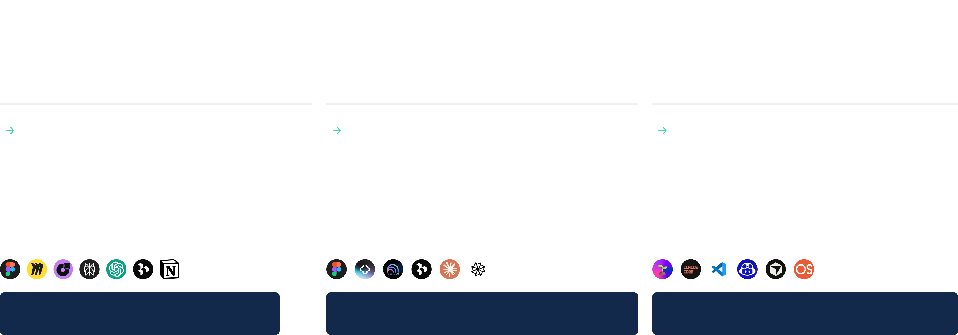
New AI Assisted SDLC
Discover
Specify
Build
Gather insights to reveal user needs and early opportunities while building shared cross-team understanding.
Explore and refine solutions quickly, validating feasibility and usability early to minimise downstream risk.
Turn discovery into actionable, aligned requirements that guide engineering toward scalable delivery.
How AI Accelerates Discovery
How AI Accelerates Definition
How AI Accelerates Building
Faster insight gathering Early opportunity detection Rapid alignment across teams
More solution exploration Prototypes in hours Early usability validation Technical architecture design
Clearer specifications Faster documentation Fewer alignment loops Validation and testing
AI TOOLS TO ACCELERATE DISCOVERY
AI TOOLS TO ACCELERATE DEFINITION
AI TOOLS TO ACCELERATE BUILDING
Transformation
Transformation
Transformation
33/50% Time Reduction / Wider Scope
33/50% Time Reduction / Risk mitigation
33/50% Faster Time to Market
Digital Design Strategy
Project Name
Month Year
© 2026

Slide 2
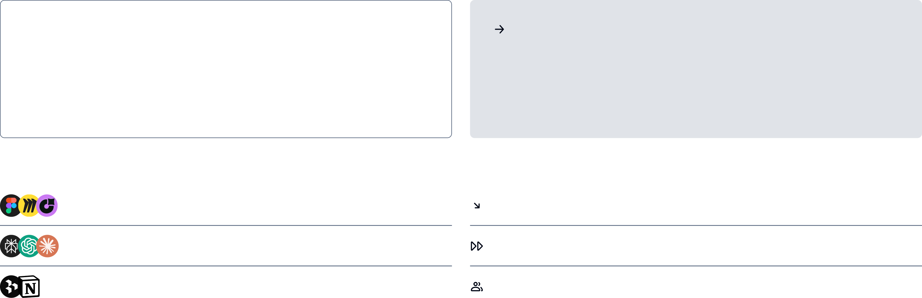
Discover
Gather insights to reveal user needs and early opportunities while building shared cross-team understanding.
Traditional Challenges
How AI Accelerates Discovery
Research synthesis slow (weeks → months) Insights scattered across documents and teams Difficult to validate assumptions early Competitive/market scans take too long
Summarizes interviews, documents, market data in minutes Clusters insights and identifies patterns early Creates draft personas, journeys, and thematic maps Enables rapid exploration of opportunity spaces
TOP TOOLS THAT WE USE TO ACCELERATE
IMPACT AND BENEFITS
FigJam, Miro, JIRA Product Discovery
Discovery reduced from ±3 months → ~1, with deeper coverage
Perplexity, ChatGPT, Claude
20–30% faster synthesis of research artifacts
Dovetail, Notion AI, Synthetic Personas
2× faster alignment across teams
Transformation
Summarizing 10–15 interviews took a week; now an AI draft arrives in 30 minutes and is refined in hours. Faster research synthesis → earlier insight patterns → reduced ambiguity
33/50% Reduction

Slide 3
Why choose Nagarro as your transformation partner?
Our existing relationship: As a trusted technology partner to FIFA over the past three years, Nagarro brings unique familiarity with FIFA’s digital landscape, operating model, and stakeholder expectations. We remain committed to supporting FIFA’s digital transformation journey and are confident that this collaboration will deliver meaningful value for FIFA and its global community Our Domain capabilities: We have more than 15 years of extensive experience working with great brands in sports, media, and gaming industry during which we have created bespoke service offerings and AI driven accelerators for driving value for our clients. We have close to 30+ large accounts with 500+ IT specialists working across the globe​ for our clients in this industry.
Our expertise in creating impactful digital experiences: We have a dedicated digital experiences practice with leadership having more than 20 years of experience in creating digital experience platforms across technologies and industries. We have strong partnerships with leading DXPs like Contentful, Sitecore, Adobe, Acquia, Builder.io to name a few. We have also developed AI powered tools and accelerators to meet the DX vision of our clients across the globe Our commitment to provide the right talent to FIFA: At Nagarro, we believe in hiring and retaining the best talent across the globe, and we have provided sample profiles in this proposal to demonstrate our technical and functional skills to FIFA.
Experience in implementing similar projects: We have worked with global brands to redesign their websites, consulted them on the features to enhance engagement, built personalised and immersive experiences and built the technical foundation to enable all these transformations. We have provided some select examples in this proposal Not just a technology partner: We position ourselves not just as implementation partners but also consulting partners to our clients by bringing in our thinking breakthrough framework and consulting frameworks like design++ that can help us identify future tracks for transformation for FIFA. Details around all these points are present in Section 8 : Why Nagarro
Digital Design Strategy
Project Name
Month Year
© 2026

Slide 4
Why choose Nagarro as your transformation partner?
Our existing relationship: As a trusted technology partner to FIFA over the past three years, Nagarro brings unique familiarity with FIFA’s digital landscape, operating model, and stakeholder expectations. We remain committed to supporting FIFA’s digital transformation journey and are confident that this collaboration will deliver meaningful value for FIFA and its global community Our Domain capabilities: We have more than 15 years of extensive experience working with great brands in sports, media, and gaming industry during which we have created bespoke service offerings and AI driven accelerators for driving value for our clients. We have close to 30+ large accounts with 500+ IT specialists working across the globe​ for our clients in this industry. Our expertise in creating impactful digital experiences: We have a dedicated digital experiences practice with leadership having more than 20 years of experience in creating digital experience platforms across technologies and industries. We have strong partnerships with leading DXPs like Contentful, Sitecore, Adobe, Acquia, Builder.io to name a few. We have also developed AI powered tools and accelerators to meet the DX vision of our clients across the globe
Our commitment to provide the right talent to FIFA: At Nagarro, we believe in hiring and retaining the best talent across the globe, and we have provided sample profiles in this proposal to demonstrate our technical and functional skills to FIFA. Experience in implementing similar projects: We have worked with global brands to redesign their websites, consulted them on the features to enhance engagement, built personalised and immersive experiences and built the technical foundation to enable all these transformations. We have provided some select examples in this proposal Not just a technology partner: We position ourselves not just as implementation partners but also consulting partners to our clients by bringing in our thinking breakthrough framework and consulting frameworks like design++ that can help us identify future tracks for transformation for FIFA. Details around all these points are present in Section 8 : Why Nagarro
Digital Design Strategy
Project Name
Month Year
© 2026

