Slide 1
What is C like?

Slide 2
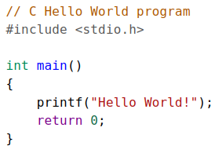
Hello World

Slide 3
bool
char
double
float
int
long
string

Slide 4
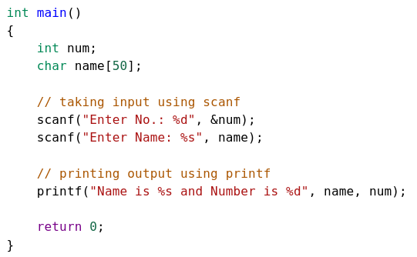
Prompt user for values
int
char
scanf()
print()

Slide 5
What does this mean?
int i = 5 < 25 ? 10 : 20;

Slide 6
What does this mean?
int i = 5 < 25 ? 10 : 20;
(condition) ? (true-exp) : (false-exp);

Slide 7
What does this mean?
int i = 5 < 25 ? 10 : 20;
(condition) ? (true-exp) : (false-exp);
So i = 10

Slide 8
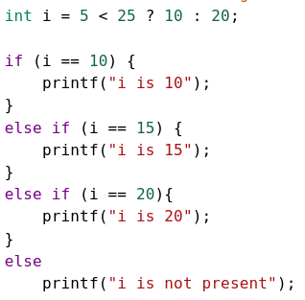
If else
if (condition) {action}
else if (condition) {action}

