Slide 1
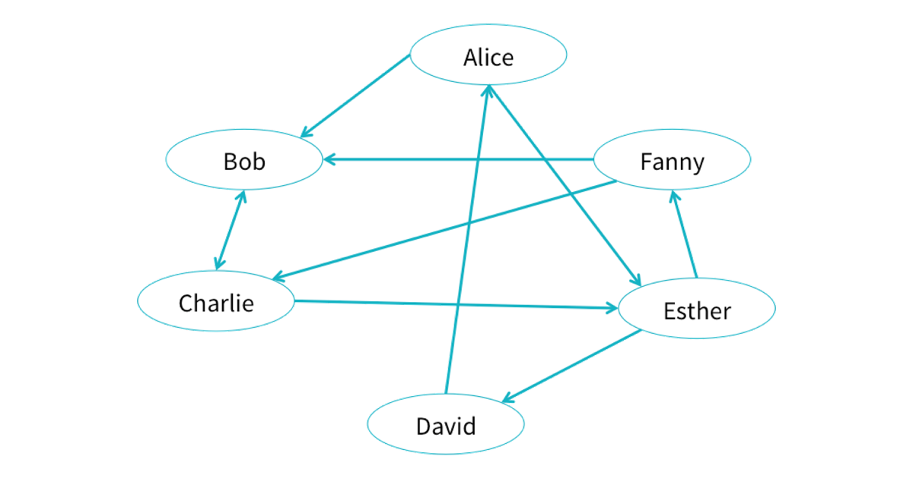
Shuo Z
Satya V
UW Data Engineering
Facebook College Data Analysis using Spark Graphframes

Slide 2
Dataset
Data is a zip file of 100 colleges
File is .mat format
Basically a sparse matrix with one row per node
Node has student info, major/minor etc.
“0” for no data

Slide 3

Data Pipeline
Data Files
Parsing & formatting
GraphFrames

Slide 4
Pipeline Flow
Queries
.MAT files
.CSV
Spark Graphframes
Visualization
Machine learning factor analysis

Slide 5
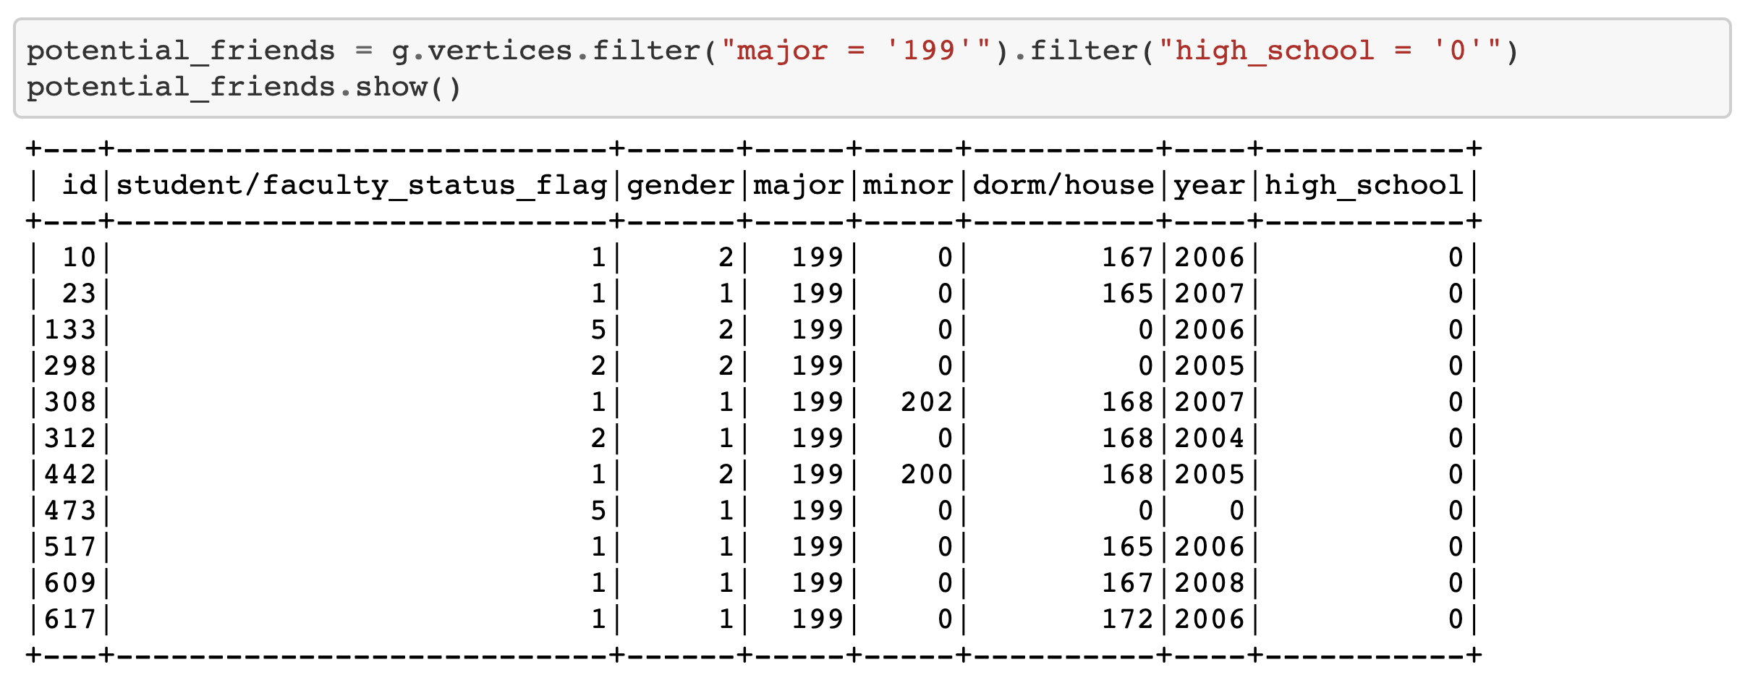
Query 1: Find Potential friends Suppose I just enter Caltech, I want to find people with the same major and from the same high school as me.

Slide 6
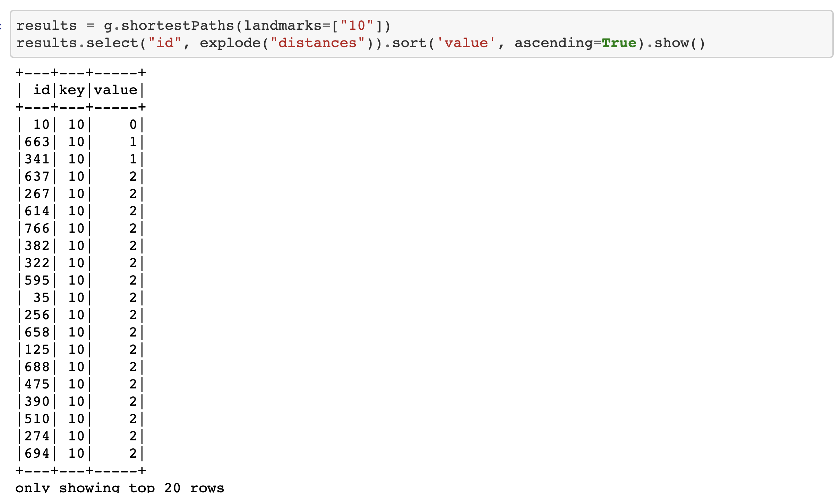
Query 2: Calculate Connection Distance Use degree of separation to calculate close connection(Direct or Mutual)
+1 Direct
+2 Mutual

Slide 7
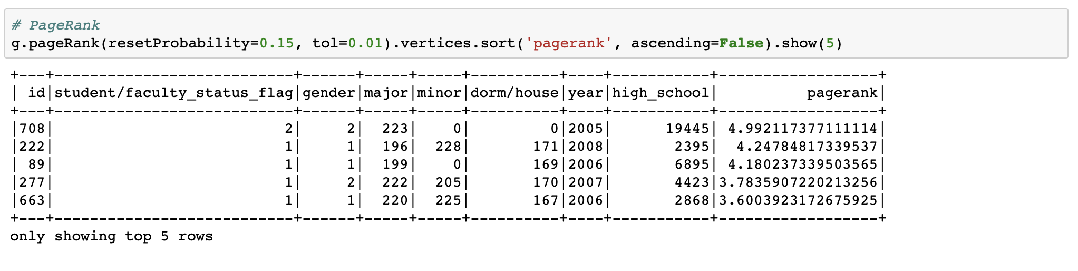
Query 3: Find the most popular people in school PageRank

Slide 8
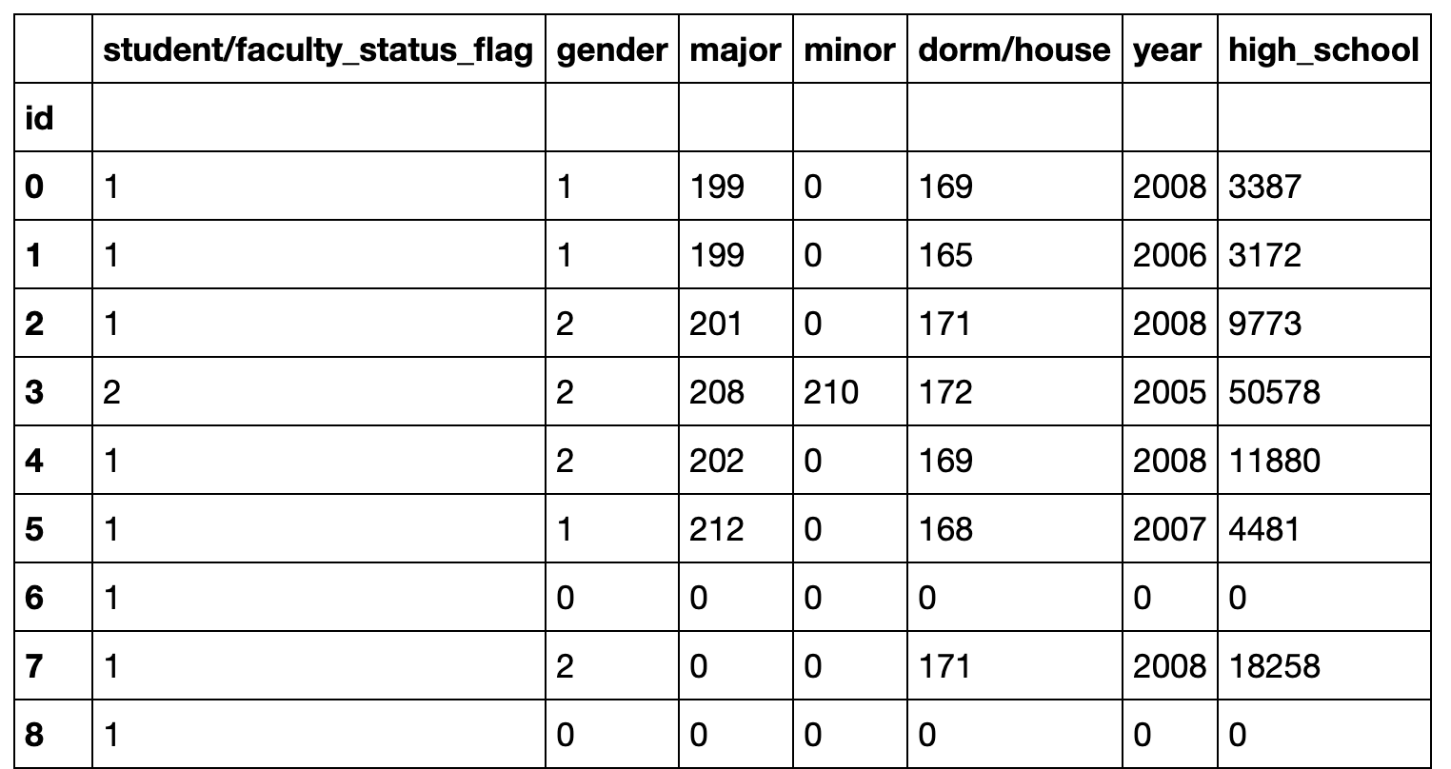
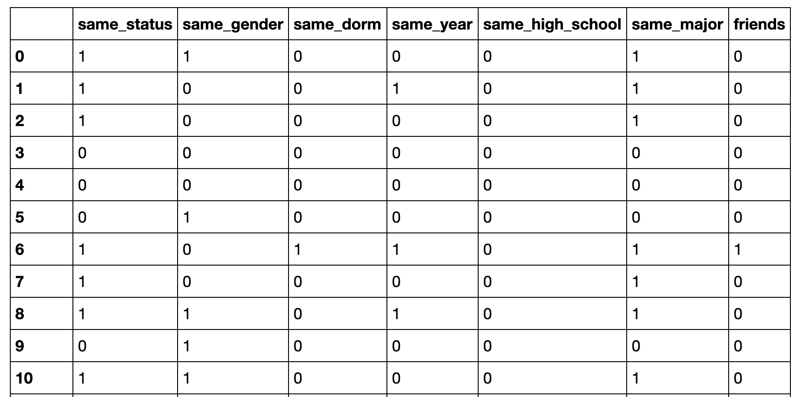
Factor Analysis
Original Data
Training Data

Slide 9
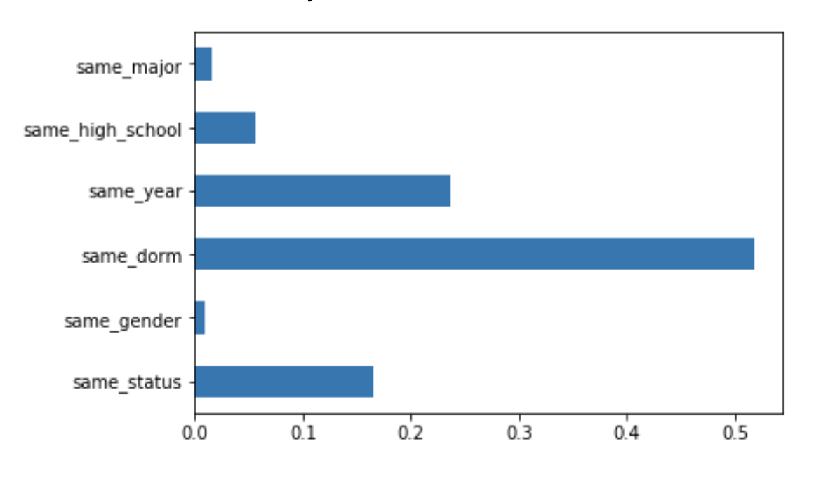
Factor Analysis Tree Classifier Feature Importance

Slide 10
Challenges
Difficult to find a proper visualization tool to integrate with GraphFrame.
No UI to make live queries.

