Slide 1
Tidyverse for COVID19 Data Analysis
J. Wall

Slide 2
Get and clean worldwide Data

Slide 3
Data from Johns Hopkins github
url_in <- "https://raw.githubusercontent.com/CSSEGISandData/COVID-19/master/csse_covid_19_data/csse_covid_19_time_series/" file_names <- c("time_series_covid19_confirmed_global.csv", "time_series_covid19_deaths_global.csv", "time_series_covid19_confirmed_US.csv", "time_series_covid19_deaths_US.csv") urls <- str_c(url_in,file_names)

Slide 4
Check urls
urls
## [1] "https://raw.githubusercontent.com/CSSEGISandData/COVID-19/master/csse_covid_19_data/csse_covid_19_time_series/time_series_covid19_confirmed_global.csv" ## [2] "https://raw.githubusercontent.com/CSSEGISandData/COVID-19/master/csse_covid_19_data/csse_covid_19_time_series/time_series_covid19_deaths_global.csv" ## [3] "https://raw.githubusercontent.com/CSSEGISandData/COVID-19/master/csse_covid_19_data/csse_covid_19_time_series/time_series_covid19_confirmed_US.csv" ## [4] "https://raw.githubusercontent.com/CSSEGISandData/COVID-19/master/csse_covid_19_data/csse_covid_19_time_series/time_series_covid19_deaths_US.csv"

Slide 5
Tidy global data
global_confirmed <- read_csv(urls[1]) %>% pivot_longer(cols = -c(`Province/State`, `Country/Region`, Lat, Long), names_to = "Date", values_to = "Confirmed_cases") global_deaths <- read_csv(urls[2]) %>% pivot_longer(cols = -c(`Province/State`, `Country/Region`, Lat, Long), names_to = "Date", values_to = "Deaths") global <- global_confirmed %>% full_join(global_deaths) %>% rename(Country_Region = `Country/Region`, Province_State = `Province/State`) %>% mutate(Date = mdy(Date))

Slide 6
fix problems
knitr::kable(summary(global))

Slide 7
 | Province_State | Country_Region | Lat | Long | Date | Confirmed_cases | Deaths
 | Length:25608 | Length:25608 | Min. :-51.796 | Min. :-135.00 | Min. :2020-01-22 | Min. : 0 | Min. : 0
 | Class :character | Class :character | 1st Qu.: 6.969 | 1st Qu.: -20.03 | 1st Qu.:2020-02-15 | 1st Qu.: 0 | 1st Qu.: 0
 | Mode :character | Mode :character | Median : 23.488 | Median : 20.54 | Median :2020-03-10 | Median : 6 | Median : 0
 | NA | NA | Mean : 21.317 | Mean : 22.17 | Mean :2020-03-10 | Mean : 2507 | Mean : 156
 | NA | NA | 3rd Qu.: 41.166 | 3rd Qu.: 78.75 | 3rd Qu.:2020-04-03 | 3rd Qu.: 188 | 3rd Qu.: 2
 | NA | NA | Max. : 71.707 | Max. : 178.06 | Max. :2020-04-27 | Max. :988197 | Max. :56259

Slide 8
# we find there are entries of -1 for Diamond Princess global <- global %>% filter(Confirmed_cases >= 0, Deaths >= 0)

Slide 9
Join population data to the dataset
uid_lookup_url <- "https://raw.githubusercontent.com/CSSEGISandData/COVID-19/master/csse_covid_19_data/UID_ISO_FIPS_LookUp_Table.csv" uid <- read_csv(uid_lookup_url) %>% select(-c(Lat, Long_, Combined_Key, code3, iso2, iso3, Admin2)) global <- global %>% left_join(uid, by = c("Province_State", "Country_Region")) %>% select(-c(UID, FIPS)) %>% select(Province_State, Country_Region, Date, Confirmed_cases, Deaths, Population, Lat, Long)

Slide 10
Get and tidy US data
US_confirmed <- read_csv(urls[3]) %>% pivot_longer(cols = -(UID:Combined_Key), names_to = "Date", values_to = "Confirmed_cases") %>% select(Admin2:Confirmed_cases) %>% mutate(Date = mdy(Date)) US_deaths <- read_csv(urls[4]) %>% pivot_longer(cols = -(UID:Population), names_to = "Date", values_to ="Deaths") %>% select(Admin2:Deaths) %>% mutate(Date = mdy(Date))

Slide 11
Join deaths and cases
US <- US_deaths %>% full_join(US_confirmed, by = c("Combined_Key", "Date", "Admin2", "Province_State", "Country_Region")) %>% rename(Long = Long_.x, Lat = Lat.x) %>% select(Admin2, Province_State, Country_Region, Lat, Long, Population, Date, Confirmed_cases, Deaths)

Slide 12
US data so far
US %>% filter(Province_State == "New York") %>% select(Admin2, Province_State, Confirmed_cases, Deaths) %>% head(n = 4)
## # A tibble: 4 x 4 ## Admin2 Province_State Confirmed_cases Deaths ## <chr> <chr> <dbl> <dbl> ## 1 Albany New York 0 0 ## 2 Albany New York 0 0 ## 3 Albany New York 0 0 ## 4 Albany New York 0 0
#Note that what we now have is county level data within each state. It would be nice to have data totaled for each state.

Slide 13
DMV data

Slide 14
get DMV data
dmv_data <- US %>% mutate(state = factor(Province_State), county = factor(Admin2)) %>% filter(state %in% c("Maryland", "Virginia", "District of Columbia")) %>% filter(county %in% c("Anne Arundel", "Montgomery", "Howard", "Frederick", "Prince George's", "Charles", "District of Columbia", "Alexandria", "Arlington", "Fairfax", "Loudoun", "Prince William")) %>% select(-c(Admin2, Province_State, Country_Region)) %>% mutate(Deaths_per_mill = 1000000 * Deaths / Population) %>% select(state, county, Date, Confirmed_cases, Deaths, Deaths_per_mill, Population, Lat, Long)

Slide 15
Plot DMV cases by county
dmv_data %>% filter(Confirmed_cases > 0) %>% ggplot(aes(x = Date, y = Confirmed_cases, group = county, col = county)) + geom_line() + geom_point() + facet_wrap(~ state) + scale_y_log10() + scale_color_brewer(palette = "Paired") + guides(color = guide_legend(ncol = 4)) + theme(legend.position="bottom", axis.text.x = element_text(angle = 90))

Slide 16
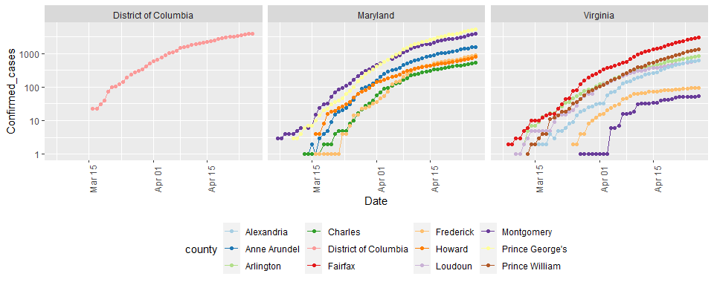

Slide 17
Compute cases & deaths in DMV
DMV_totals <- dmv_data %>% group_by(Date) %>% summarize(total_cases = sum(Confirmed_cases), total_deaths = sum(Deaths)) paste0("total deaths = ", as.character(max(DMV_totals$total_deaths)) )
## [1] "total deaths = 953"
paste0("total cases = ", as.character(max(DMV_totals$total_cases) ))
## [1] "total cases = 23309"
# Latest data from: paste0("latest data from: ", as.character( max(DMV_totals$Date) ))
## [1] "latest data from: 2020-04-27"

Slide 18
Visualize DMV cases and deaths
DMV_totals %>% filter(total_cases > 0) %>% ggplot(aes(x = Date, y = total_cases)) + geom_line() + geom_point() + labs(title = "Confirmed Cases of COVID19 in DMV", x = NULL, y = NULL)

Slide 19
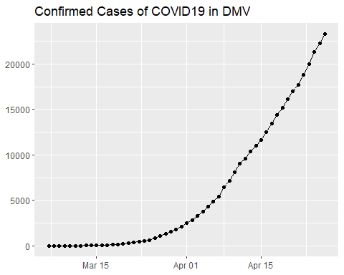

Slide 20
DMV_totals %>% filter(total_deaths > 0) %>% ggplot(aes(x = Date, y = total_deaths)) + geom_line(color = "red") + geom_point() + labs(title = "Deaths due to COVID19 in DMV", x = NULL, y = NULL)

Slide 21
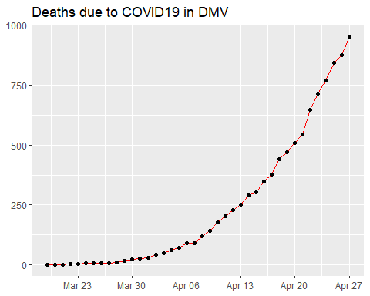

Slide 22
both on one graph
DMV_totals %>% filter(total_cases > 0) %>% ggplot(aes(x = Date, y = total_cases)) + geom_line(aes(color = "cases")) + geom_point(aes(color = "cases")) + geom_line(aes(y = total_deaths, color = "deaths"), data = DMV_totals %>% filter(total_deaths > 0)) + geom_point(aes(y = total_deaths, color = "deaths"), data = DMV_totals %>% filter(total_deaths > 0)) + scale_y_log10() + labs(title = "COVID19 in DMV", x = NULL, y = NULL)

Slide 23
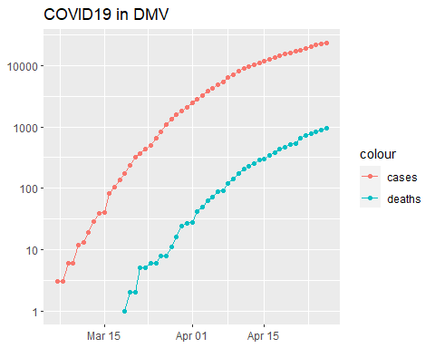

Slide 24
New cases
DMV_totals <- DMV_totals %>% mutate(new_cases = total_cases - lag(total_cases)) DMV_totals %>% filter(new_cases > 0) %>% ggplot(aes(x = Date, y = new_cases)) + geom_line(color = "red") + geom_point() + labs(title = "New COVID19 cases in DMV", x = NULL, y = NULL)

Slide 25
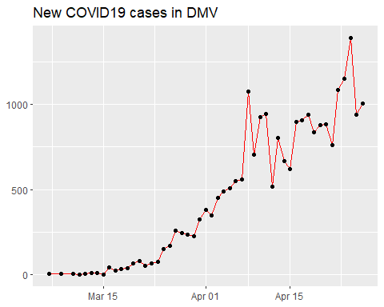

Slide 26
State analysis

Slide 27
Compute state totals
US_by_state <- US %>% group_by(Province_State, Country_Region, Date) %>% # add up counties and population summarize(Confirmed_cases = sum(Confirmed_cases), Deaths = sum(Deaths), Lat = median(Lat), Long = median(Long), Population = sum(Population)) %>% select(Province_State, Country_Region, Date, Confirmed_cases, Deaths, Population, Lat, Long) %>% ungroup()

Slide 28
State data now
US_by_state %>% head(n = 3) %>% select(Province_State, Date, Confirmed_cases, Deaths, Population, Country_Region)
## # A tibble: 3 x 6 ## Province_State Date Confirmed_cases Deaths Population Country_Region ## <chr> <date> <dbl> <dbl> <dbl> <chr> ## 1 Alabama 2020-01-22 0 0 4903185 US ## 2 Alabama 2020-01-23 0 0 4903185 US ## 3 Alabama 2020-01-24 0 0 4903185 US

Slide 29
Order deaths and cases by state
US_state_totals <- US_by_state %>% group_by(Province_State) %>% summarize(cases = max(Confirmed_cases), deaths = max(Deaths), population = max(Population)) %>% filter(cases > 0) %>% mutate(deaths_per_mill = 1000000 * deaths / population) %>% arrange(desc(cases))

Slide 30
View list by states
knitr::kable(US_state_totals %>% slice(1:10))

Slide 31
Province_State | cases | deaths | population | deaths_per_mill
New York | 291996 | 22668 | 23628065 | 959.36760
New Jersey | 111188 | 6044 | 8882190 | 680.46281
Massachusetts | 56462 | 3003 | 6892503 | 435.69078
Illinois | 45883 | 1983 | 12671821 | 156.48895
California | 44966 | 1779 | 39512223 | 45.02404
Pennsylvania | 43558 | 1886 | 12801989 | 147.32086
Michigan | 38210 | 3407 | 9986857 | 341.14837
Florida | 32138 | 1088 | 21477737 | 50.65711
Louisiana | 27068 | 1740 | 4648794 | 374.29062
Connecticut | 25997 | 2012 | 3565287 | 564.33045

Slide 32
Totals for US
# total deaths paste0("total US deaths = ", as.character(sum(US_state_totals$deaths)) )
## [1] "total US deaths = 56259"
# total cases paste0("total US cases = ", as.character(sum(US_state_totals$cases)) )
## [1] "total US cases = 988258"
# Latest data from: paste0("latest data from: ", as.character(max(US_by_state$Date)) )
## [1] "latest data from: 2020-04-27"

Slide 33
Visualizing the state data

Slide 34
library(usmap) US_data <- US_state_totals %>% mutate(state = Province_State) %>% filter(!is.na(deaths_per_mill))

Slide 35
Plot states
plot_usmap(data = US_data, values = "deaths_per_mill", color = "black") + scale_fill_gradient(name = "Deaths per million", low = "yellow", high = "red") + theme(legend.position = "right")

Slide 36
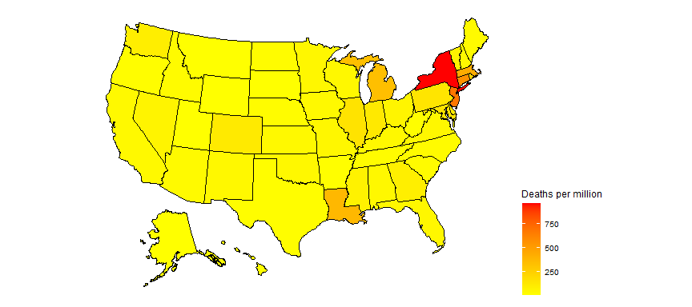

Slide 37
partition deaths per million into 10 equal ranges.
US_data <- US_data %>% filter(population > 0) %>% mutate(death_group = cut(deaths_per_mill, breaks = seq(min(deaths_per_mill), max(deaths_per_mill), length.out = 10), include.lowest = TRUE, right = FALSE, ordered_result = TRUE) )

Slide 38
Plot 10 levels
plot_usmap(data = US_data, values = "death_group", color = "black") + scale_fill_discrete(name = "Deaths_per_million") + theme(legend.position = "right")

Slide 39
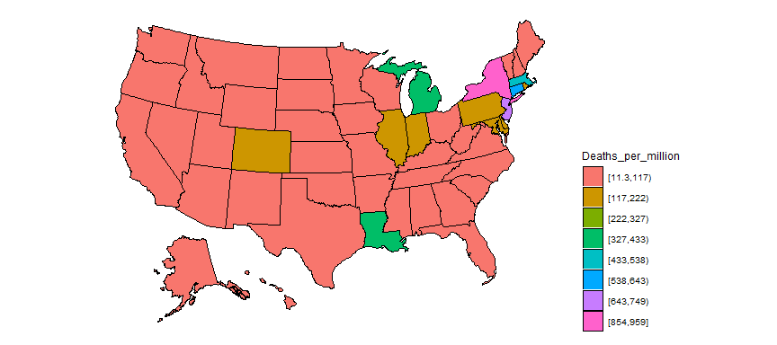

Slide 40
Add states to global
#Replace the US observations in the global dataset with the US data exp_global <- global %>% # remove the US total data from the dataset filter(Country_Region != "US") %>% # add on the totals by state bind_rows(US_by_state)

Slide 41
Add continents
library(countrycode) temp <- countrycode(exp_global$Country_Region, origin = "country.name", destination = "continent") Confirmed <- exp_global %>% mutate(continent = temp) %>% mutate(continent = case_when( Country_Region == "Cruise Ship"~"Cruiseship", Country_Region == "Diamond Princess"~"Cruiseship", Country_Region == "MS Zaandam"~"Cruiseship", Country_Region == "Kosovo" ~ "Europe", TRUE ~ continent)) %>% # create a Country_State combining Province_State & Country_Region unite(Country_State, c(Country_Region, Province_State), na.rm = TRUE, remove = FALSE) Confirmed %>% filter(is.na(continent))
## # A tibble: 0 x 10 ## # ... with 10 variables: Country_State <chr>, Province_State <chr>, ## # Country_Region <chr>, Date <date>, Confirmed_cases <dbl>, Deaths <dbl>, ## # Population <dbl>, Lat <dbl>, Long <dbl>, continent <chr>

Slide 42
Compute Deaths per million population
Confirmed <- Confirmed %>% mutate(Deaths_per_mill = 1000000 * Deaths / Population) %>% select(Country_State, Date, Confirmed_cases, Deaths, Deaths_per_mill, continent, Population, Lat, Long, everything()) %>% filter(Confirmed_cases > 0) # leave off rows w/o cases

Slide 43
Country/State’s w/ most cases
Confirmed_totals <- Confirmed %>% group_by(Country_State, Province_State, Country_Region, continent) %>% summarize(Confirmed_cases = max(Confirmed_cases), Deaths = max(Deaths), Deaths_per_mill = max(Deaths_per_mill), Date_first_case = min(Date), Population = max(Population)) %>% ungroup() %>% select(Country_State, Date_first_case, Deaths_per_mill, Deaths, Confirmed_cases, Population, everything())

Slide 44
Worldwide totals to date
# total deaths paste0("total worldwide deaths = ", as.character(sum(Confirmed_totals$Deaths)) )
## [1] "total worldwide deaths = 211169"
# total cases paste0("total worldwide cases = ", as.character(sum(Confirmed_totals$Confirmed_cases)) )
## [1] "total worldwide cases = 3041967"
# average deaths per million to date df <- Confirmed_totals %>% summarize(death_rate = 1000000 * sum(Deaths, na.rm = TRUE) / sum(Population, na.rm = TRUE)) paste0("total worldwide deaths per million to date = ", as.character(sum(df$death_rate)) )
## [1] "total worldwide deaths per million to date = 27.3897958320462"
# Latest data from: paste0("latest data from: ", as.character(max(US_by_state$Date)) )
## [1] "latest data from: 2020-04-27"

Slide 45
Top 25 and top 100
Top_25 <- Confirmed_totals %>% arrange(desc(Confirmed_cases)) %>% slice(1:25) %>% # Top_25 %>% select(Country_State, continent, Confirmed_cases, Deaths,Deaths_per_mill) knitr::kable(Top_25 %>% slice(1:8))

Slide 46
Country_State | continent | Confirmed_cases | Deaths | Deaths_per_mill
US_New York | Americas | 291996 | 22668 | 959.36760
Spain | Europe | 229422 | 23521 | 503.07153
Italy | Europe | 199414 | 26977 | 446.18234
France | Europe | 164589 | 23293 | 356.85226
Germany | Europe | 158758 | 6126 | 73.11663
United Kingdom | Europe | 157149 | 21092 | 310.69733
Turkey | Asia | 112261 | 2900 | 34.38501
US_New Jersey | Americas | 111188 | 6044 | 680.46281

Slide 47
Top_100 <- Confirmed_totals %>% arrange(desc(Confirmed_cases)) %>% slice(1:100)

Slide 48
Get data for top 25
# grab top 25 country / states for graphing Top_25_states <- Top_25$Country_State Top_25_data <- Confirmed %>% filter(Country_State %in% Top_25_states) %>% select(Country_State, continent, Date, Confirmed_cases, Deaths, Deaths_per_mill)

Slide 49
Graph top 25
Top_25_data %>% filter(Confirmed_cases > 0) %>% ggplot(aes(x = Date, y = Confirmed_cases, group = Country_State, color = Country_State)) + geom_line() + facet_wrap(~continent, scales = "free") + scale_y_log10() + labs(title = "Confirmed Cases - top 25", x = NULL, y = NULL) + guides(color = guide_legend(ncol = 6)) + theme(legend.position="bottom",axis.text.x = element_text(angle = 90))

Slide 50
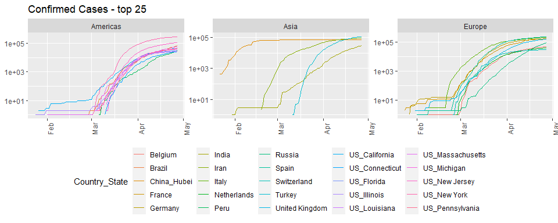

Slide 51
Top_25_data %>% filter(Deaths > 0) %>% ggplot(aes(x = Date, y = Deaths, group = Country_State, color = Country_State)) + geom_line() + facet_wrap(~continent, scales = "free") + scale_y_log10() + labs(title = "Deaths - top 25", x = NULL, y = NULL) + guides(color = guide_legend(ncol = 6)) + theme(legend.position="bottom",axis.text.x = element_text(angle = 90))

Slide 52
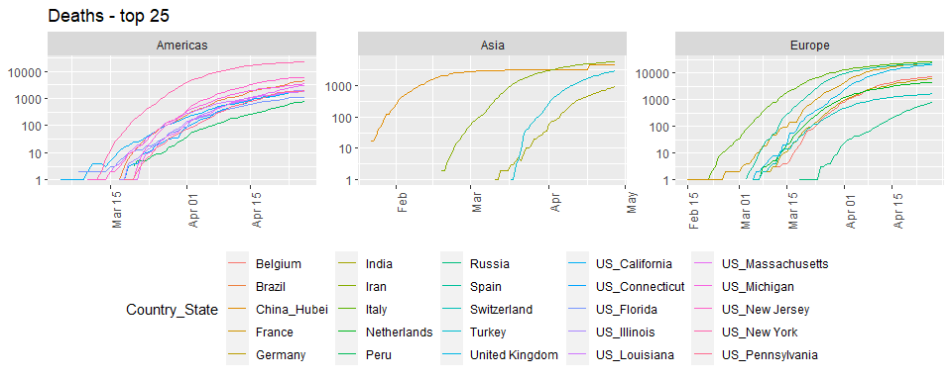

Slide 53
Top_25_data %>% filter(Deaths > 0) %>% ggplot(aes(x = Date, y = Deaths_per_mill, group = Country_State, color = Country_State)) + geom_line() + labs(title = "Deaths per million population", x = NULL, y = NULL) + facet_wrap(~continent, scales = "free") + scale_y_log10() + guides(color = guide_legend(ncol = 6)) + theme(legend.position="bottom",axis.text.x = element_text(angle = 90))

Slide 54
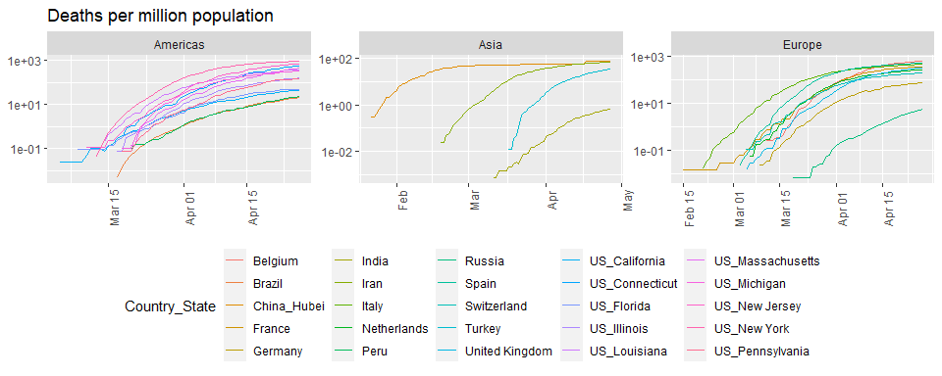

Slide 55
Scandinavia analysis

Slide 56
# look at cases in Scandinavia since Sweden has not shut down their economy like other countries have. What impact has this had on death rates? Scandinavia <- Confirmed %>% filter(Country_State %in% c("Sweden", "Denmark", "Finland")) %>% select(Country_State, Date, Confirmed_cases, Deaths, Deaths_per_mill, everything()) %>% mutate(Country_State = factor(Country_State)) Scandinavia %>% filter(Deaths > 0) %>% ggplot(aes(x = Date, y = Deaths, color = Country_State)) + geom_point() + geom_line() + labs(title = "Deaths", x = NULL, y = NULL) + scale_y_log10()

Slide 57
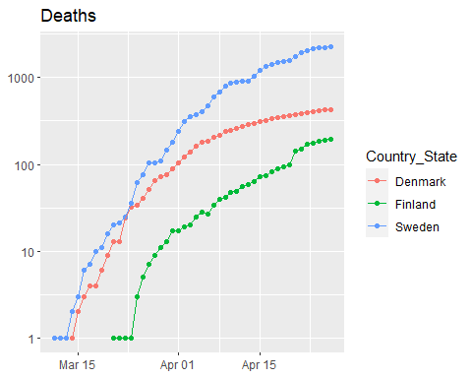

Slide 58
Scandinavia %>% filter(Deaths > 0) %>% ggplot(aes(x = Date, y = Deaths_per_mill, color = Country_State)) + geom_point() + geom_line() + labs(title = "Deaths per million", x = NULL, y = NULL) + scale_y_log10()

Slide 59
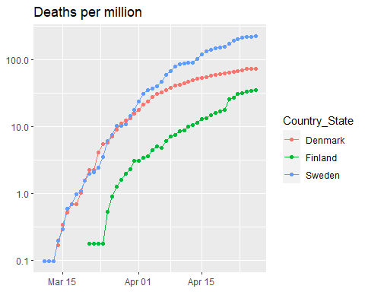

Slide 60
Scand_summ <- Scandinavia %>% group_by(Country_State) %>% summarize(Max_Deaths_per_million = max(Deaths_per_mill), Total_cases = max(Confirmed_cases), Total_deaths = max(Deaths), Population = max(Population)) knitr::kable(Scand_summ)

Slide 61
Country_State | Max_Deaths_per_million | Total_cases | Total_deaths | Population
Denmark | 73.71979 | 8698 | 427 | 5792203
Finland | 34.83303 | 4695 | 193 | 5540718
Sweden | 225.16479 | 18926 | 2274 | 10099270

Slide 62
Modeling

Slide 63
Hubei province of China and the Diamond Princess cruise ship.
Slowed_cases <- Confirmed %>% filter(Country_State %in% c("China_Hubei", "Diamond Princess")) Slowed_cases %>% ggplot(aes(x = Date, y = Confirmed_cases)) + geom_point() + facet_wrap(~ Country_State, scales = "free")

Slide 64
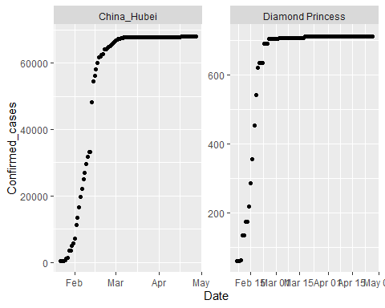

Slide 65
Fitting a sigmoid function.
# thanks to http://kyrcha.info/2012/07/08/tutorials-fitting-a-sigmoid-function-in-r # function needed for visualization purposes sigmoid = function(x, params) { params[1] / (1 + exp(-params[2] * (x - params[3]))) } x = 1:53 y = c(0,0,0,0,0,0,0,0,0,0,0,0,0,0.1,0.18,0.18,0.18,0.33,0.33,0.33,0.33,0.41,0.41,0.41,0.41,0.41,0.41,0.5,0.5,0.5,0.5,0.68,0.58,0.58,0.68,0.83,0.83,0.83,0.74,0.74,0.74,0.83,0.83,0.9,0.9,0.9,1,1,1,1,1,1,1) df <- tibble(x = x, y = y) # fitting code fitmodel <- nls(y ~ a /(1 + exp(-b * (x - c))), data = df, start = list(a = 1, b = 0.5, c = 25))

Slide 66
Plot model and data for sigmoid example
# visualization code # get the coefficients using the coef function params=coef(fitmodel) df$y2 <- sigmoid(x, params) df %>% ggplot(aes(x, y2)) + geom_line() + geom_point(y = y)

Slide 67
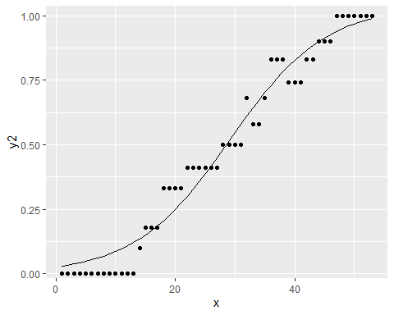

Slide 68
More generalized sigmoid function
$$y(t)=\frac{K}{{\left(1+Q*e^{\left(−B*\left(t−t0\right)\right)}\right)}^{\frac{1}{v}}}$$
Goal: use that form for Hubei and fit a sigmoid function to that data.

Slide 69
Start simply
$$y(t)=\frac{K}{\left(1+e^{\left(−B*\left(t−t0\right)\right)}\right)}$$

Slide 70
Get, visualize, model Hubei data
library(broom) Hubei_cases <- Confirmed %>% filter(Country_State == "China_Hubei") %>% mutate(date_int = unclass(Date)) Hubei_cases %>% ggplot(aes(x = Date, y = Confirmed_cases)) + geom_point()

Slide 71
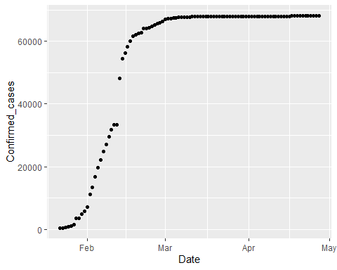

Slide 72
# first with simplified sigmoid function sigmoid <- function(x, params) { params[1] / (1 + exp(-params[2] * (x - params[3]))) } mod1 <- nls(Confirmed_cases ~ K /(1 + exp(-B * (date_int - t0))), data = Hubei_cases, start = list(K = 60000, B = 0.5, t0 = 18300)) params <- coef(mod1)

Slide 73
Plot Hubei model and data
Hubei_cases <- Hubei_cases %>% mutate(pred = sigmoid(date_int, params) ) %>% select(Confirmed_cases, pred, Date, date_int, everything()) Hubei_cases %>% ggplot(aes(Date, pred)) + geom_line() + geom_point(aes(y = Confirmed_cases))

Slide 74
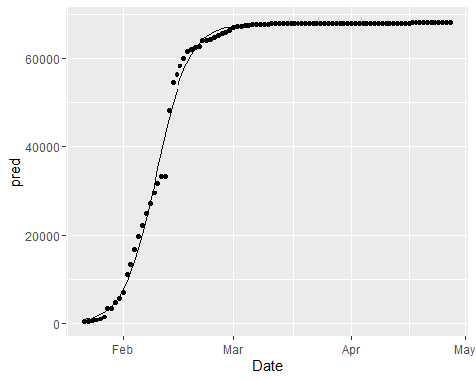

Slide 75
Model summary
summary(mod1)
## ## Formula: Confirmed_cases ~ K/(1 + exp(-B * (date_int - t0))) ## ## Parameters: ## Estimate Std. Error t value Pr(>|t|) ## K 6.783e+04 2.018e+02 336.15 <2e-16 *** ## B 2.341e-01 5.973e-03 39.19 <2e-16 *** ## t0 1.830e+04 1.247e-01 146780.39 <2e-16 *** ## --- ## Signif. codes: 0 '***' 0.001 '**' 0.01 '*' 0.05 '.' 0.1 ' ' 1 ## ## Residual standard error: 1590 on 94 degrees of freedom ## ## Number of iterations to convergence: 6 ## Achieved convergence tolerance: 6.859e-07
glance(mod1)
## # A tibble: 1 x 8 ## sigma isConv finTol logLik AIC BIC deviance df.residual ## <dbl> <lgl> <dbl> <dbl> <dbl> <dbl> <dbl> <int> ## 1 1590. TRUE 0.000000686 -851. 1710. 1721. 237712548. 94

Slide 76
One more step
$$y(t)=\frac{K}{{\left(1+e^{\left(−B*\left(t−t0\right)\right)}\right)}^{\frac{1}{v}}}$$

Slide 77
More complex model on Hubei
sigmoid_gen <- function(x, params) { params[1] / ( (1 + exp(-params[2] * (x - params[3]))) ) ^ (1 / params[4]) } startK <- max(Hubei_cases$Confirmed_cases) mod2 <- nls(Confirmed_cases ~ K /( (1 + exp(-B * (date_int - t0))) ) ^(1/v) , data = Hubei_cases, start = list(K = startK, B = .25, t0 = 18300, v = 1) )

Slide 78
Visualize both Hubei models
# get the coefficients using the coef function params <- coef(mod2) Hubei_cases <- Hubei_cases %>% mutate(pred2 = sigmoid_gen(date_int, params) ) %>% select(Confirmed_cases, pred2, pred, Date, date_int, everything()) Hubei_cases %>% ggplot(aes(x = Date)) + geom_line(aes(y = pred2), color = "red") + geom_line(aes(y = pred), color = "black") + geom_point(aes(y = Confirmed_cases))

Slide 79
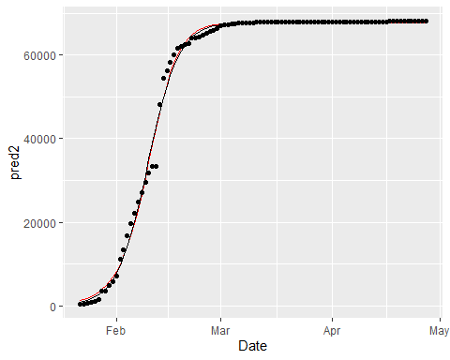

Slide 80
# use broom::glance to look at model results summary(mod2)
## ## Formula: Confirmed_cases ~ K/((1 + exp(-B * (date_int - t0))))^(1/v) ## ## Parameters: ## Estimate Std. Error t value Pr(>|t|) ## K 6.772e+04 2.032e+02 333.199 < 2e-16 *** ## B 2.679e-01 1.911e-02 14.020 < 2e-16 *** ## t0 1.830e+04 8.466e-01 21620.047 < 2e-16 *** ## v 1.382e+00 2.089e-01 6.612 2.36e-09 *** ## --- ## Signif. codes: 0 '***' 0.001 '**' 0.01 '*' 0.05 '.' 0.1 ' ' 1 ## ## Residual standard error: 1574 on 93 degrees of freedom ## ## Number of iterations to convergence: 11 ## Achieved convergence tolerance: 4.097e-06
glance(mod2)
## # A tibble: 1 x 8 ## sigma isConv finTol logLik AIC BIC deviance df.residual ## <dbl> <lgl> <dbl> <dbl> <dbl> <dbl> <dbl> <int> ## 1 1574. TRUE 0.00000410 -850. 1709. 1722. 230360130. 93

Slide 81
Our plan of attack
use a map function and nested grouped data to develop models out of this more complicated model family for the Diamond Princess and most of the China provinces
Add the model to the nested data
Use broom::tidy() to add the coefficients of the models to the dataset
Use pivot_wider to make these coefficients into columns.

Slide 82
Nest China and Princess data
by_country <- Confirmed %>% filter(Country_State != "China_Beijing", Country_State != "China_Shanxi", Country_State != "China_Tibet") %>% filter(Country_Region == "China" | Country_State == "Diamond Princess") %>% #filter(Confirmed_cases > 200) %>% mutate(date_int = unclass(Date)) %>% group_by(Country_State, Province_State, Country_Region, continent, Lat, Long) %>% nest() # by_country$data[[1]] by_country
## # A tibble: 31 x 7 ## # Groups: Country_State, continent, Lat, Long, Province_State, Country_Region ## # [31] ## Country_State continent Lat Long Province_State Country_Region data ## <chr> <chr> <dbl> <dbl> <chr> <chr> <list> ## 1 China_Anhui Asia 31.8 117. Anhui China <tibble ~ ## 2 China_Chongqing Asia 30.1 108. Chongqing China <tibble ~ ## 3 China_Fujian Asia 26.1 118. Fujian China <tibble ~ ## 4 China_Gansu Asia 37.8 101. Gansu China <tibble ~ ## 5 China_Guangdong Asia 23.3 113. Guangdong China <tibble ~ ## 6 China_Guangxi Asia 23.8 109. Guangxi China <tibble ~ ## 7 China_Guizhou Asia 26.8 107. Guizhou China <tibble ~ ## 8 China_Hainan Asia 19.2 110. Hainan China <tibble ~ ## 9 China_Hebei Asia 39.5 116. Hebei China <tibble ~ ## 10 China_Heilongj~ Asia 47.9 128. Heilongjiang China <tibble ~ ## # ... with 21 more rows

Slide 83
Add models to nested data
country_mod2 <- function(df){ startK <- max(df$Confirmed_cases) nls(Confirmed_cases ~ K /( (1 + exp(-B * (date_int - t0))) ) ^(1/v) , data = df, start = list(K = startK, B = .25, t0 = 18300, v = 1), control = list(maxiter = 1000, warnOnly = TRUE)) } by_country <- by_country %>% mutate(model = map(data, country_mod2), tm = map(model, broom::tidy)) %>% unnest(tm) %>% select(Country_State, Lat, Long, term, estimate, `std.error`, statistic, p.value, everything())

Slide 84
Look at results
by_country
## # A tibble: 124 x 13 ## # Groups: Country_State, Lat, Long, continent, Province_State, Country_Region ## # [31] ## Country_State Lat Long term estimate std.error statistic p.value ## <chr> <dbl> <dbl> <chr> <dbl> <dbl> <dbl> <dbl> ## 1 China_Anhui 31.8 117. K 9.92e+2 0.808 1228. 1.47e-197 ## 2 China_Anhui 31.8 117. B 2.74e-1 0.00545 50.2 3.90e- 69 ## 3 China_Anhui 31.8 117. t0 1.83e+4 0.320 57223. 0. ## 4 China_Anhui 31.8 117. v 9.03e-1 0.0531 17.0 2.45e- 30 ## 5 China_Chongq~ 30.1 108. K 5.79e+2 0.664 871. 1.02e-183 ## 6 China_Chongq~ 30.1 108. B 1.81e-1 0.00407 44.5 1.84e- 64 ## 7 China_Chongq~ 30.1 108. t0 1.83e+4 1.90 9634. 9.07e-281 ## 8 China_Chongq~ 30.1 108. v 1.87e-1 0.0521 3.59 5.39e- 4 ## 9 China_Fujian 26.1 118. K 3.39e+2 4.49 75.5 3.10e- 85 ## 10 China_Fujian 26.1 118. B 1.16e-1 0.0218 5.31 7.41e- 7 ## # ... with 114 more rows, and 5 more variables: continent <chr>, ## # Province_State <chr>, Country_Region <chr>, data <list>, model <list>

Slide 85
Make data per province
province_data <- by_country %>% ungroup() %>% select(Province_State, Lat, Long, term, estimate, data) %>% pivot_wider(names_from = term, values_from = estimate) %>% mutate(t0_date = as_date(t0)) province_data %>% arrange(t0_date) %>% print(n = Inf)
## # A tibble: 31 x 9 ## Province_State Lat Long data K B t0 v t0_date ## <chr> <dbl> <dbl> <list> <dbl> <dbl> <dbl> <dbl> <date> ## 1 Liaoning 41.3 123. <tibble~ 1.47e2 -0.0664 18126. -6.18 2019-08-17 ## 2 Shanghai 31.2 121. <tibble~ 7.26e2 0.0289 18253. 0.121 2019-12-23 ## 3 Gansu 37.8 101. <tibble~ 1.38e2 0.101 18256. 0.00901 2019-12-26 ## 4 Sichuan 30.6 103. <tibble~ 5.52e2 0.128 18259. 0.0108 2019-12-28 ## 5 Qinghai 35.7 96.0 <tibble~ 1.80e1 0.126 18261. 0.0249 2019-12-30 ## 6 Shaanxi 35.2 109. <tibble~ 2.55e2 0.134 18263. 0.0157 2020-01-01 ## 7 Yunnan 25.0 101. <tibble~ 1.80e2 0.116 18264. 0.0358 2020-01-02 ## 8 Hong Kong 22.3 114. <tibble~ 5.65e2 -0.576 18266. -5.56 2020-01-05 ## 9 Tianjin 39.3 117. <tibble~ 1.75e2 0.100 18267. 0.0285 2020-01-06 ## 10 Heilongjiang 47.9 128. <tibble~ 8.54e2 0.0397 18268. 0.113 2020-01-06 ## 11 Zhejiang 29.2 120. <tibble~ 1.25e3 0.139 18268. 0.0238 2020-01-06 ## 12 Fujian 26.1 118. <tibble~ 3.39e2 0.116 18269. 0.0432 2020-01-07 ## 13 Guangdong 23.3 113. <tibble~ 1.52e3 0.122 18269. 0.0304 2020-01-07 ## 14 Jilin 43.7 126. <tibble~ 1.02e2 0.164 18273. 0.0155 2020-01-11 ## 15 Macau 22.2 114. <tibble~ 2.92e1 -0.481 18273. -3.99 2020-01-12 ## 16 Shandong 36.3 118. <tibble~ 7.83e2 0.109 18274. 0.0818 2020-01-12 ## 17 Chongqing 30.1 108. <tibble~ 5.79e2 0.181 18283. 0.187 2020-01-21 ## 18 Guangxi 23.8 109. <tibble~ 2.54e2 0.183 18290. 0.471 2020-01-28 ## 19 Ningxia 37.3 106. <tibble~ 7.50e1 0.165 18290. 0.394 2020-01-29 ## 20 Hunan 27.6 112. <tibble~ 1.02e3 0.236 18291. 0.464 2020-01-29 ## 21 Jiangsu 33.0 119. <tibble~ 6.43e2 0.205 18291. 0.435 2020-01-30 ## 22 Henan 33.9 114. <tibble~ 1.28e3 0.237 18292. 0.526 2020-01-31 ## 23 Jiangxi 27.6 116. <tibble~ 9.38e2 0.261 18294. 0.646 2020-02-01 ## 24 Hebei 39.5 116. <tibble~ 3.23e2 0.193 18295. 0.611 2020-02-02 ## 25 Anhui 31.8 117. <tibble~ 9.92e2 0.274 18296. 0.903 2020-02-03 ## 26 Hainan 19.2 110. <tibble~ 1.68e2 0.296 18299. 1.74 2020-02-06 ## 27 Guizhou 26.8 107. <tibble~ 1.46e2 0.375 18300. 1.66 2020-02-08 ## 28 Xinjiang 41.1 85.2 <tibble~ 7.62e1 0.324 18303. 2.15 2020-02-10 ## 29 Hubei 31.0 112. <tibble~ 6.77e4 0.268 18304. 1.38 2020-02-11 ## 30 <NA> 0 0 <tibble~ 7.09e2 0.628 18310. 2.68 2020-02-18 ## 31 Inner Mongolia 44.1 114. <tibble~ 1.98e2 1.76 18375. 82.1 2020-04-23

Slide 86
Join with province totals
pd <- province_data %>% left_join(Confirmed_totals) %>% filter(!is.na(Province_State)) pd %>% print(n = Inf, width = Inf)
## # A tibble: 30 x 17 ## Province_State Lat Long data K B t0 v ## <chr> <dbl> <dbl> <list> <dbl> <dbl> <dbl> <dbl> ## 1 Anhui 31.8 117. <tibble [97 x 6]> 992. 0.274 18296. 0.903 ## 2 Chongqing 30.1 108. <tibble [97 x 6]> 579. 0.181 18283. 0.187 ## 3 Fujian 26.1 118. <tibble [97 x 6]> 339. 0.116 18269. 0.0432 ## 4 Gansu 37.8 101. <tibble [96 x 6]> 138. 0.101 18256. 0.00901 ## 5 Guangdong 23.3 113. <tibble [97 x 6]> 1516. 0.122 18269. 0.0304 ## 6 Guangxi 23.8 109. <tibble [97 x 6]> 254. 0.183 18290. 0.471 ## 7 Guizhou 26.8 107. <tibble [97 x 6]> 146. 0.375 18300. 1.66 ## 8 Hainan 19.2 110. <tibble [97 x 6]> 168. 0.296 18299. 1.74 ## 9 Hebei 39.5 116. <tibble [97 x 6]> 323. 0.193 18295. 0.611 ## 10 Heilongjiang 47.9 128. <tibble [96 x 6]> 854. 0.0397 18268. 0.113 ## 11 Henan 33.9 114. <tibble [97 x 6]> 1276. 0.237 18292. 0.526 ## 12 Hong Kong 22.3 114. <tibble [96 x 6]> 565. -0.576 18266. -5.56 ## 13 Hubei 31.0 112. <tibble [97 x 6]> 67716. 0.268 18304. 1.38 ## 14 Hunan 27.6 112. <tibble [97 x 6]> 1020. 0.236 18291. 0.464 ## 15 Inner Mongolia 44.1 114. <tibble [95 x 6]> 198. 1.76 18375. 82.1 ## 16 Jiangsu 33.0 119. <tibble [97 x 6]> 643. 0.205 18291. 0.435 ## 17 Jiangxi 27.6 116. <tibble [97 x 6]> 938. 0.261 18294. 0.646 ## 18 Jilin 43.7 126. <tibble [96 x 6]> 102. 0.164 18273. 0.0155 ## 19 Liaoning 41.3 123. <tibble [97 x 6]> 147. -0.0664 18126. -6.18 ## 20 Macau 22.2 114. <tibble [97 x 6]> 29.2 -0.481 18273. -3.99 ## 21 Ningxia 37.3 106. <tibble [97 x 6]> 75.0 0.165 18290. 0.394 ## 22 Qinghai 35.7 96.0 <tibble [94 x 6]> 18.0 0.126 18261. 0.0249 ## 23 Shaanxi 35.2 109. <tibble [96 x 6]> 255. 0.134 18263. 0.0157 ## 24 Shandong 36.3 118. <tibble [97 x 6]> 783. 0.109 18274. 0.0818 ## 25 Shanghai 31.2 121. <tibble [97 x 6]> 726. 0.0289 18253. 0.121 ## 26 Sichuan 30.6 103. <tibble [97 x 6]> 552. 0.128 18259. 0.0108 ## 27 Tianjin 39.3 117. <tibble [97 x 6]> 175. 0.100 18267. 0.0285 ## 28 Xinjiang 41.1 85.2 <tibble [96 x 6]> 76.2 0.324 18303. 2.15 ## 29 Yunnan 25.0 101. <tibble [97 x 6]> 180. 0.116 18264. 0.0358 ## 30 Zhejiang 29.2 120. <tibble [97 x 6]> 1255. 0.139 18268. 0.0238 ## t0_date Country_State Date_first_case Deaths_per_mill Deaths ## <date> <chr> <date> <dbl> <dbl> ## 1 2020-02-03 China_Anhui 2020-01-22 0.0949 6 ## 2 2020-01-21 China_Chongqing 2020-01-22 0.193 6 ## 3 2020-01-07 China_Fujian 2020-01-22 0.0254 1 ## 4 2019-12-26 China_Gansu 2020-01-23 0.0758 2 ## 5 2020-01-07 China_Guangdong 2020-01-22 0.0705 8 ## 6 2020-01-28 China_Guangxi 2020-01-22 0.0406 2 ## 7 2020-02-08 China_Guizhou 2020-01-22 0.0556 2 ## 8 2020-02-06 China_Hainan 2020-01-22 0.642 6 ## 9 2020-02-02 China_Hebei 2020-01-22 0.0794 6 ## 10 2020-01-06 China_Heilongjiang 2020-01-23 0.345 13 ## 11 2020-01-31 China_Henan 2020-01-22 0.229 22 ## 12 2020-01-05 China_Hong Kong 2020-01-23 0.534 4 ## 13 2020-02-11 China_Hubei 2020-01-22 76.3 4512 ## 14 2020-01-29 China_Hunan 2020-01-22 0.0580 4 ## 15 2020-04-23 China_Inner Mongolia 2020-01-24 0.0395 1 ## 16 2020-01-30 China_Jiangsu 2020-01-22 0 0 ## 17 2020-02-01 China_Jiangxi 2020-01-22 0.0215 1 ## 18 2020-01-11 China_Jilin 2020-01-23 0.0370 1 ## 19 2019-08-17 China_Liaoning 2020-01-22 0.0459 2 ## 20 2020-01-12 China_Macau 2020-01-22 0 0 ## 21 2020-01-29 China_Ningxia 2020-01-22 0 0 ## 22 2019-12-30 China_Qinghai 2020-01-25 0 0 ## 23 2020-01-01 China_Shaanxi 2020-01-23 0.0776 3 ## 24 2020-01-12 China_Shandong 2020-01-22 0.0697 7 ## 25 2019-12-23 China_Shanghai 2020-01-22 0.289 7 ## 26 2019-12-28 China_Sichuan 2020-01-22 0.0360 3 ## 27 2020-01-06 China_Tianjin 2020-01-22 0.192 3 ## 28 2020-02-10 China_Xinjiang 2020-01-23 0.121 3 ## 29 2020-01-02 China_Yunnan 2020-01-22 0.0414 2 ## 30 2020-01-06 China_Zhejiang 2020-01-22 0.0174 1 ## Confirmed_cases Population Country_Region continent ## <dbl> <dbl> <chr> <chr> ## 1 991 63240000 China Asia ## 2 579 31020000 China Asia ## 3 355 39410000 China Asia ## 4 139 26370000 China Asia ## 5 1587 113460000 China Asia ## 6 254 49260000 China Asia ## 7 147 36000000 China Asia ## 8 168 9340000 China Asia ## 9 328 75560000 China Asia ## 10 939 37730000 China Asia ## 11 1276 96050000 China Asia ## 12 1037 7496988 China Asia ## 13 68128 59170000 China Asia ## 14 1019 68990000 China Asia ## 15 199 25340000 China Asia ## 16 653 80510000 China Asia ## 17 937 46480000 China Asia ## 18 110 27040000 China Asia ## 19 146 43590000 China Asia ## 20 45 649342 China Asia ## 21 75 6880000 China Asia ## 22 18 6030000 China Asia ## 23 286 38640000 China Asia ## 24 787 100470000 China Asia ## 25 644 24240000 China Asia ## 26 561 83410000 China Asia ## 27 190 15600000 China Asia ## 28 76 24870000 China Asia ## 29 185 48300000 China Asia ## 30 1268 57370000 China Asia

