Slide 1
Using R for COVID19 Data Analysis
J. Wall

Slide 2
Where is the data?
Johns Hopkins github site
We will start with the US data and then add it to the worldwide data

Slide 3
Data from Johns Hopkins github
url_in <- "https://raw.githubusercontent.com/CSSEGISandData/COVID-19/master/csse_covid_19_data/csse_covid_19_time_series/" file_names <- c("time_series_covid19_confirmed_global.csv", "time_series_covid19_deaths_global.csv", "time_series_covid19_confirmed_US.csv", "time_series_covid19_deaths_US.csv") urls <- str_c(url_in,file_names)

Slide 4
Check urls
urls
## [1] "https://raw.githubusercontent.com/CSSEGISandData/COVID-19/master/csse_covid_19_data/csse_covid_19_time_series/time_series_covid19_confirmed_global.csv" ## [2] "https://raw.githubusercontent.com/CSSEGISandData/COVID-19/master/csse_covid_19_data/csse_covid_19_time_series/time_series_covid19_deaths_global.csv" ## [3] "https://raw.githubusercontent.com/CSSEGISandData/COVID-19/master/csse_covid_19_data/csse_covid_19_time_series/time_series_covid19_confirmed_US.csv" ## [4] "https://raw.githubusercontent.com/CSSEGISandData/COVID-19/master/csse_covid_19_data/csse_covid_19_time_series/time_series_covid19_deaths_US.csv"

Slide 5
Get and tidy US data
US_confirmed <- read_csv(urls[3]) %>% pivot_longer(cols = -(UID:Combined_Key), names_to = "Date", values_to = "Confirmed_cases") %>% select(Admin2:Confirmed_cases) %>% mutate(Date = mdy(Date)) US_deaths <- read_csv(urls[4]) %>% pivot_longer(cols = -(UID:Population), names_to = "Date", values_to ="Deaths") %>% select(Admin2:Deaths) %>% mutate(Date = mdy(Date))

Slide 6
Join deaths and cases
US <- US_deaths %>% full_join(US_confirmed, by = c("Combined_Key", "Date", "Admin2", "Province_State", "Country_Region")) %>% rename(Long = Long_.x, Lat = Lat.x) %>% select(Admin2, Province_State, Country_Region, Lat, Long, Population, Date, Confirmed_cases, Deaths)

Slide 7
US data so far
US %>% filter(Province_State == "New York") %>% select(Admin2, Province_State, Confirmed_cases, Deaths) %>% head(n = 4)
## # A tibble: 4 x 4 ## Admin2 Province_State Confirmed_cases Deaths ## <chr> <chr> <dbl> <dbl> ## 1 Albany New York 0 0 ## 2 Albany New York 0 0 ## 3 Albany New York 0 0 ## 4 Albany New York 0 0
#Note that what we now have is county level data within each state. It would be nice to have data totaled for each state.

Slide 8
DMV data

Slide 9
get DMV data
dmv_data <- US %>% mutate(state = factor(Province_State), county = factor(Admin2)) %>% filter(state %in% c("Maryland", "Virginia", "District of Columbia")) %>% filter(county %in% c("Anne Arundel", "Montgomery", "Howard", "Frederick", "Prince George's", "Charles", "District of Columbia", "Alexandria", "Arlington", "Fairfax", "Loudoun", "Prince William")) %>% select(-c(Admin2, Province_State, Country_Region)) %>% mutate(Deaths_per_mill = 1000000 * Deaths / Population) %>% select(state, county, Date, Confirmed_cases, Deaths, Deaths_per_mill, Population, Lat, Long)

Slide 10
Plot DMV cases by county
dmv_data %>% filter(Confirmed_cases > 0) %>% ggplot(aes(x = Date, y = Confirmed_cases, group = county, col = county)) + geom_line() + geom_point() + facet_wrap(~ state) + scale_y_log10() + scale_color_brewer(palette = "Paired") + guides(color = guide_legend(ncol = 4)) + theme(legend.position="bottom", axis.text.x = element_text(angle = 90))

Slide 11
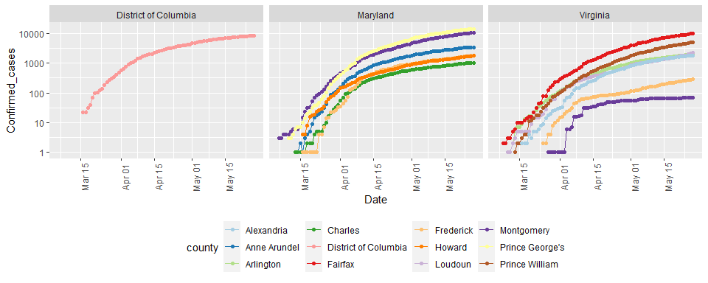

Slide 12
Compute cases & deaths in DMV
DMV_totals <- dmv_data %>% group_by(Date) %>% summarize(total_cases = sum(Confirmed_cases), total_deaths = sum(Deaths)) paste0("total deaths = ", as.character(max(DMV_totals$total_deaths)) )
## [1] "total deaths = 2600"
paste0("total cases = ", as.character(max(DMV_totals$total_cases) ))
## [1] "total cases = 62570"
# Latest data from: paste0("latest data from: ", as.character( max(DMV_totals$Date) ))
## [1] "latest data from: 2020-05-27"

Slide 13
Visualize DMV cases and deaths
DMV_totals %>% filter(total_cases > 0) %>% ggplot(aes(x = Date, y = total_cases)) + geom_line() + geom_point() + labs(title = "Confirmed Cases of COVID19 in DMV", x = NULL, y = NULL)

Slide 14
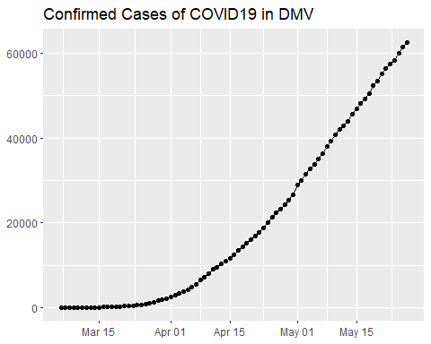

Slide 15
DMV_totals %>% filter(total_deaths > 0) %>% ggplot(aes(x = Date, y = total_deaths)) + geom_line(color = "red") + geom_point() + labs(title = "Deaths due to COVID19 in DMV", x = NULL, y = NULL)

Slide 16
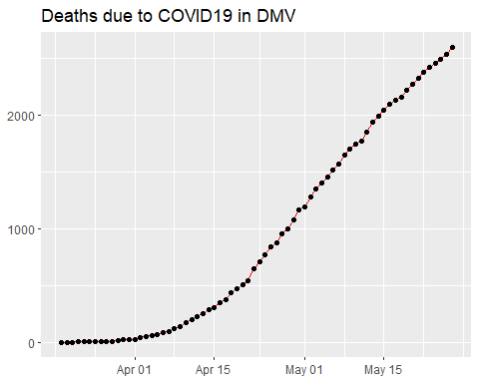

Slide 17
both on one graph
DMV_totals %>% filter(total_cases > 0) %>% ggplot(aes(x = Date, y = total_cases)) + geom_line(aes(color = "cases")) + geom_point(aes(color = "cases")) + geom_line(aes(y = total_deaths, color = "deaths"), data = DMV_totals %>% filter(total_deaths > 0)) + geom_point(aes(y = total_deaths, color = "deaths"), data = DMV_totals %>% filter(total_deaths > 0)) + scale_y_log10() + labs(title = "COVID19 in DMV", x = NULL, y = NULL)

Slide 18
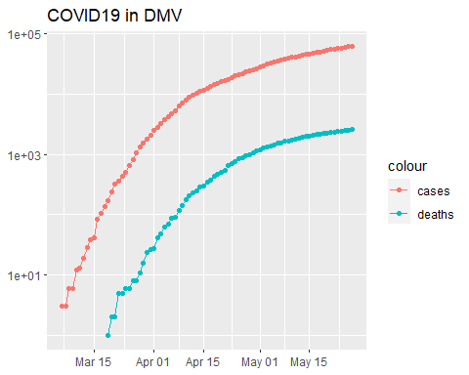

Slide 19
New cases
DMV_totals <- DMV_totals %>% mutate(new_cases = total_cases - lag(total_cases), roll_mean = rollmean(new_cases, 7, na.pad = TRUE, align = "right")) DMV_totals %>% filter(new_cases > 0) %>% ggplot(aes(x = Date, y = new_cases)) + geom_line(color = "red") + geom_point() + geom_line(aes(y = roll_mean),color = "blue", size = 2) + labs(title = "New COVID19 cases in DMV", x = NULL, y = NULL)

Slide 20
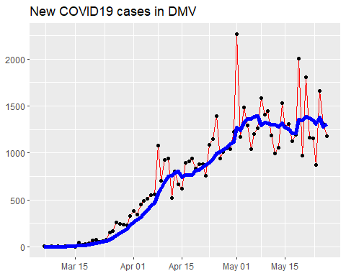

Slide 21
Top ten counties death rate
temp <- US %>% mutate(Deaths_per_100K = 100000 * Deaths / Population) %>% select(Admin2, Province_State, Date, Deaths, Deaths_per_100K, Confirmed_cases, Population) temp_top <- temp %>% group_by(Admin2, Province_State) %>% summarize(Deaths_per_100K = max(Deaths_per_100K), Deaths = max(Deaths), Population = max(Population)) %>% ungroup() %>% arrange(desc(Deaths_per_100K)) %>% slice(1:10) knitr::kable(temp_top)

Slide 22
Admin2 | Province_State | Deaths_per_100K | Deaths | Population
Randolph | Georgia | 309.8259 | 21 | 6778
Terrell | Georgia | 304.7708 | 26 | 8531
Early | Georgia | 294.4063 | 30 | 10190
Hancock | Georgia | 260.1395 | 22 | 8457
New York | New York | 256.2369 | 21362 | 8336817
Essex | New Jersey | 203.2604 | 1624 | 798975
Rockland | New York | 192.1489 | 626 | 325789
Union | New Jersey | 187.2952 | 1042 | 556341
St. John the Baptist | Louisiana | 182.0856 | 78 | 42837
Passaic | New Jersey | 179.1458 | 899 | 501826

Slide 23
NC counties
NC <- temp %>% group_by(Admin2, Province_State) %>% summarize(Deaths_per_100K = max(Deaths_per_100K), Deaths = max(Deaths), Population = max(Population)) %>% ungroup() %>% filter(Province_State == "North Carolina") %>% slice_max(order_by = Population, n = 15) knitr::kable(NC)

Slide 24
Admin2 | Province_State | Deaths_per_100K | Deaths | Population
Wake | North Carolina | 3.238106 | 36 | 1111761
Mecklenburg | North Carolina | 7.204896 | 80 | 1110356
Guilford | North Carolina | 10.052609 | 54 | 537174
Forsyth | North Carolina | 2.354203 | 9 | 382295
Cumberland | North Carolina | 5.364983 | 18 | 335509
Durham | North Carolina | 14.308466 | 46 | 321488
Buncombe | North Carolina | 7.657232 | 20 | 261191
Union | North Carolina | 7.087497 | 17 | 239859
New Hanover | North Carolina | 1.705953 | 4 | 234473
Gaston | North Carolina | 3.117637 | 7 | 224529
Cabarrus | North Carolina | 10.163869 | 22 | 216453
Johnston | North Carolina | 9.553881 | 20 | 209339
Onslow | North Carolina | 1.010417 | 2 | 197938
Iredell | North Carolina | 3.300221 | 6 | 181806
Pitt | North Carolina | 1.106550 | 2 | 180742

Slide 25
State analysis

Slide 26
Compute state totals
US_by_state <- US %>% group_by(Province_State, Country_Region, Date) %>% # add up counties and population summarize(Confirmed_cases = sum(Confirmed_cases), Deaths = sum(Deaths), Lat = median(Lat), Long = median(Long), Population = sum(Population)) %>% select(Province_State, Country_Region, Date, Confirmed_cases, Deaths, Population, Lat, Long) %>% ungroup()

Slide 27
State data now
US_by_state %>% head(n = 3) %>% select(Province_State, Date, Confirmed_cases, Deaths, Population, Country_Region)
## # A tibble: 3 x 6 ## Province_State Date Confirmed_cases Deaths Population Country_Region ## <chr> <date> <dbl> <dbl> <dbl> <chr> ## 1 Alabama 2020-01-22 0 0 4903185 US ## 2 Alabama 2020-01-23 0 0 4903185 US ## 3 Alabama 2020-01-24 0 0 4903185 US

Slide 28
Order deaths and cases by state
US_state_totals <- US_by_state %>% group_by(Province_State) %>% summarize(cases = max(Confirmed_cases), deaths = max(Deaths), population = max(Population)) %>% filter(cases > 0) %>% mutate(deaths_per_mill = 1000000 * deaths / population) %>% arrange(desc(cases))

Slide 29
View list by states
knitr::kable(US_state_totals %>% slice(1:10))

Slide 30
Province_State | cases | deaths | population | deaths_per_mill
New York | 364965 | 29484 | 26161672 | 1126.99219
New Jersey | 156628 | 11339 | 8882190 | 1276.59958
Illinois | 114306 | 5083 | 12671821 | 401.12625
California | 101050 | 3894 | 39512223 | 98.55178
Massachusetts | 94220 | 6547 | 6892503 | 949.87264
Pennsylvania | 73557 | 5265 | 12801989 | 411.26422
Texas | 58542 | 1581 | 28995881 | 54.52499
Michigan | 55608 | 5334 | 9986857 | 534.10197
Florida | 52634 | 2319 | 21477737 | 107.97227
Maryland | 48423 | 2392 | 6045680 | 395.65442

Slide 31
Totals for US
# total deaths paste0("total US deaths = ", as.character(sum(US_state_totals$deaths)) )
## [1] "total US deaths = 100421"
# total cases paste0("total US cases = ", as.character(sum(US_state_totals$cases)) )
## [1] "total US cases = 1699212"
# Latest data from: paste0("latest data from: ", as.character(max(US_by_state$Date)) )
## [1] "latest data from: 2020-05-27"

Slide 32
Visualizing the state data

Slide 33
library(usmap) US_data <- US_state_totals %>% mutate(state = Province_State) %>% filter(!is.na(deaths_per_mill))

Slide 34
Plot states
plot_usmap(data = US_data, values = "deaths_per_mill", color = "black") + scale_fill_gradient(name = "Deaths per million", low = "yellow", high = "red") + theme(legend.position = "right")

Slide 35
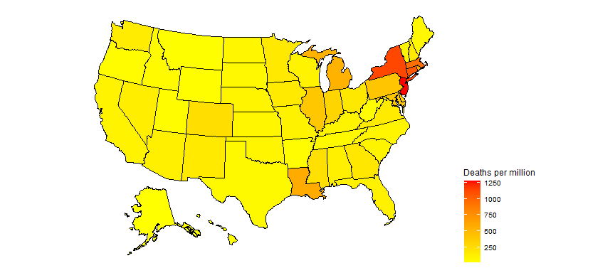

Slide 36
partition deaths per million into 10 equal ranges.
US_data <- US_data %>% filter(population > 0) %>% mutate(death_group = cut(deaths_per_mill, breaks = seq(min(deaths_per_mill), max(deaths_per_mill), length.out = 10), include.lowest = TRUE, right = FALSE, ordered_result = TRUE) )

Slide 37
Plot 10 levels
plot_usmap(data = US_data, values = "death_group", color = "black") + scale_fill_discrete(name = "Deaths_per_million") + theme(legend.position = "right")

Slide 38
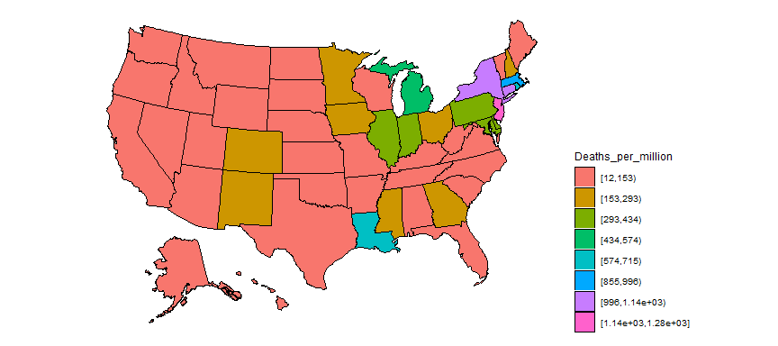

Slide 39
Global analysis

Slide 40
Tidy global data
global_confirmed <- read_csv(urls[1]) %>% pivot_longer(cols = -c(`Province/State`, `Country/Region`, Lat, Long), names_to = "Date", values_to = "Confirmed_cases") global_deaths <- read_csv(urls[2]) %>% pivot_longer(cols = -c(`Province/State`, `Country/Region`, Lat, Long), names_to = "Date", values_to = "Deaths") global <- global_confirmed %>% full_join(global_deaths, by = c("Province/State", "Country/Region", "Date")) %>% rename(Long = Long.x, Lat = Lat.x) %>% select(-c(Lat.y, Long.y)) %>% rename(Country_Region = `Country/Region`, Province_State = `Province/State`) %>% mutate(Date = mdy(Date))

Slide 41
Join population data to the dataset
uid_lookup_url <- "https://raw.githubusercontent.com/CSSEGISandData/COVID-19/master/csse_covid_19_data/UID_ISO_FIPS_LookUp_Table.csv" uid <- read_csv(uid_lookup_url) %>% select(-c(Lat, Long_, Combined_Key, code3, iso2, iso3, Admin2)) global <- global %>% left_join(uid, by = c("Province_State", "Country_Region")) %>% select(-c(UID, FIPS)) %>% select(Province_State, Country_Region, Date, Confirmed_cases, Deaths, Population, Lat, Long)

Slide 42
Add states to global
#Replace the US observations in the global dataset with the US data exp_global <- global %>% # remove the US total data from the dataset filter(Country_Region != "US") %>% # add on the totals by state bind_rows(US_by_state) %>% filter(!is.na(Deaths))

Slide 43
Add continents
library(countrycode) temp <- countrycode(exp_global$Country_Region, origin = "country.name", destination = "continent") Confirmed <- exp_global %>% mutate(continent = temp) %>% mutate(continent = case_when( Country_Region == "Cruise Ship"~"Cruiseship", Country_Region == "Diamond Princess"~"Cruiseship", Country_Region == "MS Zaandam"~"Cruiseship", Country_Region == "Kosovo" ~ "Europe", TRUE ~ continent)) %>% # create a Country_State combining Province_State & Country_Region unite(Country_State, c(Country_Region, Province_State), na.rm = TRUE, remove = FALSE)

Slide 44
Compute Deaths per million population
Confirmed <- Confirmed %>% mutate(Deaths_per_mill = 1000000 * Deaths / Population) %>% select(Country_State, Date, Confirmed_cases, Deaths, Deaths_per_mill, continent, Population, Lat, Long, everything()) %>% filter(Confirmed_cases > 0) # leave off rows w/o cases

Slide 45
Country/State’s w/ most cases
Confirmed_totals <- Confirmed %>% group_by(Country_State, Province_State, Country_Region, continent) %>% summarize(Confirmed_cases = max(Confirmed_cases), Deaths = max(Deaths), Deaths_per_mill = max(Deaths_per_mill), Date_first_case = min(Date), Population = max(Population)) %>% ungroup() %>% select(Country_State, Date_first_case, Deaths_per_mill, Deaths, Confirmed_cases, Population, everything())

Slide 46
Worldwide totals to date
## [1] "total worldwide deaths = 357273"
## [1] "total worldwide cases = 5692083"
## [1] "total worldwide deaths per million to date = 46.305485620758"
## [1] "latest data from: 2020-05-27"

Slide 47
Top 25
Top_25 <- Confirmed_totals %>% arrange(desc(Confirmed_cases)) %>% slice(1:25) %>% # Top_25 %>% select(Country_State, continent, Confirmed_cases, Deaths,Deaths_per_mill) knitr::kable(Top_25 %>% slice(1:8))

Slide 48
Country_State | continent | Confirmed_cases | Deaths | Deaths_per_mill
Brazil | Americas | 411821 | 25598 | 120.42751
Russia | Europe | 370680 | 3968 | 27.19029
US_New York | Americas | 364965 | 29484 | 1126.99219
United Kingdom | Europe | 267240 | 37460 | 551.80741
Spain | Europe | 236259 | 28752 | 614.95313
Italy | Europe | 231139 | 33072 | 546.98975
Germany | Europe | 181524 | 8428 | 100.59206
France | Europe | 180166 | 28546 | 437.32900

Slide 49
Get data for top 25
# grab top 25 country / states for graphing Top_25_states <- Top_25$Country_State Top_25_data <- Confirmed %>% filter(Country_State %in% Top_25_states) %>% select(Country_State, continent, Date, Confirmed_cases, Deaths, Deaths_per_mill)

Slide 50
Graph top 25
Top_25_data %>% filter(Confirmed_cases > 0) %>% ggplot(aes(x = Date, y = Confirmed_cases, group = Country_State, color = Country_State)) + geom_line() + facet_wrap(~continent, scales = "free") + scale_y_log10() + labs(title = "Confirmed Cases - top 25", x = NULL, y = NULL) + guides(color = guide_legend(ncol = 6)) + theme(legend.position="bottom",axis.text.x = element_text(angle = 90))

Slide 51
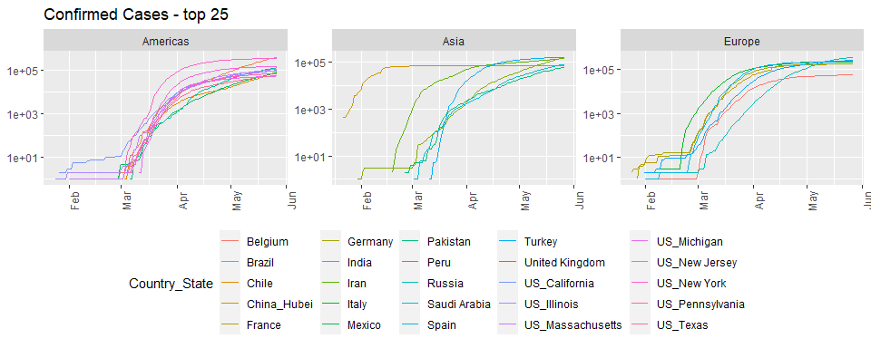

Slide 52
Top_25_data %>% filter(Deaths > 0) %>% ggplot(aes(x = Date, y = Deaths, group = Country_State, color = Country_State)) + geom_line() + facet_wrap(~continent, scales = "free") + scale_y_log10() + labs(title = "Deaths - top 25", x = NULL, y = NULL) + guides(color = guide_legend(ncol = 6)) + theme(legend.position="bottom",axis.text.x = element_text(angle = 90))

Slide 53
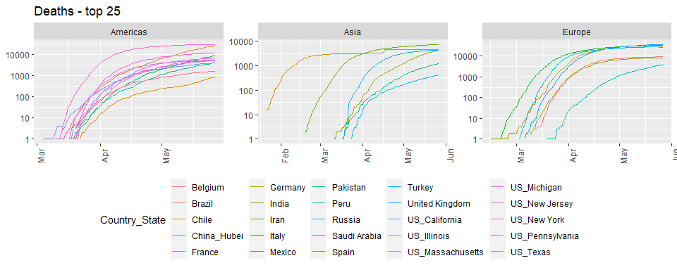

Slide 54
Top_25_data %>% filter(Deaths > 0) %>% ggplot(aes(x = Date, y = Deaths_per_mill, group = Country_State, color = Country_State)) + geom_line() + labs(title = "Deaths per million population", x = NULL, y = NULL) + facet_wrap(~continent, scales = "free") + scale_y_log10() + guides(color = guide_legend(ncol = 6)) + theme(legend.position="bottom",axis.text.x = element_text(angle = 90))

Slide 55
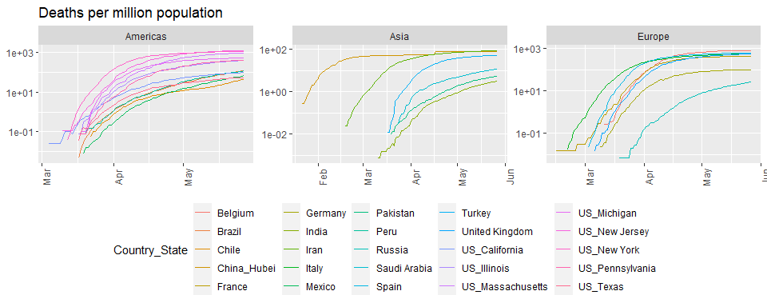

Slide 56
Scandinavia analysis

Slide 57
# look at cases in Scandinavia since Sweden has not shut down their economy like other countries have. What impact has this had on death rates? Scandinavia <- Confirmed %>% filter(Country_State %in% c("Sweden", "Denmark", "Finland")) %>% select(Country_State, Date, Confirmed_cases, Deaths, Deaths_per_mill, everything()) %>% mutate(Country_State = factor(Country_State)) Scandinavia %>% filter(Deaths > 0) %>% ggplot(aes(x = Date, y = Deaths, color = Country_State)) + geom_point() + geom_line() + labs(title = "Deaths", x = NULL, y = NULL) + scale_y_log10()

Slide 58
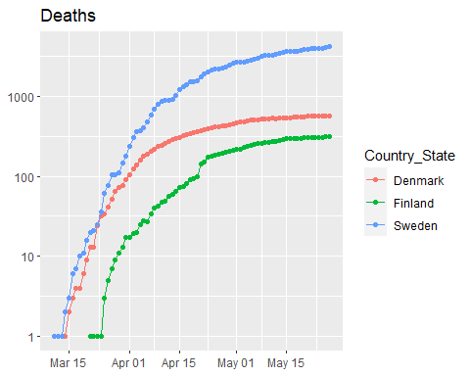

Slide 59
Scandinavia %>% filter(Deaths > 0) %>% ggplot(aes(x = Date, y = Deaths_per_mill, color = Country_State)) + geom_point() + geom_line() + labs(title = "Deaths per million", x = NULL, y = NULL) + scale_y_log10()

Slide 60
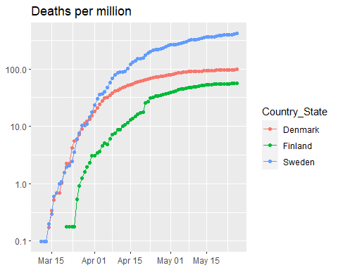

Slide 61
Scand_summ <- Scandinavia %>% group_by(Country_State) %>% summarize(Max_Deaths_per_million = max(Deaths_per_mill), Total_cases = max(Confirmed_cases), Total_deaths = max(Deaths), Population = max(Population)) knitr::kable(Scand_summ)

Slide 62
Country_State | Max_Deaths_per_million | Total_cases | Total_deaths | Population
Denmark | 97.54492 | 11480 | 565 | 5792203
Finland | 56.49087 | 6692 | 313 | 5540718
Sweden | 417.85198 | 35088 | 4220 | 10099270

