Slide 1
Tidyverse for COVID19 Data Analysis
J. Wall

Slide 2
Get and clean worldwide Data

Slide 3
Data from Johns Hopkins github
url_in <- "https://raw.githubusercontent.com/CSSEGISandData/COVID-19/master/csse_covid_19_data/csse_covid_19_time_series/" file_names <- c("time_series_covid19_confirmed_global.csv", "time_series_covid19_deaths_global.csv", "time_series_covid19_confirmed_US.csv", "time_series_covid19_deaths_US.csv") urls <- str_c(url_in,file_names)

Slide 4
Check urls
urls
## [1] "https://raw.githubusercontent.com/CSSEGISandData/COVID-19/master/csse_covid_19_data/csse_covid_19_time_series/time_series_covid19_confirmed_global.csv" ## [2] "https://raw.githubusercontent.com/CSSEGISandData/COVID-19/master/csse_covid_19_data/csse_covid_19_time_series/time_series_covid19_deaths_global.csv" ## [3] "https://raw.githubusercontent.com/CSSEGISandData/COVID-19/master/csse_covid_19_data/csse_covid_19_time_series/time_series_covid19_confirmed_US.csv" ## [4] "https://raw.githubusercontent.com/CSSEGISandData/COVID-19/master/csse_covid_19_data/csse_covid_19_time_series/time_series_covid19_deaths_US.csv"

Slide 5
Tidy global data
global_confirmed <- read_csv(urls[1]) %>% pivot_longer(cols = -c(`Province/State`, `Country/Region`, Lat, Long), names_to = "Date", values_to = "Confirmed_cases") global_deaths <- read_csv(urls[2]) %>% pivot_longer(cols = -c(`Province/State`, `Country/Region`, Lat, Long), names_to = "Date", values_to = "Deaths") global <- global_confirmed %>% full_join(global_deaths) %>% rename(Country_Region = `Country/Region`, Province_State = `Province/State`) %>% mutate(Date = mdy(Date))

Slide 6
fix problems
knitr::kable(summary(global))

Slide 7
 | Province_State | Country_Region | Lat | Long | Date | Confirmed_cases | Deaths
 | Length:25872 | Length:25872 | Min. :-51.796 | Min. :-135.00 | Min. :2020-01-22 | Min. : 0 | Min. : 0.0
 | Class :character | Class :character | 1st Qu.: 6.969 | 1st Qu.: -20.03 | 1st Qu.:2020-02-15 | 1st Qu.: 0 | 1st Qu.: 0.0
 | Mode :character | Mode :character | Median : 23.488 | Median : 20.54 | Median :2020-03-10 | Median : 7 | Median : 0.0
 | NA | NA | Mean : 21.317 | Mean : 22.17 | Mean :2020-03-10 | Mean : 2601 | Mean : 162.8
 | NA | NA | 3rd Qu.: 41.166 | 3rd Qu.: 78.75 | 3rd Qu.:2020-04-04 | 3rd Qu.: 197 | 3rd Qu.: 2.0
 | NA | NA | Max. : 71.707 | Max. : 178.06 | Max. :2020-04-28 | Max. :1012582 | Max. :58355.0

Slide 8
# we find there are entries of -1 for Diamond Princess global <- global %>% filter(Confirmed_cases >= 0, Deaths >= 0)

Slide 9
Join population data to the dataset
uid_lookup_url <- "https://raw.githubusercontent.com/CSSEGISandData/COVID-19/master/csse_covid_19_data/UID_ISO_FIPS_LookUp_Table.csv" uid <- read_csv(uid_lookup_url) %>% select(-c(Lat, Long_, Combined_Key, code3, iso2, iso3, Admin2)) global <- global %>% left_join(uid, by = c("Province_State", "Country_Region")) %>% select(-c(UID, FIPS)) %>% select(Province_State, Country_Region, Date, Confirmed_cases, Deaths, Population, Lat, Long)

Slide 10
Get and tidy US data
US_confirmed <- read_csv(urls[3]) %>% pivot_longer(cols = -(UID:Combined_Key), names_to = "Date", values_to = "Confirmed_cases") %>% select(Admin2:Confirmed_cases) %>% mutate(Date = mdy(Date)) US_deaths <- read_csv(urls[4]) %>% pivot_longer(cols = -(UID:Population), names_to = "Date", values_to ="Deaths") %>% select(Admin2:Deaths) %>% mutate(Date = mdy(Date))

Slide 11
Join deaths and cases
US <- US_deaths %>% full_join(US_confirmed, by = c("Combined_Key", "Date", "Admin2", "Province_State", "Country_Region")) %>% rename(Long = Long_.x, Lat = Lat.x) %>% select(Admin2, Province_State, Country_Region, Lat, Long, Population, Date, Confirmed_cases, Deaths)

Slide 12
US data so far
US %>% filter(Province_State == "New York") %>% select(Admin2, Province_State, Confirmed_cases, Deaths) %>% head(n = 4)
## # A tibble: 4 x 4 ## Admin2 Province_State Confirmed_cases Deaths ## <chr> <chr> <dbl> <dbl> ## 1 Albany New York 0 0 ## 2 Albany New York 0 0 ## 3 Albany New York 0 0 ## 4 Albany New York 0 0
#Note that what we now have is county level data within each state. It would be nice to have data totaled for each state.

Slide 13
DMV data

Slide 14
get DMV data
dmv_data <- US %>% mutate(state = factor(Province_State), county = factor(Admin2)) %>% filter(state %in% c("Maryland", "Virginia", "District of Columbia")) %>% filter(county %in% c("Anne Arundel", "Montgomery", "Howard", "Frederick", "Prince George's", "Charles", "District of Columbia", "Alexandria", "Arlington", "Fairfax", "Loudoun", "Prince William")) %>% select(-c(Admin2, Province_State, Country_Region)) %>% mutate(Deaths_per_mill = 1000000 * Deaths / Population) %>% select(state, county, Date, Confirmed_cases, Deaths, Deaths_per_mill, Population, Lat, Long)

Slide 15
Plot DMV cases by county
dmv_data %>% filter(Confirmed_cases > 0) %>% ggplot(aes(x = Date, y = Confirmed_cases, group = county, col = county)) + geom_line() + geom_point() + facet_wrap(~ state) + scale_y_log10() + scale_color_brewer(palette = "Paired") + guides(color = guide_legend(ncol = 4)) + theme(legend.position="bottom", axis.text.x = element_text(angle = 90))

Slide 16
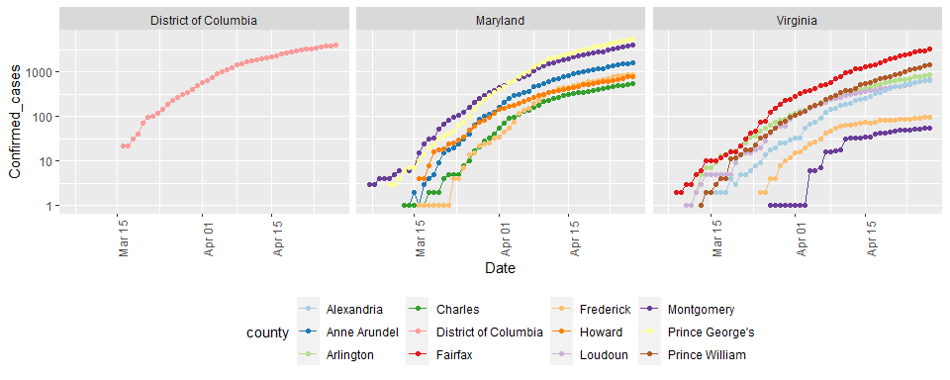

Slide 17
Compute cases & deaths in DMV
DMV_totals <- dmv_data %>% group_by(Date) %>% summarize(total_cases = sum(Confirmed_cases), total_deaths = sum(Deaths)) paste0("total deaths = ", as.character(max(DMV_totals$total_deaths)) )
## [1] "total deaths = 1000"
paste0("total cases = ", as.character(max(DMV_totals$total_cases) ))
## [1] "total cases = 24359"
# Latest data from: paste0("latest data from: ", as.character( max(DMV_totals$Date) ))
## [1] "latest data from: 2020-04-28"

Slide 18
Visualize DMV cases and deaths
DMV_totals %>% filter(total_cases > 0) %>% ggplot(aes(x = Date, y = total_cases)) + geom_line() + geom_point() + labs(title = "Confirmed Cases of COVID19 in DMV", x = NULL, y = NULL)

Slide 19
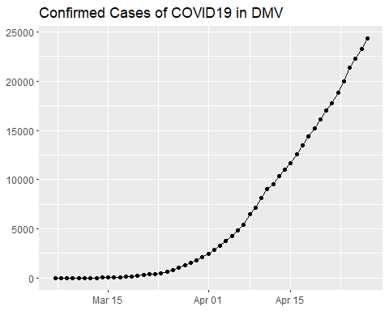

Slide 20
DMV_totals %>% filter(total_deaths > 0) %>% ggplot(aes(x = Date, y = total_deaths)) + geom_line(color = "red") + geom_point() + labs(title = "Deaths due to COVID19 in DMV", x = NULL, y = NULL)

Slide 21
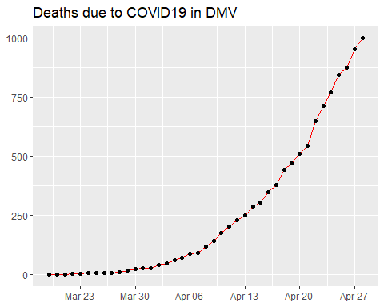

Slide 22
both on one graph
DMV_totals %>% filter(total_cases > 0) %>% ggplot(aes(x = Date, y = total_cases)) + geom_line(aes(color = "cases")) + geom_point(aes(color = "cases")) + geom_line(aes(y = total_deaths, color = "deaths"), data = DMV_totals %>% filter(total_deaths > 0)) + geom_point(aes(y = total_deaths, color = "deaths"), data = DMV_totals %>% filter(total_deaths > 0)) + scale_y_log10() + labs(title = "COVID19 in DMV", x = NULL, y = NULL)

Slide 23
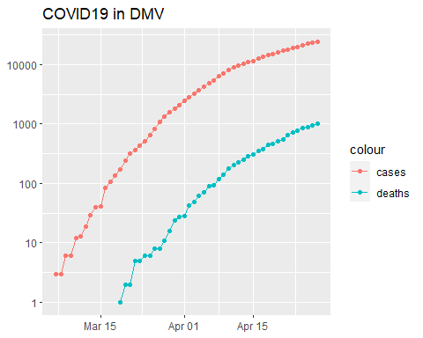

Slide 24
New cases
DMV_totals <- DMV_totals %>% mutate(new_cases = total_cases - lag(total_cases)) DMV_totals %>% filter(new_cases > 0) %>% ggplot(aes(x = Date, y = new_cases)) + geom_line(color = "red") + geom_point() + labs(title = "New COVID19 cases in DMV", x = NULL, y = NULL)

Slide 25
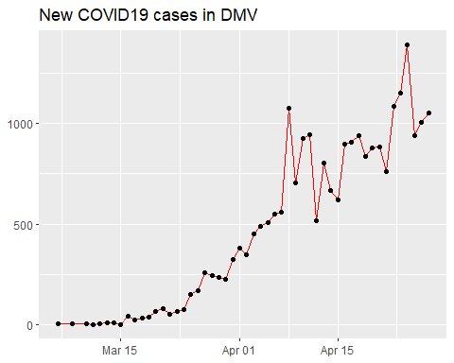

Slide 26
Top ten counties death rate
temp <- US %>% mutate(Deaths_per_100K = 100000 * Deaths / Population) %>% select(Admin2, Province_State, Date, Deaths, Deaths_per_100K, Confirmed_cases, Population) temp %>% group_by(Admin2, Province_State) %>% summarize(Deaths_per_100K = max(Deaths_per_100K), Deaths = max(Deaths), Population = max(Population)) %>% ungroup() %>% arrange(desc(Deaths_per_100K)) %>% slice(1:10)
## # A tibble: 10 x 5 ## Admin2 Province_State Deaths_per_100K Deaths Population ## <chr> <chr> <dbl> <dbl> <dbl> ## 1 New York New York 305. 17682 5803210 ## 2 Randolph Georgia 280. 19 6778 ## 3 Terrell Georgia 211. 18 8531 ## 4 St. John the Baptist Louisiana 154. 66 42837 ## 5 Rockland New York 148. 481 325789 ## 6 Early Georgia 147. 15 10190 ## 7 Essex New Jersey 136. 1090 798975 ## 8 Dougherty Georgia 134. 118 87956 ## 9 Mitchell Georgia 133. 29 21863 ## 10 Toole Montana 127. 6 4736

Slide 27
State analysis

Slide 28
Compute state totals
US_by_state <- US %>% group_by(Province_State, Country_Region, Date) %>% # add up counties and population summarize(Confirmed_cases = sum(Confirmed_cases), Deaths = sum(Deaths), Lat = median(Lat), Long = median(Long), Population = sum(Population)) %>% select(Province_State, Country_Region, Date, Confirmed_cases, Deaths, Population, Lat, Long) %>% ungroup()

Slide 29
State data now
US_by_state %>% head(n = 3) %>% select(Province_State, Date, Confirmed_cases, Deaths, Population, Country_Region)
## # A tibble: 3 x 6 ## Province_State Date Confirmed_cases Deaths Population Country_Region ## <chr> <date> <dbl> <dbl> <dbl> <chr> ## 1 Alabama 2020-01-22 0 0 4903185 US ## 2 Alabama 2020-01-23 0 0 4903185 US ## 3 Alabama 2020-01-24 0 0 4903185 US

Slide 30
Order deaths and cases by state
US_state_totals <- US_by_state %>% group_by(Province_State) %>% summarize(cases = max(Confirmed_cases), deaths = max(Deaths), population = max(Population)) %>% filter(cases > 0) %>% mutate(deaths_per_mill = 1000000 * deaths / population) %>% arrange(desc(cases))

Slide 31
View list by states
knitr::kable(US_state_totals %>% slice(1:10))

Slide 32
Province_State | cases | deaths | population | deaths_per_mill
New York | 295106 | 22912 | 23628065 | 969.69430
New Jersey | 113856 | 6442 | 8882190 | 725.27158
Massachusetts | 58302 | 3153 | 6892503 | 457.45355
Illinois | 48102 | 2125 | 12671821 | 167.69492
California | 46164 | 1864 | 39512223 | 47.17528
Pennsylvania | 45137 | 2046 | 12801989 | 159.81892
Michigan | 39262 | 3568 | 9986857 | 357.26956
Florida | 32848 | 1171 | 21477737 | 54.52157
Louisiana | 27286 | 1801 | 4648794 | 387.41231
Texas | 26357 | 719 | 28995881 | 24.79663

Slide 33
Totals for US
# total deaths paste0("total US deaths = ", as.character(sum(US_state_totals$deaths)) )
## [1] "total US deaths = 58368"
# total cases paste0("total US cases = ", as.character(sum(US_state_totals$cases)) )
## [1] "total US cases = 1012598"
# Latest data from: paste0("latest data from: ", as.character(max(US_by_state$Date)) )
## [1] "latest data from: 2020-04-28"

Slide 34
Visualizing the state data

Slide 35
library(usmap) US_data <- US_state_totals %>% mutate(state = Province_State) %>% filter(!is.na(deaths_per_mill))

Slide 36
Plot states
plot_usmap(data = US_data, values = "deaths_per_mill", color = "black") + scale_fill_gradient(name = "Deaths per million", low = "yellow", high = "red") + theme(legend.position = "right")

Slide 37
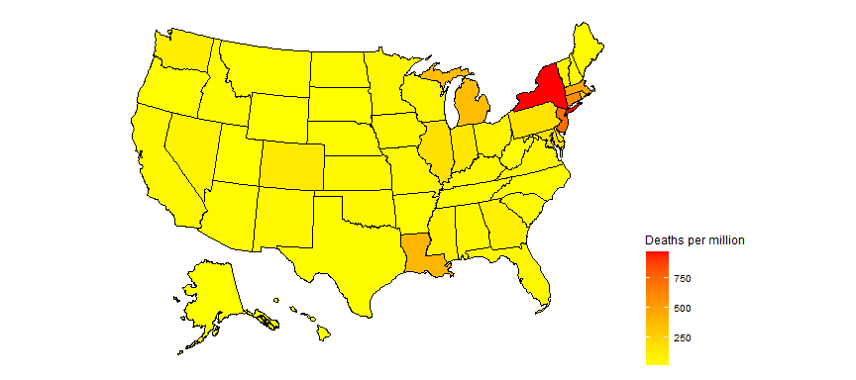

Slide 38
partition deaths per million into 10 equal ranges.
US_data <- US_data %>% filter(population > 0) %>% mutate(death_group = cut(deaths_per_mill, breaks = seq(min(deaths_per_mill), max(deaths_per_mill), length.out = 10), include.lowest = TRUE, right = FALSE, ordered_result = TRUE) )

Slide 39
Plot 10 levels
plot_usmap(data = US_data, values = "death_group", color = "black") + scale_fill_discrete(name = "Deaths_per_million") + theme(legend.position = "right")

Slide 40
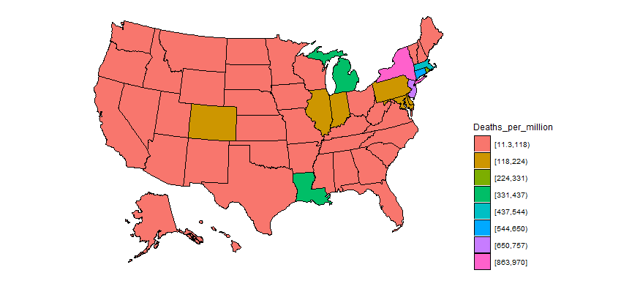

Slide 41
Add states to global
#Replace the US observations in the global dataset with the US data exp_global <- global %>% # remove the US total data from the dataset filter(Country_Region != "US") %>% # add on the totals by state bind_rows(US_by_state)

Slide 42
Add continents
library(countrycode) temp <- countrycode(exp_global$Country_Region, origin = "country.name", destination = "continent") Confirmed <- exp_global %>% mutate(continent = temp) %>% mutate(continent = case_when( Country_Region == "Cruise Ship"~"Cruiseship", Country_Region == "Diamond Princess"~"Cruiseship", Country_Region == "MS Zaandam"~"Cruiseship", Country_Region == "Kosovo" ~ "Europe", TRUE ~ continent)) %>% # create a Country_State combining Province_State & Country_Region unite(Country_State, c(Country_Region, Province_State), na.rm = TRUE, remove = FALSE) Confirmed %>% filter(is.na(continent))
## # A tibble: 0 x 10 ## # ... with 10 variables: Country_State <chr>, Province_State <chr>, ## # Country_Region <chr>, Date <date>, Confirmed_cases <dbl>, Deaths <dbl>, ## # Population <dbl>, Lat <dbl>, Long <dbl>, continent <chr>

Slide 43
Compute Deaths per million population
Confirmed <- Confirmed %>% mutate(Deaths_per_mill = 1000000 * Deaths / Population) %>% select(Country_State, Date, Confirmed_cases, Deaths, Deaths_per_mill, continent, Population, Lat, Long, everything()) %>% filter(Confirmed_cases > 0) # leave off rows w/o cases

Slide 44
Country/State’s w/ most cases
Confirmed_totals <- Confirmed %>% group_by(Country_State, Province_State, Country_Region, continent) %>% summarize(Confirmed_cases = max(Confirmed_cases), Deaths = max(Deaths), Deaths_per_mill = max(Deaths_per_mill), Date_first_case = min(Date), Population = max(Population)) %>% ungroup() %>% select(Country_State, Date_first_case, Deaths_per_mill, Deaths, Confirmed_cases, Population, everything())

Slide 45
Worldwide totals to date
# total deaths paste0("total worldwide deaths = ", as.character(sum(Confirmed_totals$Deaths)) )
## [1] "total worldwide deaths = 217168"
# total cases paste0("total worldwide cases = ", as.character(sum(Confirmed_totals$Confirmed_cases)) )
## [1] "total worldwide cases = 3117077"
# average deaths per million to date df <- Confirmed_totals %>% summarize(death_rate = 1000000 * sum(Deaths, na.rm = TRUE) / sum(Population, na.rm = TRUE)) paste0("total worldwide deaths per million to date = ", as.character(sum(df$death_rate)) )
## [1] "total worldwide deaths per million to date = 28.1678995555872"
# Latest data from: paste0("latest data from: ", as.character(max(US_by_state$Date)) )
## [1] "latest data from: 2020-04-28"

Slide 46
Top 25 and top 100
Top_25 <- Confirmed_totals %>% arrange(desc(Confirmed_cases)) %>% slice(1:25) %>% # Top_25 %>% select(Country_State, continent, Confirmed_cases, Deaths,Deaths_per_mill) knitr::kable(Top_25 %>% slice(1:8))

Slide 47
Country_State | continent | Confirmed_cases | Deaths | Deaths_per_mill
US_New York | Americas | 295106 | 22912 | 969.69430
Spain | Europe | 232128 | 23822 | 509.50937
Italy | Europe | 201505 | 27359 | 452.50038
France | Europe | 167605 | 23660 | 362.47475
United Kingdom | Europe | 161145 | 21678 | 319.32945
Germany | Europe | 159912 | 6314 | 75.36050
Turkey | Asia | 114653 | 2992 | 35.47585
US_New Jersey | Americas | 113856 | 6442 | 725.27158

Slide 48
Top_100 <- Confirmed_totals %>% arrange(desc(Confirmed_cases)) %>% slice(1:100)

Slide 49
Get data for top 25
# grab top 25 country / states for graphing Top_25_states <- Top_25$Country_State Top_25_data <- Confirmed %>% filter(Country_State %in% Top_25_states) %>% select(Country_State, continent, Date, Confirmed_cases, Deaths, Deaths_per_mill)

Slide 50
Graph top 25
Top_25_data %>% filter(Confirmed_cases > 0) %>% ggplot(aes(x = Date, y = Confirmed_cases, group = Country_State, color = Country_State)) + geom_line() + facet_wrap(~continent, scales = "free") + scale_y_log10() + labs(title = "Confirmed Cases - top 25", x = NULL, y = NULL) + guides(color = guide_legend(ncol = 6)) + theme(legend.position="bottom",axis.text.x = element_text(angle = 90))

Slide 51
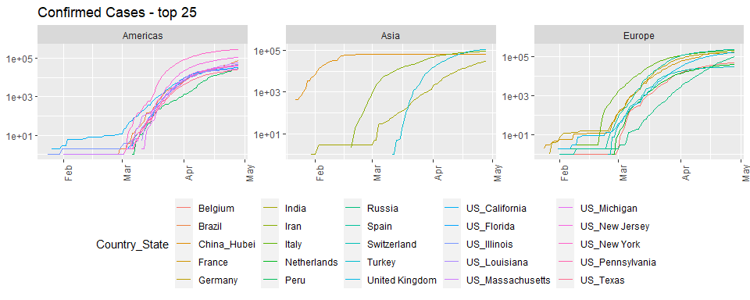

Slide 52
Top_25_data %>% filter(Deaths > 0) %>% ggplot(aes(x = Date, y = Deaths, group = Country_State, color = Country_State)) + geom_line() + facet_wrap(~continent, scales = "free") + scale_y_log10() + labs(title = "Deaths - top 25", x = NULL, y = NULL) + guides(color = guide_legend(ncol = 6)) + theme(legend.position="bottom",axis.text.x = element_text(angle = 90))

Slide 53
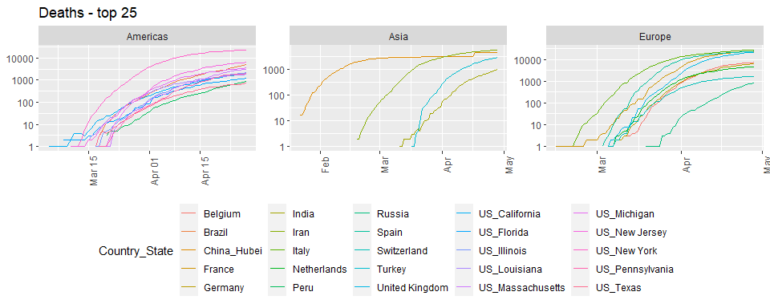

Slide 54
Top_25_data %>% filter(Deaths > 0) %>% ggplot(aes(x = Date, y = Deaths_per_mill, group = Country_State, color = Country_State)) + geom_line() + labs(title = "Deaths per million population", x = NULL, y = NULL) + facet_wrap(~continent, scales = "free") + scale_y_log10() + guides(color = guide_legend(ncol = 6)) + theme(legend.position="bottom",axis.text.x = element_text(angle = 90))

Slide 55
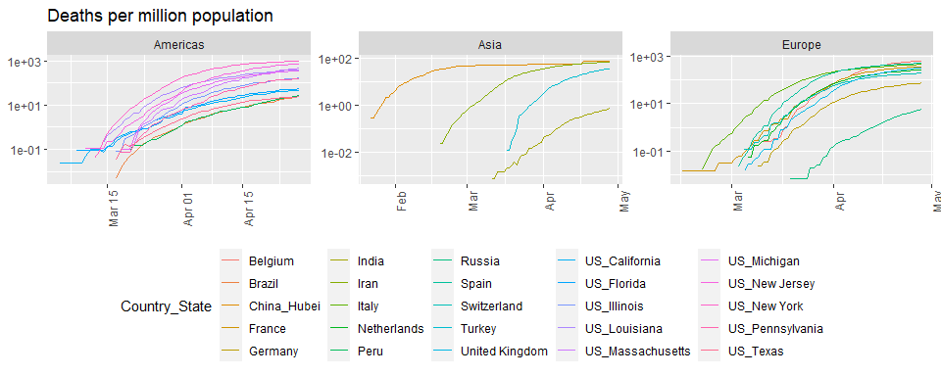

Slide 56
Scandinavia analysis

Slide 57
# look at cases in Scandinavia since Sweden has not shut down their economy like other countries have. What impact has this had on death rates? Scandinavia <- Confirmed %>% filter(Country_State %in% c("Sweden", "Denmark", "Finland")) %>% select(Country_State, Date, Confirmed_cases, Deaths, Deaths_per_mill, everything()) %>% mutate(Country_State = factor(Country_State)) Scandinavia %>% filter(Deaths > 0) %>% ggplot(aes(x = Date, y = Deaths, color = Country_State)) + geom_point() + geom_line() + labs(title = "Deaths", x = NULL, y = NULL) + scale_y_log10()

Slide 58
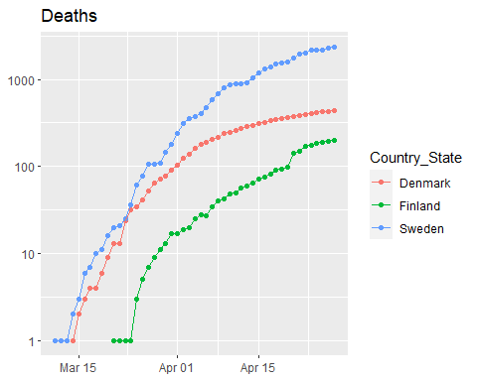

Slide 59
Scandinavia %>% filter(Deaths > 0) %>% ggplot(aes(x = Date, y = Deaths_per_mill, color = Country_State)) + geom_point() + geom_line() + labs(title = "Deaths per million", x = NULL, y = NULL) + scale_y_log10()

Slide 60
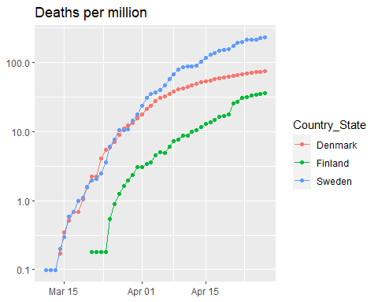

Slide 61
Scand_summ <- Scandinavia %>% group_by(Country_State) %>% summarize(Max_Deaths_per_million = max(Deaths_per_mill), Total_cases = max(Confirmed_cases), Total_deaths = max(Deaths), Population = max(Population)) knitr::kable(Scand_summ)

Slide 62
Country_State | Max_Deaths_per_million | Total_cases | Total_deaths | Population
Denmark | 74.92831 | 8851 | 434 | 5792203
Finland | 35.91592 | 4740 | 199 | 5540718
Sweden | 233.18517 | 19621 | 2355 | 10099270

Slide 63
Modeling

Slide 64
Hubei province of China and the Diamond Princess cruise ship.
Slowed_cases <- Confirmed %>% filter(Country_State %in% c("China_Hubei", "Diamond Princess")) Slowed_cases %>% ggplot(aes(x = Date, y = Confirmed_cases)) + geom_point() + facet_wrap(~ Country_State, scales = "free")

Slide 65
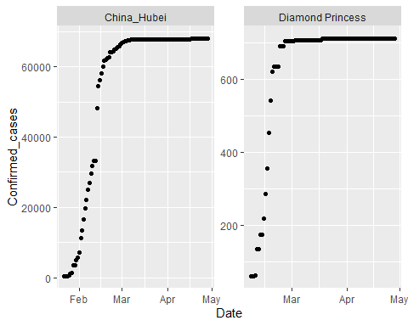

Slide 66
Fitting a sigmoid function.
# thanks to http://kyrcha.info/2012/07/08/tutorials-fitting-a-sigmoid-function-in-r # function needed for visualization purposes sigmoid = function(x, params) { params[1] / (1 + exp(-params[2] * (x - params[3]))) } x = 1:53 y = c(0,0,0,0,0,0,0,0,0,0,0,0,0,0.1,0.18,0.18,0.18,0.33,0.33,0.33,0.33,0.41,0.41,0.41,0.41,0.41,0.41,0.5,0.5,0.5,0.5,0.68,0.58,0.58,0.68,0.83,0.83,0.83,0.74,0.74,0.74,0.83,0.83,0.9,0.9,0.9,1,1,1,1,1,1,1) df <- tibble(x = x, y = y) # fitting code fitmodel <- nls(y ~ a /(1 + exp(-b * (x - c))), data = df, start = list(a = 1, b = 0.5, c = 25))

Slide 67
Plot model and data for sigmoid example
# visualization code # get the coefficients using the coef function params=coef(fitmodel) df$y2 <- sigmoid(x, params) df %>% ggplot(aes(x, y2)) + geom_line() + geom_point(y = y)

Slide 68
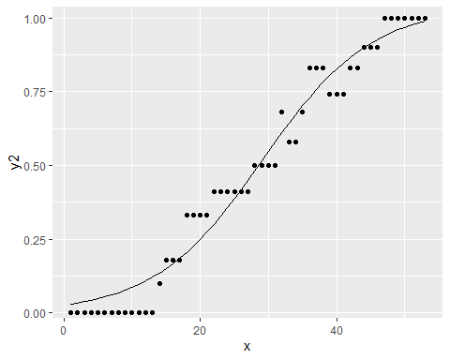

Slide 69
More generalized sigmoid function
$$y(t)=\frac{K}{{\left(1+Q*e^{\left(−B*\left(t−t0\right)\right)}\right)}^{\frac{1}{v}}}$$
Goal: use that form for Hubei and fit a sigmoid function to that data.

Slide 70
Start simply
$$y(t)=\frac{K}{\left(1+e^{\left(−B*\left(t−t0\right)\right)}\right)}$$

Slide 71
Get, visualize, model Hubei data
library(broom) Hubei_cases <- Confirmed %>% filter(Country_State == "China_Hubei") %>% mutate(date_int = unclass(Date)) Hubei_cases %>% ggplot(aes(x = Date, y = Confirmed_cases)) + geom_point()

Slide 72
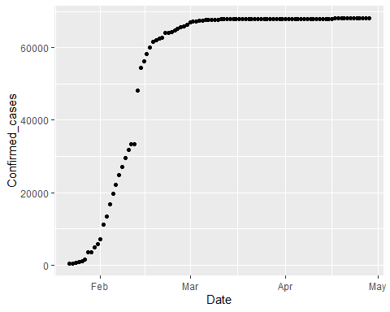

Slide 73
# first with simplified sigmoid function sigmoid <- function(x, params) { params[1] / (1 + exp(-params[2] * (x - params[3]))) } mod1 <- nls(Confirmed_cases ~ K /(1 + exp(-B * (date_int - t0))), data = Hubei_cases, start = list(K = 60000, B = 0.5, t0 = 18300)) params <- coef(mod1)

Slide 74
Plot Hubei model and data
Hubei_cases <- Hubei_cases %>% mutate(pred = sigmoid(date_int, params) ) %>% select(Confirmed_cases, pred, Date, date_int, everything()) Hubei_cases %>% ggplot(aes(Date, pred)) + geom_line() + geom_point(aes(y = Confirmed_cases))

Slide 75
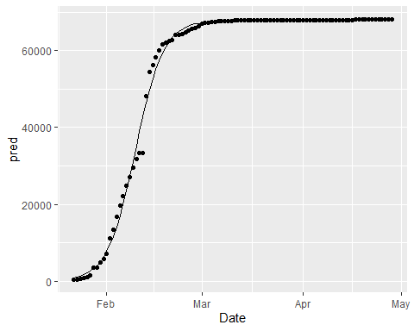

Slide 76
Model summary
summary(mod1)
## ## Formula: Confirmed_cases ~ K/(1 + exp(-B * (date_int - t0))) ## ## Parameters: ## Estimate Std. Error t value Pr(>|t|) ## K 6.783e+04 1.992e+02 340.60 <2e-16 *** ## B 2.340e-01 5.937e-03 39.42 <2e-16 *** ## t0 1.830e+04 1.240e-01 147637.95 <2e-16 *** ## --- ## Signif. codes: 0 '***' 0.001 '**' 0.01 '*' 0.05 '.' 0.1 ' ' 1 ## ## Residual standard error: 1582 on 95 degrees of freedom ## ## Number of iterations to convergence: 6 ## Achieved convergence tolerance: 6.606e-07
glance(mod1)
## # A tibble: 1 x 8 ## sigma isConv finTol logLik AIC BIC deviance df.residual ## <dbl> <lgl> <dbl> <dbl> <dbl> <dbl> <dbl> <int> ## 1 1582. TRUE 0.000000661 -859. 1727. 1737. 237802098. 95

Slide 77
One more step
$$y(t)=\frac{K}{{\left(1+e^{\left(−B*\left(t−t0\right)\right)}\right)}^{\frac{1}{v}}}$$

Slide 78
More complex model on Hubei
sigmoid_gen <- function(x, params) { params[1] / ( (1 + exp(-params[2] * (x - params[3]))) ) ^ (1 / params[4]) } startK <- max(Hubei_cases$Confirmed_cases) mod2 <- nls(Confirmed_cases ~ K /( (1 + exp(-B * (date_int - t0))) ) ^(1/v) , data = Hubei_cases, start = list(K = startK, B = .25, t0 = 18300, v = 1) )

Slide 79
Visualize both Hubei models
# get the coefficients using the coef function params <- coef(mod2) Hubei_cases <- Hubei_cases %>% mutate(pred2 = sigmoid_gen(date_int, params) ) %>% select(Confirmed_cases, pred2, pred, Date, date_int, everything()) Hubei_cases %>% ggplot(aes(x = Date)) + geom_line(aes(y = pred2), color = "red") + geom_line(aes(y = pred), color = "black") + geom_point(aes(y = Confirmed_cases))

Slide 80
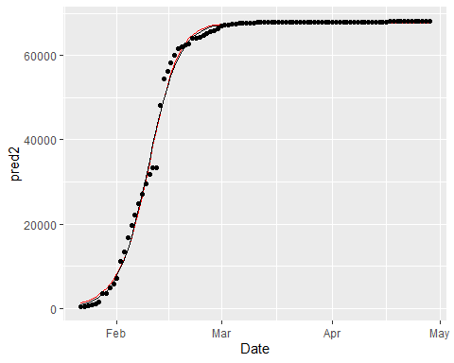

Slide 81
# use broom::glance to look at model results summary(mod2)
## ## Formula: Confirmed_cases ~ K/((1 + exp(-B * (date_int - t0))))^(1/v) ## ## Parameters: ## Estimate Std. Error t value Pr(>|t|) ## K 6.772e+04 2.006e+02 337.641 < 2e-16 *** ## B 2.676e-01 1.896e-02 14.112 < 2e-16 *** ## t0 1.830e+04 8.435e-01 21699.685 < 2e-16 *** ## v 1.379e+00 2.075e-01 6.645 1.96e-09 *** ## --- ## Signif. codes: 0 '***' 0.001 '**' 0.01 '*' 0.05 '.' 0.1 ' ' 1 ## ## Residual standard error: 1566 on 94 degrees of freedom ## ## Number of iterations to convergence: 11 ## Achieved convergence tolerance: 4.094e-06
glance(mod2)
## # A tibble: 1 x 8 ## sigma isConv finTol logLik AIC BIC deviance df.residual ## <dbl> <lgl> <dbl> <dbl> <dbl> <dbl> <dbl> <int> ## 1 1566. TRUE 0.00000409 -858. 1726. 1739. 230526602. 94

Slide 82
Our plan of attack
use a map function and nested grouped data to develop models out of this more complicated model family for the Diamond Princess and most of the China provinces
Add the model to the nested data
Use broom::tidy() to add the coefficients of the models to the dataset
Use pivot_wider to make these coefficients into columns.

Slide 83
Nest China and Princess data
by_country <- Confirmed %>% filter(Country_State != "China_Beijing", Country_State != "China_Shanxi", Country_State != "China_Tibet") %>% filter(Country_Region == "China" | Country_State == "Diamond Princess") %>% #filter(Confirmed_cases > 200) %>% mutate(date_int = unclass(Date)) %>% group_by(Country_State, Province_State, Country_Region, continent, Lat, Long) %>% nest() # by_country$data[[1]] by_country
## # A tibble: 31 x 7 ## # Groups: Country_State, continent, Lat, Long, Province_State, Country_Region ## # [31] ## Country_State continent Lat Long Province_State Country_Region data ## <chr> <chr> <dbl> <dbl> <chr> <chr> <list> ## 1 China_Anhui Asia 31.8 117. Anhui China <tibble ~ ## 2 China_Chongqing Asia 30.1 108. Chongqing China <tibble ~ ## 3 China_Fujian Asia 26.1 118. Fujian China <tibble ~ ## 4 China_Gansu Asia 37.8 101. Gansu China <tibble ~ ## 5 China_Guangdong Asia 23.3 113. Guangdong China <tibble ~ ## 6 China_Guangxi Asia 23.8 109. Guangxi China <tibble ~ ## 7 China_Guizhou Asia 26.8 107. Guizhou China <tibble ~ ## 8 China_Hainan Asia 19.2 110. Hainan China <tibble ~ ## 9 China_Hebei Asia 39.5 116. Hebei China <tibble ~ ## 10 China_Heilongj~ Asia 47.9 128. Heilongjiang China <tibble ~ ## # ... with 21 more rows

Slide 84
Add models to nested data
country_mod2 <- function(df){ startK <- max(df$Confirmed_cases) nls(Confirmed_cases ~ K /( (1 + exp(-B * (date_int - t0))) ) ^(1/v) , data = df, start = list(K = startK, B = .25, t0 = 18300, v = 1), control = list(maxiter = 1000, warnOnly = TRUE)) } by_country <- by_country %>% mutate(model = map(data, country_mod2), tm = map(model, broom::tidy)) %>% unnest(tm) %>% select(Country_State, Lat, Long, term, estimate, `std.error`, statistic, p.value, everything())

Slide 85
Look at results
by_country
## # A tibble: 124 x 13 ## # Groups: Country_State, Lat, Long, continent, Province_State, Country_Region ## # [31] ## Country_State Lat Long term estimate std.error statistic p.value ## <chr> <dbl> <dbl> <chr> <dbl> <dbl> <dbl> <dbl> ## 1 China_Anhui 31.8 117. K 9.92e+2 0.797 1243. 5.73e-200 ## 2 China_Anhui 31.8 117. B 2.74e-1 0.00542 50.5 6.96e- 70 ## 3 China_Anhui 31.8 117. t0 1.83e+4 0.318 57548. 0. ## 4 China_Anhui 31.8 117. v 9.04e-1 0.0528 17.1 1.17e- 30 ## 5 China_Chongq~ 30.1 108. K 5.79e+2 0.655 883. 5.33e-186 ## 6 China_Chongq~ 30.1 108. B 1.81e-1 0.00404 44.8 3.52e- 65 ## 7 China_Chongq~ 30.1 108. t0 1.83e+4 1.89 9687. 8.92e-284 ## 8 China_Chongq~ 30.1 108. v 1.87e-1 0.0518 3.60 5.02e- 4 ## 9 China_Fujian 26.1 118. K 3.39e+2 4.41 77.0 1.02e- 86 ## 10 China_Fujian 26.1 118. B 1.16e-1 0.0215 5.37 5.56e- 7 ## # ... with 114 more rows, and 5 more variables: continent <chr>, ## # Province_State <chr>, Country_Region <chr>, data <list>, model <list>

Slide 86
Make data per province
province_data <- by_country %>% ungroup() %>% select(Province_State, Lat, Long, term, estimate, data) %>% pivot_wider(names_from = term, values_from = estimate) %>% mutate(t0_date = as_date(t0)) province_data %>% arrange(t0_date) %>% print(n = Inf)
## # A tibble: 31 x 9 ## Province_State Lat Long data K B t0 v t0_date ## <chr> <dbl> <dbl> <list> <dbl> <dbl> <dbl> <dbl> <date> ## 1 Liaoning 41.3 123. <tibble~ 1.48e2 -0.0682 18116. -6.23 2019-08-07 ## 2 Shanghai 31.2 121. <tibble~ 6.82e2 0.0347 18230. 0.0397 2019-11-30 ## 3 Gansu 37.8 101. <tibble~ 1.38e2 0.0943 18251. 0.00660 2019-12-20 ## 4 Sichuan 30.6 103. <tibble~ 5.52e2 0.128 18259. 0.0108 2019-12-28 ## 5 Qinghai 35.7 96.0 <tibble~ 1.80e1 0.126 18261. 0.0252 2019-12-31 ## 6 Yunnan 25.0 101. <tibble~ 1.80e2 0.116 18264. 0.0364 2020-01-02 ## 7 Shaanxi 35.2 109. <tibble~ 2.56e2 0.132 18264. 0.0186 2020-01-03 ## 8 Hong Kong 22.3 114. <tibble~ 5.73e2 -0.589 18266. -5.67 2020-01-04 ## 9 Tianjin 39.3 117. <tibble~ 1.75e2 0.0984 18267. 0.0270 2020-01-05 ## 10 Zhejiang 29.2 120. <tibble~ 1.26e3 0.139 18268. 0.0243 2020-01-06 ## 11 Fujian 26.1 118. <tibble~ 3.39e2 0.116 18268. 0.0425 2020-01-07 ## 12 Guangdong 23.3 113. <tibble~ 1.52e3 0.121 18269. 0.0308 2020-01-07 ## 13 Macau 22.2 114. <tibble~ 2.95e1 -0.491 18273. -4.06 2020-01-11 ## 14 Jilin 43.7 126. <tibble~ 1.02e2 0.162 18273. 0.0163 2020-01-11 ## 15 Shandong 36.3 118. <tibble~ 7.83e2 0.109 18273. 0.0803 2020-01-12 ## 16 Chongqing 30.1 108. <tibble~ 5.79e2 0.181 18283. 0.187 2020-01-21 ## 17 Inner Mongolia 44.1 114. <tibble~ 1.73e2 0.115 18286. -0.00682 2020-01-25 ## 18 Guangxi 23.8 109. <tibble~ 2.54e2 0.183 18290. 0.470 2020-01-28 ## 19 Ningxia 37.3 106. <tibble~ 7.50e1 0.165 18290. 0.394 2020-01-29 ## 20 Hunan 27.6 112. <tibble~ 1.02e3 0.236 18291. 0.464 2020-01-29 ## 21 Jiangsu 33.0 119. <tibble~ 6.43e2 0.205 18291. 0.432 2020-01-30 ## 22 Henan 33.9 114. <tibble~ 1.28e3 0.237 18292. 0.526 2020-01-31 ## 23 Jiangxi 27.6 116. <tibble~ 9.38e2 0.261 18294. 0.646 2020-02-01 ## 24 Heilongjiang 47.9 128. <tibble~ 7.71e2 0.133 18294. -0.00316 2020-02-02 ## 25 Hebei 39.5 116. <tibble~ 3.23e2 0.193 18294. 0.607 2020-02-02 ## 26 Anhui 31.8 117. <tibble~ 9.92e2 0.274 18296. 0.904 2020-02-03 ## 27 Hainan 19.2 110. <tibble~ 1.68e2 0.296 18299. 1.74 2020-02-06 ## 28 Guizhou 26.8 107. <tibble~ 1.46e2 0.375 18300. 1.66 2020-02-08 ## 29 Xinjiang 41.1 85.2 <tibble~ 7.62e1 0.324 18303. 2.15 2020-02-10 ## 30 Hubei 31.0 112. <tibble~ 6.77e4 0.268 18304. 1.38 2020-02-11 ## 31 <NA> 0 0 <tibble~ 7.09e2 0.628 18310. 2.68 2020-02-18

Slide 87
Join with province totals
pd <- province_data %>% left_join(Confirmed_totals) %>% filter(!is.na(Province_State)) pd %>% print(n = Inf, width = Inf)
## # A tibble: 30 x 17 ## Province_State Lat Long data K B t0 v ## <chr> <dbl> <dbl> <list> <dbl> <dbl> <dbl> <dbl> ## 1 Anhui 31.8 117. <tibble [98 x 6]> 992. 0.274 18296. 0.904 ## 2 Chongqing 30.1 108. <tibble [98 x 6]> 579. 0.181 18283. 0.187 ## 3 Fujian 26.1 118. <tibble [98 x 6]> 339. 0.116 18268. 0.0425 ## 4 Gansu 37.8 101. <tibble [97 x 6]> 138. 0.0943 18251. 0.00660 ## 5 Guangdong 23.3 113. <tibble [98 x 6]> 1518. 0.121 18269. 0.0308 ## 6 Guangxi 23.8 109. <tibble [98 x 6]> 254. 0.183 18290. 0.470 ## 7 Guizhou 26.8 107. <tibble [98 x 6]> 146. 0.375 18300. 1.66 ## 8 Hainan 19.2 110. <tibble [98 x 6]> 168. 0.296 18299. 1.74 ## 9 Hebei 39.5 116. <tibble [98 x 6]> 323. 0.193 18294. 0.607 ## 10 Heilongjiang 47.9 128. <tibble [97 x 6]> 771. 0.133 18294. -0.00316 ## 11 Henan 33.9 114. <tibble [98 x 6]> 1276. 0.237 18292. 0.526 ## 12 Hong Kong 22.3 114. <tibble [97 x 6]> 573. -0.589 18266. -5.67 ## 13 Hubei 31.0 112. <tibble [98 x 6]> 67723. 0.268 18304. 1.38 ## 14 Hunan 27.6 112. <tibble [98 x 6]> 1020. 0.236 18291. 0.464 ## 15 Inner Mongolia 44.1 114. <tibble [96 x 6]> 173. 0.115 18286. -0.00682 ## 16 Jiangsu 33.0 119. <tibble [98 x 6]> 643. 0.205 18291. 0.432 ## 17 Jiangxi 27.6 116. <tibble [98 x 6]> 938. 0.261 18294. 0.646 ## 18 Jilin 43.7 126. <tibble [97 x 6]> 102. 0.162 18273. 0.0163 ## 19 Liaoning 41.3 123. <tibble [98 x 6]> 148. -0.0682 18116. -6.23 ## 20 Macau 22.2 114. <tibble [98 x 6]> 29.5 -0.491 18273. -4.06 ## 21 Ningxia 37.3 106. <tibble [98 x 6]> 75.0 0.165 18290. 0.394 ## 22 Qinghai 35.7 96.0 <tibble [95 x 6]> 18.0 0.126 18261. 0.0252 ## 23 Shaanxi 35.2 109. <tibble [97 x 6]> 256. 0.132 18264. 0.0186 ## 24 Shandong 36.3 118. <tibble [98 x 6]> 783. 0.109 18273. 0.0803 ## 25 Shanghai 31.2 121. <tibble [98 x 6]> 682. 0.0347 18230. 0.0397 ## 26 Sichuan 30.6 103. <tibble [98 x 6]> 552. 0.128 18259. 0.0108 ## 27 Tianjin 39.3 117. <tibble [98 x 6]> 175. 0.0984 18267. 0.0270 ## 28 Xinjiang 41.1 85.2 <tibble [97 x 6]> 76.2 0.324 18303. 2.15 ## 29 Yunnan 25.0 101. <tibble [98 x 6]> 180. 0.116 18264. 0.0364 ## 30 Zhejiang 29.2 120. <tibble [98 x 6]> 1255. 0.139 18268. 0.0243 ## t0_date Country_State Date_first_case Deaths_per_mill Deaths ## <date> <chr> <date> <dbl> <dbl> ## 1 2020-02-03 China_Anhui 2020-01-22 0.0949 6 ## 2 2020-01-21 China_Chongqing 2020-01-22 0.193 6 ## 3 2020-01-07 China_Fujian 2020-01-22 0.0254 1 ## 4 2019-12-20 China_Gansu 2020-01-23 0.0758 2 ## 5 2020-01-07 China_Guangdong 2020-01-22 0.0705 8 ## 6 2020-01-28 China_Guangxi 2020-01-22 0.0406 2 ## 7 2020-02-08 China_Guizhou 2020-01-22 0.0556 2 ## 8 2020-02-06 China_Hainan 2020-01-22 0.642 6 ## 9 2020-02-02 China_Hebei 2020-01-22 0.0794 6 ## 10 2020-02-02 China_Heilongjiang 2020-01-23 0.345 13 ## 11 2020-01-31 China_Henan 2020-01-22 0.229 22 ## 12 2020-01-04 China_Hong Kong 2020-01-23 0.534 4 ## 13 2020-02-11 China_Hubei 2020-01-22 76.3 4512 ## 14 2020-01-29 China_Hunan 2020-01-22 0.0580 4 ## 15 2020-01-25 China_Inner Mongolia 2020-01-24 0.0395 1 ## 16 2020-01-30 China_Jiangsu 2020-01-22 0 0 ## 17 2020-02-01 China_Jiangxi 2020-01-22 0.0215 1 ## 18 2020-01-11 China_Jilin 2020-01-23 0.0370 1 ## 19 2019-08-07 China_Liaoning 2020-01-22 0.0459 2 ## 20 2020-01-11 China_Macau 2020-01-22 0 0 ## 21 2020-01-29 China_Ningxia 2020-01-22 0 0 ## 22 2019-12-31 China_Qinghai 2020-01-25 0 0 ## 23 2020-01-03 China_Shaanxi 2020-01-23 0.0776 3 ## 24 2020-01-12 China_Shandong 2020-01-22 0.0697 7 ## 25 2019-11-30 China_Shanghai 2020-01-22 0.289 7 ## 26 2019-12-28 China_Sichuan 2020-01-22 0.0360 3 ## 27 2020-01-05 China_Tianjin 2020-01-22 0.192 3 ## 28 2020-02-10 China_Xinjiang 2020-01-23 0.121 3 ## 29 2020-01-02 China_Yunnan 2020-01-22 0.0414 2 ## 30 2020-01-06 China_Zhejiang 2020-01-22 0.0174 1 ## Confirmed_cases Population Country_Region continent ## <dbl> <dbl> <chr> <chr> ## 1 991 63240000 China Asia ## 2 579 31020000 China Asia ## 3 355 39410000 China Asia ## 4 139 26370000 China Asia ## 5 1588 113460000 China Asia ## 6 254 49260000 China Asia ## 7 147 36000000 China Asia ## 8 168 9340000 China Asia ## 9 328 75560000 China Asia ## 10 939 37730000 China Asia ## 11 1276 96050000 China Asia ## 12 1037 7496988 China Asia ## 13 68128 59170000 China Asia ## 14 1019 68990000 China Asia ## 15 199 25340000 China Asia ## 16 653 80510000 China Asia ## 17 937 46480000 China Asia ## 18 110 27040000 China Asia ## 19 146 43590000 China Asia ## 20 45 649342 China Asia ## 21 75 6880000 China Asia ## 22 18 6030000 China Asia ## 23 306 38640000 China Asia ## 24 787 100470000 China Asia ## 25 645 24240000 China Asia ## 26 561 83410000 China Asia ## 27 190 15600000 China Asia ## 28 76 24870000 China Asia ## 29 185 48300000 China Asia ## 30 1268 57370000 China Asia

