Slide 1
Tidyverse for COVID19 Data Analysis
J. Wall

Slide 2
Get and clean worldwide Data

Slide 3
Data from Johns Hopkins github
url_in <- "https://raw.githubusercontent.com/CSSEGISandData/COVID-19/master/csse_covid_19_data/csse_covid_19_time_series/" file_names <- c("time_series_covid19_confirmed_global.csv", "time_series_covid19_deaths_global.csv", "time_series_covid19_confirmed_US.csv", "time_series_covid19_deaths_US.csv") urls <- str_c(url_in,file_names)

Slide 4
Check urls
urls
## [1] "https://raw.githubusercontent.com/CSSEGISandData/COVID-19/master/csse_covid_19_data/csse_covid_19_time_series/time_series_covid19_confirmed_global.csv" ## [2] "https://raw.githubusercontent.com/CSSEGISandData/COVID-19/master/csse_covid_19_data/csse_covid_19_time_series/time_series_covid19_deaths_global.csv" ## [3] "https://raw.githubusercontent.com/CSSEGISandData/COVID-19/master/csse_covid_19_data/csse_covid_19_time_series/time_series_covid19_confirmed_US.csv" ## [4] "https://raw.githubusercontent.com/CSSEGISandData/COVID-19/master/csse_covid_19_data/csse_covid_19_time_series/time_series_covid19_deaths_US.csv"

Slide 5
Tidy global data
global_confirmed <- read_csv(urls[1]) %>% pivot_longer(cols = -c(`Province/State`, `Country/Region`, Lat, Long), names_to = "Date", values_to = "Confirmed_cases") global_deaths <- read_csv(urls[2]) %>% pivot_longer(cols = -c(`Province/State`, `Country/Region`, Lat, Long), names_to = "Date", values_to = "Deaths") global <- global_confirmed %>% full_join(global_deaths) %>% rename(Country_Region = `Country/Region`, Province_State = `Province/State`) %>% mutate(Date = mdy(Date))

Slide 6
fix problems
knitr::kable(summary(global))

Slide 7
 | Province_State | Country_Region | Lat | Long | Date | Confirmed_cases | Deaths
 | Length:24552 | Length:24552 | Min. :-51.796 | Min. :-135.00 | Min. :2020-01-22 | Min. : -1 | Min. : -1.0
 | Class :character | Class :character | 1st Qu.: 6.969 | 1st Qu.: -20.03 | 1st Qu.:2020-02-14 | 1st Qu.: 0 | 1st Qu.: 0.0
 | Mode :character | Mode :character | Median : 23.488 | Median : 20.54 | Median :2020-03-08 | Median : 4 | Median : 0.0
 | NA | NA | Mean : 21.317 | Mean : 22.17 | Mean :2020-03-08 | Mean : 2137 | Mean : 126.9
 | NA | NA | 3rd Qu.: 41.166 | 3rd Qu.: 78.75 | 3rd Qu.:2020-03-31 | 3rd Qu.: 160 | 3rd Qu.: 2.0
 | NA | NA | Max. : 71.707 | Max. : 178.06 | Max. :2020-04-23 | Max. :869170 | Max. :49954.0

Slide 8
# we find there are entries of -1 for Diamond Princess global <- global %>% filter(Confirmed_cases >= 0, Deaths >= 0)

Slide 9
Join population data to the dataset
uid_lookup_url <- "https://raw.githubusercontent.com/CSSEGISandData/COVID-19/master/csse_covid_19_data/UID_ISO_FIPS_LookUp_Table.csv" uid <- read_csv(uid_lookup_url) %>% select(-c(Lat, Long_, Combined_Key, code3, iso2, iso3, Admin2)) global <- global %>% left_join(uid, by = c("Province_State", "Country_Region")) %>% select(-c(UID, FIPS)) %>% select(Province_State, Country_Region, Date, Confirmed_cases, Deaths, Population, Lat, Long)

Slide 10
Get and tidy US data
US_confirmed <- read_csv(urls[3]) %>% pivot_longer(cols = -(UID:Combined_Key), names_to = "Date", values_to = "Confirmed_cases") %>% select(Admin2:Confirmed_cases) %>% mutate(Date = mdy(Date)) US_deaths <- read_csv(urls[4]) %>% pivot_longer(cols = -(UID:Population), names_to = "Date", values_to ="Deaths") %>% select(Admin2:Deaths) %>% mutate(Date = mdy(Date))

Slide 11
Join deaths and cases
US <- US_deaths %>% full_join(US_confirmed, by = c("Combined_Key", "Date", "Admin2", "Province_State", "Country_Region")) %>% rename(Long = Long_.x, Lat = Lat.x) %>% select(Admin2, Province_State, Country_Region, Lat, Long, Population, Date, Confirmed_cases, Deaths)

Slide 12
US data so far
US %>% filter(Province_State == "New York") %>% select(Admin2, Province_State, Confirmed_cases, Deaths) %>% head(n = 4)
## # A tibble: 4 x 4 ## Admin2 Province_State Confirmed_cases Deaths ## <chr> <chr> <dbl> <dbl> ## 1 Albany New York 0 0 ## 2 Albany New York 0 0 ## 3 Albany New York 0 0 ## 4 Albany New York 0 0
#Note that what we now have is county level data within each state. It would be nice to have data totaled for each state.

Slide 13
DMV data

Slide 14
get DMV data
dmv_data <- US %>% mutate(state = factor(Province_State), county = factor(Admin2)) %>% filter(state %in% c("Maryland", "Virginia", "District of Columbia")) %>% filter(county %in% c("Anne Arundel", "Montgomery", "Howard", "Frederick", "Prince George's", "Charles", "District of Columbia", "Alexandria", "Arlington", "Fairfax", "Loudoun", "Prince William")) %>% select(-c(Admin2, Province_State, Country_Region)) %>% mutate(Deaths_per_mill = 1000000 * Deaths / Population) %>% select(state, county, Date, Confirmed_cases, Deaths, Deaths_per_mill, Population, Lat, Long)

Slide 15
Plot DMV cases by county
dmv_data %>% filter(Confirmed_cases > 0) %>% ggplot(aes(x = Date, y = Confirmed_cases, group = county, col = county)) + geom_line() + geom_point() + facet_wrap(~ state) + scale_y_log10() + scale_color_brewer(palette = "Paired") + guides(color = guide_legend(ncol = 4)) + theme(legend.position="bottom", axis.text.x = element_text(angle = 90))

Slide 16
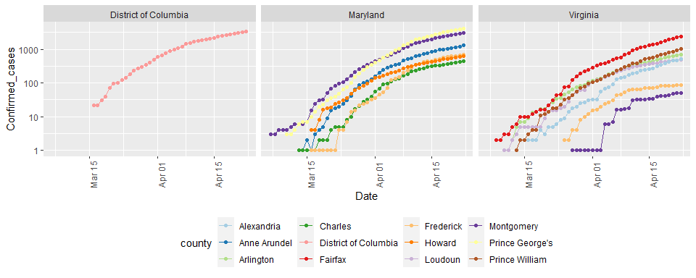

Slide 17
Compute cases & deaths in DMV
DMV_totals <- dmv_data %>% group_by(Date) %>% summarize(total_cases = sum(Confirmed_cases), total_deaths = sum(Deaths)) paste0("total deaths = ", as.character(max(DMV_totals$total_deaths)) )
## [1] "total deaths = 714"
paste0("total cases = ", as.character(max(DMV_totals$total_cases) ))
## [1] "total cases = 18828"
# Latest data from: paste0("latest data from: ", as.character( max(DMV_totals$Date) ))
## [1] "latest data from: 2020-04-23"

Slide 18
Visualize DMV cases and deaths
DMV_totals %>% filter(total_cases > 0) %>% ggplot(aes(x = Date, y = total_cases)) + geom_line() + geom_point() + labs(title = "Confirmed Cases of COVID19 in DMV", x = NULL, y = NULL)

Slide 19
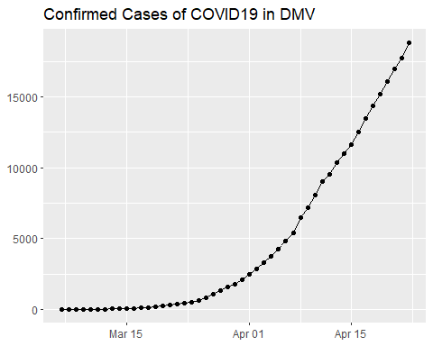

Slide 20
DMV_totals %>% filter(total_deaths > 0) %>% ggplot(aes(x = Date, y = total_deaths)) + geom_line(color = "red") + geom_point() + labs(title = "Deaths due to COVID19 in DMV", x = NULL, y = NULL)

Slide 21
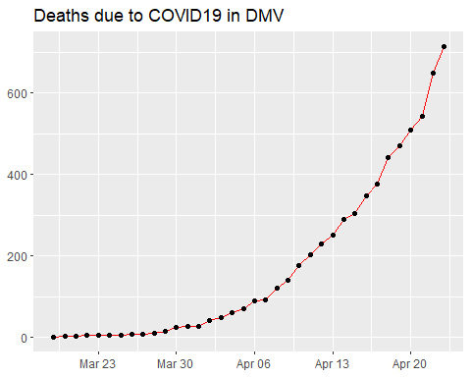

Slide 22
both on one graph
DMV_totals %>% filter(total_cases > 0) %>% ggplot(aes(x = Date, y = total_cases)) + geom_line(aes(color = "cases")) + geom_point(aes(color = "cases")) + geom_line(aes(y = total_deaths, color = "deaths"), data = DMV_totals %>% filter(total_deaths > 0)) + geom_point(aes(y = total_deaths, color = "deaths"), data = DMV_totals %>% filter(total_deaths > 0)) + scale_y_log10() + labs(title = "COVID19 in DMV", x = NULL, y = NULL)

Slide 23
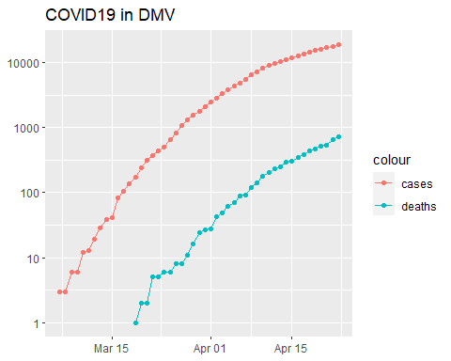

Slide 24
State analysis

Slide 25
Compute state totals
US_by_state <- US %>% group_by(Province_State, Country_Region, Date) %>% # add up counties and population summarize(Confirmed_cases = sum(Confirmed_cases), Deaths = sum(Deaths), Lat = median(Lat), Long = median(Long), Population = sum(Population)) %>% select(Province_State, Country_Region, Date, Confirmed_cases, Deaths, Population, Lat, Long) %>% ungroup()

Slide 26
State data now
US_by_state %>% head(n = 3) %>% select(Province_State, Date, Confirmed_cases, Deaths, Population, Country_Region)
## # A tibble: 3 x 6 ## Province_State Date Confirmed_cases Deaths Population Country_Region ## <chr> <date> <dbl> <dbl> <dbl> <chr> ## 1 Alabama 2020-01-22 0 0 4903185 US ## 2 Alabama 2020-01-23 0 0 4903185 US ## 3 Alabama 2020-01-24 0 0 4903185 US

Slide 27
Order deaths and cases by state
US_state_totals <- US_by_state %>% group_by(Province_State) %>% summarize(cases = max(Confirmed_cases), deaths = max(Deaths), population = max(Population)) %>% filter(cases > 0) %>% mutate(deaths_per_mill = 1000000 * deaths / population) %>% arrange(desc(cases))

Slide 28
View list by states
knitr::kable(US_state_totals %>% slice(1:10))

Slide 29
Province_State | cases | deaths | population | deaths_per_mill
New York | 263460 | 20973 | 23628065 | 887.63087
New Jersey | 100025 | 5426 | 8882190 | 610.88538
Massachusetts | 46023 | 2360 | 6892503 | 342.40101
California | 39561 | 1533 | 39512223 | 38.79812
Pennsylvania | 38379 | 1724 | 12801989 | 134.66657
Illinois | 36937 | 1688 | 12671821 | 133.20895
Michigan | 35296 | 2977 | 9986857 | 298.09178
Florida | 29648 | 987 | 21477737 | 45.95456
Louisiana | 25739 | 1599 | 4648794 | 343.96018
Connecticut | 23100 | 1639 | 3565287 | 459.71054

Slide 30
Totals for US
# total deaths paste0("total US deaths = ", as.character(sum(US_state_totals$deaths)) )
## [1] "total US deaths = 49954"
# total cases paste0("total US cases = ", as.character(sum(US_state_totals$cases)) )
## [1] "total US cases = 869170"
# Latest data from: paste0("latest data from: ", as.character(max(US_by_state$Date)) )
## [1] "latest data from: 2020-04-23"

Slide 31
Visualizing the state data

Slide 32
library(usmap) US_data <- US_state_totals %>% mutate(state = Province_State) %>% filter(!is.na(deaths_per_mill))

Slide 33
Plot states
plot_usmap(data = US_data, values = "deaths_per_mill", color = "black") + scale_fill_gradient(name = "Deaths per million", low = "yellow", high = "red") + theme(legend.position = "right")

Slide 34
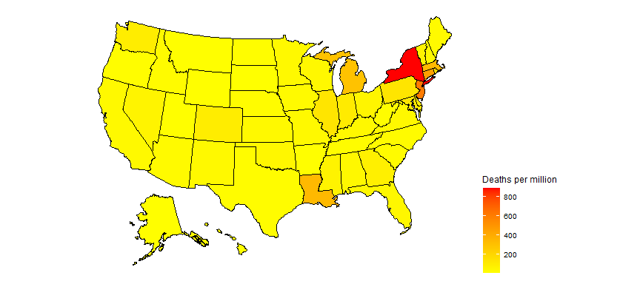

Slide 35
partition deaths per million into 10 equal ranges.
US_data <- US_data %>% filter(population > 0) %>% mutate(death_group = cut(deaths_per_mill, breaks = seq(min(deaths_per_mill), max(deaths_per_mill), length.out = 10), include.lowest = TRUE, right = FALSE, ordered_result = TRUE) )

Slide 36
Plot 10 levels
plot_usmap(data = US_data, values = "death_group", color = "black") + scale_fill_discrete(name = "Deaths_per_million") + theme(legend.position = "right")

Slide 37
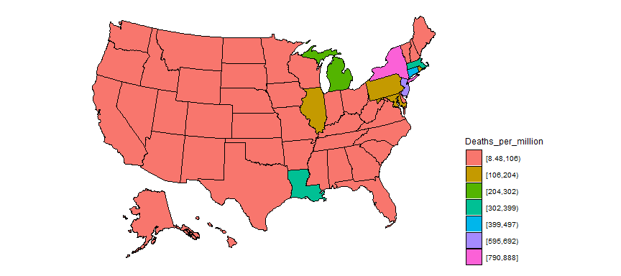

Slide 38
Add states to global
#Replace the US observations in the global dataset with the US data exp_global <- global %>% # remove the US total data from the dataset filter(Country_Region != "US") %>% # add on the totals by state bind_rows(US_by_state)

Slide 39
Add continents
library(countrycode) temp <- countrycode(exp_global$Country_Region, origin = "country.name", destination = "continent") Confirmed <- exp_global %>% mutate(continent = temp) %>% mutate(continent = case_when( Country_Region == "Cruise Ship"~"Cruiseship", Country_Region == "Diamond Princess"~"Cruiseship", Country_Region == "MS Zaandam"~"Cruiseship", Country_Region == "Kosovo" ~ "Europe", TRUE ~ continent)) %>% # create a Country_State combining Province_State & Country_Region unite(Country_State, c(Country_Region, Province_State), na.rm = TRUE, remove = FALSE) Confirmed %>% filter(is.na(continent))
## # A tibble: 0 x 10 ## # ... with 10 variables: Country_State <chr>, Province_State <chr>, ## # Country_Region <chr>, Date <date>, Confirmed_cases <dbl>, Deaths <dbl>, ## # Population <dbl>, Lat <dbl>, Long <dbl>, continent <chr>

Slide 40
Compute Deaths per million population
Confirmed <- Confirmed %>% mutate(Deaths_per_mill = 1000000 * Deaths / Population) %>% select(Country_State, Date, Confirmed_cases, Deaths, Deaths_per_mill, continent, Population, Lat, Long, everything()) %>% filter(Confirmed_cases > 0) # leave off rows w/o cases

Slide 41
Country/State’s w/ most cases
Confirmed_totals <- Confirmed %>% group_by(Country_State, Province_State, Country_Region, continent) %>% summarize(Confirmed_cases = max(Confirmed_cases), Deaths = max(Deaths), Deaths_per_mill = max(Deaths_per_mill), Date_first_case = min(Date), Population = max(Population)) %>% ungroup() %>% select(Country_State, Date_first_case, Deaths_per_mill, Deaths, Confirmed_cases, Population, everything())

Slide 42
Worldwide totals to date
# total deaths paste0("total worldwide deaths = ", as.character(sum(Confirmed_totals$Deaths)) )
## [1] "total worldwide deaths = 190858"
# total cases paste0("total worldwide cases = ", as.character(sum(Confirmed_totals$Confirmed_cases)) )
## [1] "total worldwide cases = 2708900"
# average deaths per million to date df <- Confirmed_totals %>% summarize(death_rate = 1000000 * sum(Deaths, na.rm = TRUE) / sum(Population, na.rm = TRUE)) paste0("total worldwide deaths per million to date = ", as.character(sum(df$death_rate)) )
## [1] "total worldwide deaths per million to date = 24.7553459689285"
# Latest data from: paste0("latest data from: ", as.character(max(US_by_state$Date)) )
## [1] "latest data from: 2020-04-23"

Slide 43
Top 25 and top 100
Top_25 <- Confirmed_totals %>% arrange(desc(Confirmed_cases)) %>% slice(1:25) %>% # Top_25 %>% select(Country_State, continent, Confirmed_cases, Deaths,Deaths_per_mill) knitr::kable(Top_25 %>% slice(1:8))

Slide 44
Country_State | continent | Confirmed_cases | Deaths | Deaths_per_mill
US_New York | Americas | 263460 | 20973 | 887.63087
Spain | Europe | 213024 | 22157 | 473.89804
Italy | Europe | 189973 | 25549 | 422.56413
France | Europe | 158183 | 21856 | 334.83720
Germany | Europe | 153129 | 5575 | 66.54019
United Kingdom | Europe | 138078 | 18738 | 276.02155
Turkey | Asia | 101790 | 2491 | 29.53554
US_New Jersey | Americas | 100025 | 5426 | 610.88538

Slide 45
Top_100 <- Confirmed_totals %>% arrange(desc(Confirmed_cases)) %>% slice(1:100)

Slide 46
Get data for top 25
# grab top 25 country / states for graphing Top_25_states <- Top_25$Country_State Top_25_data <- Confirmed %>% filter(Country_State %in% Top_25_states) %>% select(Country_State, continent, Date, Confirmed_cases, Deaths, Deaths_per_mill)

Slide 47
Graph top 25
Top_25_data %>% filter(Confirmed_cases > 0) %>% ggplot(aes(x = Date, y = Confirmed_cases, group = Country_State, color = Country_State)) + geom_line() + facet_wrap(~continent, scales = "free") + scale_y_log10() + labs(title = "Confirmed Cases - top 25", x = NULL, y = NULL) + guides(color = guide_legend(ncol = 6)) + theme(legend.position="bottom",axis.text.x = element_text(angle = 90))

Slide 48
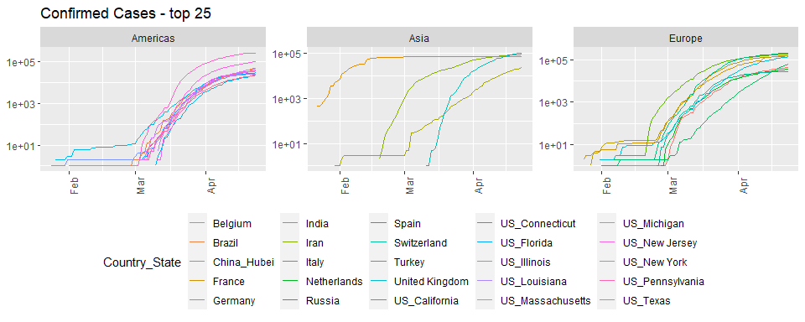

Slide 49
Top_25_data %>% filter(Deaths > 0) %>% ggplot(aes(x = Date, y = Deaths, group = Country_State, color = Country_State)) + geom_line() + facet_wrap(~continent, scales = "free") + scale_y_log10() + labs(title = "Deaths - top 25", x = NULL, y = NULL) + guides(color = guide_legend(ncol = 6)) + theme(legend.position="bottom",axis.text.x = element_text(angle = 90))

Slide 50
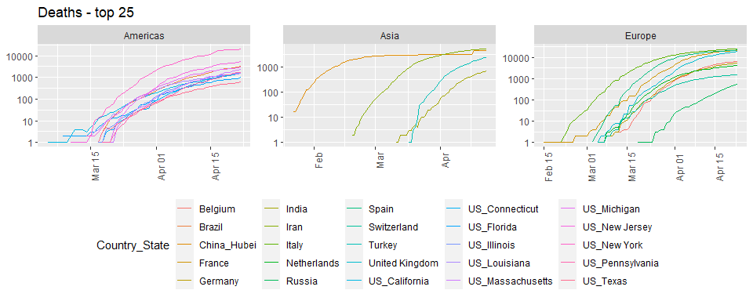

Slide 51
Top_25_data %>% filter(Deaths > 0) %>% ggplot(aes(x = Date, y = Deaths_per_mill, group = Country_State, color = Country_State)) + geom_line() + labs(title = "Deaths per million population", x = NULL, y = NULL) + facet_wrap(~continent, scales = "free") + scale_y_log10() + guides(color = guide_legend(ncol = 6)) + theme(legend.position="bottom",axis.text.x = element_text(angle = 90))

Slide 52
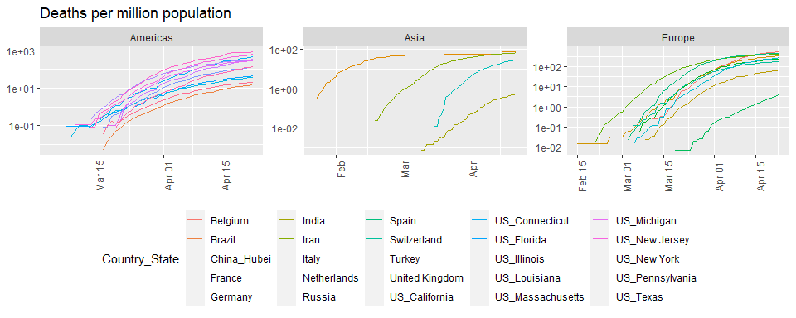

Slide 53
Scandinavia analysis

Slide 54
# look at cases in Scandinavia since Sweden has not shut down their economy like other countries have. What impact has this had on death rates? Scandinavia <- Confirmed %>% filter(Country_State %in% c("Sweden", "Denmark", "Finland")) %>% select(Country_State, Date, Confirmed_cases, Deaths, Deaths_per_mill, everything()) %>% mutate(Country_State = factor(Country_State)) Scandinavia %>% filter(Deaths > 0) %>% ggplot(aes(x = Date, y = Deaths, color = Country_State)) + geom_point() + geom_line() + labs(title = "Deaths", x = NULL, y = NULL) + scale_y_log10()

Slide 55
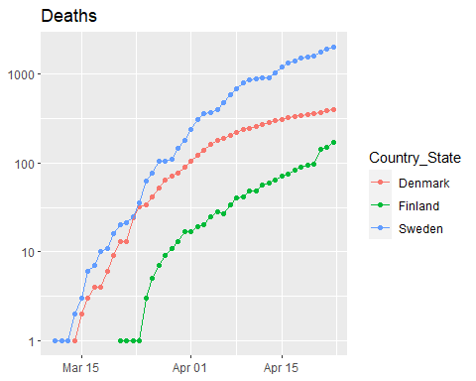

Slide 56
Scandinavia %>% filter(Deaths > 0) %>% ggplot(aes(x = Date, y = Deaths_per_mill, color = Country_State)) + geom_point() + geom_line() + labs(title = "Deaths per million", x = NULL, y = NULL) + scale_y_log10()

Slide 57
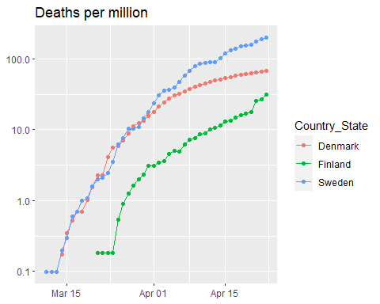

Slide 58
Scand_summ <- Scandinavia %>% group_by(Country_State) %>% summarize(Max_Deaths_per_million = max(Deaths_per_mill), Total_cases = max(Confirmed_cases), Total_deaths = max(Deaths), Population = max(Population)) knitr::kable(Scand_summ)

Slide 59
Country_State | Max_Deaths_per_million | Total_cases | Total_deaths | Population
Denmark | 68.02248 | 8073 | 394 | 5792203
Finland | 31.04291 | 4284 | 172 | 5540718
Sweden | 200.11347 | 16755 | 2021 | 10099270

Slide 60
Modeling

Slide 61
Hubei province of China and the Diamond Princess cruise ship.
Slowed_cases <- Confirmed %>% filter(Country_State %in% c("China_Hubei", "Diamond Princess")) Slowed_cases %>% ggplot(aes(x = Date, y = Confirmed_cases)) + geom_point() + facet_wrap(~ Country_State, scales = "free")

Slide 62
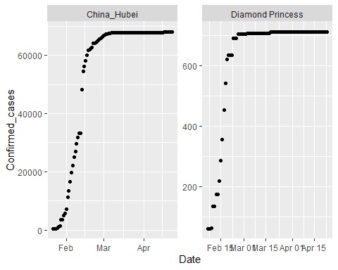

Slide 63
Fitting a sigmoid function.
# thanks to http://kyrcha.info/2012/07/08/tutorials-fitting-a-sigmoid-function-in-r # function needed for visualization purposes sigmoid = function(x, params) { params[1] / (1 + exp(-params[2] * (x - params[3]))) } x = 1:53 y = c(0,0,0,0,0,0,0,0,0,0,0,0,0,0.1,0.18,0.18,0.18,0.33,0.33,0.33,0.33,0.41,0.41,0.41,0.41,0.41,0.41,0.5,0.5,0.5,0.5,0.68,0.58,0.58,0.68,0.83,0.83,0.83,0.74,0.74,0.74,0.83,0.83,0.9,0.9,0.9,1,1,1,1,1,1,1) df <- tibble(x = x, y = y) # fitting code fitmodel <- nls(y ~ a /(1 + exp(-b * (x - c))), data = df, start = list(a = 1, b = 0.5, c = 25))

Slide 64
Plot model and data for sigmoid example
# visualization code # get the coefficients using the coef function params=coef(fitmodel) df$y2 <- sigmoid(x, params) df %>% ggplot(aes(x, y2)) + geom_line() + geom_point(y = y)

Slide 65
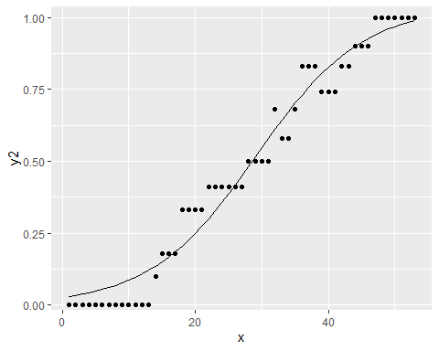

Slide 66
More generalized sigmoid function
$$y(t)=\frac{K}{{\left(1+Q*e^{\left(−B*\left(t−t0\right)\right)}\right)}^{\frac{1}{v}}}$$
Goal: use that form for Hubei and fit a sigmoid function to that data.

Slide 67
Start simply
$$y(t)=\frac{K}{\left(1+e^{\left(−B*\left(t−t0\right)\right)}\right)}$$

Slide 68
Get, visualize, model Hubei data
library(broom) Hubei_cases <- Confirmed %>% filter(Country_State == "China_Hubei") %>% mutate(date_int = unclass(Date)) Hubei_cases %>% ggplot(aes(x = Date, y = Confirmed_cases)) + geom_point()

Slide 69
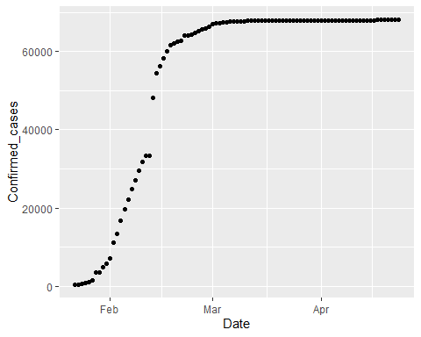

Slide 70
# first with simplified sigmoid function sigmoid <- function(x, params) { params[1] / (1 + exp(-params[2] * (x - params[3]))) } mod1 <- nls(Confirmed_cases ~ K /(1 + exp(-B * (date_int - t0))), data = Hubei_cases, start = list(K = 60000, B = 0.5, t0 = 18300)) params <- coef(mod1)

Slide 71
Plot Hubei model and data
Hubei_cases <- Hubei_cases %>% mutate(pred = sigmoid(date_int, params) ) %>% select(Confirmed_cases, pred, Date, date_int, everything()) Hubei_cases %>% ggplot(aes(Date, pred)) + geom_line() + geom_point(aes(y = Confirmed_cases))

Slide 72
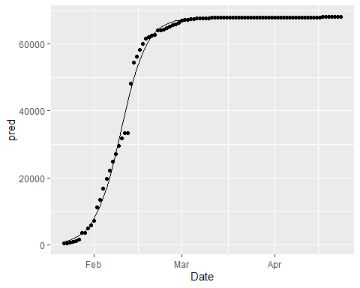

Slide 73
Model summary
summary(mod1)
## ## Formula: Confirmed_cases ~ K/(1 + exp(-B * (date_int - t0))) ## ## Parameters: ## Estimate Std. Error t value Pr(>|t|) ## K 6.781e+04 2.130e+02 318.36 <2e-16 *** ## B 2.342e-01 6.122e-03 38.26 <2e-16 *** ## t0 1.830e+04 1.277e-01 143292.80 <2e-16 *** ## --- ## Signif. codes: 0 '***' 0.001 '**' 0.01 '*' 0.05 '.' 0.1 ' ' 1 ## ## Residual standard error: 1624 on 90 degrees of freedom ## ## Number of iterations to convergence: 6 ## Achieved convergence tolerance: 7.793e-07
glance(mod1)
## # A tibble: 1 x 8 ## sigma isConv finTol logLik AIC BIC deviance df.residual ## <dbl> <lgl> <dbl> <dbl> <dbl> <dbl> <dbl> <int> ## 1 1624. TRUE 0.000000779 -818. 1644. 1654. 237323771. 90

Slide 74
One more step
$$y(t)=\frac{K}{{\left(1+e^{\left(−B*\left(t−t0\right)\right)}\right)}^{\frac{1}{v}}}$$

Slide 75
More complex model on Hubei
sigmoid_gen <- function(x, params) { params[1] / ( (1 + exp(-params[2] * (x - params[3]))) ) ^ (1 / params[4]) } startK <- max(Hubei_cases$Confirmed_cases) mod2 <- nls(Confirmed_cases ~ K /( (1 + exp(-B * (date_int - t0))) ) ^(1/v) , data = Hubei_cases, start = list(K = startK, B = .25, t0 = 18300, v = 1) )

Slide 76
Visualize both Hubei models
# get the coefficients using the coef function params <- coef(mod2) Hubei_cases <- Hubei_cases %>% mutate(pred2 = sigmoid_gen(date_int, params) ) %>% select(Confirmed_cases, pred2, pred, Date, date_int, everything()) Hubei_cases %>% ggplot(aes(x = Date)) + geom_line(aes(y = pred2), color = "red") + geom_line(aes(y = pred), color = "black") + geom_point(aes(y = Confirmed_cases))

Slide 77
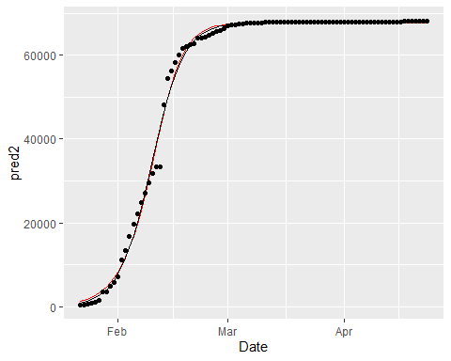

Slide 78
# use broom::glance to look at model results summary(mod2)
## ## Formula: Confirmed_cases ~ K/((1 + exp(-B * (date_int - t0))))^(1/v) ## ## Parameters: ## Estimate Std. Error t value Pr(>|t|) ## K 6.769e+04 2.146e+02 315.427 < 2e-16 *** ## B 2.691e-01 1.973e-02 13.643 < 2e-16 *** ## t0 1.830e+04 8.591e-01 21305.101 < 2e-16 *** ## v 1.393e+00 2.150e-01 6.478 4.98e-09 *** ## --- ## Signif. codes: 0 '***' 0.001 '**' 0.01 '*' 0.05 '.' 0.1 ' ' 1 ## ## Residual standard error: 1606 on 89 degrees of freedom ## ## Number of iterations to convergence: 11 ## Achieved convergence tolerance: 4.356e-06
glance(mod2)
## # A tibble: 1 x 8 ## sigma isConv finTol logLik AIC BIC deviance df.residual ## <dbl> <lgl> <dbl> <dbl> <dbl> <dbl> <dbl> <int> ## 1 1606. TRUE 0.00000436 -816. 1643. 1655. 229632115. 89

Slide 79
Our plan of attack
use a map function and nested grouped data to develop models out of this more complicated model family for the Diamond Princess and most of the China provinces
Add the model to the nested data
Use broom::tidy() to add the coefficients of the models to the dataset
Use pivot_wider to make these coefficients into columns.

Slide 80
Nest China and Princess data
by_country <- Confirmed %>% filter(Country_State != "China_Beijing", Country_State != "China_Shanxi", Country_State != "China_Tibet") %>% filter(Country_Region == "China" | Country_State == "Diamond Princess") %>% #filter(Confirmed_cases > 200) %>% mutate(date_int = unclass(Date)) %>% group_by(Country_State, Province_State, Country_Region, continent, Lat, Long) %>% nest() # by_country$data[[1]] by_country
## # A tibble: 31 x 7 ## # Groups: Country_State, continent, Lat, Long, Province_State, Country_Region ## # [31] ## Country_State continent Lat Long Province_State Country_Region data ## <chr> <chr> <dbl> <dbl> <chr> <chr> <list> ## 1 China_Anhui Asia 31.8 117. Anhui China <tibble ~ ## 2 China_Chongqing Asia 30.1 108. Chongqing China <tibble ~ ## 3 China_Fujian Asia 26.1 118. Fujian China <tibble ~ ## 4 China_Gansu Asia 37.8 101. Gansu China <tibble ~ ## 5 China_Guangdong Asia 23.3 113. Guangdong China <tibble ~ ## 6 China_Guangxi Asia 23.8 109. Guangxi China <tibble ~ ## 7 China_Guizhou Asia 26.8 107. Guizhou China <tibble ~ ## 8 China_Hainan Asia 19.2 110. Hainan China <tibble ~ ## 9 China_Hebei Asia 39.5 116. Hebei China <tibble ~ ## 10 China_Heilongj~ Asia 47.9 128. Heilongjiang China <tibble ~ ## # ... with 21 more rows

Slide 81
Add models to nested data
country_mod2 <- function(df){ startK <- max(df$Confirmed_cases) nls(Confirmed_cases ~ K /( (1 + exp(-B * (date_int - t0))) ) ^(1/v) , data = df, start = list(K = startK, B = .25, t0 = 18300, v = 1), control = list(maxiter = 1000, warnOnly = TRUE)) } by_country <- by_country %>% mutate(model = map(data, country_mod2), tm = map(model, broom::tidy)) %>% unnest(tm) %>% select(Country_State, Lat, Long, term, estimate, `std.error`, statistic, p.value, everything())

Slide 82
Look at results
by_country
## # A tibble: 124 x 13 ## # Groups: Country_State, Lat, Long, continent, Province_State, Country_Region ## # [31] ## Country_State Lat Long term estimate std.error statistic p.value ## <chr> <dbl> <dbl> <chr> <dbl> <dbl> <dbl> <dbl> ## 1 China_Anhui 31.8 117. K 9.92e+2 8.51e-1 1.16e+3 6.09e-188 ## 2 China_Anhui 31.8 117. B 2.73e-1 5.59e-3 4.90e+1 3.83e- 66 ## 3 China_Anhui 31.8 117. t0 1.83e+4 3.27e-1 5.59e+4 0. ## 4 China_Anhui 31.8 117. v 9.03e-1 5.43e-2 1.66e+1 4.71e- 29 ## 5 China_Chongq~ 30.1 108. K 5.79e+2 7.02e-1 8.25e+2 1.34e-174 ## 6 China_Chongq~ 30.1 108. B 1.81e-1 4.18e-3 4.33e+1 1.38e- 61 ## 7 China_Chongq~ 30.1 108. t0 1.83e+4 1.94e+0 9.42e+3 9.70e-269 ## 8 China_Chongq~ 30.1 108. v 1.87e-1 5.34e-2 3.51e+0 7.15e- 4 ## 9 China_Fujian 26.1 118. K 3.66e+2 2.73e+9 1.34e-7 1.00e+ 0 ## 10 China_Fujian 26.1 118. B -7.22e-2 2.15e+5 -3.36e-7 1.00e+ 0 ## # ... with 114 more rows, and 5 more variables: continent <chr>, ## # Province_State <chr>, Country_Region <chr>, data <list>, model <list>

Slide 83
Make data per province
province_data <- by_country %>% ungroup() %>% select(Province_State, Lat, Long, term, estimate, data) %>% pivot_wider(names_from = term, values_from = estimate) %>% mutate(t0_date = as_date(t0)) province_data %>% arrange(t0_date) %>% print(n = Inf)
## # A tibble: 31 x 9 ## Province_State Lat Long data K B t0 v t0_date ## <chr> <dbl> <dbl> <list> <dbl> <dbl> <dbl> <dbl> <date> ## 1 Fujian 26.1 118. <tibbl~ 3.66e2 -0.0722 18109. -5.41e+0 2019-08-01 ## 2 Shanghai 31.2 121. <tibbl~ 6.10e2 0.0459 18241. 3.17e-2 2019-12-11 ## 3 Sichuan 30.6 103. <tibbl~ 5.52e2 0.129 18257. 8.51e-3 2019-12-27 ## 4 Gansu 37.8 101. <tibbl~ 1.38e2 0.102 18258. 9.56e-3 2019-12-27 ## 5 Qinghai 35.7 96.0 <tibbl~ 1.80e1 0.126 18261. 2.53e-2 2019-12-30 ## 6 Liaoning 41.3 123. <tibbl~ 1.35e2 0.0755 18262. 9.31e-2 2020-01-01 ## 7 Yunnan 25.0 101. <tibbl~ 1.80e2 0.119 18264. 3.45e-2 2020-01-02 ## 8 Tianjin 39.3 117. <tibbl~ 1.73e2 0.104 18267. 2.84e-2 2020-01-06 ## 9 Zhejiang 29.2 120. <tibbl~ 1.25e3 0.140 18268. 2.33e-2 2020-01-06 ## 10 Hong Kong 22.3 114. <tibbl~ 5.32e2 -0.521 18269. -5.12e+0 2020-01-07 ## 11 Guangdong 23.3 113. <tibbl~ 1.51e3 0.125 18269. 2.86e-2 2020-01-07 ## 12 Heilongjiang 47.9 128. <tibbl~ 7.17e2 0.115 18270. -3.52e-3 2020-01-08 ## 13 Shandong 36.3 118. <tibbl~ 7.82e2 0.109 18274. 8.86e-2 2020-01-13 ## 14 Macau 22.2 114. <tibbl~ 2.81e1 -0.438 18275. -3.64e+0 2020-01-13 ## 15 Chongqing 30.1 108. <tibbl~ 5.79e2 0.181 18283. 1.87e-1 2020-01-21 ## 16 Shaanxi 35.2 109. <tibbl~ 2.53e2 0.142 18285. -1.43e-2 2020-01-24 ## 17 Jilin 43.7 126. <tibbl~ 9.99e1 0.166 18285. -2.34e-3 2020-01-24 ## 18 Guangxi 23.8 109. <tibbl~ 2.54e2 0.183 18290. 4.72e-1 2020-01-28 ## 19 Ningxia 37.3 106. <tibbl~ 7.50e1 0.165 18290. 3.94e-1 2020-01-29 ## 20 Hunan 27.6 112. <tibbl~ 1.02e3 0.236 18291. 4.63e-1 2020-01-29 ## 21 Jiangsu 33.0 119. <tibbl~ 6.42e2 0.207 18291. 4.49e-1 2020-01-30 ## 22 Henan 33.9 114. <tibbl~ 1.28e3 0.237 18292. 5.26e-1 2020-01-31 ## 23 Jiangxi 27.6 116. <tibbl~ 9.38e2 0.261 18294. 6.45e-1 2020-02-01 ## 24 Hebei 39.5 116. <tibbl~ 3.23e2 0.195 18295. 6.31e-1 2020-02-02 ## 25 Anhui 31.8 117. <tibbl~ 9.92e2 0.273 18296. 9.03e-1 2020-02-03 ## 26 Hainan 19.2 110. <tibbl~ 1.68e2 0.296 18299. 1.74e+0 2020-02-06 ## 27 Guizhou 26.8 107. <tibbl~ 1.46e2 0.376 18300. 1.66e+0 2020-02-08 ## 28 Xinjiang 41.1 85.2 <tibbl~ 7.62e1 0.324 18303. 2.14e+0 2020-02-10 ## 29 Hubei 31.0 112. <tibbl~ 6.77e4 0.269 18304. 1.39e+0 2020-02-11 ## 30 <NA> 0 0 <tibbl~ 7.09e2 0.630 18310. 2.69e+0 2020-02-18 ## 31 Inner Mongolia 44.1 114. <tibbl~ 1.73e2 122. 18372. 3.57e+3 2020-04-20

Slide 84
Join with province totals
pd <- province_data %>% left_join(Confirmed_totals) %>% filter(!is.na(Province_State)) pd %>% print(n = Inf, width = Inf)
## # A tibble: 30 x 17 ## Province_State Lat Long data K B t0 ## <chr> <dbl> <dbl> <list> <dbl> <dbl> <dbl> ## 1 Anhui 31.8 117. <tibble [93 x 6]> 992. 0.273 18296. ## 2 Chongqing 30.1 108. <tibble [93 x 6]> 579. 0.181 18283. ## 3 Fujian 26.1 118. <tibble [93 x 6]> 366. -0.0722 18109. ## 4 Gansu 37.8 101. <tibble [92 x 6]> 138. 0.102 18258. ## 5 Guangdong 23.3 113. <tibble [93 x 6]> 1507. 0.125 18269. ## 6 Guangxi 23.8 109. <tibble [93 x 6]> 254. 0.183 18290. ## 7 Guizhou 26.8 107. <tibble [93 x 6]> 146. 0.376 18300. ## 8 Hainan 19.2 110. <tibble [93 x 6]> 168. 0.296 18299. ## 9 Hebei 39.5 116. <tibble [93 x 6]> 323. 0.195 18295. ## 10 Heilongjiang 47.9 128. <tibble [92 x 6]> 717. 0.115 18270. ## 11 Henan 33.9 114. <tibble [93 x 6]> 1276. 0.237 18292. ## 12 Hong Kong 22.3 114. <tibble [92 x 6]> 532. -0.521 18269. ## 13 Hubei 31.0 112. <tibble [93 x 6]> 67686. 0.269 18304. ## 14 Hunan 27.6 112. <tibble [93 x 6]> 1020. 0.236 18291. ## 15 Inner Mongolia 44.1 114. <tibble [91 x 6]> 173. 122. 18372. ## 16 Jiangsu 33.0 119. <tibble [93 x 6]> 642. 0.207 18291. ## 17 Jiangxi 27.6 116. <tibble [93 x 6]> 938. 0.261 18294. ## 18 Jilin 43.7 126. <tibble [92 x 6]> 99.9 0.166 18285. ## 19 Liaoning 41.3 123. <tibble [93 x 6]> 135. 0.0755 18262. ## 20 Macau 22.2 114. <tibble [93 x 6]> 28.1 -0.438 18275. ## 21 Ningxia 37.3 106. <tibble [93 x 6]> 75.0 0.165 18290. ## 22 Qinghai 35.7 96.0 <tibble [90 x 6]> 18.0 0.126 18261. ## 23 Shaanxi 35.2 109. <tibble [92 x 6]> 253. 0.142 18285. ## 24 Shandong 36.3 118. <tibble [93 x 6]> 782. 0.109 18274. ## 25 Shanghai 31.2 121. <tibble [93 x 6]> 610. 0.0459 18241. ## 26 Sichuan 30.6 103. <tibble [93 x 6]> 552. 0.129 18257. ## 27 Tianjin 39.3 117. <tibble [93 x 6]> 173. 0.104 18267. ## 28 Xinjiang 41.1 85.2 <tibble [92 x 6]> 76.2 0.324 18303. ## 29 Yunnan 25.0 101. <tibble [93 x 6]> 180. 0.119 18264. ## 30 Zhejiang 29.2 120. <tibble [93 x 6]> 1254. 0.140 18268. ## v t0_date Country_State Date_first_case Deaths_per_mill ## <dbl> <date> <chr> <date> <dbl> ## 1 0.903 2020-02-03 China_Anhui 2020-01-22 0.0949 ## 2 0.187 2020-01-21 China_Chongqing 2020-01-22 0.193 ## 3 -5.41 2019-08-01 China_Fujian 2020-01-22 0.0254 ## 4 0.00956 2019-12-27 China_Gansu 2020-01-23 0.0758 ## 5 0.0286 2020-01-07 China_Guangdong 2020-01-22 0.0705 ## 6 0.472 2020-01-28 China_Guangxi 2020-01-22 0.0406 ## 7 1.66 2020-02-08 China_Guizhou 2020-01-22 0.0556 ## 8 1.74 2020-02-06 China_Hainan 2020-01-22 0.642 ## 9 0.631 2020-02-02 China_Hebei 2020-01-22 0.0794 ## 10 -0.00352 2020-01-08 China_Heilongjiang 2020-01-23 0.345 ## 11 0.526 2020-01-31 China_Henan 2020-01-22 0.229 ## 12 -5.12 2020-01-07 China_Hong Kong 2020-01-23 0.534 ## 13 1.39 2020-02-11 China_Hubei 2020-01-22 76.3 ## 14 0.463 2020-01-29 China_Hunan 2020-01-22 0.0580 ## 15 3566. 2020-04-20 China_Inner Mongolia 2020-01-24 0.0395 ## 16 0.449 2020-01-30 China_Jiangsu 2020-01-22 0 ## 17 0.645 2020-02-01 China_Jiangxi 2020-01-22 0.0215 ## 18 -0.00234 2020-01-24 China_Jilin 2020-01-23 0.0370 ## 19 0.0931 2020-01-01 China_Liaoning 2020-01-22 0.0459 ## 20 -3.64 2020-01-13 China_Macau 2020-01-22 0 ## 21 0.394 2020-01-29 China_Ningxia 2020-01-22 0 ## 22 0.0253 2019-12-30 China_Qinghai 2020-01-25 0 ## 23 -0.0143 2020-01-24 China_Shaanxi 2020-01-23 0.0776 ## 24 0.0886 2020-01-13 China_Shandong 2020-01-22 0.0697 ## 25 0.0317 2019-12-11 China_Shanghai 2020-01-22 0.289 ## 26 0.00851 2019-12-27 China_Sichuan 2020-01-22 0.0360 ## 27 0.0284 2020-01-06 China_Tianjin 2020-01-22 0.192 ## 28 2.14 2020-02-10 China_Xinjiang 2020-01-23 0.121 ## 29 0.0345 2020-01-02 China_Yunnan 2020-01-22 0.0414 ## 30 0.0233 2020-01-06 China_Zhejiang 2020-01-22 0.0174 ## Deaths Confirmed_cases Population Country_Region continent ## <dbl> <dbl> <dbl> <chr> <chr> ## 1 6 991 63240000 China Asia ## 2 6 579 31020000 China Asia ## 3 1 355 39410000 China Asia ## 4 2 139 26370000 China Asia ## 5 8 1585 113460000 China Asia ## 6 2 254 49260000 China Asia ## 7 2 147 36000000 China Asia ## 8 6 168 9340000 China Asia ## 9 6 328 75560000 China Asia ## 10 13 928 37730000 China Asia ## 11 22 1276 96050000 China Asia ## 12 4 1035 7496988 China Asia ## 13 4512 68128 59170000 China Asia ## 14 4 1019 68990000 China Asia ## 15 1 194 25340000 China Asia ## 16 0 653 80510000 China Asia ## 17 1 937 46480000 China Asia ## 18 1 108 27040000 China Asia ## 19 2 146 43590000 China Asia ## 20 0 45 649342 China Asia ## 21 0 75 6880000 China Asia ## 22 0 18 6030000 China Asia ## 23 3 279 38640000 China Asia ## 24 7 787 100470000 China Asia ## 25 7 641 24240000 China Asia ## 26 3 561 83410000 China Asia ## 27 3 189 15600000 China Asia ## 28 3 76 24870000 China Asia ## 29 2 184 48300000 China Asia ## 30 1 1268 57370000 China Asia

